Slide 1
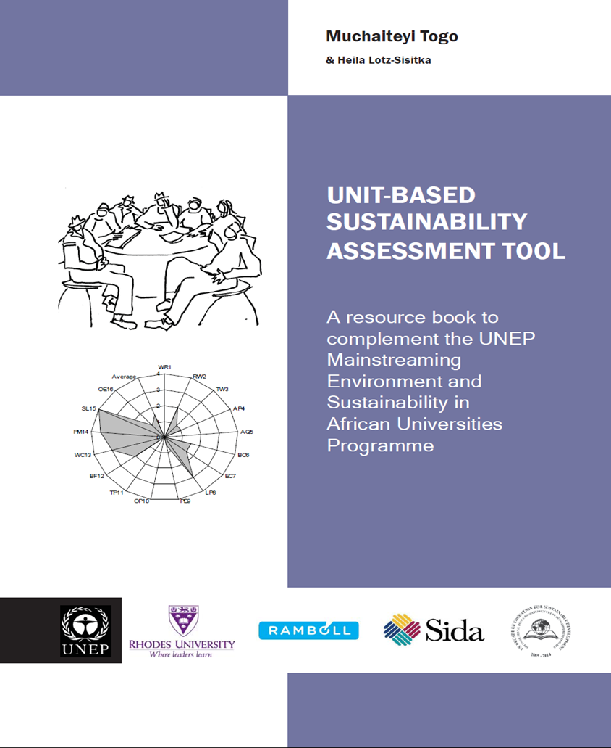
The USAT: A theory informed indicator-based assessment tool and its relevance in green skills research
Mucha Togo
Unisa
muchatogo@gmail.com

Slide 2
Aims for developing the tool
To support a whole systems approach to sustainability mainstreaming
An understanding of a systems thinking approach and critical realist analysis in assessing and enhancing mainstreaming of sustainable development

Slide 3
Enhancing Systemic Contextual Understanding: The USAT TOOL
Background to its development
Theory informed design
Systems theory
support a whole systems approach to sustainability mainstreaming
Basic Critical Realism
Reality exists independent of knowledge
Social reality is stratified into three levels (Real – causal mechanisms; Actual – activated mechanisms; and Empirical – current experiences)
Determining sustainability issues mainstreamed
Exploring causal factors behind the sustainability picture
levels of integration of sustainability in practices
Analytical framework - abduction
interrelationships and interconnections among phenomena
a systems view of education
determining systemic issues to be addressed in developing a systems thinking approach to mainstreaming
Other SATs
-SAQ
-AISHE
-GASU
Environment
-Context
-Sustainability declarations
Theories
-Critical Realism
-Systems thinking
USAT

Slide 4
The USAT
USAT Part A: Curriculum, Teaching approaches, Research, Community Service, Examinations, Staff Expertise
USAT Part B: Operations and Management
USAT Part C: Students Involvement
USAT Part D: Policy and written statements

Slide 5
The design of the tool
Flexibility of use: Unit versus whole
teaching departments
University operational divisions
Different strata may possess different powers therefore influencing the whole in different ways (Archer, 1995)
Inclusive of various university sections
Students, management (staffing), policy etc in addition to common functions like teaching, research and CE
Indicator-based
Guidelines
For benchmarking, comparative analysis, progress
Indicators

Slide 6
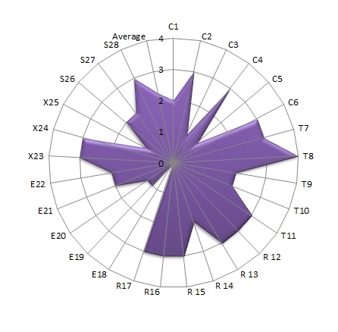
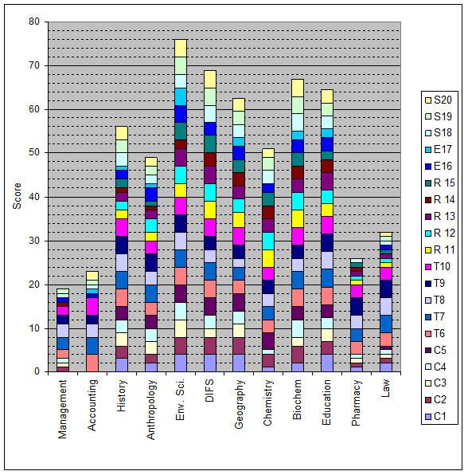
Using the USAT
Head of department, faculty or programme coordinator, etc.
Rating of indicators by completing the score sheet
Based on the score X
-Interviews
-Content analysis (course outline/contents, PEQ papers etc.)

Slide 7
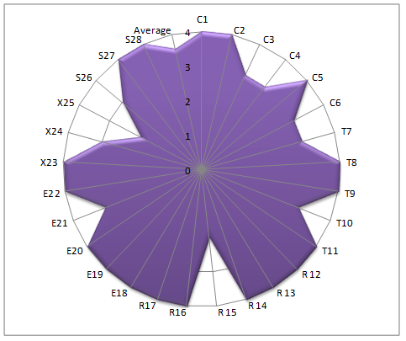
EXAMPLE: Part A USAT Assessment results (UNISWA)
Geography, Env Sciences and Planning
Academic communication and skills
Geography, Env Sciences and Planning | Academic communication and skills
Quite a number of courses with sustainability content | Low integration on sustainability in the curriculum
A high level of engagement with sustainability in research | There is integration of sustainability in research
Community engagement initiatives which focus on sustainability | No community engagement initiatives with a focus on sustainability
Average score from the sustainability assessment: 3.6 | Average score from the sustainability assessment: 0.5

Slide 8
CR analysis
What it enables
Significance
Providing mainstreaming
guidelines and targets
Benchmarking initiatives
Assessing progress
Reporting
Empirical: USAT - level of integration
Actual: Systems theory – recontextualisation of data to determine responsiveness of practices to relevant sustainability challenges
Morphogenesis – historical emergence of sustainability
Real: ontological depth - Causal factors influencing practices

Slide 9
Noted Challenges
Clear picture of sustainability mainstreaming but no explanation, no examples - Use of other methods to complement collected data
Not all respondents had a good understanding of sustainable development issues – elaboration
Understanding the tool (indicators and rating) – involvement of researcher in the assessment process

Slide 10
Significance
Significance of theory informed indicator based tools in green skills research
Understanding of existing green practices – their history and causality (CR)
Relevance to context (systems theory - recontextualisation)
decision-making tool: identifying key and relevant practices for mainstreaming
baseline data enabling on-going assessment of progress.
Quick and easy identification of mainstreaming gaps (pictorial view)

