Slide 1

CARBON CONVERSATIONS AND ACTION-BASED education for sustainability at the university of st Andrews
Rebecca Petford
ESD Topic Support Network, June 2014
Notes:
Hello
Rebecca Petford – Project Worker for Transition University of St Andrews
Carbon Conversations and Admin
Thank you for inviting me along to share our experiences on ESD out-of-the-classroom today

Slide 2
High Level Policy
Teaching and Research
Operations
Living and Working
ESD at the University of St Andrews
Notes:
Premise of this presentation - considerations of sustainability at the University of St Andrews are embedded within the university’s activities - Education for Sustainability is not just in the Classroom.
Important to with an idea of the context
ESD takes place through direct learning in many academic subjects, and particularly in our Undergraduate and Postgraduate Degrees in Sustainable Development, and the St Andrews Sustainability Institute works to promote research, and particularly interdisciplinary research, but ESD also takes place in out-of-the-classroom experiences of students, staff members, and also local community members.
Transition University of St Andrews, and the Environment Team who are based in Estates, influence all these areas of the University – and so how people learn about sustainability.
We will touch upon all these areas, but I’ll start with a brief introduction to the University as a whole, and it’s position on sustainability.

Slide 3

600 years old and counting...
Around 7,200 students and 1,800 staff
Approximately 1/3 of town
The University of St Andrews
Notes:
Approx 1/3 of town – fairly unique in being such a high proportion of the town rather than part of a larger city or on our own campus – advantages in allowing engagement with community, including on sustainability projects, but also brings challenges...

Slide 4
600 years old and counting...
Around 7,200 students and 1,800 staff
Approximately 1/3 of town
Sustainable Development Working Group
Sustainable Development Policy and Strategy
University Court Vision Paper
Carbon Management Plan and Energy Strategy
The University of St Andrews
Notes:
High-level commitment to sustainable development
SDWG – academic, estates and senior management – chaired by the Master – responsibility for SD across teaching, research, operations and community engagement - accountable for the Sustainable Development Policy and Strategy
Sustainability Policy and strategy – for 2012 to 2022 – supports and develops the University’s strategic plan (which mentions SD teaching and sustainable operations) – specific aims and objectives for teaching and learning (both SD-specific degrees and inclusion in discipline-specific degree programmes), research and knowledge exchange, living within environmental limits in operations, including changing behaviour and communicating environmental and sustainability issues to all students and staff, and promoting a healthy and just society through our operations and teaching. It closes with a commitment to ‘seek to act as an exemplar of sustainable development practice and to promote the principles of sustainable development at a local, regional, national and international level.’ Published annual review
University Court, which is the governing body of the University, final stages of developing a Vision Paper around sustainbility – not yet released - values
Carbon Management Plan and Energy Strategy
Influencing behaviour through awareness training – Network of Environmental facilitators
£2.5 million invested in Carbon Trust SALIX fund for a rolling cycle of energy efficiency measures for University estate’s buildings
Implementing micro and macro renewable solutions, including only building to BREEAM excellent and outstanding levels

Slide 5
600 years old and counting...
Around 7,200 students and 1,800 staff
Approximately 1/3 of town
Sustainable Development Working Group
Sustainable Development Policy and Strategy
University Court Vision Paper
Carbon Management Plan and Energy Strategy
Carbon Neutral in Energy Supply by 2016
The University of St Andrews
Notes:
Plan for Carbon Neutrality – Kenly Community Windfarm – 6 x 2MW - (community benefit as well as to the university) and Guardbridge low carbon energy centre with heat from locally sourced and sustainable biomass, solar thermal and ground sources
Of course a large incentive is size of our projected energy bills if we do not lower our energy use and invest in our own energy sources!
High-level support for sustainability action at the university – NEXT SLIDE

Slide 6
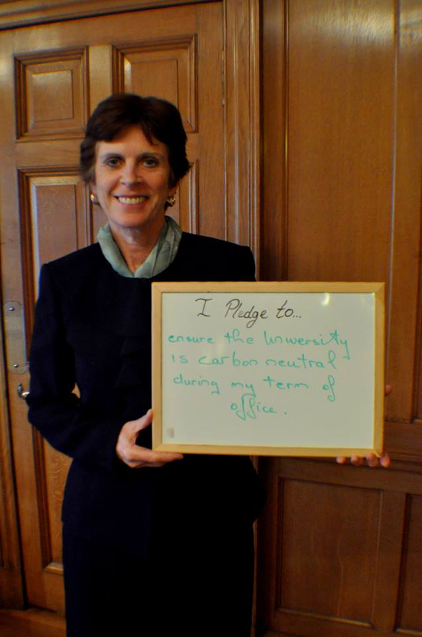
Principal Dr Louise Richardson’s pledge for Green Week 2014:
“I pledge to… ensure the University is carbon neutral during my term of office.”
High Level Support
Notes:
This photo has been well-used by Transition and the Environment team since!
However, the University is less good at publicising their work so far and goals for the future, and this is something Transition and the Environment Team need to continue to support using our many media channels

Slide 7
Four lectures, essay and exam in first year SD Degree
Half Day Briefing with Site Visit for 4th Year and PG SD
Lecture for core Management PG course
Engineering Challenge for Summer ELT Trainees
Open Association talks
Multiple ‘shout outs’ in lectures
University Practical Action and Teaching
Notes:
Alongside the degrees and courses in sustainable development as an academic subject, the Estates Environment Team and Transition support the academic side of things in a number of ways
Mixture of education about technologies and ideas
Management – Responsible Enterprise focus
Open Association talks by PhD students and Staff on SD issues
Shout outs about projects and events being run by the Environment Team or Transition
More information on Transition and what we do…

Slide 8
Established 2009
Steering Group of Staff, Students and Community
CCF Funded 2011-12 and 2012-15 (with St AndEN)
Currently 1 FT and 4 PT Positions funded by CCF
  Edible Campus, Carbon Conversations, Saint Exchange, Carbon Calculator, Cook SMARTER
1 FT Position Funded by the University (shared)
  Projects from Previous Funding and SD Research
Transition University of St Andrews
Notes:
Part of the International Transition Movement of grass-roots action against the dual challenges of CC and peak oil
Established 2009 through the student society One World, which is part of People and Planet. Launched in November 2009 with goals in Energy, Food, Transport and Waste, and it quickly became apparent that full time staff would help the projects progress. Applied to CCF 3 times, and were successful the second and third time...
2011-12 was 3 FT staff from June to March – great input but issues with continuity due to short term – funding period not ideal for University terms!
2012-15 - with St Andrews Energy Network who promote and provide support with energy-saving home alterations and technologies in St Andrews and the surrounding areas
Edible Campus – 9 growing spaces, 2 orchards and 2 seed-sewing locations, one in a Greenhouse in the botanic Garden – 950 trees planed between March 2013 and March 2014
Carbon Conversations – more about later!
Saint Exchange – local economic trading scheme – 45 regular traders with 250 trades March 2013-14, mostly food-related!
Carbon Calculator – St Andrews-specific – integrating consumption data from hall of residences and considering St Andrews options – still under development
Cook Smarter – food waste reduction focus, compost bins trial, rolled out more widely in self-catered halls after the summer
Master funded Uni role
Previous Funding projects which continue –
Interhall Energy Competition (over two years has saved 234 tonnes of CO2 and almost £39,000!!),
Skillshare - focus on bike repair
St AndRe-Use – 5 years old now, encourages and facilitates the passing-on of items throughout the year, then collects items at the end of the academic year from students leaving St Andrews and stores them and gives them away at the start of the next year - re-used over 800kg of unwanted goods over the last 2 years up to March 2014 – Summer collection filled both SARU storage space and Transition Office so we don’t have the final figures on that!
Carbon savings from the first two funded years estimated to be around 374 tonnes CO2 – but carbon isn’t the whole story – that is what we report!
Steering Group, Volunteers and supporters work on other projects, supported by the employed staff
SD research...

Slide 9

Practical Dissertations
Student Conference Presentations on Practical Action
Participation in External Research
University Practical Action and Research
Notes:
Practical Dissertations
environment team, transition and residential and business services brainstorm on input they wanted
List of topics handout – also PDF online
Promoted to UG and PG SD and MN heads of teaching (Resp enterprise) and on programmes
Now making into searchable database through practical projects for two masters level computer scientists
Issues with disseminating – library database and all other publication and copyright
Conferences
Keele University Student Action for Sustainability Conference - Reflections on learning from developing the student garden
EAUC Scotland Conference – St AndRe-Use and how a student project is supported by staff members
Poster at the EAUC Scotland Conference on the Bike Pool development
External Research
German Student researching on Transition Universities
My research from Edinburgh on using social media for community engagement
Oxford University monitoring research on sustainability action in communities – helps us too!

Slide 10
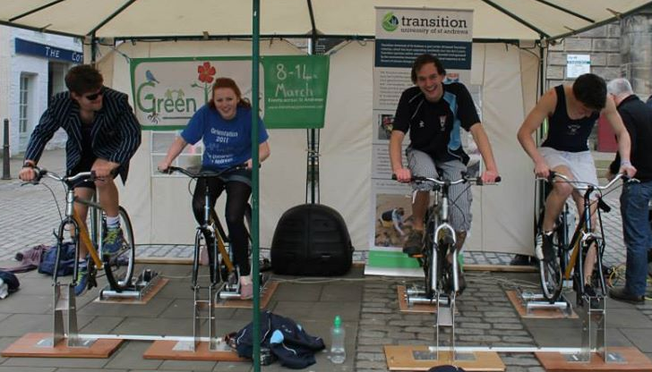
Individual Events
Green Week
Film Festival
Involvement in
Transition Projects
Other societies
Encouraging Participation
Notes:
Transition events have been attended by over 3,300 people this year
The St AndRe-Use Give-Away in Freshers’ Week was the biggest, with over 1,100 people
Green Week events in March were attended by almost 500 people, with the photo pledge campaign album (including the one of the principal) reaching 9,400 people on Facebook – the pictured cycletricity event is a competition between the sports clubs to see who can produce the most energy on the bikes over a set time period
The first Green Film Festival in November attracted 140 film buffs, with talks from film-makers as well as the films, and the next one is now in development

Slide 11

Volunteers – 16 Volunteers
Summer Internships
Environmental Facilitators for
Departments and Units
Hall Environment Reps – Students
Transition UStA Steering Group
Facilitating Deeper Participation
Notes:
Once Engaged... – Deeper participation and leaderships roles
Volunteers – formal programme which we had a small amount of funding to developed -16 volunteers supporting different Transition Projects, 2 hours a week, Training, Mentors but a fair amount of autonomy, Journal
Internships –
1 in transition working on engagement issues with interhall, 2 in Estates, one working on Sustainability Awards and another on developing the content and ideas for the Estates and Environment Team Website
All administered by careers and focused on employability skills
Env Facilitators and Environment Reps are trained by a partnership between the Environment Team, Transition, and CAPOD who work on personal and professional development within the university - passport

Slide 12
Getting Involved in Practical Projects
Notes:
This the data from our consultation survey for our ideas for future projects, which has had around 100 respondents.
They were asked ‘What was your first contact with Transition?’
How do people get involved most in Transition – Carbon Conversations!
Carbon conversations also seems to encourage further engagement – almost all of the new SG members participated in Carbon Conversations over the last year, and a number of past participants were key volunteers over the past year.
So what is all the fuss about?

Slide 13

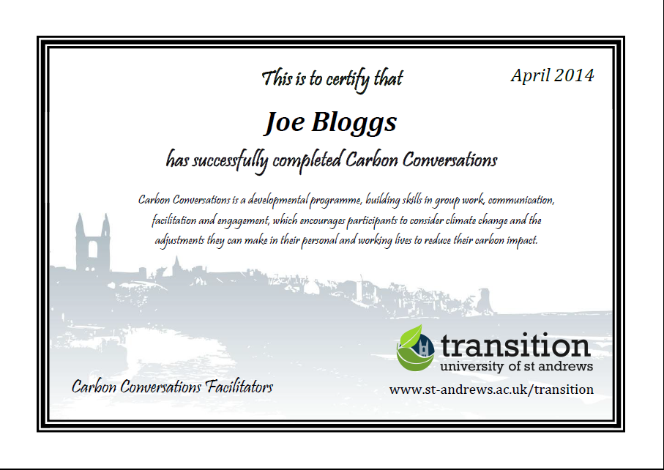
Carbon Conversations
Notes:
Six sessions of two hours - Sessions on climate change, home energy, travel, food and water, consumption, moving on
Developed in Cambridge by a team with expertise on values and behaviour change, and takes the form of a supportive group to share ideas, questions, and the experience of change.
Activities are a mixture of short talks and explanations introducing the topic by the facilitators, paired activities, group brainstorms and discussions, group games, and small amounts of ‘homework’
Led by two trained facilitators – around 20 in St Andrews at the moment
Groups between 6 and 12 people – relaxed and friendly non-judgemental atmosphere, tea and coffee etc
Course Handbook of activities, information and guidance – Funded so free in St A but nominal fee to cover refreshments – pricing varies
Develop skills in communicating about environmental issues
Ultimate aim = lower your carbon footprint! – to 1 tonne in each area or ½ if large
Sign up as individuals or a group – great for team-building
Adapted in St Andrews to be weekly rather than fortnightly to fit the term structure, and to include certificates to emphasise the developmental aspect of the course, which particularly appeals to students
Feedback is generally very positive – enjoyed and learned a lot

Slide 14
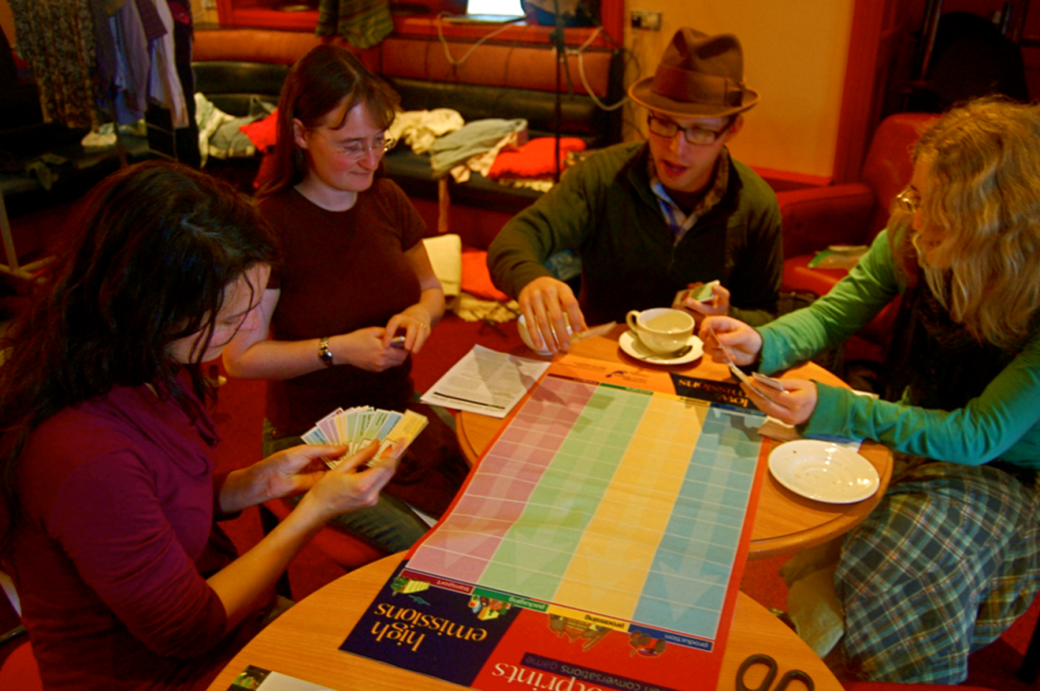
Getting the word out
Commitment
University setting
Monitoring for funders
vs. for participants
Difficulties of Carbon Conversations
Notes:
Difficulties we have had to work through...
Word out – promotion hard! Hard to explain. Now on PDMS as well as website and social media, and as many newsletters as it can be!
Town and gown sessions vs. established groups
Commitment – high drop-out rate – free...
University setting – deadlines, rented accommodation, perception of locals not feeling part of it
Monitoring – for CCF = carbon calculator initially and after 6 months, any electricity monitor data
We have added a pledge system based on researched carbon tables by the University of Strathclyde, with a list of almost 200 actions. We ask them to select 5 for within a year and 5 for within 5 years (after they have graduated and left). NEXT SLIDE

Slide 15

Difficulties of Carbon Conversations
Notes:
The pledges are on the back of their certificates, and provide a reminder for participants on their actions, and state the savings they will make by taking particular actions
Positive feedback from facilitators and participants on this so far

Slide 16
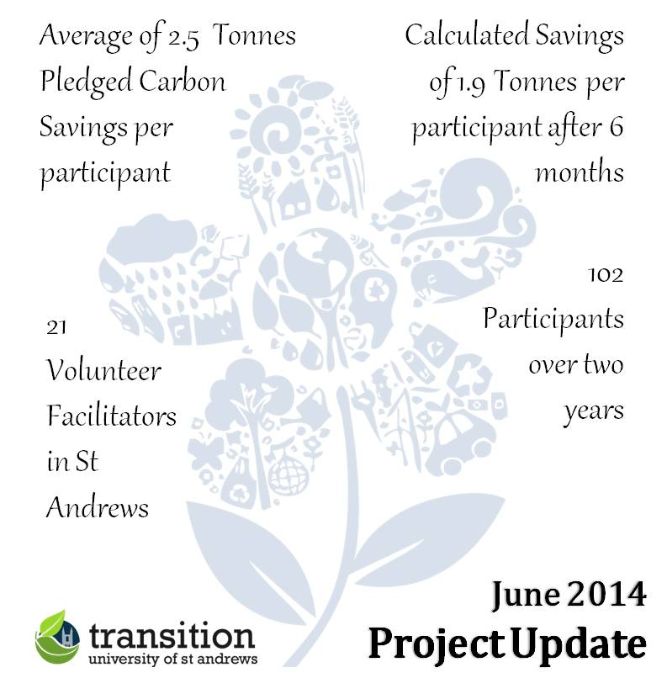
Carbon Conversations Achievements
Notes:
This is our recent update, 2 years into our current funded project
We are almost on target with our CCF bid, but need to work now on attracting those who are not just ‘low hanging fruit’, as it has been running for almost 3 years now.
Amazing carbon savings!

Slide 17
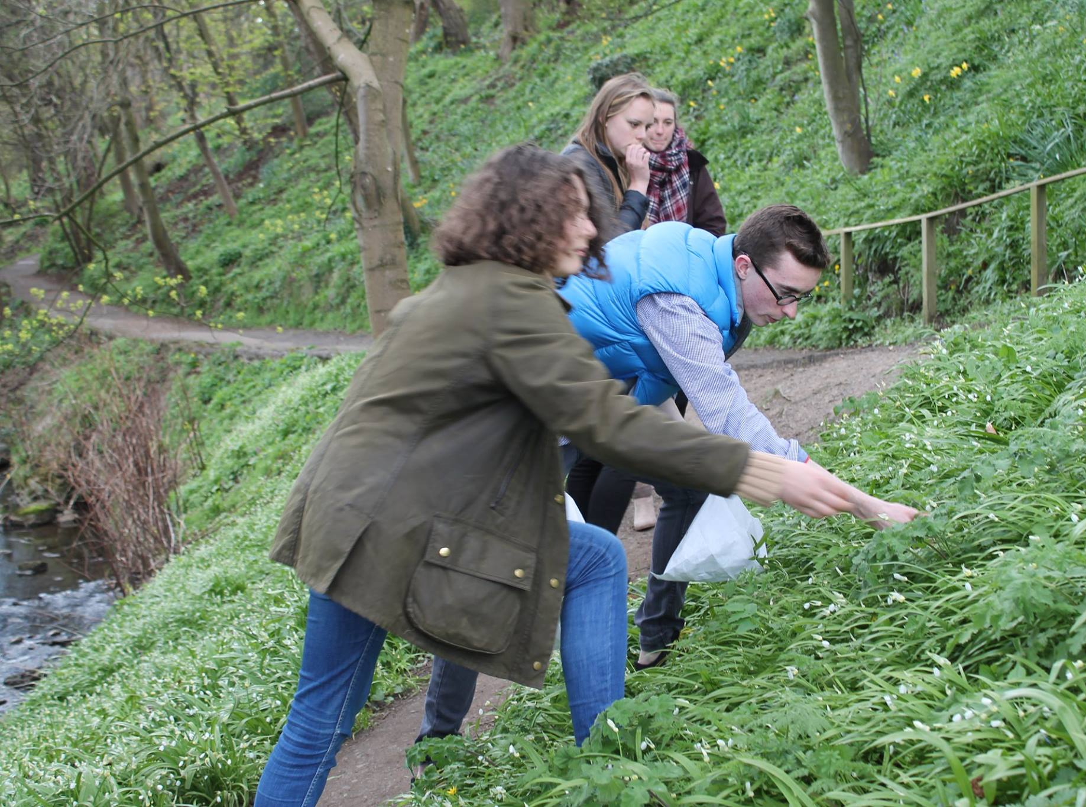
Being reviewed
by developers
The future of Carbon
Conversations in St
Andrews?
Next Steps for Carbon Conversations
Notes:
Being reviewed – new edition of the book with updated research, prices, ‘stories’ etc – changes to home energy game with rental options – all positive
Working with facilitators and talked to us quite a lot about different updates and ideas
New CCF application to be written for funding from March 2015
Requires consultation with community to demonstrate need and demand – support for carbon conversations exists.
Need to do something different – Carbon Conversations Streets (like Transition Streets)
Building local support networks and strengthening community
Potential for more links with other projects, including heat camera use and St AndEN
We think it is worth continuing – and not just due to trained facilitators! This photo...

Slide 18
High Level Policy
Teaching and Research
Operations
Living and Working
Carbon Conversations for ESD
Notes:
Why is Carbon Conversations effective for ESD in St Andrews?
It ties everything together –
broad content and open to discussing all Transition’s projects and other activities and action locally within the sessions – each area on the venn diagram is talked about, with a focus on living and working
Makes sense to people with all levels of understanding – peer learning – each group is different – facilitators learn too
Brings together people from different walks of life
Not academic but also not too touchy-feely for most! Fact-based, talks a lot about values, but not too preachy
Transformative learning for sustainability, with an action plan and value-change rather than just facts.

Slide 19
Educating for Sustainability Through Action
Notes:
Educating for Sustainability isn’t just about the classroom – action based research and practical actions - transform the way people see the world and engage with sustainability issues.
So difficult to prepare this presentation because there is no logical order to the topic as everything seems to interlink, but I hope you have followed me! Everything interacts to create an environment supporting academic learning and practical understanding of ESD, in an institution with a strategy wanting to ‘act as an exemplar of sustainable development practice’.
Carbon Conversations supports the aim of raising awareness of sustainability and its different aspects practically, influencing the way people live and work, both within university buildings and elsewhere, and tying many strands of action together. However without other opportunities to get involved, or the support of senior management, or evidence of the university taking practical actions to practice what they preach, perhaps it would be less successful – or just different as each group is different anyway!
Anyway – I think it’s very good to run it in St Andrews, supporting the Transition movement as well as all other practical, and academic, activities within the University.

Slide 20
Any Questions?

