Slide 1
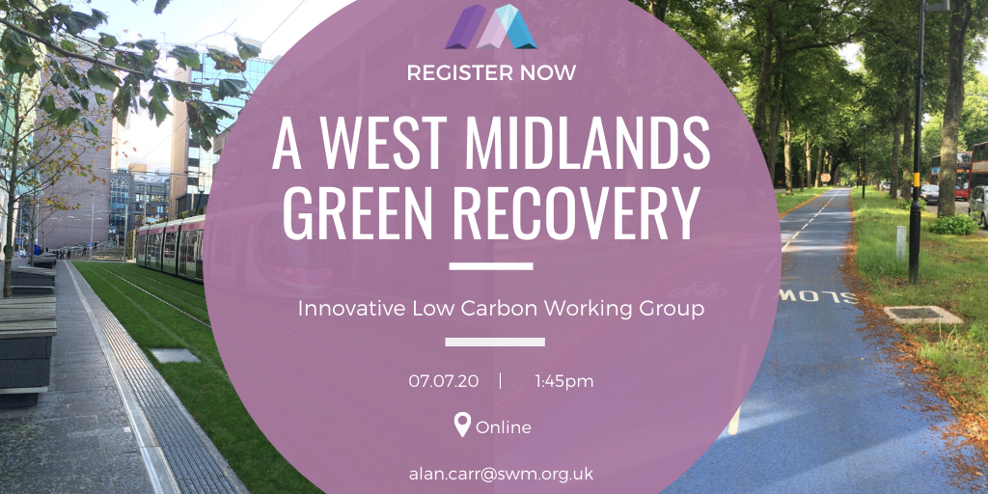
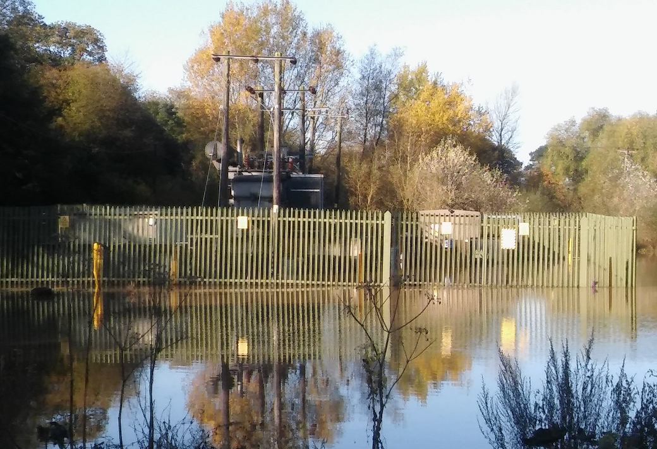
Midlands Sustainability Education Network
SWM update
Alan Carr
6 July 2020

Slide 2
About Us
We are the sustainability adviser for leaders of the West Midlands.
Not-for-profit company working across all sectors.
Our vision: That the West Midlands is leading in contributing to the national target of net zero greenhouse gas emissions by 2050 whilst addressing health inequality and driving inclusive growth.
We coordinate and monitor the only existing regional Sustainability Roadmap; a framework to 2030 (NB – we’ve changed the baseline from 2020 to 2019!)
We support our members and other local stakeholders to implement these changes by enabling them to demonstrate innovation and leadership and provide opportunities to collaborate and celebrate success.
www.swm.org.uk
Notes:
Key points
We are the sustainability adviser to the leaders of the West Midlands
Private sector led and cross-sector – not-for profit
Our role is to act as a catalyst to help others – main areas policy & project advice & sharing good practice
4. We learn from project and annual customer feedback – and this has helped us to maintain a high satisfaction rate during very challenging times
What our customers say they like about us is
Our independence
Our cross-sector good practice networks
Our vision, plan and coordination of actions for a better West Midlands

Slide 3
Improving the accessibility of the UK Climate Change Risk Assessment (UK CCRA)
Client: Committee on Climate Change
‘Independent advice to government on building a low-carbon economy and preparing for climate change’
Context: UK CCRA
The UK Government is required, under the 2008 Climate Change Act, to publish a climate change risk assessment (CCRA) every five years. The assessment sets out the risks and opportunities facing the UK from climate change.
Problem:
The evidence reports that inform the CCRA are hugely important in outlining what the key risks are to our health, infrastructure, natural environment and business… but they’re far too long and technical for government or anyone else to bother reading…
Notes:
Key points
We are the sustainability adviser to the leaders of the West Midlands
Private sector led and cross-sector – not-for profit
Our role is to act as a catalyst to help others – main areas policy & project advice & sharing good practice
4. We learn from project and annual customer feedback – and this has helped us to maintain a high satisfaction rate during very challenging times
What our customers say they like about us is
Our independence
Our cross-sector good practice networks
Our vision, plan and coordination of actions for a better West Midlands

Slide 4
Improving the accessibility of the CCRA https://www.sustainabilitywestmidlands.org.uk/resources/improving-the-accessibility-of-the-uk-climate-change-risk-assessment-part-1/
Project aim: To provide the CCC with advice and products to improve the impact of the CCRA by enhancing its accessibility to its primary customers, which are UK Government departments, the devolved administrations and government-funded arm’s length bodies.
Tasks:
Extensive stakeholder feedback from all UK nations (completed)
Good practice examples from elsewhere (completed)
Develop an advisory report based on these findings (completed)
Develop a draft communications plan based on findings (by autumn 2020)
Develop national/DA summaries (by late spring 2021)
Develop sector factsheets (by late spring 2021)
Support the launch event and run focus groups (summer 2021)
Support the development of a new CCRA website (on-going)
Notes:
Key points
We are the sustainability adviser to the leaders of the West Midlands
Private sector led and cross-sector – not-for profit
Our role is to act as a catalyst to help others – main areas policy & project advice & sharing good practice
4. We learn from project and annual customer feedback – and this has helped us to maintain a high satisfaction rate during very challenging times
What our customers say they like about us is
Our independence
Our cross-sector good practice networks
Our vision, plan and coordination of actions for a better West Midlands

Slide 5
Findings 1
Some example quotes from stakeholders:
“Important to be able to download individual chapters and specific figures.”
“Provision of infographics, diagrams for each sector / department i.e. infrastructure, health, built environment etc. aimed at practitioners.”
“Have themed workshops/ information days on findings of the CCRA after its publication.”
“Should consider key messages/ summaries for each Government department and clarity on what their roles are in relation to the CCRA.”
“If the main audience is Government then provide info for specific policy areas with factsheets, for example.”
“Place-based case studies to personalise and localise issues and to highlight interconnected and systems approach, overlapping issues, urgency and solutions.”
“It is important to tie together both the scenarios and risk assessment rather than have them sit separately (i.e. UKCP18 and CCRA).”
“Pre-prepared presentations for stakeholders summarising key points from the report.”
“Provision of a summary of cross-sector interactions to pull out interacting/cross-cutting risks (e.g. flooding).”
Notes:
Key points
We are the sustainability adviser to the leaders of the West Midlands
Private sector led and cross-sector – not-for profit
Our role is to act as a catalyst to help others – main areas policy & project advice & sharing good practice
4. We learn from project and annual customer feedback – and this has helped us to maintain a high satisfaction rate during very challenging times
What our customers say they like about us is
Our independence
Our cross-sector good practice networks
Our vision, plan and coordination of actions for a better West Midlands

Slide 6
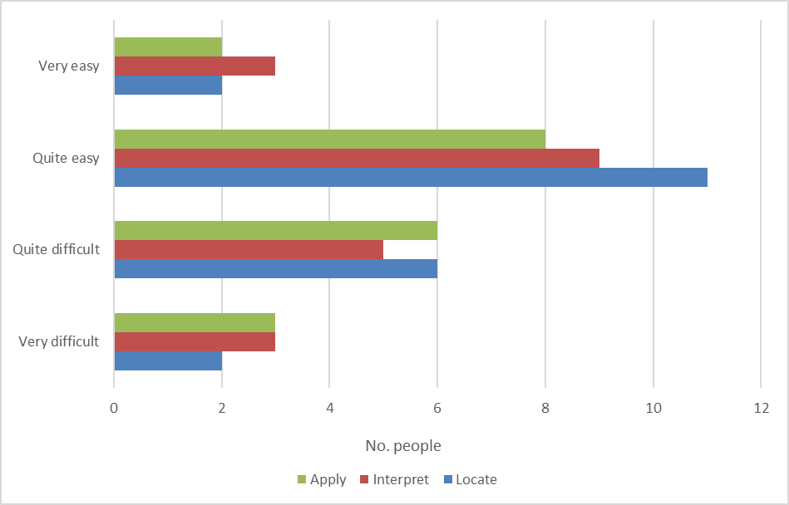
Findings 2
Q. If you used CCRA2, how easy or challenging was it to locate, interpret and apply the information that you were looking for? [30 interviewees]
Notes:
Key points
We are the sustainability adviser to the leaders of the West Midlands
Private sector led and cross-sector – not-for profit
Our role is to act as a catalyst to help others – main areas policy & project advice & sharing good practice
4. We learn from project and annual customer feedback – and this has helped us to maintain a high satisfaction rate during very challenging times
What our customers say they like about us is
Our independence
Our cross-sector good practice networks
Our vision, plan and coordination of actions for a better West Midlands

Slide 7
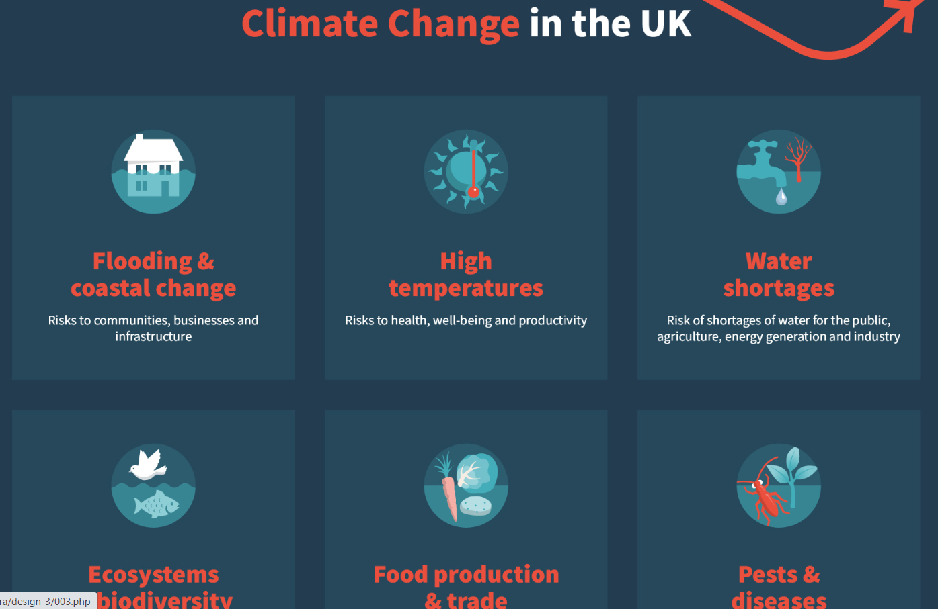
Findings 3
People liked:
Infographics
Factsheets
Stakeholder engagement
Case studies
Ready made slide pack
People wanted:
More of the above
More brevity/less technical outputs
More reflection of devolved administration policy
Way of looking at local risks (maps)
Better navigation between documents
Easier way of searching for key terms
Standalone website
Could universities use these for educational or resilience purposes?
Some of these we’ll be taking forward in our contract, others will be done by CCC – where budget allows!
Notes:
Key points
We are the sustainability adviser to the leaders of the West Midlands
Private sector led and cross-sector – not-for profit
Our role is to act as a catalyst to help others – main areas policy & project advice & sharing good practice
4. We learn from project and annual customer feedback – and this has helped us to maintain a high satisfaction rate during very challenging times
What our customers say they like about us is
Our independence
Our cross-sector good practice networks
Our vision, plan and coordination of actions for a better West Midlands

Slide 8
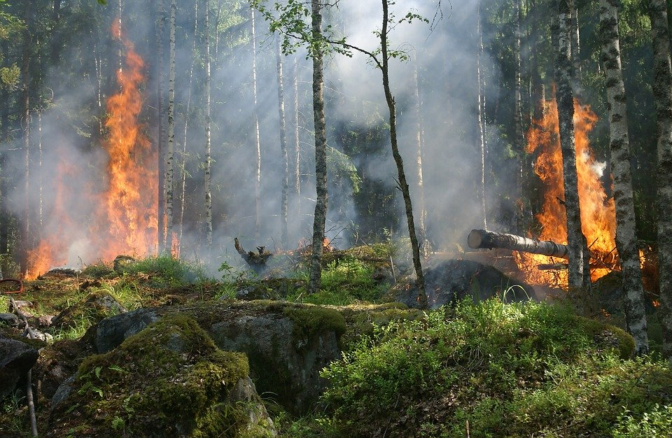
Factsheets…
Agriculture and Food
Business, including supply chains and trade
Energy
Flooding and coastal change
Health and social care
Housing
Land use, land use change and forestry (i.e. Impacts on decarbonisation/sequestration)
Marine environment
Telecoms
Transport
Terrestrial biodiversity
Water
Young people
To be short (2 pages) and include one or two key charts/figures to summarise the risks.
Notes:
Key points
We are the sustainability adviser to the leaders of the West Midlands
Private sector led and cross-sector – not-for profit
Our role is to act as a catalyst to help others – main areas policy & project advice & sharing good practice
4. We learn from project and annual customer feedback – and this has helped us to maintain a high satisfaction rate during very challenging times
What our customers say they like about us is
Our independence
Our cross-sector good practice networks
Our vision, plan and coordination of actions for a better West Midlands

Slide 9
West Midlands Green Recovery https://www.sustainabilitywestmidlands.org.uk/?post_type=events&p=15775
Notes:
Key points
We are the sustainability adviser to the leaders of the West Midlands
Private sector led and cross-sector – not-for profit
Our role is to act as a catalyst to help others – main areas policy & project advice & sharing good practice
4. We learn from project and annual customer feedback – and this has helped us to maintain a high satisfaction rate during very challenging times
What our customers say they like about us is
Our independence
Our cross-sector good practice networks
Our vision, plan and coordination of actions for a better West Midlands

Slide 10
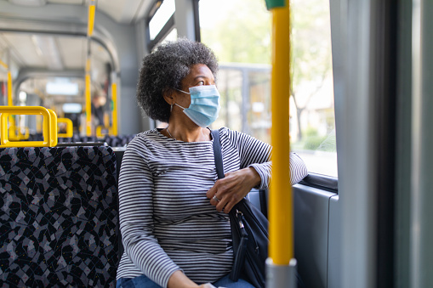
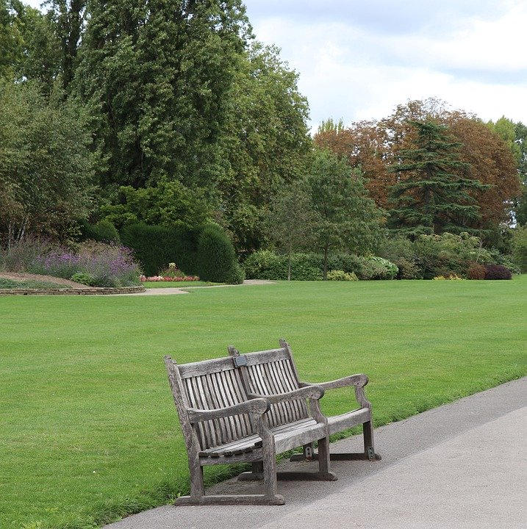
WM Green Recovery
WMCA Board signed off ‘green recovery’ approach to Covid-19, with priorities including:
Transport
Circular economy
Fuel poverty/retrofit
Natural capital/green space
Green financing/procurement
How can we identify and nurture projects that align with these themes and find innovative solutions and approaches to the challenges of recovery?
Could any of our universities provide some of these
solutions?
Notes:
Key points
We are the sustainability adviser to the leaders of the West Midlands
Private sector led and cross-sector – not-for profit
Our role is to act as a catalyst to help others – main areas policy & project advice & sharing good practice
4. We learn from project and annual customer feedback – and this has helped us to maintain a high satisfaction rate during very challenging times
What our customers say they like about us is
Our independence
Our cross-sector good practice networks
Our vision, plan and coordination of actions for a better West Midlands

Slide 11
Running events… virtually
In the purple corner In the blue corner
Which is best for what purpose??
Note – some (usually larger) organisations don’t have a choice which to use due to strict firewalls!
Good for meetings with a few people
Built into our MS Office package, so easier to arrange meeting through Teams
Less functionality for larger meetings and process seems clunky
Have generally come across more technical issues with Teams compared to Zoom.
You also have:
Teams Live
Zoom webinar
WebEx
Go to Webinar…
As the names suggest, these are good for… yep you guessed it… webinars, or so I’m told.
Not much use unless you pay for the upgrade
More and slicker functionality when arranging larger events, e.g. breakout rooms
Needs a lot of prep for larger events to run them properly/smoothly!
Watch out for Zoom bombing!
Notes:
Key points
We are the sustainability adviser to the leaders of the West Midlands
Private sector led and cross-sector – not-for profit
Our role is to act as a catalyst to help others – main areas policy & project advice & sharing good practice
4. We learn from project and annual customer feedback – and this has helped us to maintain a high satisfaction rate during very challenging times
What our customers say they like about us is
Our independence
Our cross-sector good practice networks
Our vision, plan and coordination of actions for a better West Midlands

Slide 12
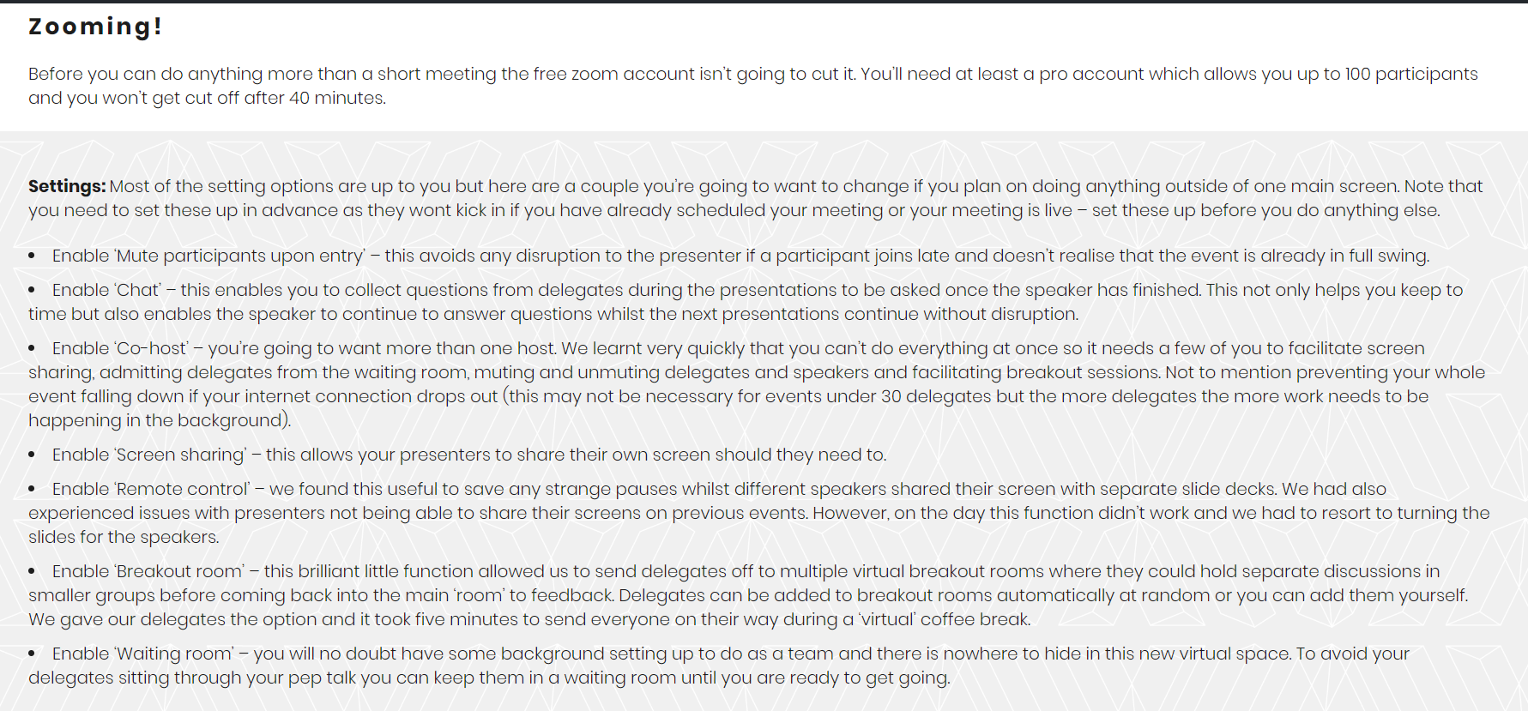
Zoom like a Pro! https://innovationwm.co.uk/2020/05/07/zoom-like-a-pro/
Notes:
Key points
We are the sustainability adviser to the leaders of the West Midlands
Private sector led and cross-sector – not-for profit
Our role is to act as a catalyst to help others – main areas policy & project advice & sharing good practice
4. We learn from project and annual customer feedback – and this has helped us to maintain a high satisfaction rate during very challenging times
What our customers say they like about us is
Our independence
Our cross-sector good practice networks
Our vision, plan and coordination of actions for a better West Midlands

Slide 13
Thank you
Alan Carr
Senior Sustainability Adviser
alan.carr@swm.org.uk
07599 658889
www.swm.org.uk
@SWMtweet
LinkedIn: Sustainability West Midlands
Photo: Gnosall, Staffordshire,
late October 2019
Notes:
Key points
We are the sustainability adviser to the leaders of the West Midlands
Private sector led and cross-sector – not-for profit
Our role is to act as a catalyst to help others – main areas policy & project advice & sharing good practice
4. We learn from project and annual customer feedback – and this has helped us to maintain a high satisfaction rate during very challenging times
What our customers say they like about us is
Our independence
Our cross-sector good practice networks
Our vision, plan and coordination of actions for a better West Midlands

