Slide 1
Buildings for sustainability - how buildings are utilised to develop skills and community participation
Facilitator: Huw Evans (Keele University).
Speakers: Professor Pat Bailey, Pro Vice-Chancellor Environment and Sustainability and Dean of Natural Sciences (Keele University),
Dr Sharon George, HUB Building manager (Keele University),
Graham Waddell, Head of EaRTH Programme (Bicton College)

Slide 2
Objectives:
An introduction to how buildings are used to interact with communities, staff and students.
Environmental Sustainability Strategy at Keele University
Keele University Sustainability HUB (KUSH)
Bicton College EaRTH Centre
Q&A
Notes:
with a case study from a University and College. Keele University’s Sustainability HUB opened in Autumn 2011 and acts as a focus for the research into, teaching of, and management for sustainability and green technology. It is a means to bring all these different activities in disparate units together and then to communicate the innovations and implications out to the rest of campus, businesses and the wider community. The Bicton EaRTH Centre will be a dedicated training centre and conferencing space for renewable energy and sustainable building. Questions and discussions with speakers

Slide 3
Aligning you institutional sustainability strategy with a dedicated building/space.
A range of sustainability activities that can be delivered.
A business case for a sustainable building/space.

Slide 4
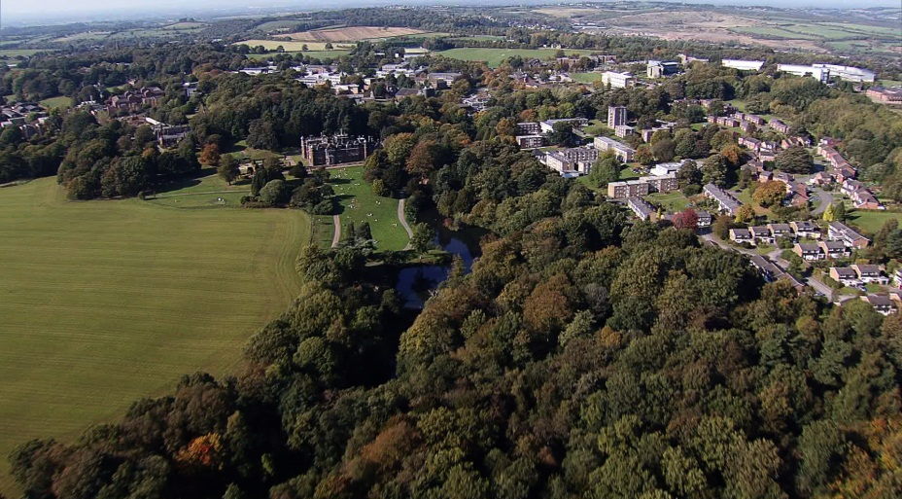
Buildings for sustainability: the context for Keele
Environmental Vision
Integration of a range of features at Keele
Our vision
Timeline for the Hub
What is the Hub
Observations
Energy plans
Research
Education
Campus and community
ethically
Why is ‘sustainability’ important for Keele University?
practically

Slide 5
1) Keele’s sustainability ‘vision’ (2008)
'Green'
energy
Keele
campus
Education
The best
universities/
international
experts
Local and regional communities
Keele University
Sustainability Hub
Businesses
and other
organisations
Schools and
colleges
Fuel cells
and photo-
voltaics
Research Expertise
Green IT
Wind energy
Geothermal
energy
Eco-coal
Environmental
biology
Political,
social &
legal policy issues

Slide 6
Strategy (top level) 2011
Keele University’s Strategic Aim 5: To develop an environmentally aware and sustainable outward-facing campus community
Strategic Objectives
To demonstrate environmental sustainability through innovation, good practice and ethical choices in all our activities
To unlock the potential of the University Estate so that it underpins the attainment of our vision
To share and provide the University’s expertise in environment and sustainability to local, regional, national and international communities and partners

Slide 7
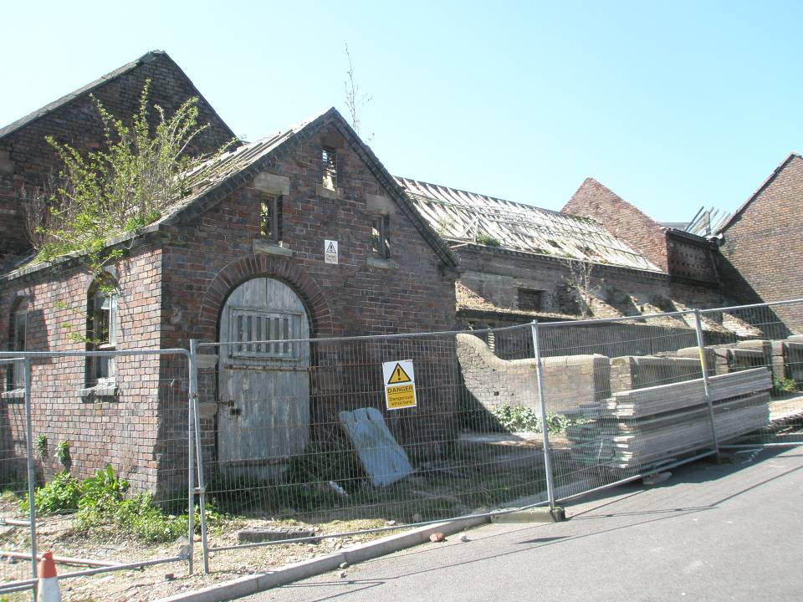
2) Timeline for the Hub
2000-07 Top campus developed:
Home Farm (200 yr old; deserted 1980)
Renovation ←→ planning permission
Commercial plans; anchor tenants
2008 Deep Green Agenda
Environmental Vision
2009 Planned a new building
SDF funding from HEFCE (£2.5m for building)
Recession hit (no AWM match; loss of anchor tenants)
Spot listing (6 month hiatus and major deterioration)
2010 Stabilisation (April); works started (Autumn)
2011 August – the keys!

Slide 8
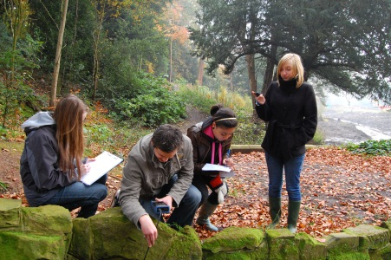
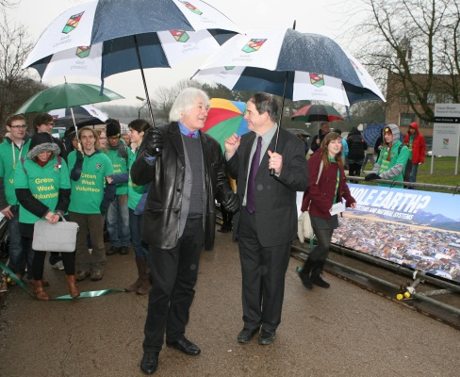
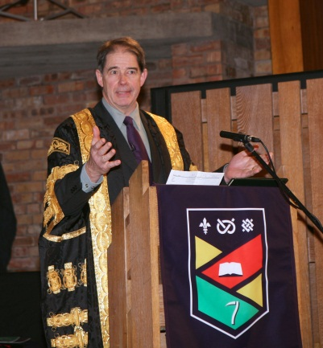
Sustainability timeline at Keele
08
09
10
11
12
13
?
Council
‘Deep Green’
Home farm
developments
PVC
JP as
Chancellor
SDF
£3.4m
Hub
opening
‘Environmental
Vision’
New:
BSc – Env & Sus
MSc – ESGT
‘Whole
Earth’
ESSG
(KHERG)
Strategy
Sustainability
in the
curriculum
Student
House
project
Education, estates and
research initiatives
‘Project
Green’

Slide 9
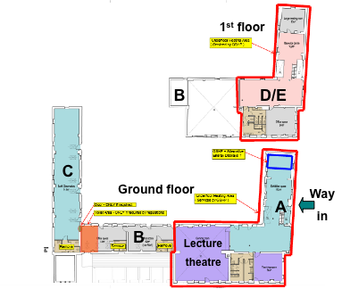
3) What is Keele University Sustainability Hub?
Keele University
Sustainability Hub
A) Exhibition area
B) Resources suite
C) Earth Observatory
D) Teaching (UG and PG)
E) Applied research
April 2010

Slide 10
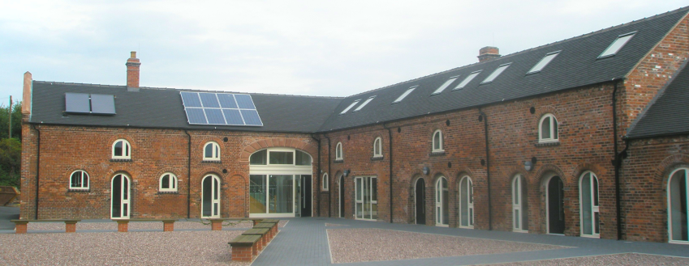
4) Some observations
2010
2012
Need an over-arching vision (not strategy)
Top level buy-in (PVC, Strategic Plan)
Not ‘stand-alone’ building – other developments
Be able to respond to opportunities quickly
Have a business plan – but use the building to help you to understand its potential, and its users

Slide 12
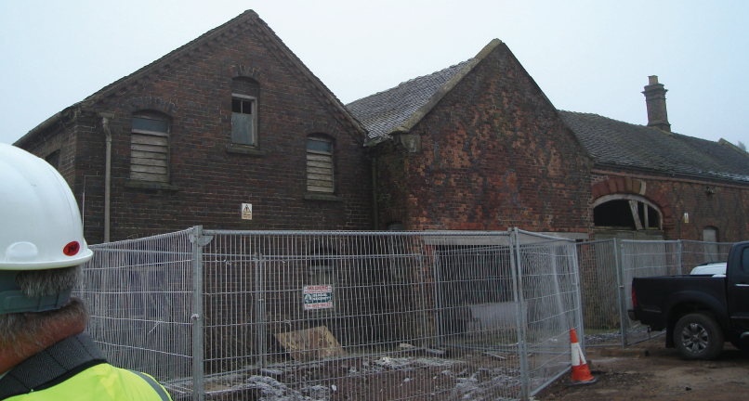
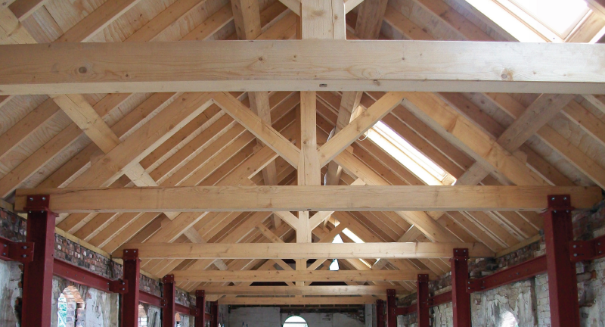

Slide 13
Delivering the vision
Realisation of potential within strategic vision
Translating the vision to strategy to operation
Delivering intangibles = delivering value
Strategic Objectives
To demonstrate environmental sustainability
To unlock the potential of the University Estate
To share and provide the University’s expertise in environment and sustainability
Operational action
Purchasing decisions, through exhibits, tours, websites, talks, workshops, external speaking
Accessible through open times, websites, maps to woodlands and lakes, links to research and teaching linked to campus
Forming new links and collaborations with external organisations through research projects, networking, funding, relationships and collaborations

Slide 14
Facilities
Environmental Outreach Centre
KEO
Exhibition Area
Resources Suite
Teaching facilities
Research facilities
these themes are interlinked within the Centre and across campus

Slide 15
Challenges
Engagement of people is vital
External marketing
Location
Relevance
Internal marketing
Location
Relevance

Slide 16
Vehicles
Really Rubbish
Grey Matters
Masters projects
Industry events

Slide 17
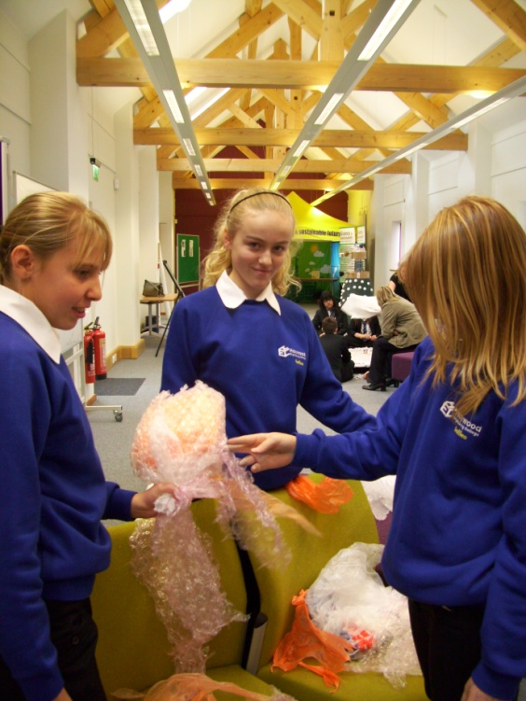
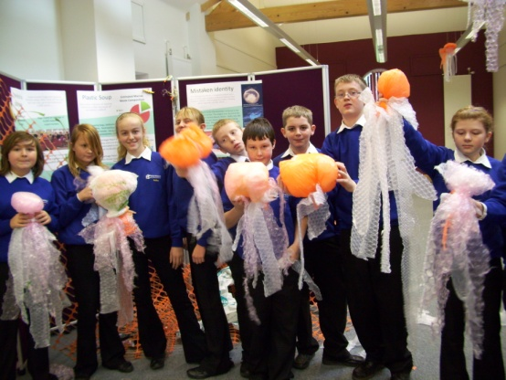
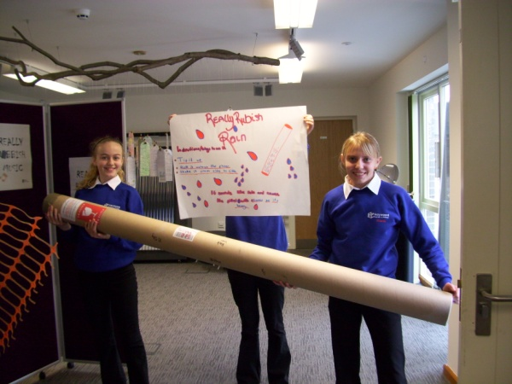
Really Rubbish
Four local schools
Really Rubbish activities:
House with furniture
Music
Jellyfish
Rockets
World
Litter
Darlek

Slide 18
Really Rubbish
Earth Observatory
Link to campus
Lakes
Woods
Courtyard
Allotments

Slide 19
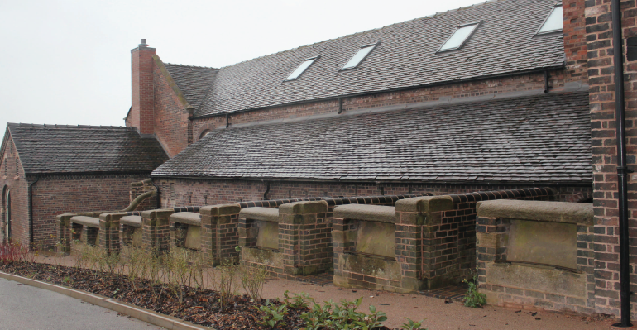

Slide 20
Intergenerational workshops
Community days
Awareness
Politics
Grey Matters
Sustainable Living
Gardening Club
Changing Planet
Students
Speakers
Students
Estates
Partnerships
North Staffs Organic Gardeners
Speakers
Trips
Laboratory days
Observatory
Courtyard
Community days
Demonstrations
Students
Staff
Schools

Slide 21
Grey Matters
100 members
Links to clinical, psychology, social science research
Through the eyes of…….
Intergenerational link to community

Slide 22
Smart Materials
Networking and CPD for businesses
Catalyst for new research and development
Link to teaching
!!Links for new staff!!
Springboard for new collaborations

Slide 23
MSc projects
Environmental Sustainability and Green Technology
Students linked to organisations according to their intended destinations
Vehicle for link between teaching and industry
Projects on campus
Science, technology, behaviour, education, politics, management, etc., etc.
Projects at the Hub
Building performance, systems performance, engagement and behaviour, technology development, etc., etc.

Slide 24
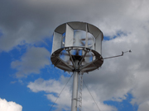
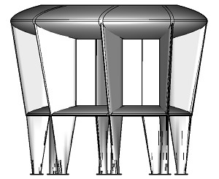
MSc projects – wind turbine
McCamley Ltd
1 kW vertical axis turbine
Self starting
Works in turbulent and high speed wind
Spring valve at 12ms⁻¹ feathers blade
Expected load factor 55% (usually only 30%)
No light flicker and low noise
Bird and bat friendly
1st in UK of this type
Demonstrates innovation

Slide 25
Development ongoing

Slide 26
Planning for the future
Seeing forward using feedback now
Senior leadership support
Trust to enable agile decision making

Slide 27
Thank you for listening
Dr Sharon George
s.m.george@esci.keele.ac.uk
Huw Evans
h.a.evans@kfm.keele.ac.uk
Professor Patrick Bailey
p.bailey@natsci.keele.ac.uk

Slide 28
Inspiring Through Creativity
Graham Waddell
Head of EaRTH
Section Leader Environment & Sustainability
Bicton College

Slide 29
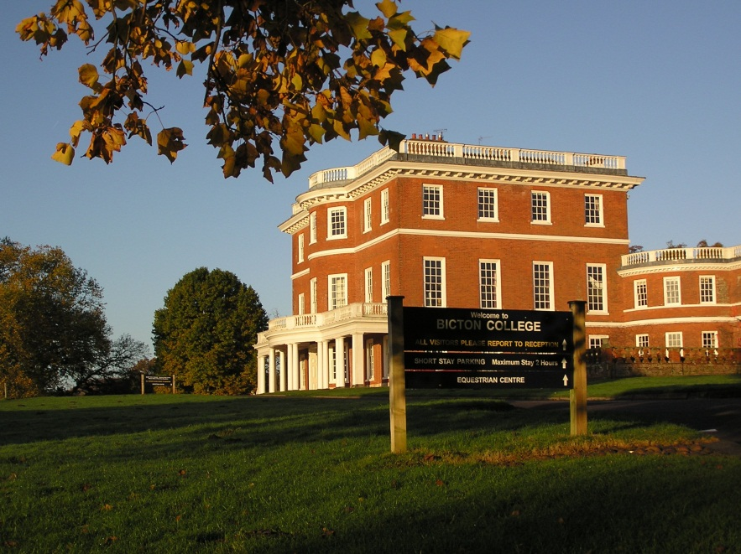
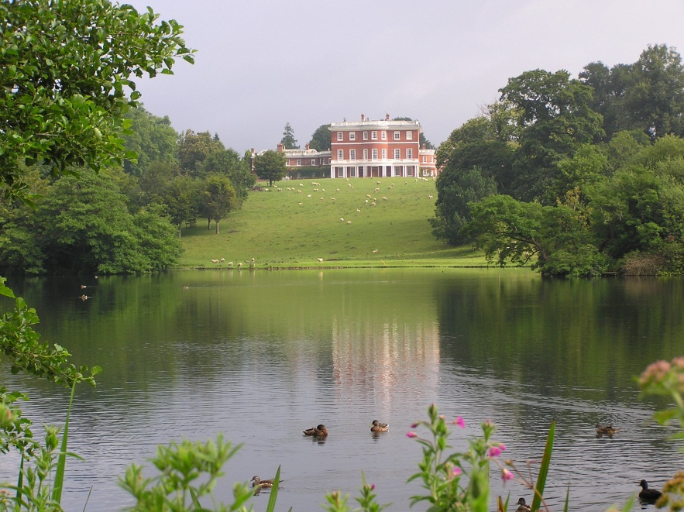
Bicton College
Land-based and environmental college
Strong history & tradition
Strong vision for innovative and creative growth
Sustainability at our heart
EaRTH is a core part of our vision

Slide 30
Bicton Strategy
Education
Environment
Enterprise
Growth

Slide 31
EaRTH Objective
An outstanding environmental centre of excellence for industry, education and communities

Slide 32
Rationale & Drivers
Green Skills & Low Carbon Economy
SW strong renewables credentials
Devon large off-gas grid & hard to heat
Refurbish vs. new build > 60%+ by 2050
Bicton as sustainable college
Multi functional learning resource
Rural innovation, business growth & opportunities
Enterprise culture & diversification
Communities & Schools

Slide 33
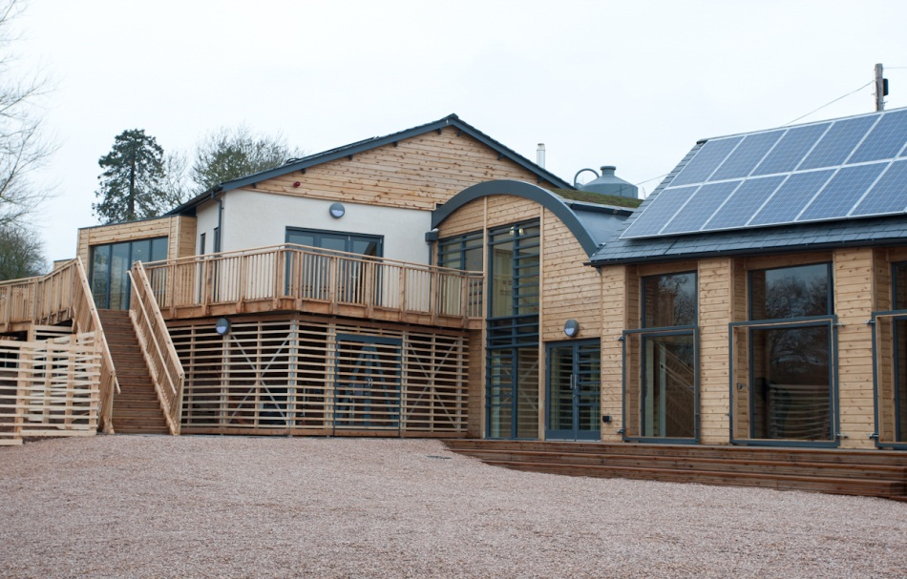
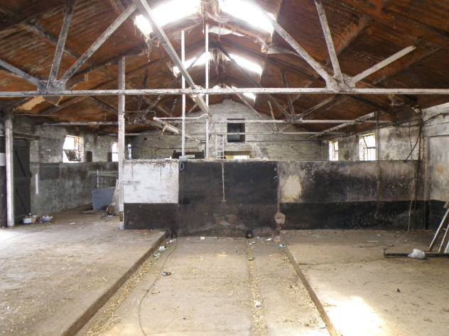
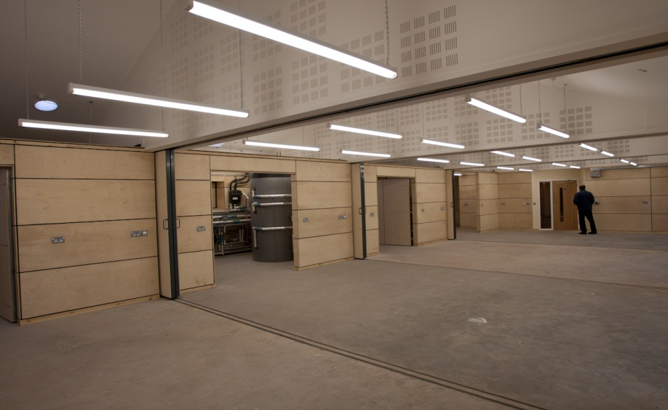
History

Slide 34
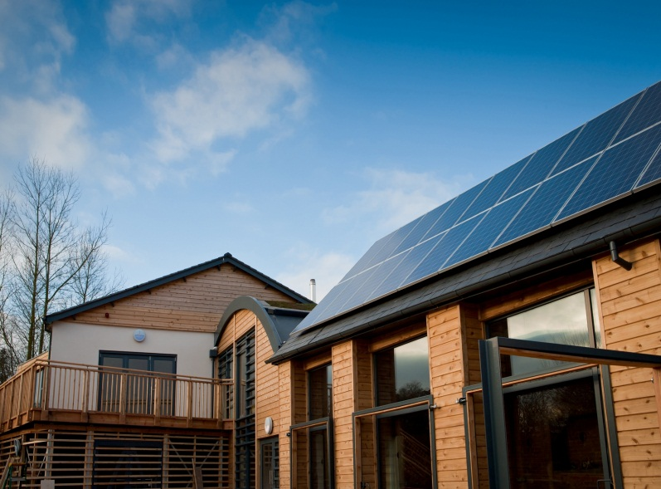
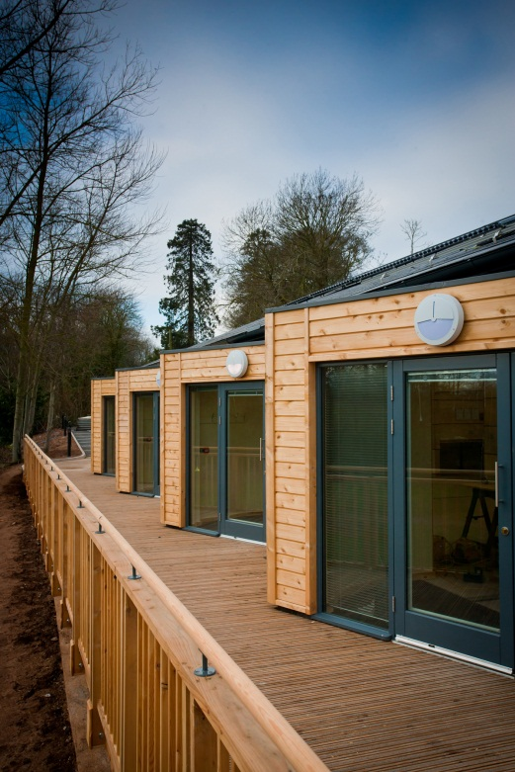
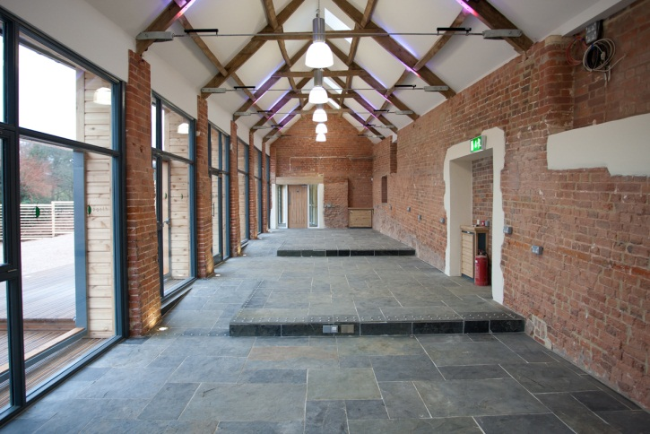
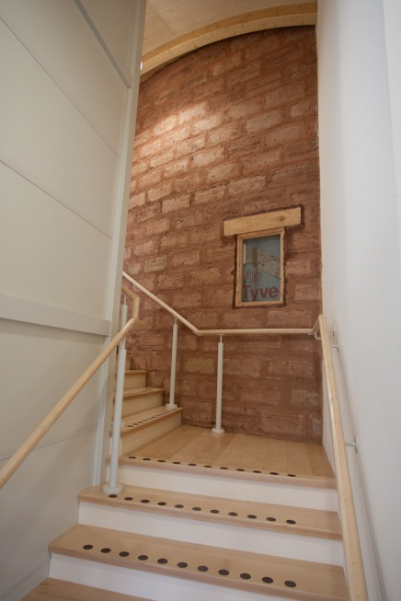
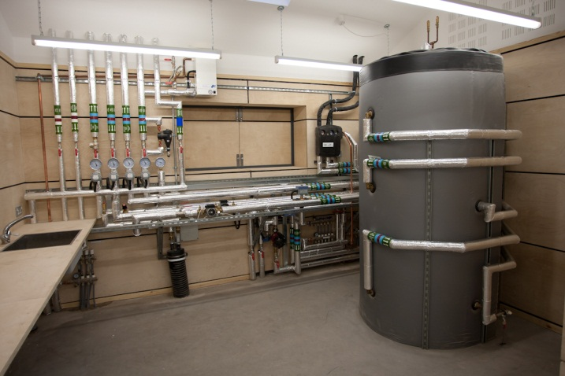
Key Features

Slide 35
The Model
Green Sector Training & Growth
FE / HE Students
Education
Community Resource
Demonstration
Schools
Teacher PDP
Business
Information
Cross-sectors
Trades
Enterprise
Embed Curriculum
Curriculum
Support
Practical Resource

Slide 36
Integration
Trades & Wider Sectors
FE & HE Env / SD / Energy
Sustainability & Curriculum
Schools & Communities
Installer / Commercial

Slide 37
The Future
Estate
Decentralised > biomass / solar / ASHP
AD on Farm
Energy efficiency
Curriculum
Embed sustainability
Enterprise and entrepreneurialism
EaRTH as a catalyst
Behaviour
Hub & Spoke
New innovative and enterprising collaborations

Slide 38
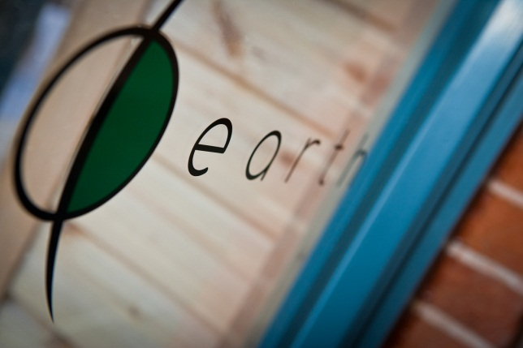
3 Key messages:
Engage widely
Seek to inspire
Deliver the ‘Why’ not the ‘What’

Slide 39
Q&A

Slide 40
Your next steps – making the most of your EAUC Membership…
Resources
visit the dedicated construction and community sections on the EAUC resource bank
visit SORTED, the online resource for sustainability in the Learning and Skills sector
Recognition - enter the 2012 Green Gown Awards Sustainable construction and refurbishment category. Entries open summer 2012
Measure and improve - sign up to LiFE www.thelifeindex.org.uk. EAUC Members receive a significant discount
LiFE offers dedicated ‘sustainable construction and renovation’ and ‘community and public engagement’ frameworks
Membership matters at www.eauc.org.uk

