Slide 1
RossMcCulloch
Twitter: @ThirdSectorLab
www.rossmcculloch.com
ross@thirdsectorlab.co.uk
Notes:
Slide 1
Intro
My name is Ross McCulloch, my time is split between my role as a Development Manager with a family support charity and as a consultant working with organisations to help them understand how they can utilise social media effectively. My recent clients include Relationships Scotland, Tramway Theatre and ENABLE.
As well as my paid work I also sit on Scottish Community Foundation's Grants Committee and I'm the founder of ThirdSectorForums.co.uk - an online community for social entrepreneurs and charity professionals.
I'm going to start off with a vague attempt to define the term 'social media', then move on to social media stats before finally looking at a few case studies...

Slide 2
We build conversations

Slide 4
Tell us...
- Your organisation and your role
- How do you currently use social media within your role
- What do you hope to learn today

Slide 5
10.00am
Social media - a discussion Why should you be using social media?
4 elements of a social media strategy
Developing a social media policy
11.00am
Helen MacDonald - GWL
11.30am
Angela - Rape Crisis Glasgow
12.00pm
Lunch
12.30pm
Key channels:
Website
Blogging
Video & Audio
Facebook
1.30pm
Content Planning - Group Activity
(Grab tea & coffee)
2.00pm Twitter Hands-On
3.00pm
Finish

Slide 6
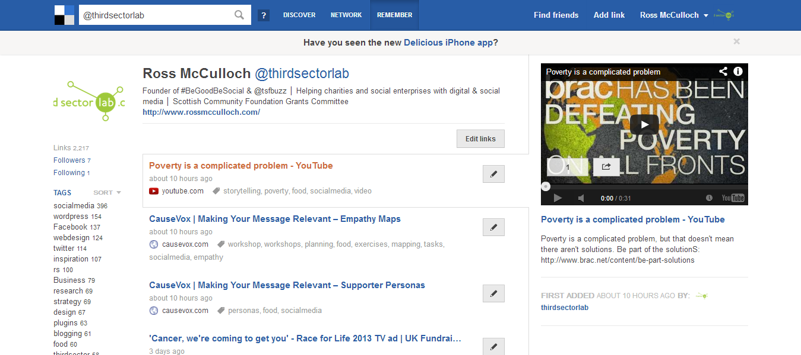
All of today’s resources: delicious.com/thirdsectorlab

Slide 7
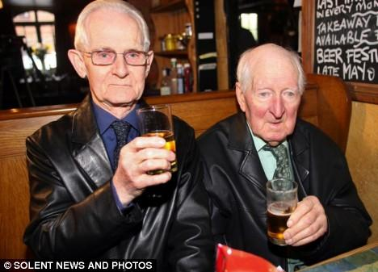
Social what?
Notes:
Slide 2
Social what?
If you google "what is social media?'' you'll find umpteem definitions, most of which unnecessarily complicate things by getting bogged down in technology.

Slide 9
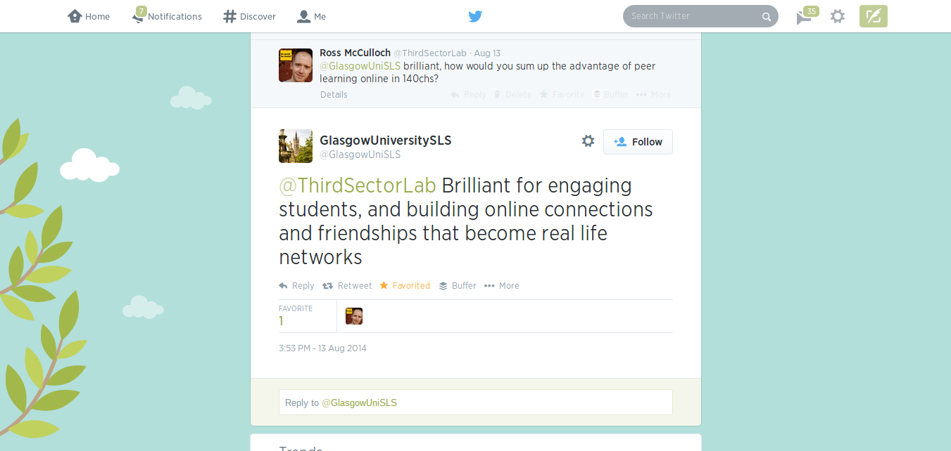

Slide 10
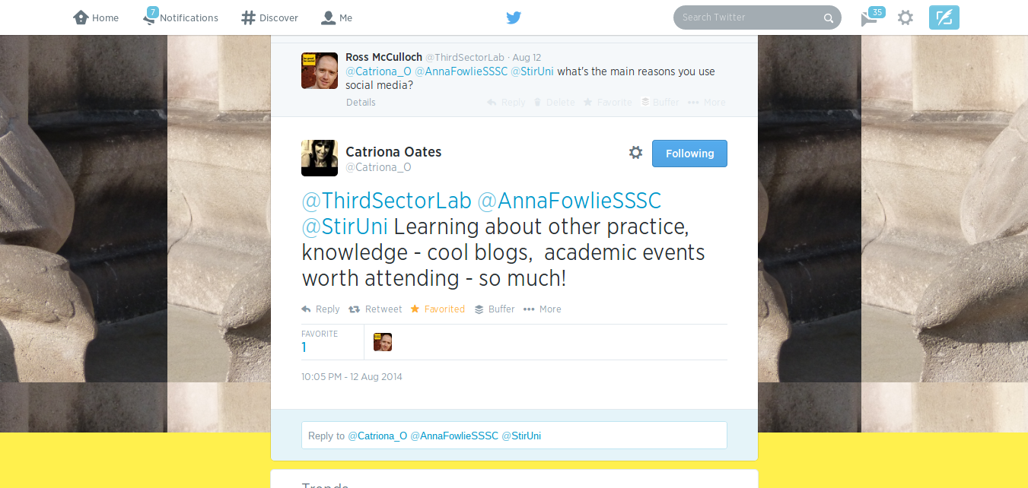

Slide 11
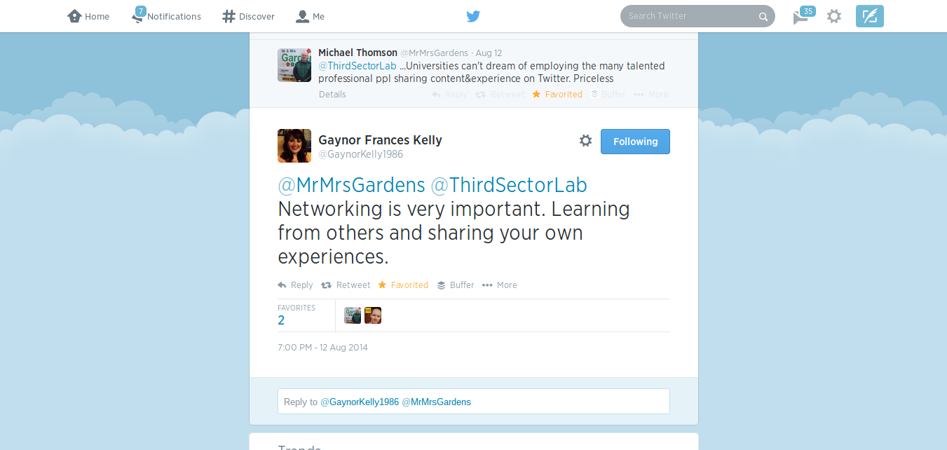

Slide 12
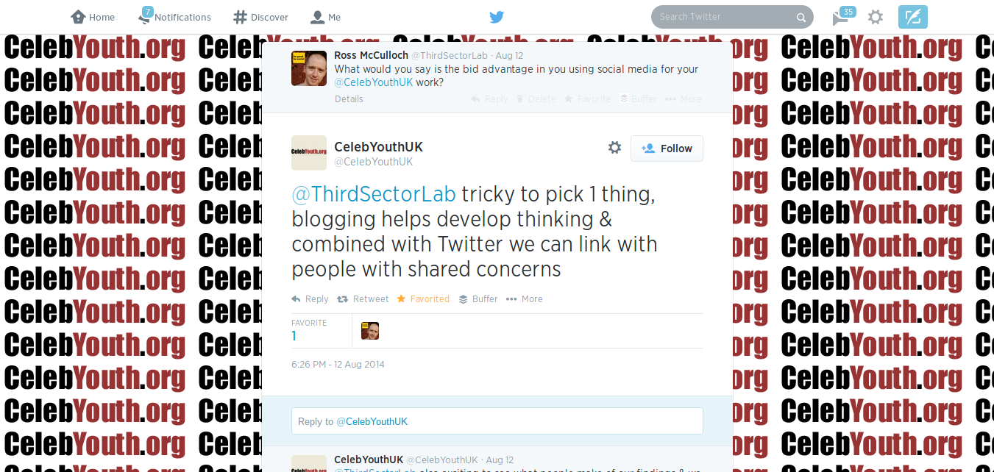

Slide 13
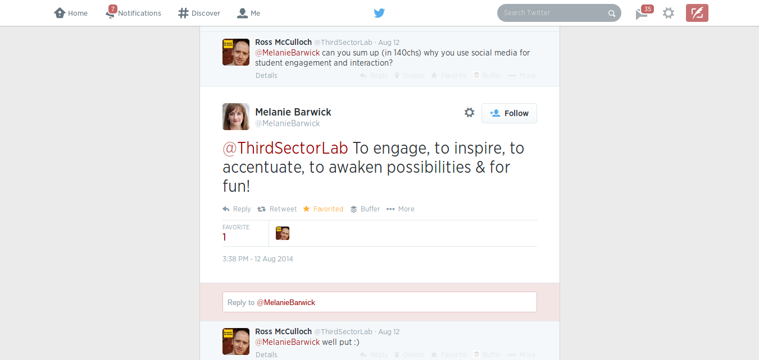

Slide 14
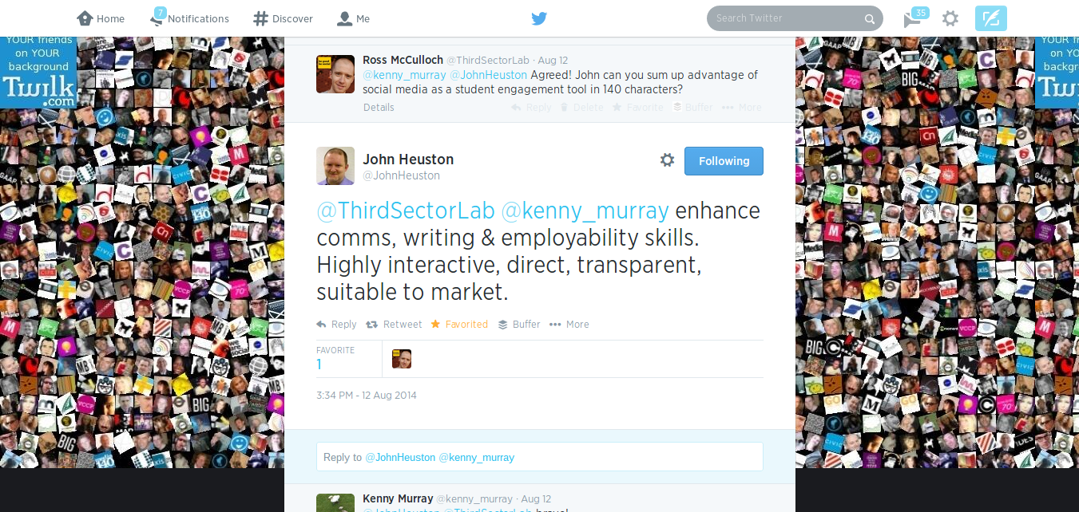

Slide 15
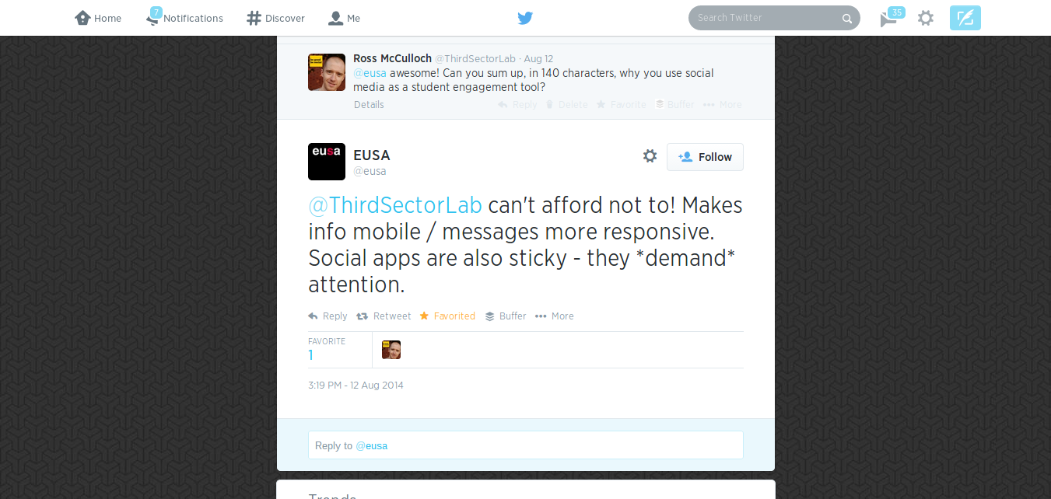

Slide 16
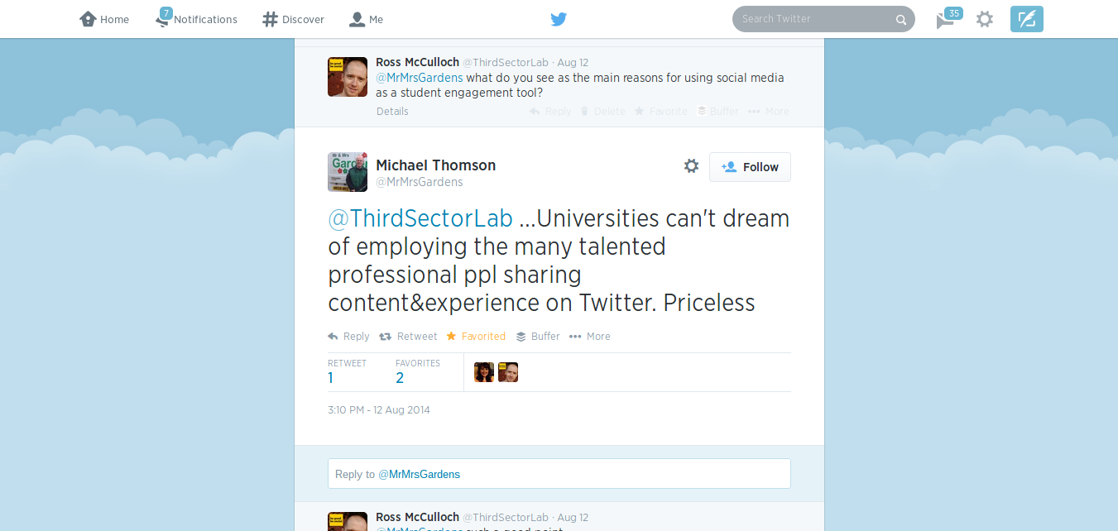

Slide 17
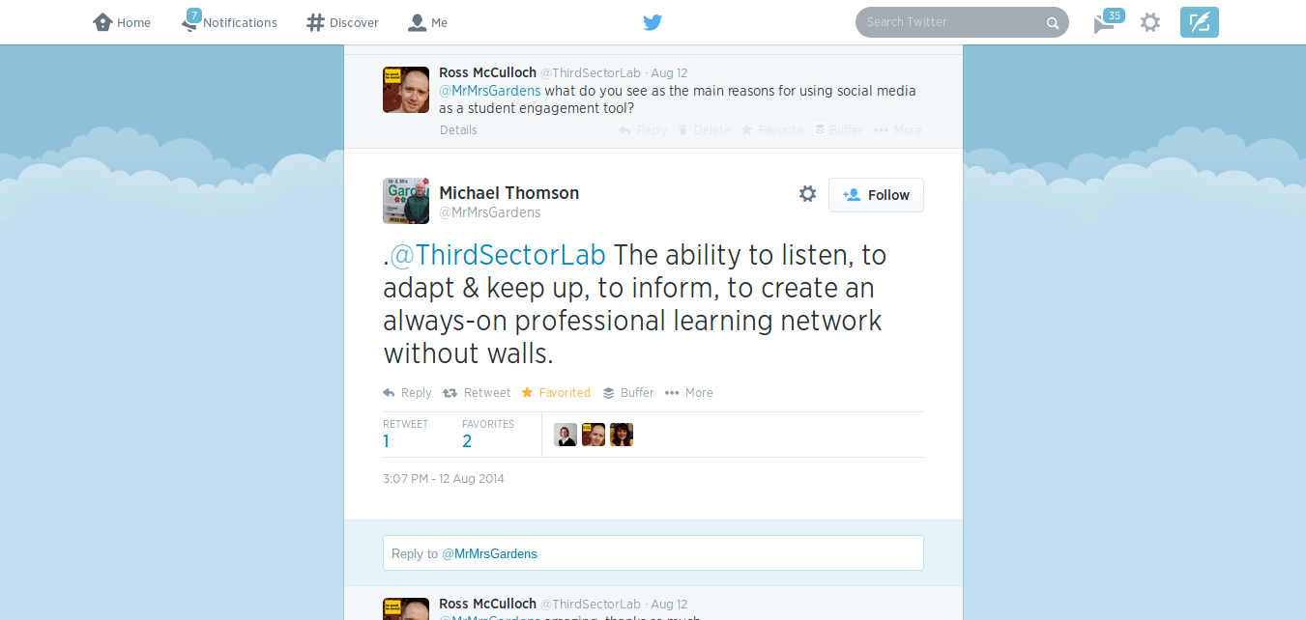

Slide 19
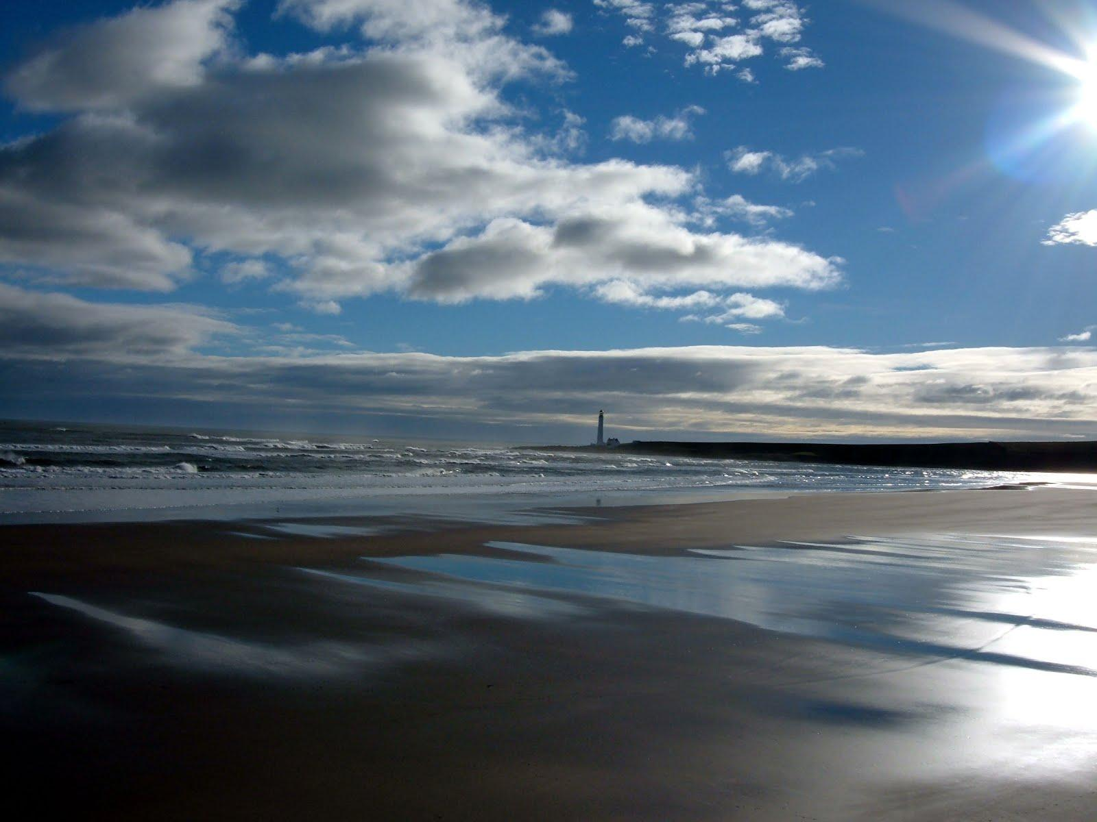
Why your organisation should use social media...
1. Story telling & thought leadership
Your website or blog as a hub of thought leadership, students’ success stories and other useful or intersting posts. Utilising written, audio and video content, with social media driving the conversation. 2. Customer service channel
Providing online support or singposting via Twitter, LinkedIn and beyond.
3. Being part of the conversation
Connecting with students, academics, other universities, traditional journalists, politicians, the third sector, the private sector and key influencers via social media channels.

Slide 20
“People don’t care about what you’re doing, they care about why you do it.”
— Jesse Sanchak, SmartBlog
*Don't fall into the programme trap

Slide 21
4 key elements of a social media strategy
1. Set yourself goals.
2. Carry out a social media audit.
3. Your strategy in practice.
4. Measuring success.

Slide 22
Why use social media?
The all-important question to ask yourself.
Set yourself some goals, thinking about the following:
What do you want to achieve with social media?
Who are your target audience(s)?
What is the current image of your organisation?
How can social media improve the way you work at the moment?
How can social media affect the effectiveness of campaigns?

Slide 23
Examples....
- Position our charity as the go to source online for information about mediation
- Connect with more women aged 25-34
- Break down stereotypes about autism using Facebook - Use Twitter as a key volunteer recruitment channel
- Increase signups to our newsletter via social media
- Use social media as a way of increasing readership of our annual report/toolkit/guides/etc
- Use social media as a way of making our organisation seem more personable
- Use our blog to give our service users a voice - Engage with key journalists and politicians to bring about legislative change - Use Twitter to build up a conversation around a campaign using a hashtag

Slide 24
What do you want to achieve?
- Work in pairs to come up with 3 goals
- Assign a key audience(s) to each goal

Slide 25
Social media audit
1. What's being said about issues relevant to your work and the key brands in your sector?
2. Who is talking about you and what channels are they using?
3. What is your team's social media skill-set?
Choose a tool and explore:
- SocialMention.com (Fine tune with advanced search)
- Google.com (Click more to filter by ‘blogs’, ‘discussions’, etc and use search tools to focus in on UK topics from the last month)
- Facebook.com Graph Search (Set your language to English US to access this powerful search functionality)
- Twitter.com/search (Fine tune with advanced search)
Notes:
Slide 4
these conversations are powered by blogs, social networks, forums, podcasts, video and photo sharing and so on [Inforgraphic of social media tools]
What's important to remember is that the tools themselves are just that, tools...it's the social interaction that's matters.

Slide 26
Your strategy in practice
Who are you going to talk to?
Where will you engage with them?
What will you say?
How will you say it?

Slide 27
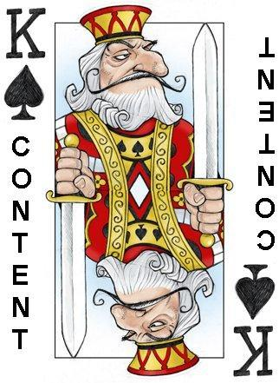
People on social media channels engage with content that is either interesting or useful.

Slide 28
Measuring success (setting KPIs)
1. Website/Blog traffic 2. e-Newsletter subscribers 3. Downloads/reads on a piece of research, annual report, guide, etc 5. Staff or volunteer recruitment (also use offline ways of measurement)
6. Event Attendance (also use offline ways of measurement) 7. Online petition signatures 8. Number of mentions for a specific campaign hashtag
9. Significant impact - policy change, piece in press, new high level connection, etc. 9. Number of Likes, Followers etc

Slide 29
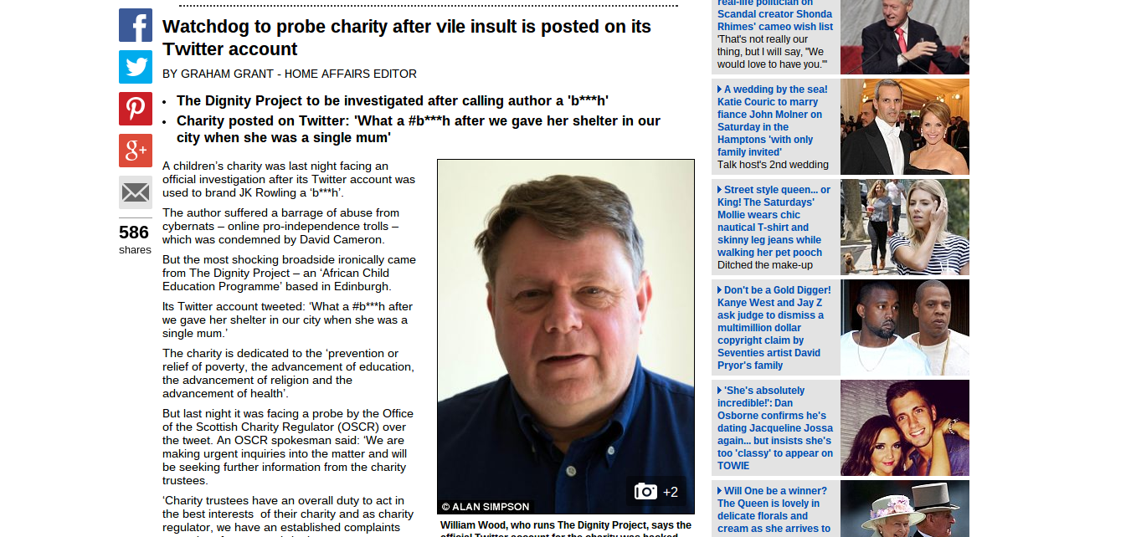

Slide 30
“Think of CNN, your mother and your boss:
Don't say anything online that you wouldn't be comfortable seeing quoted on CNN, being asked about by your mother or having to justify to your boss.”
- International Red Cross

Slide 31
Social media policy & guidelines 1. What Does A Social Media Policy Mean To You? 2. Social Media Roles: Who Does What? 3. What Should You Say Online? 4. Monitoring Policy 5. Responding to negative comments 6. Privacy and Permissions 7. Thinking through Copyright and Attribution 8. Personal vs. Professional

Slide 32
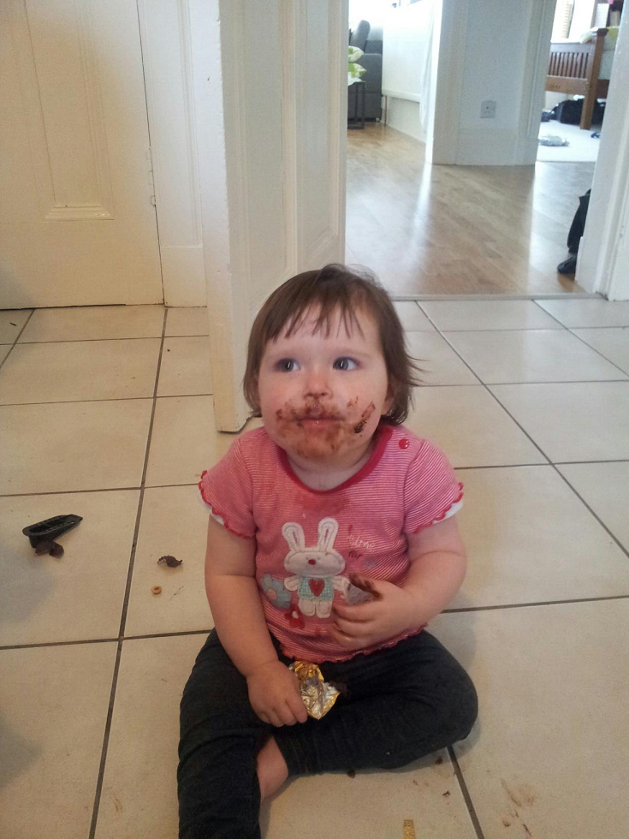
Dip your toast in grapefruit juice.

Slide 34
Key channels
Your website
Blogging
Video/Audio
Facebook
Twitter

Slide 35
Is your current website up to the job?

Slide 37
Who Blogs?
Are there any ideas you can borrow from these blogs?
www.jrf.org.uk/blog
http://blogs.nottingham.ac.uk/
http://oxfamblogs.org/fp2p/

Slide 38
Ten blog content ideas
1. Share and comment on breaking news
2. Post calls to action
3. Share stories, photos and videos from events
4. Tell your beneficiaries’ stories
5. Interview experts
6. Allow guest bloggers to share their expertise
7. Share resources and useful tips
8. Ask for feedback
9. Lists...people love a top ten
10. Highlight philanthropists, grant holders, beneficiaries and your staff

Slide 39
“People will forget what you tell them, but will never forget how you make them feel.”
- Maya Angelou

Slide 46
Ideas for videos
1. Document events
2. Give a tour office or facilities 3. Interview staff members, supporters or experts 4. Create montages with powerful statistics & quotes 5. Feature beneficiaries of your nonprofit’s services

Slide 47
How can you make podcasts work for you?
- A one-to-one interview with an expert in your field. This could be a simple Skype recording.
- A series of conversations on a particular theme
- A recording of a talk or workshop
- A podcast focused on something really practical, a how-to or top tips
- A way of gathering evidence, feedback or stories from your users, supporters or customers

Slide 48
Using audio to tell your story
https://soundcloud.com/thirdsectorlab/the-truth-povertyassembly
http://www.rspb.org.uk/podcasts/
http://www.nytimes.com/packages/html/nyregion/1-in-8-million/index.html#/michel_kramermetraux
https://itunes.apple.com/gb/itunes-u/justice-with-michael-sandel/id379064095
http://podacademy.org/about-pod-academy/
http://philosophybites.com/2013/02/jeff-mcmahan-on-gun-control.html
http://markcarrigan.net/2012/07/20/ultimately-if-im-honest-i-do-it-because-its-fun-elebelfiore-on-using-social-media-as-an-academic/
http://www2.warwick.ac.uk/fac/arts/history/atoz/thinkingaloud/
http://blogs.lse.ac.uk/lsereviewofbooks/podcasts/
http://www.mentalhealth.org.uk/help-information/podcasts/

Slide 49
Create a simple content calendar for your organisation covering the next quarter: - Write down a content idea for May, June and July.
- One video, one audio and one written.
- Focus on your audience, ticking either the useful or the interesting box.
*This technique can be used to plan content for your blog, website news, YouTube, Soundcloud and other channels

Slide 50
Ten blog content ideas
1. Share and comment on breaking news
2. Post calls to action
3. Share stories, photos and videos from events
4. Tell your beneficiaries’ stories
5. Interview experts
6. Allow guest bloggers to share their expertise
7. Share resources and useful tips
8. Ask for feedback
9. Lists...people love a top ten
10. Highlight philanthropists, grant holders, beneficiaries and your staff

Slide 51
Facebook
- Allows people to take action and feel empowered.
- Allows you to reach approx 75% of adults in Scotland.
- Helps you get urgent information out without relying on traditional media.
- Helps build relationships and shows you care.
- You get to know how people really feel.
- It ensures you remain relevant.

Slide 52
“The vast majority of social housing tenants I have talked to – even those who use Facebook to keep up with their friends – just don't want to interact with their landlord in this way.”
Mark Thomas, Word Assocation - The Guardian Housing Network Blog
“[It would be more productive] supporting customers to set up their own local community pages, and we (as the Housing Association) interact with them there, rather than simply expecting them to come to our pages.”
Jayne Hilditch, Thames Valley Housing Association

Slide 55
1. Set clear goals

Slide 56
2. Know your audience

Slide 57
3.Create mini campaigns

Slide 58
4. Involve other staff & volunteers

Slide 59
5. Use online & offline tools to drive people to your Page

Slide 60
6. Understand Edgderank*
*You'll never really understand Edgerank

Slide 61
7. Be prepared to spend a few quid

Slide 62
8. Post photos*
*or maybe text

Slide 63
9. Post at 8pm midweek or
at weekends*
*or 3.48pm on a Tuesday

Slide 64
10. Ask closed questions

Slide 65
11. Don't broadcast

Slide 66
Pick one of the Facebook pages from the list below and discuss what works well and what doesn't...
facebook.com/relationshipsscotland
facebook.com/officialDAFC
facebook.com/georgehtakei
facebook.com/universityofaberdeen
facebook.com/dogstrust
facebook.com/disabledaccessglasgow
What are the lessons learned from these pages?
How are they engaging their audience?

Slide 68
Twitter
- Levels the playing field. Allowing you to directly connect with key influencers, including journalists, bloggers, community activists and politicians.
- Enables you to build and maintain partnerships with others working to a common aim.
- Highly effective CPD tool.
- An incredible real-time listening channel.
- Simple but incredibly powerful campaigning tool.

Slide 69
“Aside from my team of health professionals, I can honestly say that Twitter has been the most important thing in my recovery so far...”
“It’s named on my safety plan as ‘someone I can contact in a crisis’ and I know I can.”
Zoe Smith, a keen blogger and Tweeter, speaking to Scottish Recovery Network.

Slide 70
"From an operational perspective we have ditched automated tweets, broadcasting and self-congratulation. We have realised the importance of getting our extended network online and focus on building capacity...
The longer-term vision is to enable practitioners to support people's recovery journeys in both their offline and online lives. And our hope is that as we continue our journey of using social media, our stakeholders will play a significant role in collaborating with us."
Victoria Betton, Deputy Director, Leeds & York Partnership NHS Foundation Trust

Slide 71
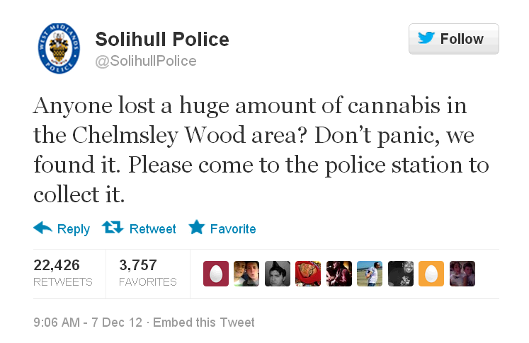
Solihull Police
http://www.guardian.co.uk/uk/2012/dec/11/huge-amount-of-cannabis-twitter

Slide 72
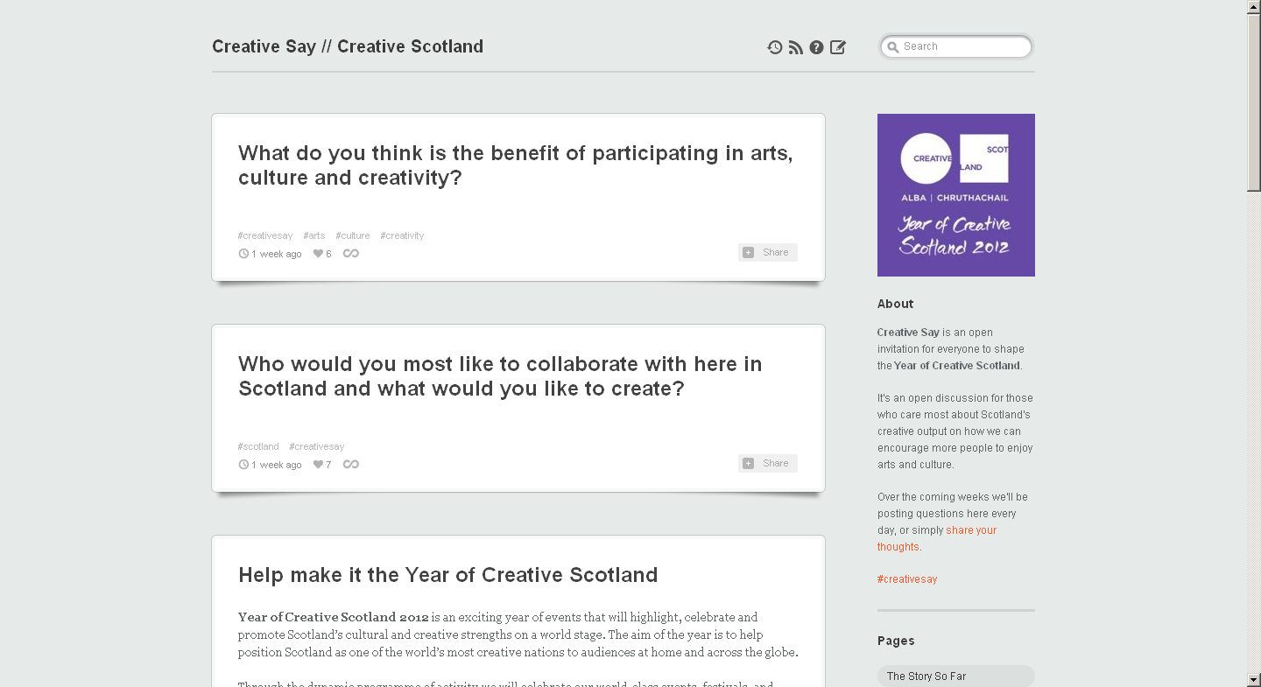
#CreativeSay
http://creativesay.tumblr.com/

Slide 73
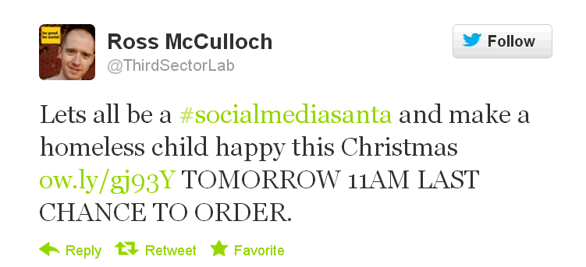
#SocialMediaSanta
http://www.rossmcculloch.com/oi-twitter-lets-all-be-a-socialmediasanta

Slide 74
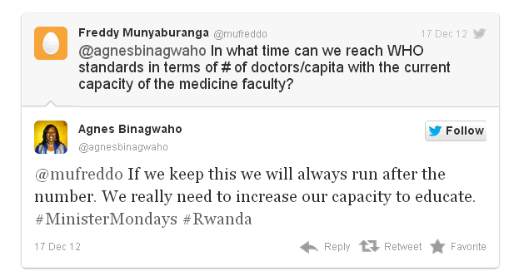
#MinisterMondays
http://www.guardian.co.uk/global-development/poverty-matters/2013/jan/04/saving-world-social-media-development-digital

Slide 75
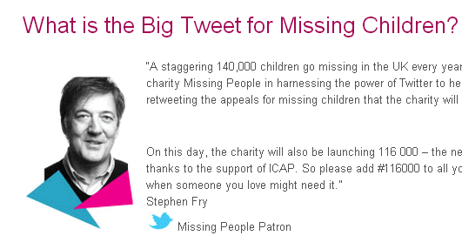
The Big Tweet
http://www.missingpeople.org.uk/missing-people/landing-pages/the-big-tweet

Slide 76
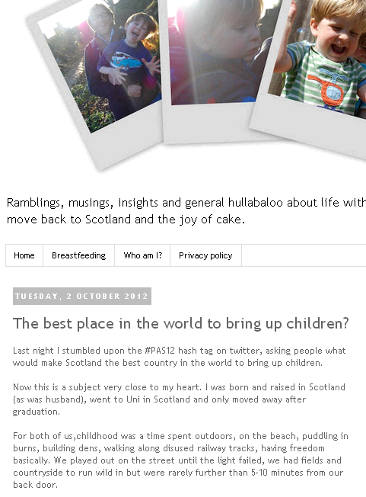
#PAS12
http://delicious.com/thirdsectorlab/%23pas12

Slide 77
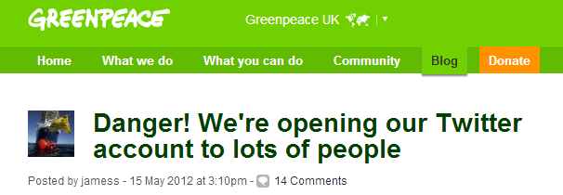
Greenpeace
http://www.simply-communicate.com/case-studies/company-profile/greenpeace-embark-six-week-twitter-experiment

Slide 78
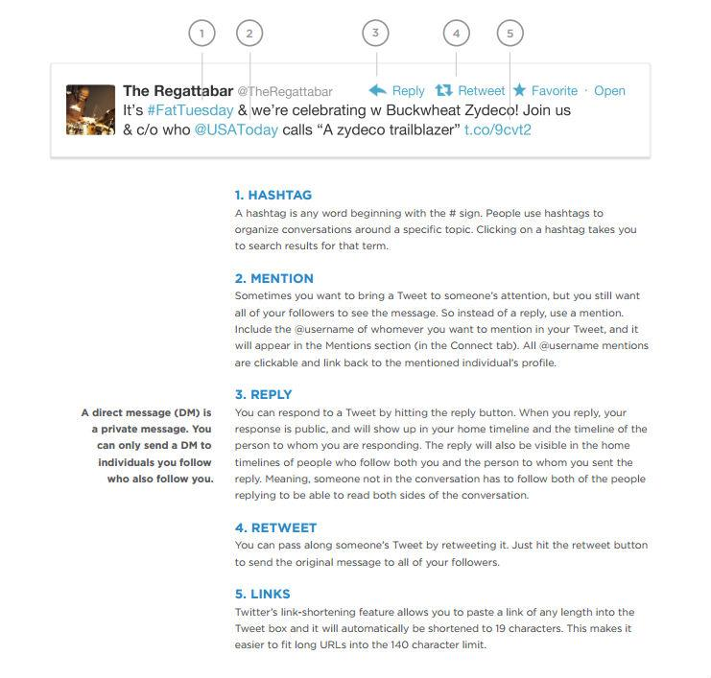

Slide 79
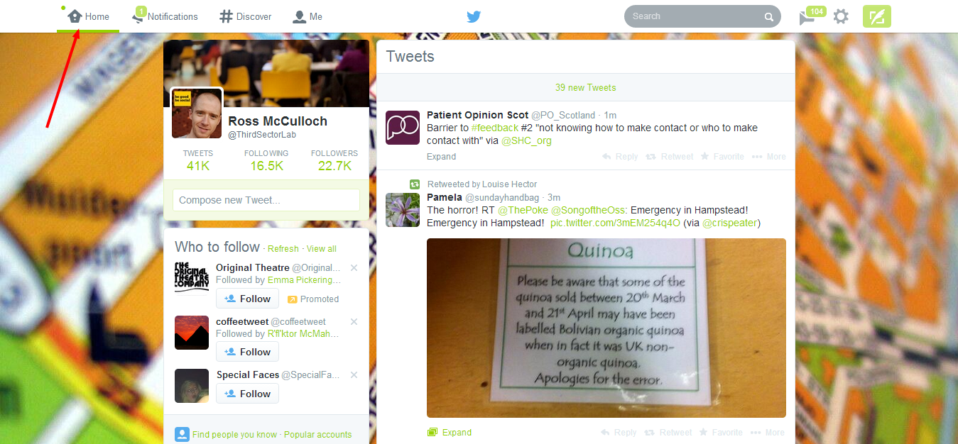

Slide 80
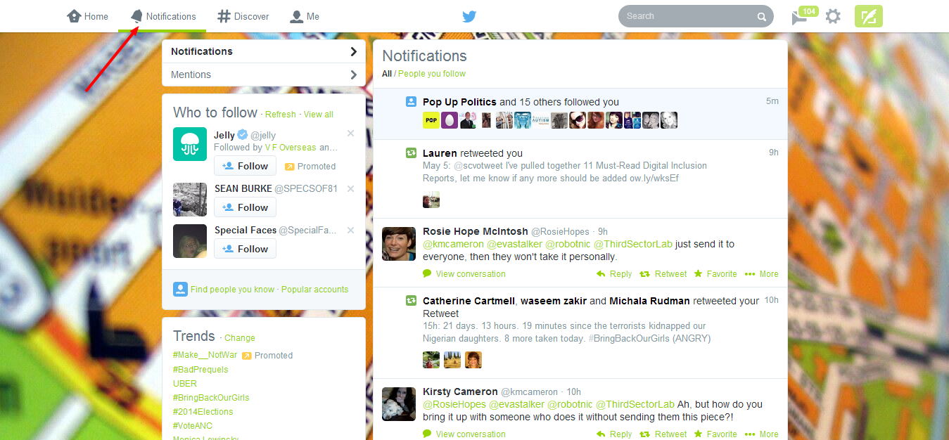

Slide 81
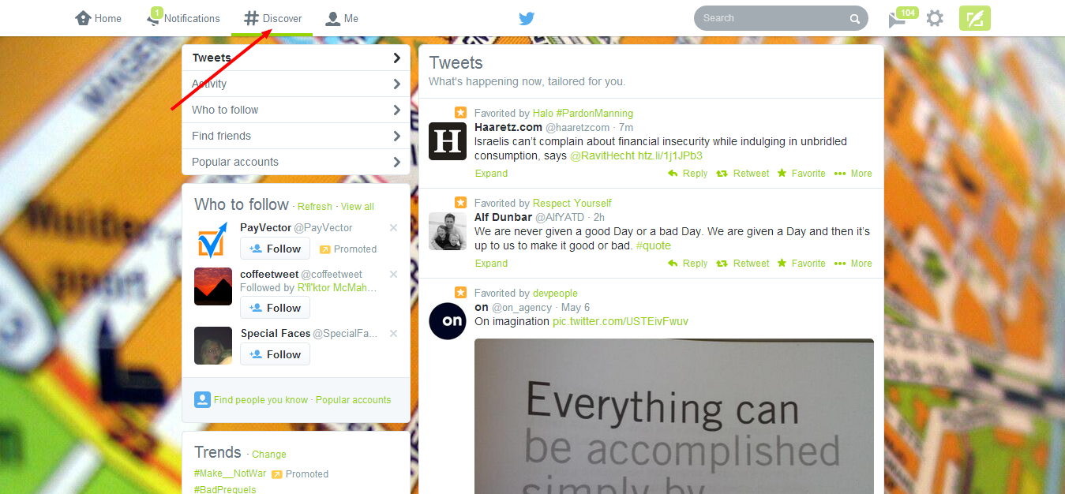

Slide 82
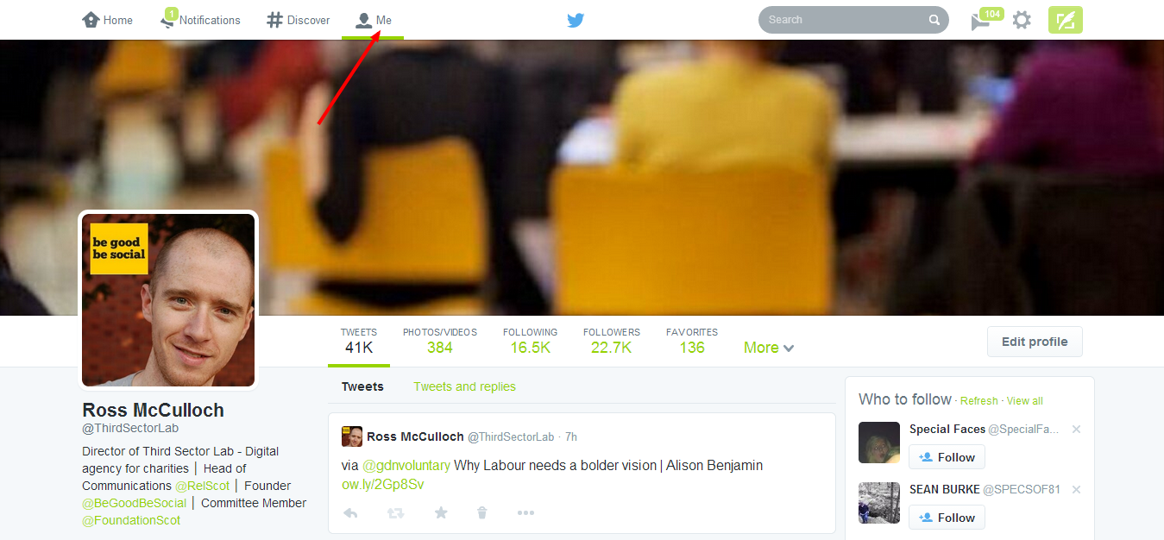

Slide 83
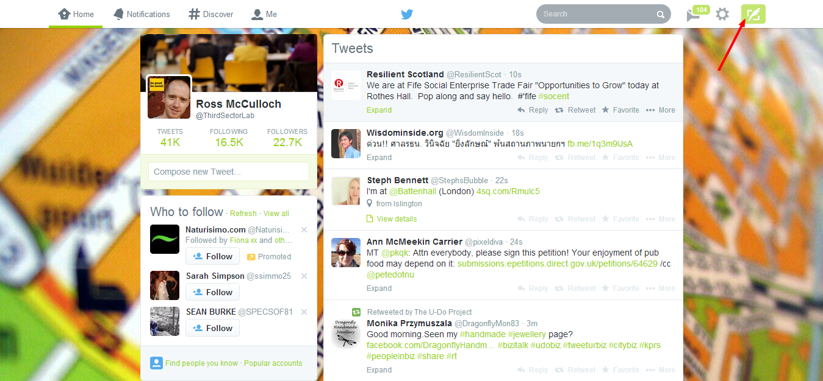

Slide 84
4 types of tweets:
1. Update 2. @reply/mention 3. Retweet (RT) 4. Direct Message (DM)

Slide 85
Pick one of these accounts, look at what they're tweeting about and who they're connecting with:
@shelterscotland
@thirdsectorlab @mikefifediet @aberdeenuni
@louisemac
@oxfamscotland
Task:
- Retweet one of their tweets.
- Send a tweet to one of them.
- Follow one of them.

Slide 87
Explore these hashtags by entering them in to the search box:
#indyref - Latest thoughts on the Scottish Independence debate. #edchat - Discussing latest research and developments in the education sector.
#ferguson - Events unfolding around the Feguson shooting.
#sustainability - Global issues focusing on environmental sustainability.
#B4E - ‘Business for the Environment summit’ or ‘Besties 4 Ever’?
Task:
- Send a tweet using one of the above hashtags, a reply or retweet is ok.
- Try entering a search term relevant to your work (do a general search without using the hashtag symbol) and fine tune with 'advanced search'.

Slide 88
Explore these twitter lists and understand how they work:
- www.twitter.com/BigScotland/scottish-third-sector
- www.twitter.com/newsdirect/msps
- www.twitter.com/oliblom/scotland-eduction
- www.twitter.com/craigmcgill/scottish-press
Task:
- Find lists a twitter user is subscribed to or a member of by clicking 'lists' on the left hand side of their profile.
- Find and subscribe to at least one twitter list relevant to your work.
- Follow 5 new accounts from a twitter list.

Slide 89
Send each of these types of tweets right now:
1. Post a tweet about today's event using #edchat. If you have a camera phone take photo of this workshop and tweet it using the hashtag.
2. Share an interesting link. This could be a useful video, a piece of research, a useful website, a blog post, a news article, etc.
3. Tweet someone else in the room to say hello.

Slide 90
25 minutes a day cheat sheet:
1. Post three tweets as you go about your day and ask others how their day is going. 2. Share four interesting links. This could be a useful video, a piece of research, a useful website, a blog post, a news article, etc. 3. Post two tweets about your particular area of expertise. What may seem like self-promotion can often be helpful content to others. 4. Reply to any @ tweets you’ve received that day. 5. Retweet four useful, interesting or funny tweets you’ve stumbled across today. 6. Search for and answer direct questions relevant to your sector. 7. Recommend three Twitter accounts for your followers to follow. 8. Follow ten relevant Twitter accounts. 9. Search for and join in on conversations relevant to your sector. Use hashtags where possible. 10. Reply to DMs.

Slide 91
Twitter best practice
1. Find your Twitter voice
2. Track your links
3. Don’t Tweet only your own content
4. Plan who's going to be tweeting and when
5. Follow often and follow on a 1:1 ratio
6. Create ‘lists’ to organise the chaos
7. Use #hashtags well
8. Tweet four to six times a day
9. Use Twitter to build your e-newsletter list, Facebook Likes, YouTube views...
10. Use third party tools to make your life easier

Slide 92
Experiment with additional tools... - Hootsuite.com (Management, monitoring and measurement).
- Bufferapp.com (Schedule and share tweets intelligently).
- Listorious.com (Find key people and lists to follow).
- Tweepi.com (Powerful follow/unfollow tool).
- Manageflitter.com (Unfollow people who have unfollowed you).
- Rowfeeder.com (Measurement tool - great for events & campaigns).
- Tweetreach.com (Measurement tool).
- Archivist.visitmix.com (Measurement tool).
- Tweettronics.com (Measurement tool).
- Grouptweet.com (Multiple contributors to a single Twitter account).

Slide 93
How can social media support each step? 1. Organising an event
2. Promoting an event
3. Enhancing the live experience
4. Extending the conversation after the event
A social media strategy in 20 minutes

Slide 94
What would it take to make this happen in your organisation?

Slide 95
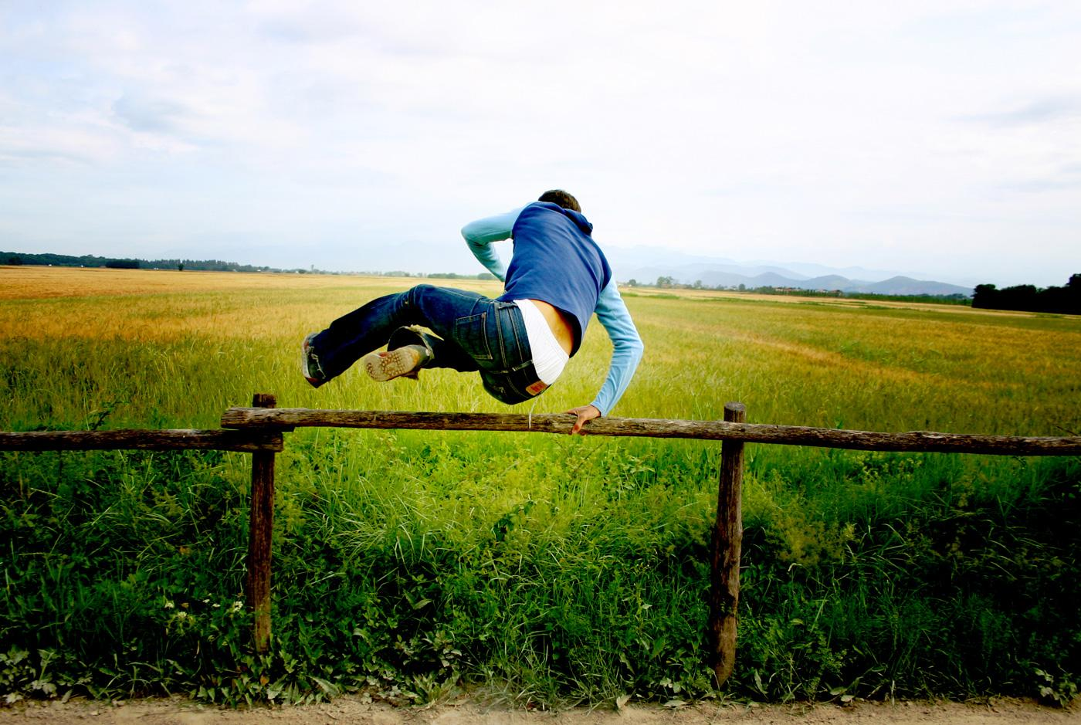
Any questions?
Say hello...
ross@thirdsectorlab.co.uk
www.twitter.com/thirdsectorlab
www.rossmcculloch.com
www.begoodbesocial.org.uk
07515162686
Notes:
Slide 22
Closing
So what's the lesson from all of these case studies? Well, for me, it that's we have to give up on the illusion of control. In a networked world, organisations can no longer control what people think or say about them. If you’re worried, jump in with both feet and join the conversation.

