Slide 1
Green and Grey Spaces: opportunities to enhance biodiversity wherever your campus is located
Steve Ansdell, Durham University
Sara Kassam, University of East London

Slide 2
About us
Sara Kassam
Energy & Environment Manager
University (primarily teaching)
Steve Ansdell
Horticultural Manager
28,000 students and 1,500 staff
2 campuses, Stratford and Docklands
University (primarily research)
16,046 students and 3,854 staff
2 campuses, Durham and Stockton
Notes:
Highlight that we’re still on a learning curve too and this workshop presents out experiences rather than the ‘perfect’ way to develop an EMS and internal auditing programme!
SK / AC / RW / GB

Slide 3
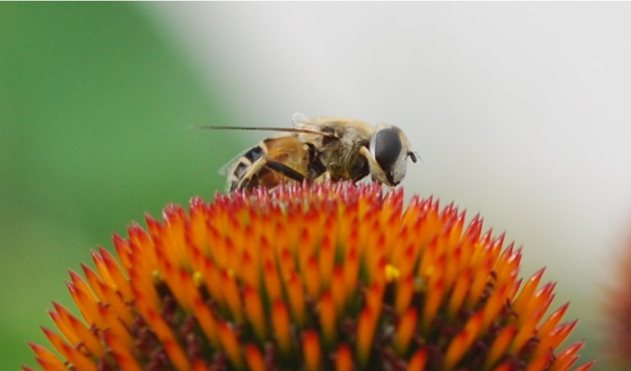
Common factors
Biodiversity Duty - The Natural Environment and Rural Communities (NERC)2006
requires all public bodies to have regard to biodiversity conservation when carrying
out their functions. The aim of the biodiversity duty is to raise the profile of
biodiversity in England and Wales, so that the conservation of biodiversity becomes
properly embedded in all relevant policies and decisions made by public authorities.
Resource: staff time
Funding: tie into existing projects e.g. refurbishments, new buildings
Priority: seen as important but is it really compared to other issues e.g. carbon management.

Slide 4
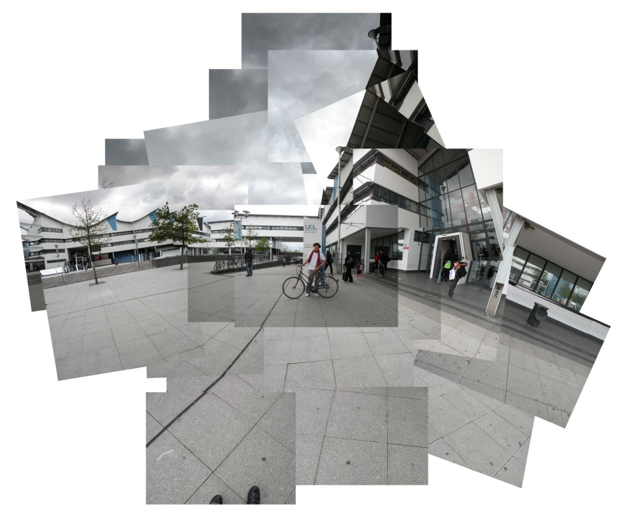
Do the Green Thing
Environmental management
Energy and water
Waste and recycling
Biodiversity
Transport
Sustainable procurement
Construction and refurbishment
Community involvement

Slide 5
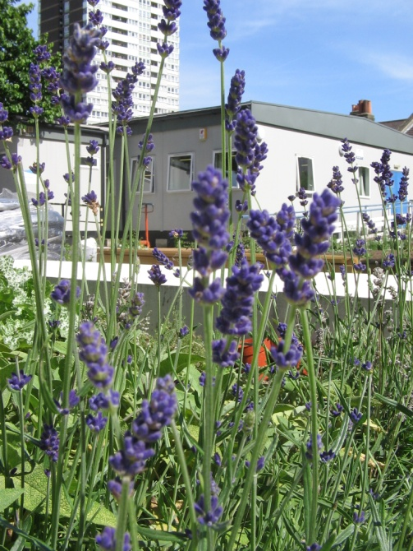
Where did we start?
In its environmental policy UEL commits to: ‘conserving and enhancing biodiversity
across the estate’
Commissioned a biodiversity baseline.
Produced a Biodiversity Action Plan.
Involved staff and students.
Fit into local context i.e. local authority plans, Thames Corridor.
Embed into university consciousness.
Notes:
Broad statement but what does it mean??
Have to do what we can within resources – 2 full time members of environment team with a focus on ISO and energy
Environmental Research Group
Asked by Finance – what is the benefit?

Slide 6
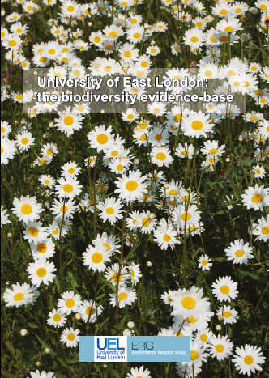
Biodiversity Baseline
Survey carried out in May 2010 by UEL’s Environmental Research Group.
Recorders surveyed all campuses from the roof‐space down to ground level, breaking them down into their descriptive units (habitat types).
77 trees found at Stratford campus comprising 13 species including Turkish hazelnut.
2 flower-rich meadows observed at Docklands campus, containing 58 species.
Invertebrates recorded include; buff‐tailed bumblebee, white tailed‐bumblebee, garden bumblebee, red‐tailed bumblebee, common carder bee, wasp, hoverflies, micro‐moths and 7‐spot ladybird.

Slide 7
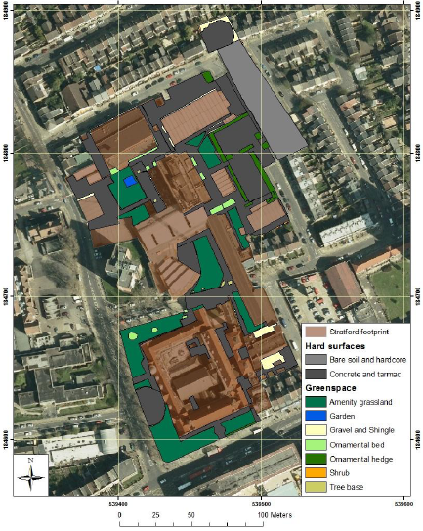
Stratford Campus
Footprint for Stratford campus (total 27,130m²)showing amount of hard‐space (68%) compared with green‐space (32%).

Slide 8
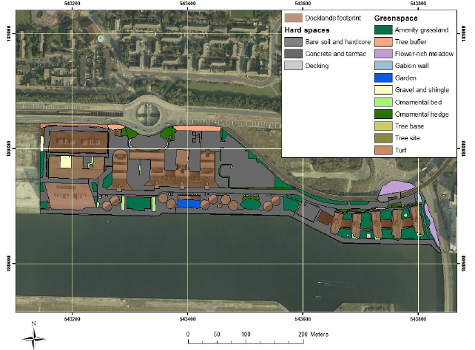
Dockland Campus
Footprint for Docklands campus (total 78,905m²⁾ showing amount of hard‐space (70%) compared with green‐space (30%).

Slide 9
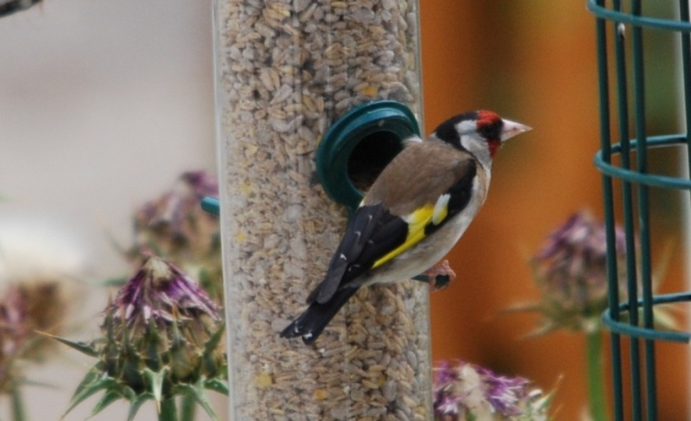
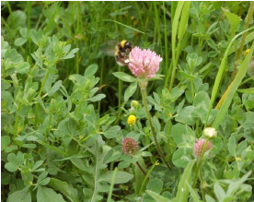
Biodiversity Action Plan
Estate management – To adopt general management practices to enhance biodiversity and to balance this with other functions of estates management and organisational needs.
Development of complex habitats – To break up the homogeneity of the UEL estate and develop a complexity of habitats to increase biodiversity interest, ensuring that the planting of native species is promoted.
Species management and protection – To target specific species identified in the Newham Biodiversity Action Plan and where relevant, the London Biodiversity Action plan for protection and habitat management.

Slide 10
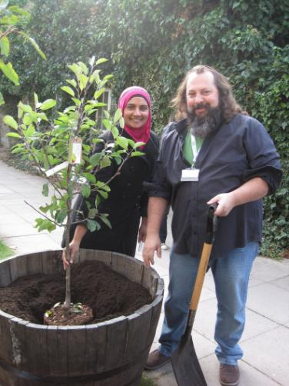
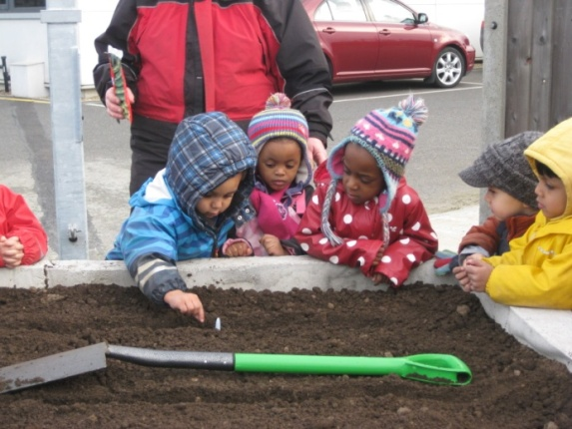
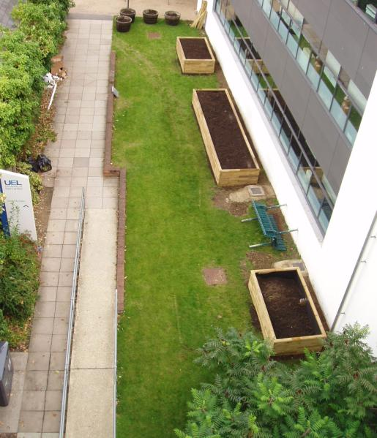
Biodiversity Action Plan
Training and communications – To raise awareness amongst staff and students about the importance of biodiversity and the activities they can get involved with on campus.

Slide 11
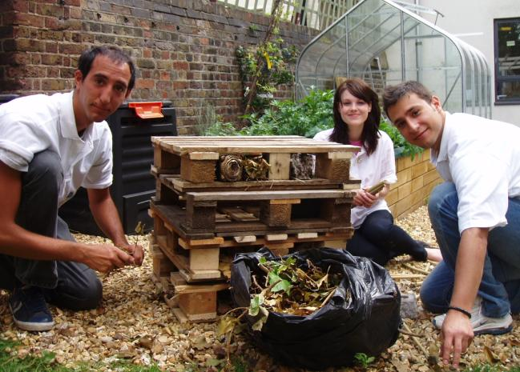
Biodiversity Action Plan
Strategic management – To ensure that biodiversity protection and enhancement is incorporated into UEL plans and procedures as necessary.
Future research and monitoring – To build upon the first UEL biodiversity baseline and to continue survey and monitoring work as required. Also to incorporate biodiversity enhancement and monitoring into UEL teaching and research activities.
Community links – To work with others in the wider local community to enhance biodiversity.

Slide 12
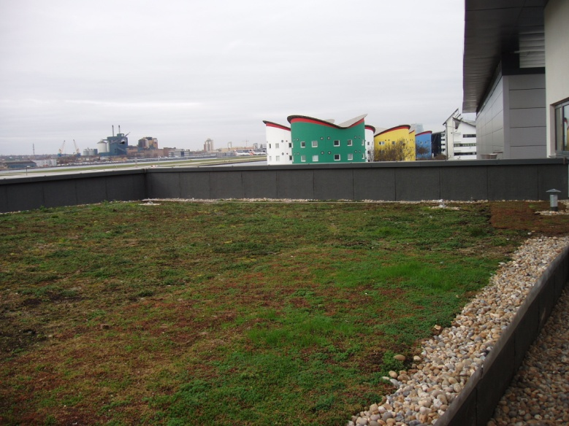
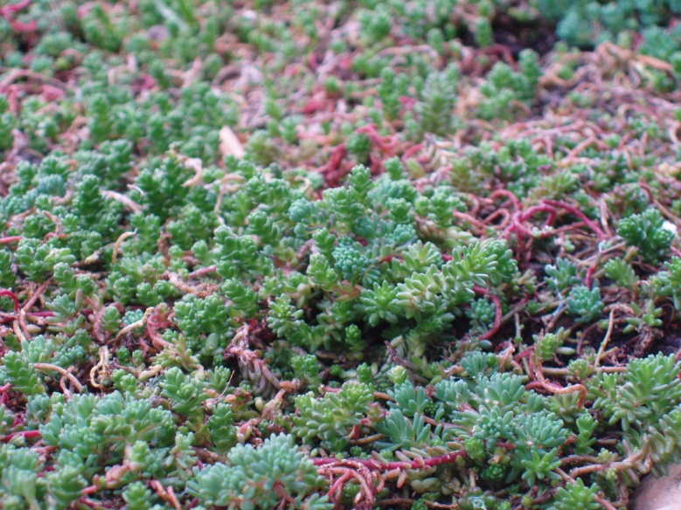
Capital projects
Does ecology report tie up with the landscape report?
Beware of tick box exercise for BREEAM.
What ‘looks nice’ rather than something with fits with native species ethos.
Opportunity for living roofs and interesting habitat creation e.g. brown field.

Slide 13
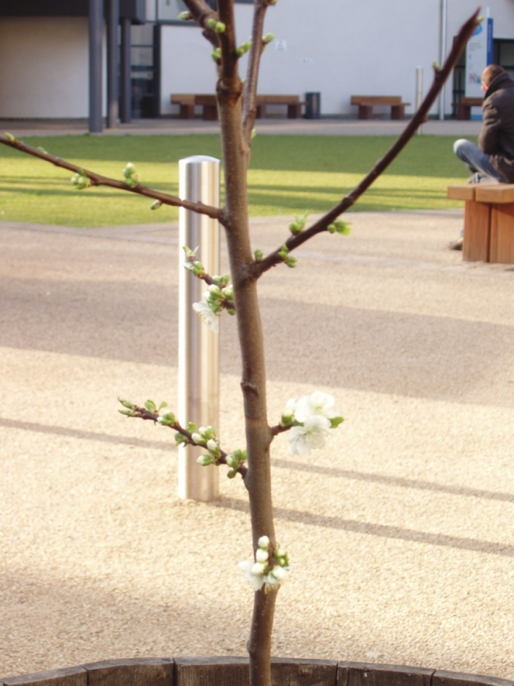
What next?
Survey – commission another biodiversity survey for both campuses.
Revisit action plan – identify specific targets and areas for action (recognising resource, financial and time implications).
Implementation – assign specific people to take responsibility for implementing identified actions and to monitor/review progress. Currently sits with Environment Team who don’t have enough capacity.

Slide 14
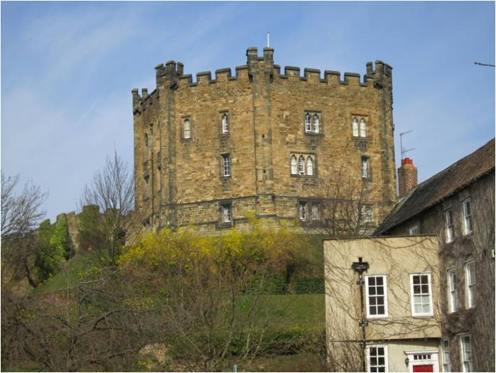
16 Colleges
47 Hectares of Woodland
112 Hectares of Grounds
10 Hectares of Botanic Garden

Slide 15
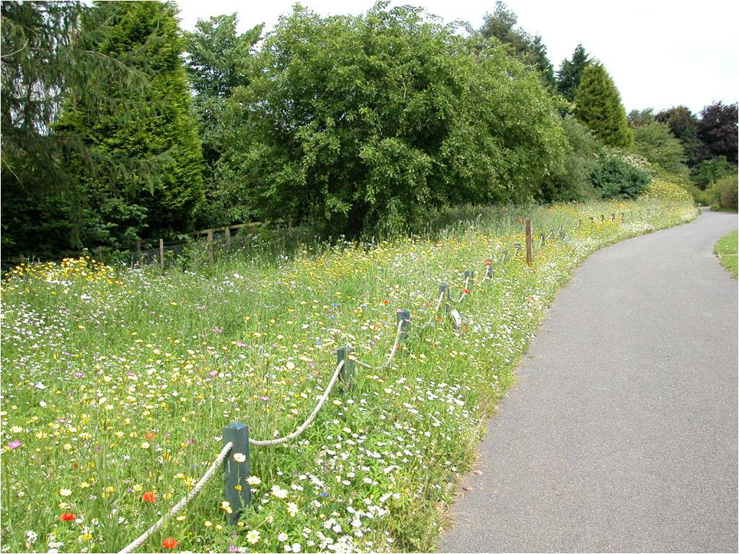

Slide 16
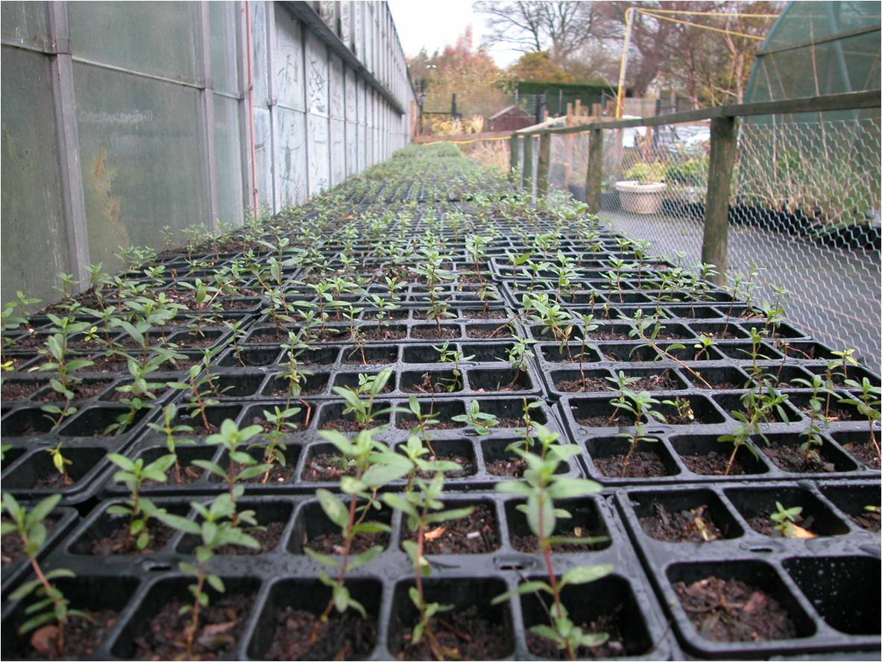

Slide 17
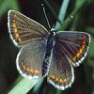

Slide 18
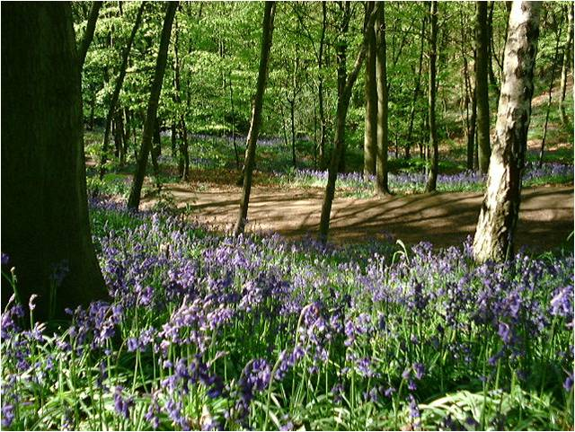

Slide 19
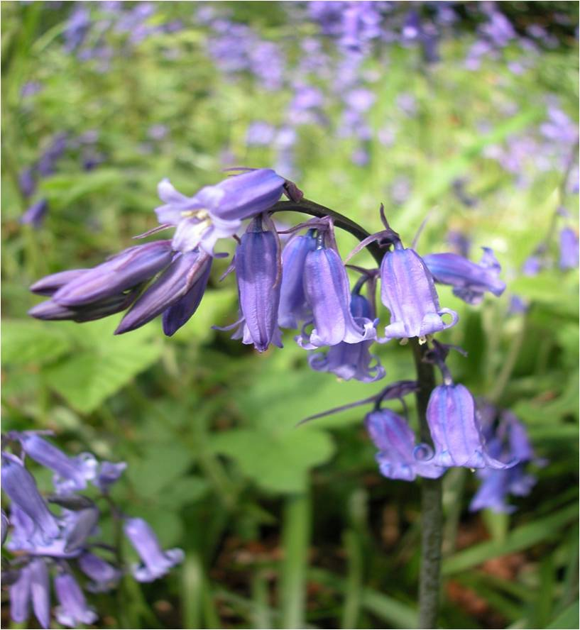

Slide 20
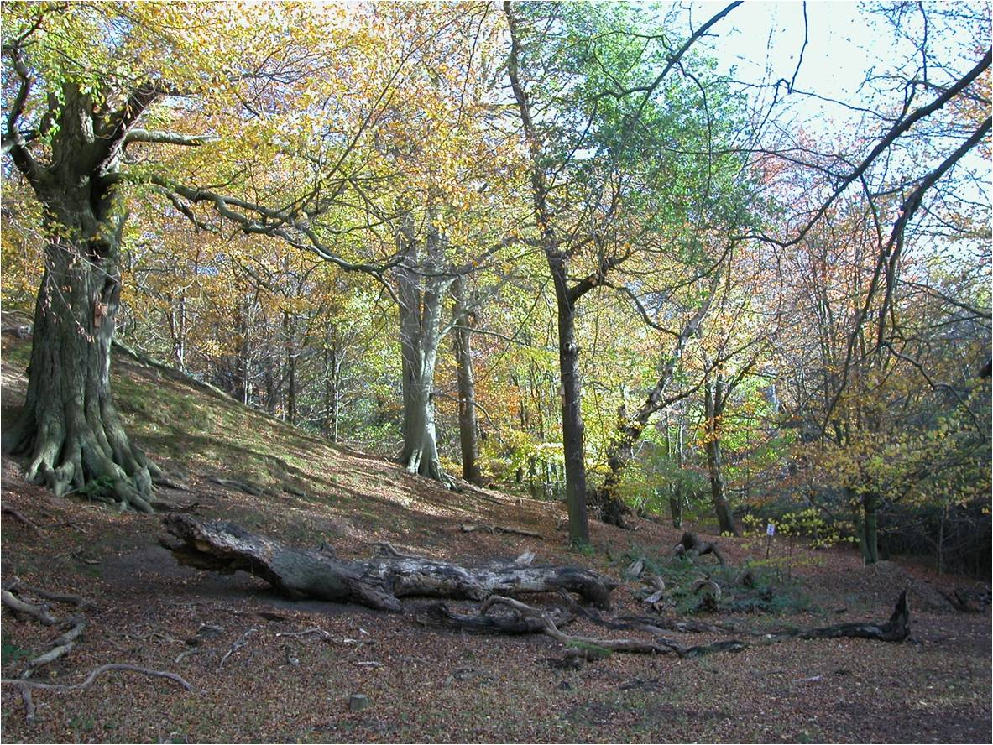

Slide 21
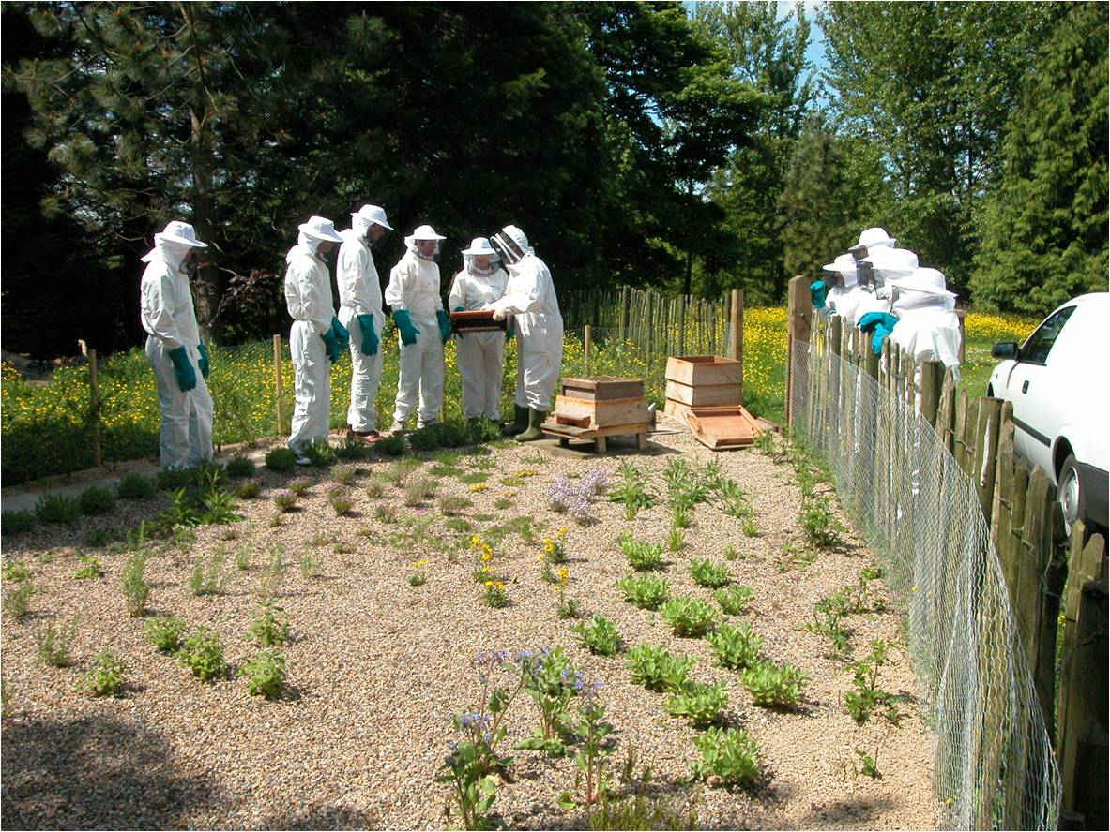

Slide 22
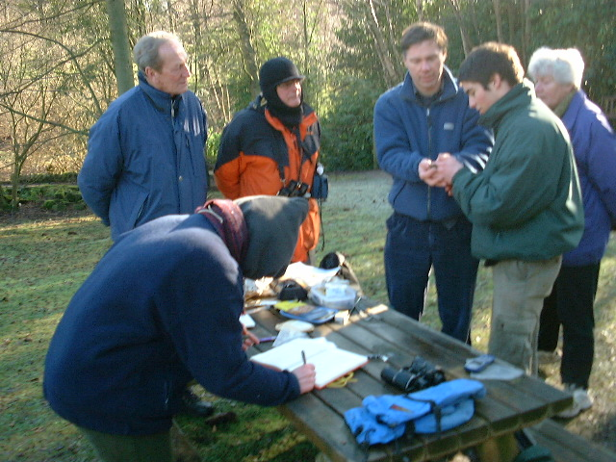

Slide 23
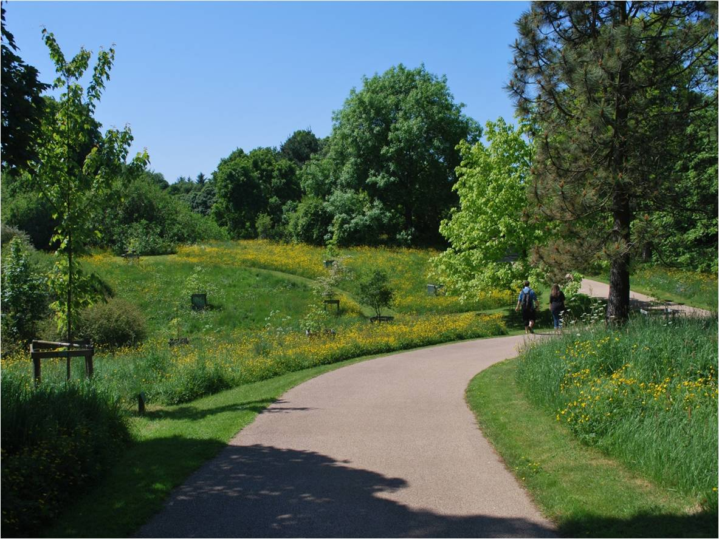

Slide 24
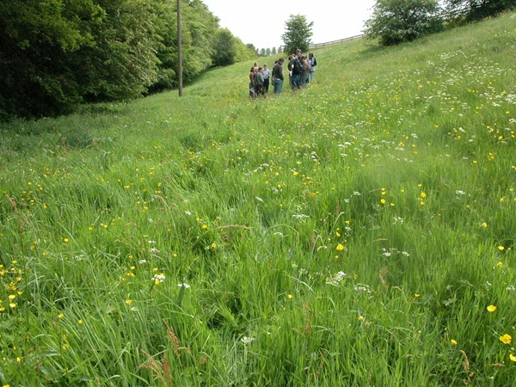
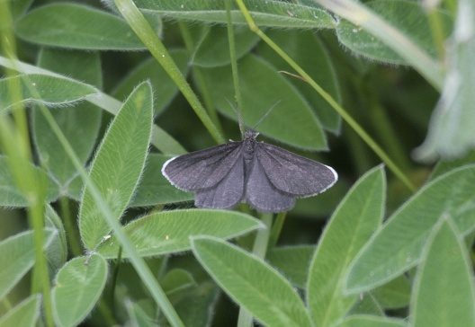

Slide 25
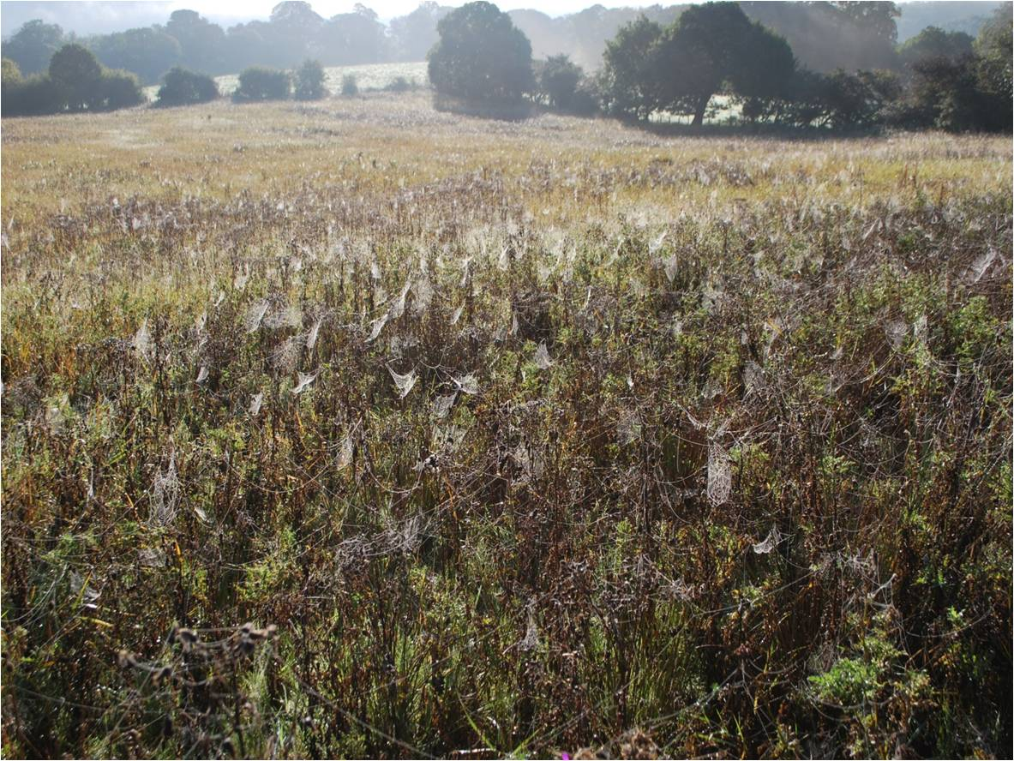

Slide 26
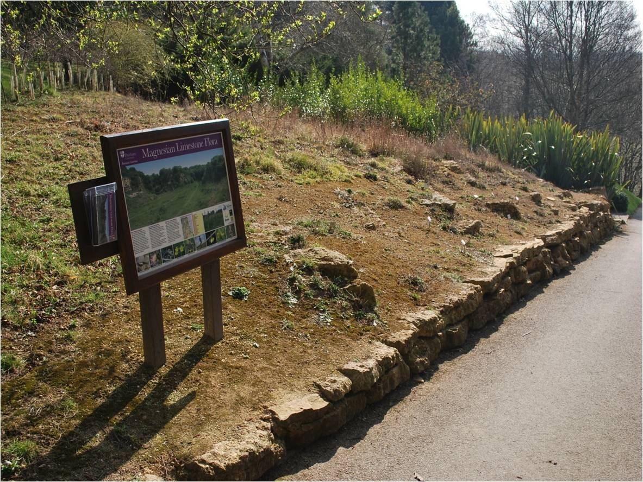

Slide 27
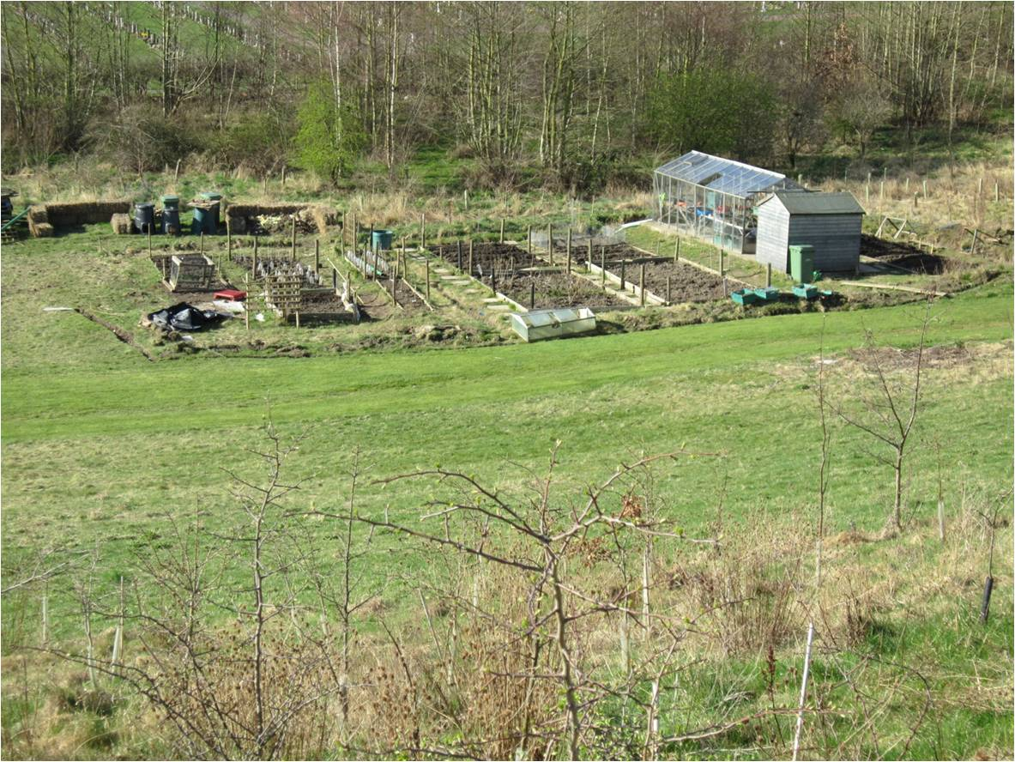

Slide 28
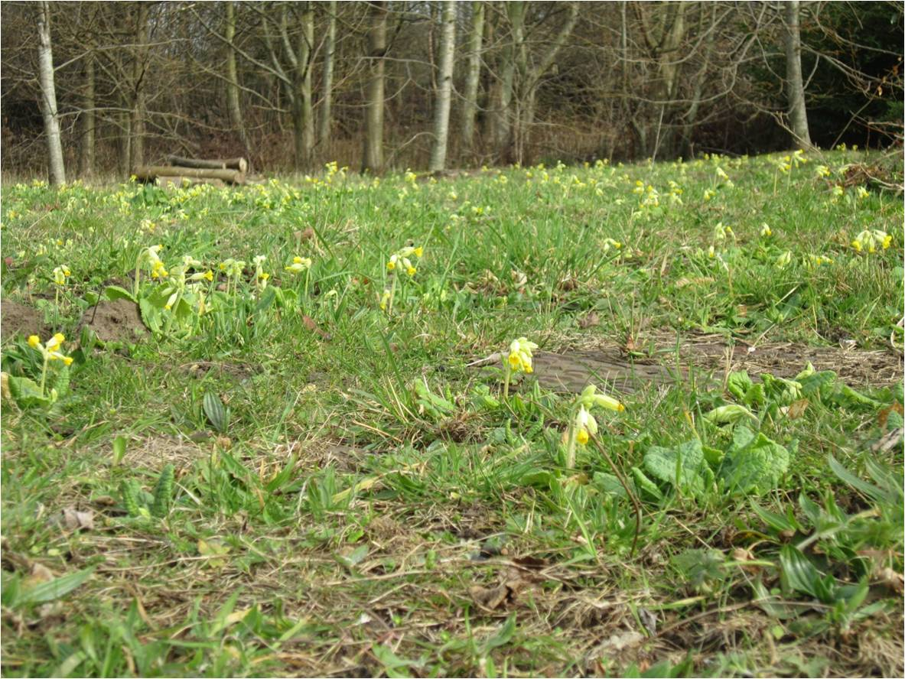

Slide 29
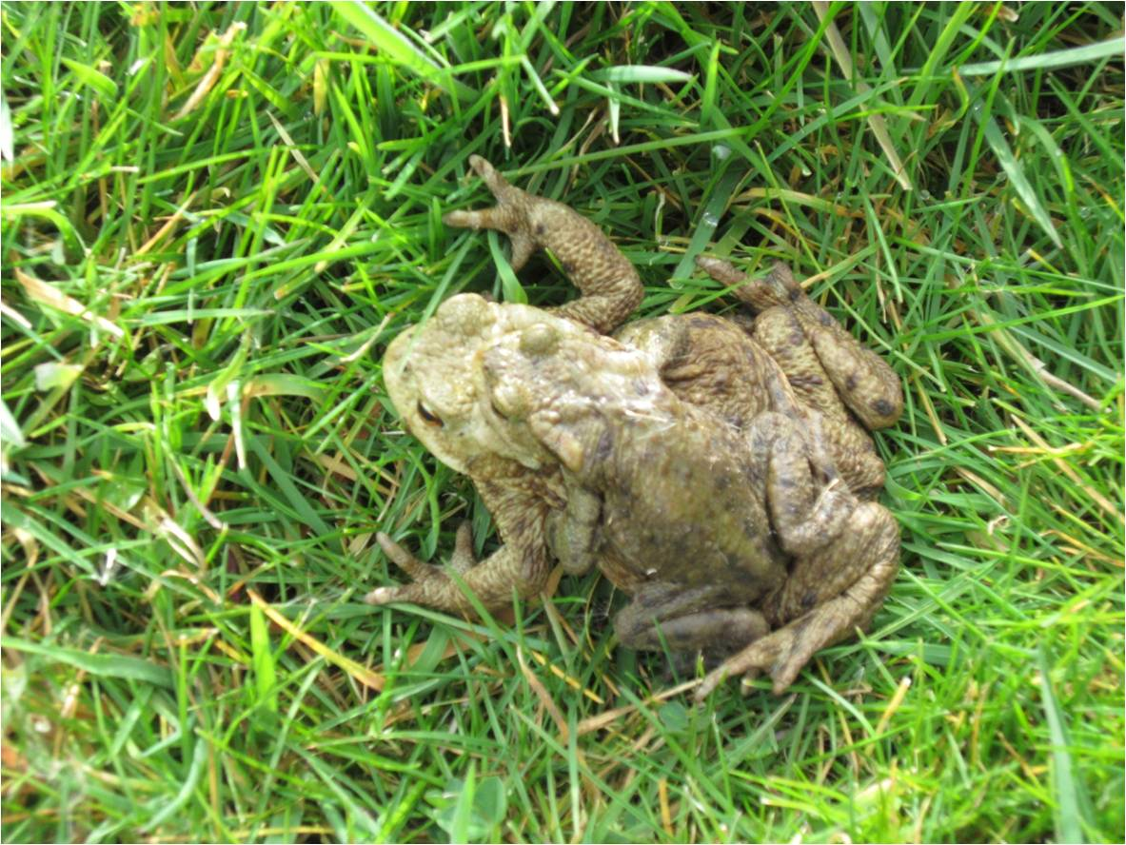

Slide 30
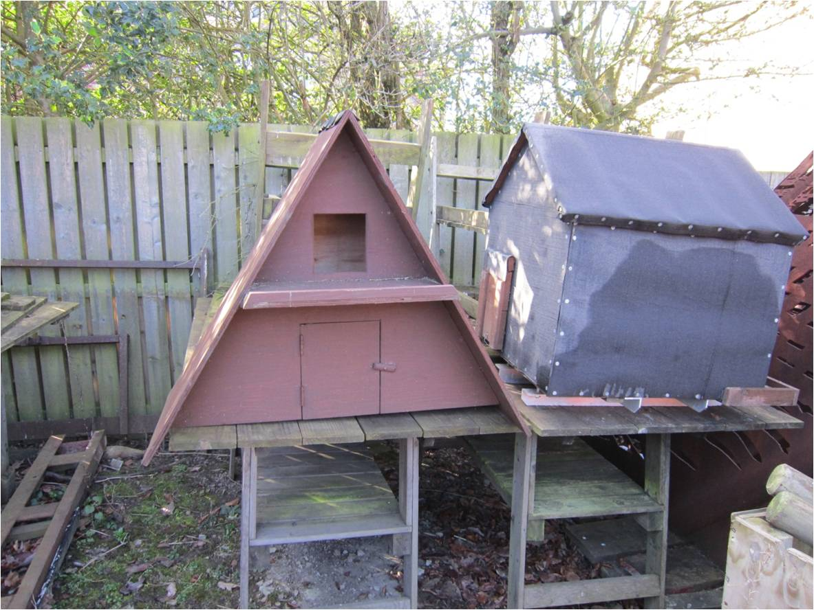

Slide 31
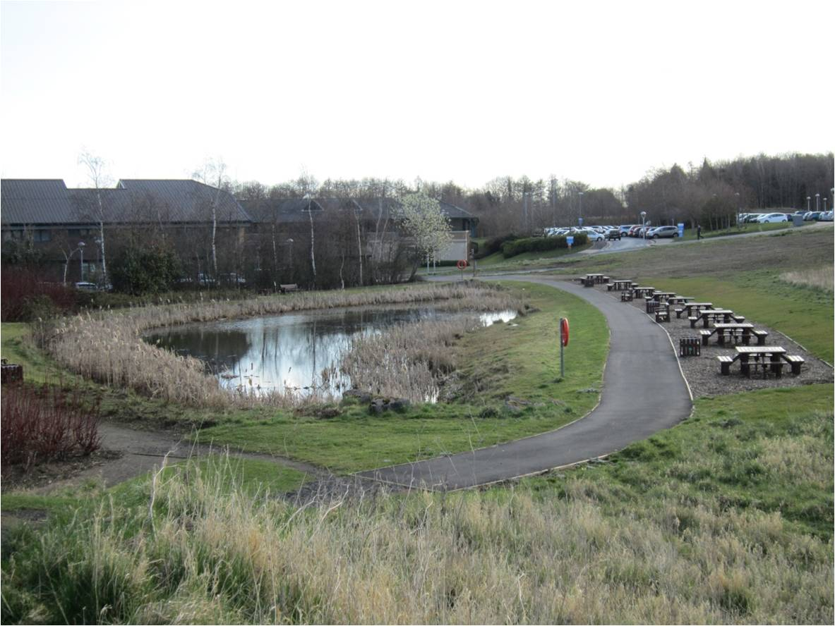

Slide 32
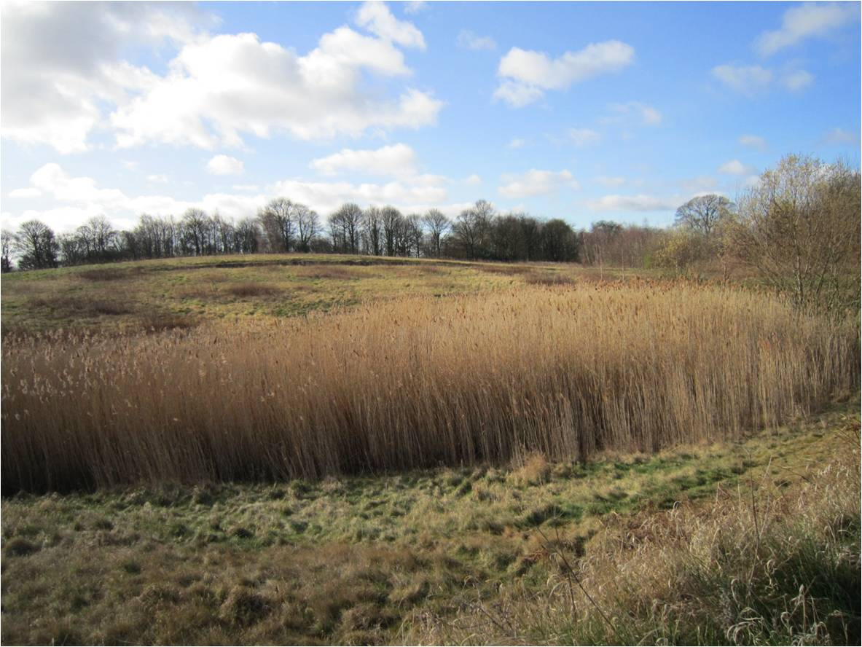

Slide 33
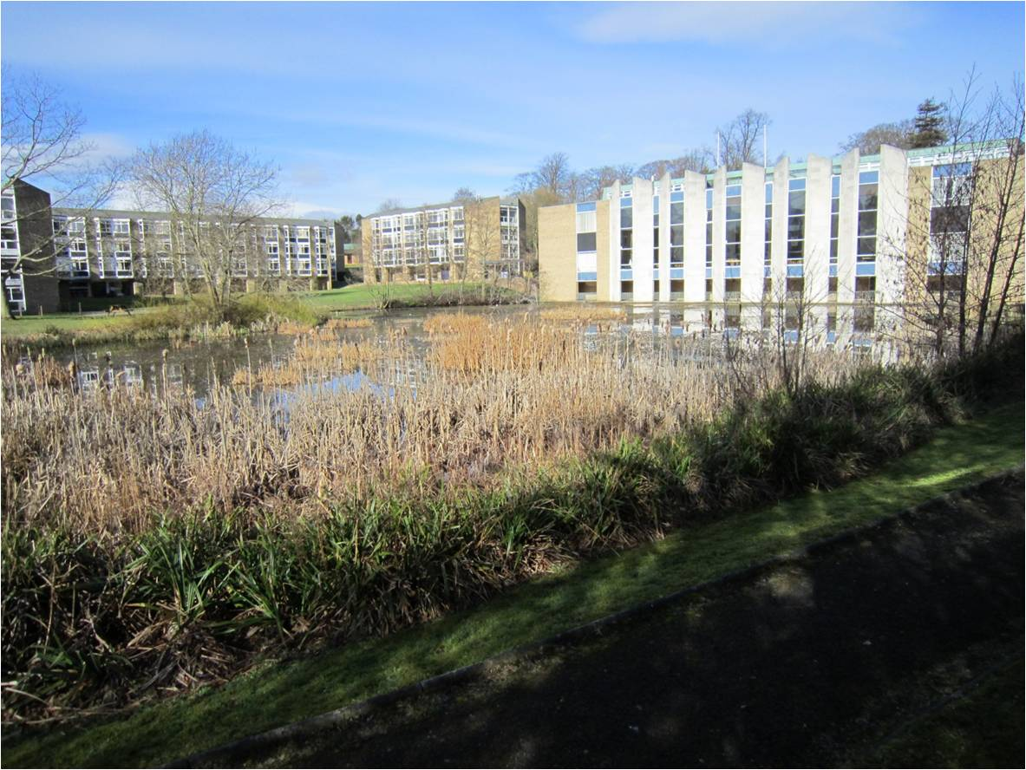

Slide 34
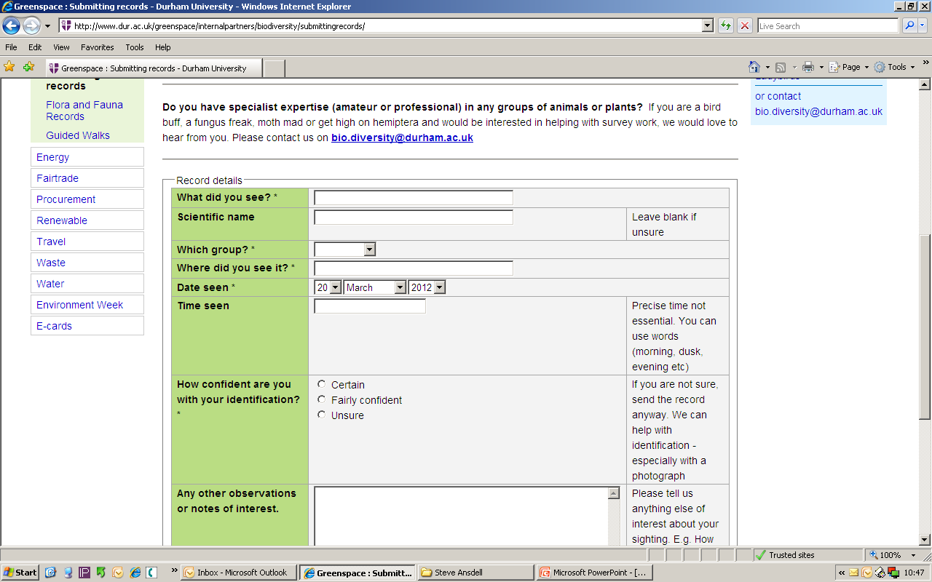

Slide 35
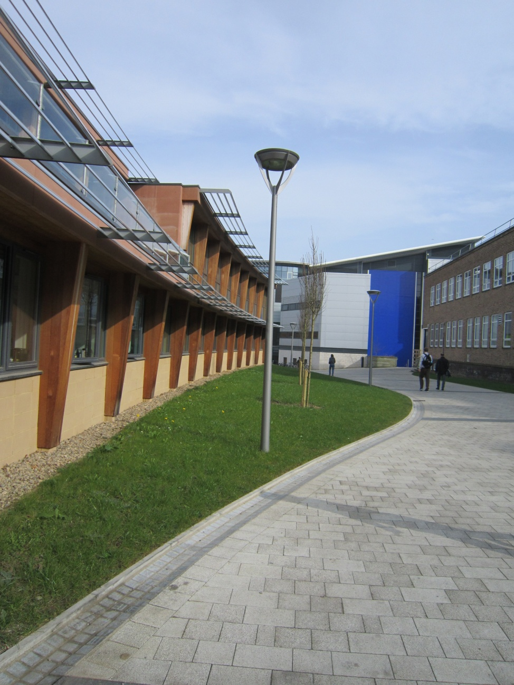

Slide 36
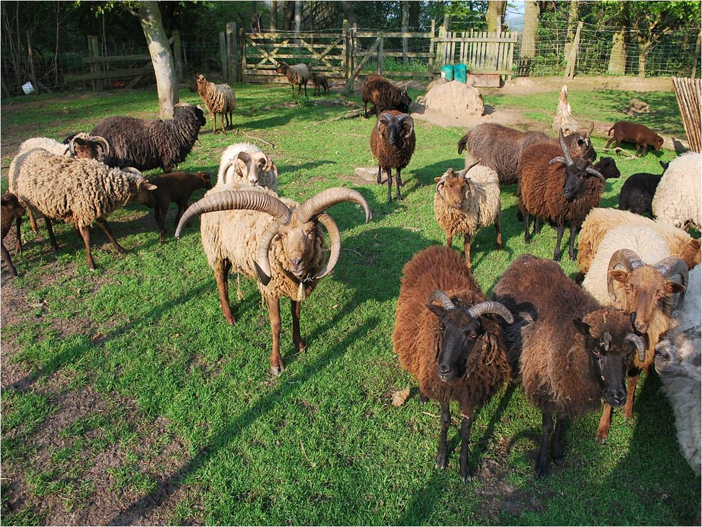

Slide 37
Take home messages
Know what you have on site – baseline survey.
Incorporate biodiversity into existing activities, contracts, maintenance schedules and projects.
Staff and student engagement is vital!

Slide 38
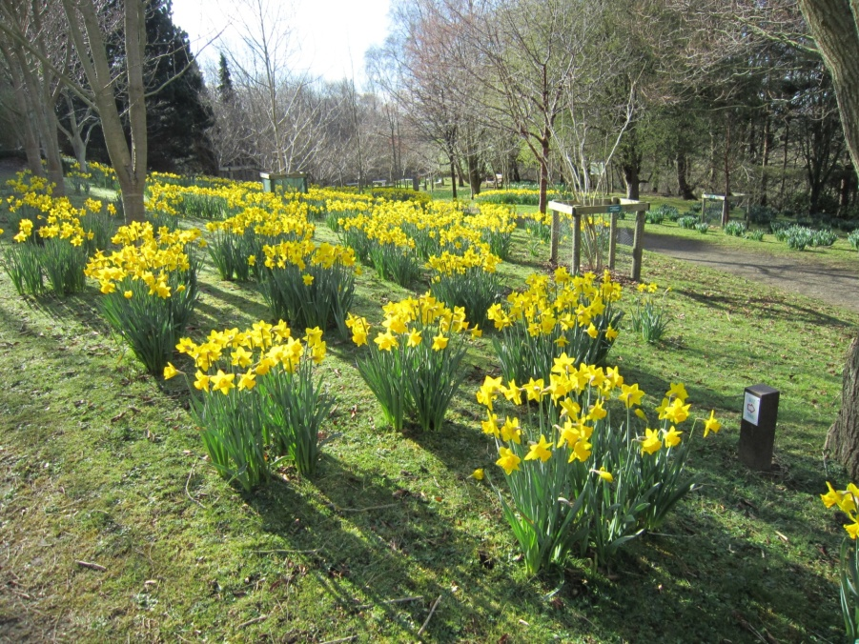
Contact
University of East London
s.kassam@uel.ac.uk
www.uel.ac.uk/greenthing
Durham University
s.j.ansdell@durham.ac.uk
www.dur.ac.uk/greenspace/internalpartners/biodiversity

Slide 39
Your next steps – making the most of your EAUC Membership…
Resources - view our biodiversity guide on the EAUC resource bank
Recognition - want recognition for your biodiversity excellence, enter the 2012 Green Gown Awards. Entries open in summer 2012
Measure and improve - sign up to LiFE - www.thelifeindex.org.uk. EAUC Members receive a significant discount
LiFE offers a dedicated ‘biodiversity’ framework for implementation
Membership matters at www.eauc.org.uk

