Slide 1
Institutionalising sustainability in the curriculum and the student experience: lessons from the Green Academy
Simon Kemp, Academic Lead Education for Sustainable Development, Higher Education Academy
Sarah Speight, Associate Professor, University of Nottingham
Stephen Scoffham, Principal Lecturer, Canterbury Christ Church University
Julia Heaton, Green Academy Assistant, University of Southampton

Slide 2
Workshop structure
Background to the Green Academy
Investigation of three case studies
Workshop exercise 1
Outcomes of Green Academy
Workshop exercise 2
Group feedback session
Summary of main recommendations, concerns, and the way forward

Slide 3
Background to Green Academy
An institutional change programme in partnership with the National Union of Students (NUS) and Environmental Association for Universities and Colleges (EAUC).
Primary aim to help universities strategically embed ESD into the student experience, with an initial focus on the curriculum.
Project teams had to comprise of academics, senior management (Pro-Vice Chancellors), estates managers, and students to ensure an appropriately holistic approach to ESD

Slide 4
Background to Green Academy
Two HEA led formal team-leader meetings (February & May 2011)
Programme teams two & a half days residential meeting (March 2011)
Independent guidance from expert ‘critical friends’
Institution evaluation visits (February 2012)
First report to be published mid 2012

Slide 5
Green Academy Institutions
University of Bristol
Canterbury Christ Church University
Keele University
University of Nottingham
University of Southampton
Swansea University
University of Wales Trinity Saint David
University of Worcester

Slide 6
Progression of ESD from supportive statements to practical action
Networking opportunities with other participants and the critical friends allowing time and space to work on a shared vision for embedding ESD in the curriculum
Establishment of ESD as a ‘Grand Challenge’ giving access to funding & support
ESD as shared understanding rather than agreed definition
ESD added to the Nottingham Advantage Award
Sustainability literacy now viewed as an important graduate capability

Slide 7
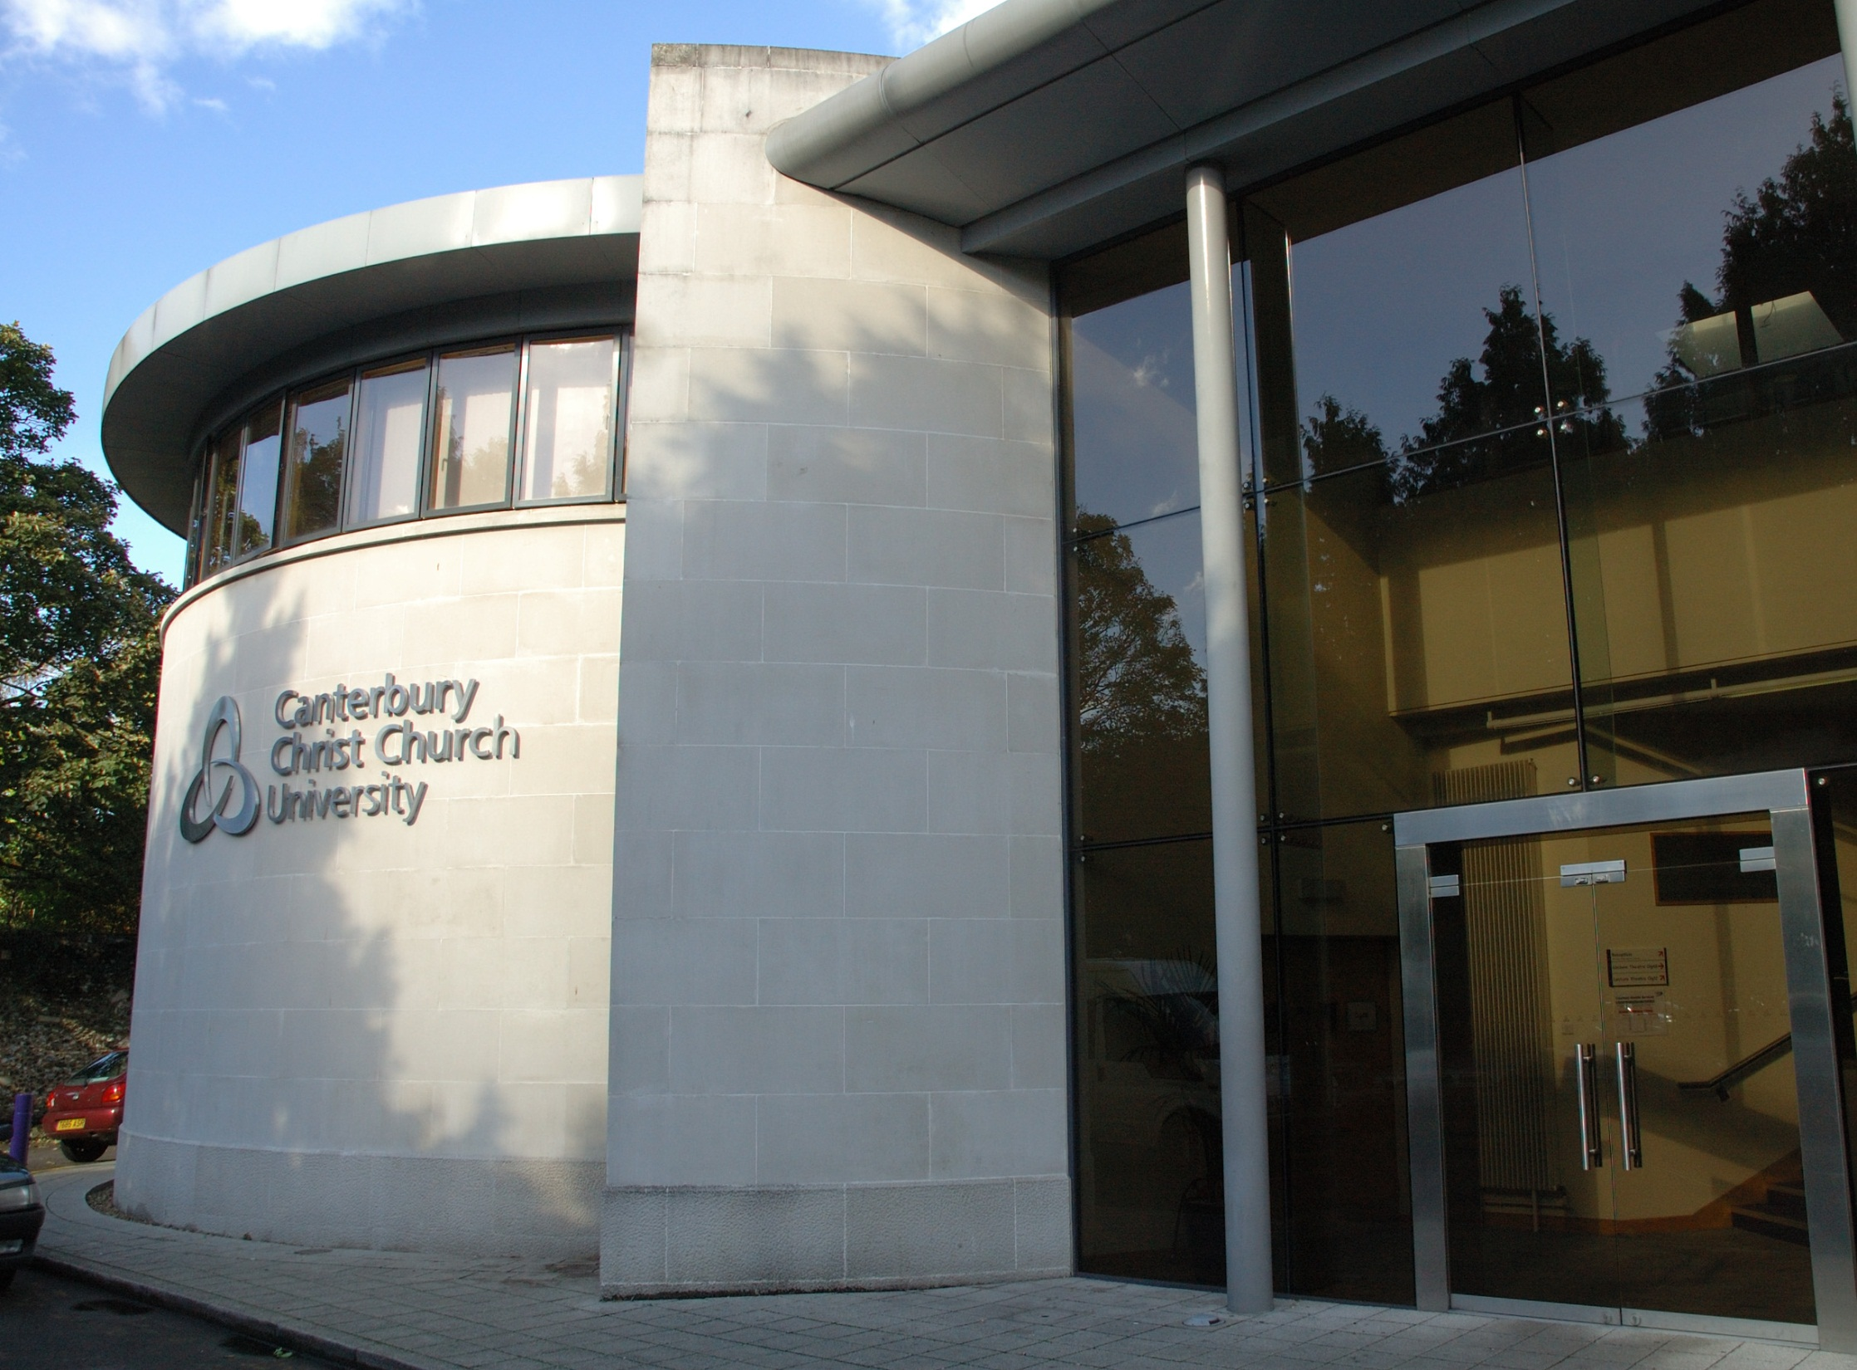
Canterbury
Christ
Church
University
Stephen
Scoffham

Slide 8
The Need for a New Paradigm
More associative More linked More webbed
Non-linear
thinking
(wicked problems)
Deep ecological awareness
Fundamental changes in attitudes and behaviours

Slide 9
The Student Experience
Formal
Accredited
Activities
Inquiry based learning
Module choice
Interdisciplinary links
Work-based opportunities
International experience
Informal
Unstructured
Activities
Student union
Volunteering
Health and well-being
Biodiversity
Local politics
Level 7
Level 6
Level 5
Level 4
Initial
contact
with CCCU
School experience

Slide 10
The Futures Initiative
Enhanced knowledge
& understanding
Creative engagement
Environmentally literate
students
Problem solvers
Ethical awareness
Critical thinkers

Slide 12
Historic, but fragmented engagement with sustainability
Participation in G.A. was intended to bring together disparate activities into a coherent sustainability strategy focused on practice
Events enabled engagement with other institutions & critical friends
Developed the sustainability plan during the residential event
Use of partner competitor institutions for project leverage
Funding for a full-time G.A. programme assistant
Vision that emerged is for sustainability to be at the CORE of the institution

Slide 13
Workshop exercise 1: The Sustainability Elevator Pitch
You are responsible for leading the embedding of sustainability across the curriculum of your institution
You ‘bump’ into a sceptical programme director who wants you to justify why and how they should include sustainability in their curriculum

Slide 14
Workshop exercise 1: The Sustainability Elevator Pitch
Working in pairs, and taking it in turns to be the sustainability person and the sceptical programme director, you have three minutes each to convince your colleague why and how they should include sustainability in their curriculum
You will each be given a piece of paper which states the discipline of the programme director

Slide 15
Outcomes of Green Academy
The focus on the positive nature of the ‘challenges’, not the traditional negativity of sustainability ‘problems’
Recognition of the difficulty of tackling sustainability through traditional pedagogy – the need to work collaboratively and imaginatively (e.g. through wicked problems)
Value of engaging students as change agents
The role of critical friends

Slide 16
Outcomes of Green Academy
Dissemination in national and international conferences, including the World Symposium on Sustainability in Universities (parallel event to the UN Conference on Sustainable Development)
Development of an informal ESD change management network where the participants have exchanged ideas and resources
The value of a collegial approach focused on knowledge and practice sharing, driven by friendly competition

Slide 17
Workshop 2: Future models for embedding sustainability
Working in groups you are requested to conduct the following discussion:
How can the outcomes of the first Green Academy be used to help develop new models for embedding sustainability across HEIs?
Each group has a facilitator to record discussions
Please can one member of each group report back from 16:45 onwards

Slide 18
Green Academy Take-Home Messages
Sustainability cannot be embedded through the curriculum and student experience through traditional pedagogy
The importance an approach that combines students, operational staff and academics in a holistic cross-institutional team
The value of engaging critical friends and collegial competition

Slide 19
Your next steps – making the most of your EAUC Membership…
Resources - visit the dedicated Education for Sustainability section on the EAUC resource bank
Networks - Join SHED, the leading cross sector Community of Practice in the UK for Education for Sustainability (EfS). Developed in collaboration with Higher Education Academy.
Find out more about this group at 5pm today – see programme for details
Recognition - want recognition for your student engagement initiatives – enter the 2012 Green Gown Awards courses and/or skills categories. Entries open summer 2012
Measure and improve - sign up to LiFE for help on embedding ESD into your institution www.thelifeindex.org.uk. EAUC Members receive a significant discount
LiFE offers a dedicated ‘learning and teaching’ framework
Membership matters at www.eauc.org.uk

Slide 20
In a strong position prior to Green Academy - >6000 students engaged in sustainability activities, Cabot Institute, ISO14001
Opportunity for embedded institutional approach for ESD
G.A. programme enabled the development of a more radical approach than originally planned
The Bristol approach seeks all students to have access to sustainability experience
Funded staff and interns to support subject areas in embedding sustainability in all curriculum areas (2 (of 6) faculties in progress)
Enabled external benchmarking and clarity regarding the strategic role of ESD in the Bristol context

Slide 21
Numerous sustainability initiatives already in place including a ‘Hub’, PVC for Environment and Sustainability, a sustainability module for all 1st years, SD focused UG & PG programmes – but little integration or coherent strategy
Sustainability in the new Mission Statement, Vision, & Strategic Aims
Sustainability now one of the 3 key themes of an institution-wide curriculum review
Proactive G.A. team developed a ‘multi-strand’ vision to inserting ESD in all programmes, co-curriculum, PG, CPD
Education and student experience now a stronger part of the sustainability agenda

Slide 22
Core mission ‘delivering for a sustainable Wales, locally, regionally, nationally and internationally’.
Commits to engaging all students with sustainability concepts and issues in an appropriate context through learning and enhancing their employability
Each Faculty to offer one new UG and one new PG sustainability related course from 2013
Sustainability to be embedded into 15% of all students’ experiences by Autumn 2013
To be delivered through all faculties under the INSPIRE brand: Institute for Sustainable Practice, Innovation and Resource Effectiveness

Slide 23
Participation in a sector-wide cross-institutional knowledge exchange project, with insights of the critical friends
Increased student participation through the SU and student societies
Development of a sustainability focused curriculum and modules at the residential meeting
Development of new academic programmes – Jan 2012 a new curriculum with a Sustainability “Elective” study path for students from any programme
Guidance of sustainability beyond just environment and facilities
Sustainability as a cross-institution offer to students

