Slide 1
Notes:
Introduction – Donna Gutteridge Senior Transport Planner at JMP Consultants based in the Liverpool office.
JMP has been working for Shop Direct since 2011 to provide transport planning support to its uk sites.

Slide 2
Notes:
UK and Ireland’s leading multi-brand digital retailer, delivering 48 million products every year to millions of customers.
Well known brands including Very, ISME and Woolworths
The company operators from six up sites which includes a range of call centre, design and warehouses focused in the North West.

Slide 3
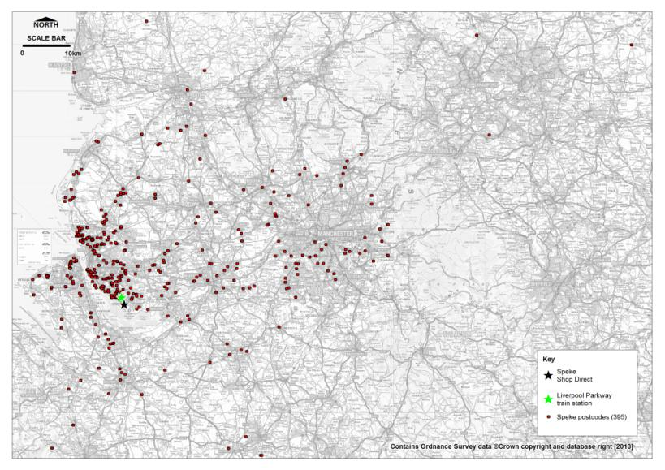
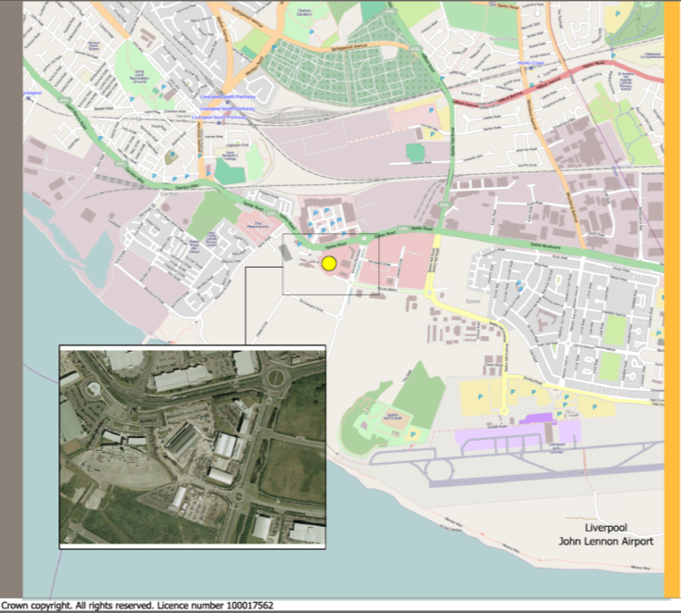
Notes:
Focus of our work initially was on the HQ site in Speke, Liverpool. The company had relocated from Manchester around ten years ago. Due to the nature of the work undertaken at the HQ site, including designers, fashion buyers etc turn over at the company is relatively low and therefore staff have tended to travel long distances to reach work.
39% of staff live over 20 miles from the site

Slide 4
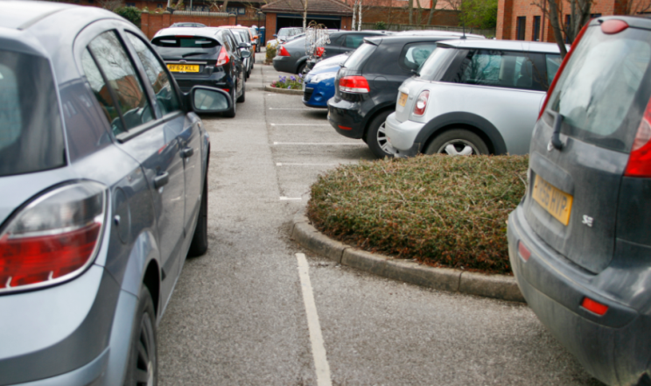
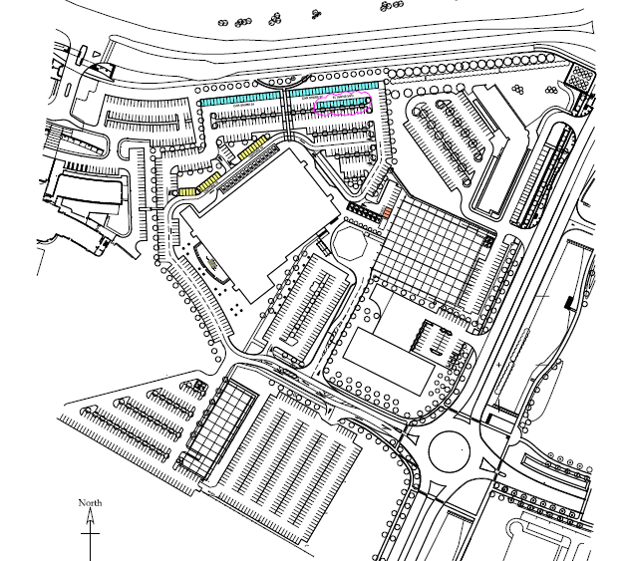
Notes:
Shop Direct had implemented a travel plan for many years when JMP was commissioned. Shop Direct needed support to address on site car parking issues which included an updated travel plan required to secure support for a temporary car park to reduce costs of renting car parking spaces at a nearby hotel. In addition on street car parking was leading to complaints from neighbours which the company wanted to address.

Slide 5
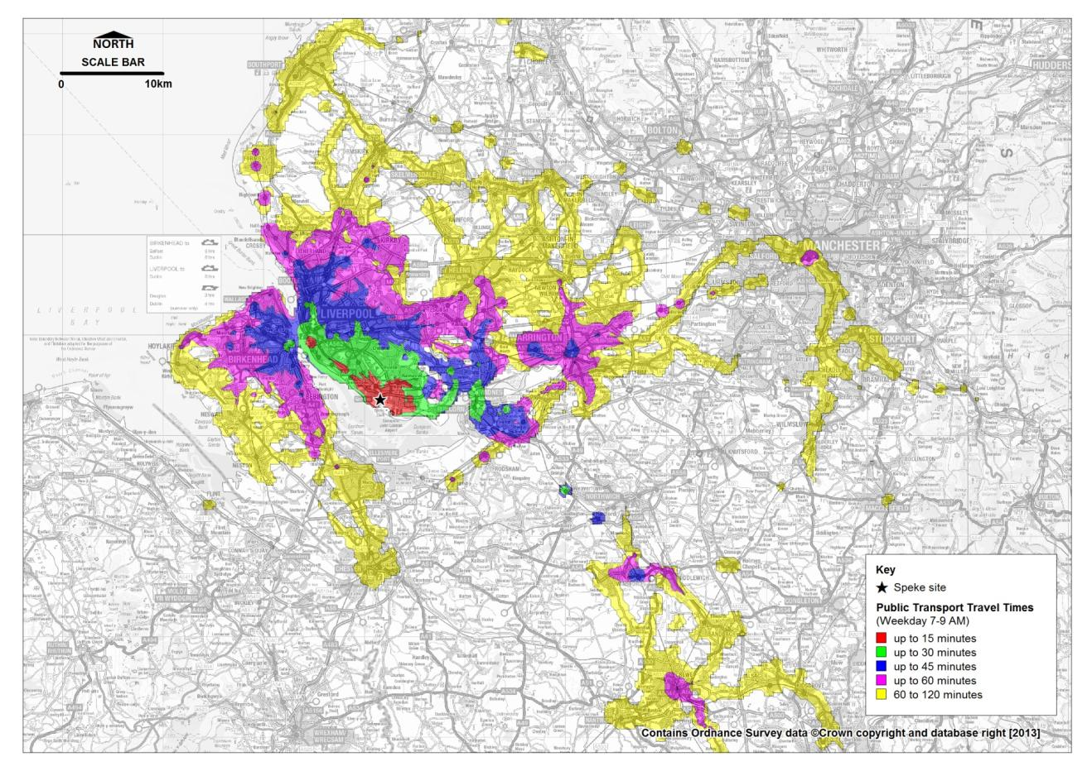
Notes:
The site benefits from good public transport links with frequent regular services into Liverpool city centre. A car share scheme already existed although it was not achieving its potential. Other measures had been implemented such as cycle parking and promotional events.

Slide 6
Notes:
JMP undertook a full staff travel survey to gain an up to date understanding of site issues. The survey revealed that staff were still travelling great distances to the site which lead to car sharing to be identified as the real opportunity to reduce single occupant trips to the site.

Slide 7
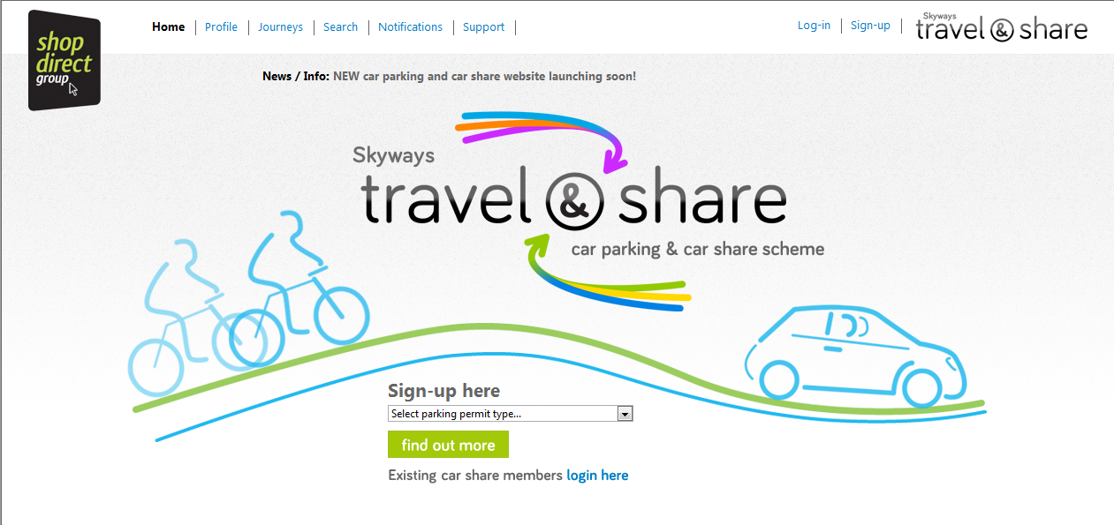
Notes:
The existing car park and car share scheme was managed through a complicated excel spreadsheet that was long overdue a refresh and update.
The travel plan set out to deal more appropriately with car park management issues and it was clear that a better management system was required to ensure that car parking was prioritised and that costs to the company of paying for off site parking could be reduced.

Slide 8
Current Mode Split
Mode | 2009 Results (%) | 2013 Results (%) | Change (%) | 2015 Target (%)
Car alone | 68.5 | 62.8 | -5.7 | 59
Car share | 15.6 | 19.6 | +4 | 22
Bus | 5.4 | 10.1 | +4.7 | 11.5
Train | 5.6 | 4.6 | -1 | 5
Walk | 0.6 | 0.7 | +0.1 | 1
Bicycle | 1 | 0.7 | -0.3 | 1
Motorcycle | 1.5 | 1.4 | -0.1 | 0.5
Notes:
Good progress has been made on reducing single occupancy car travel to the Speke site with a reduction from 68.5% in 2009 to 62.8 in 2013. To comply with the requirements of the planning consent for the site the target for 2015 is 59% with a corresponding increase in car sharing and bus being the main focus.
With the new car park management tool introduced in 2013 and the range of travel plan measures currently being introduced we are on track to meet the target.

Slide 9
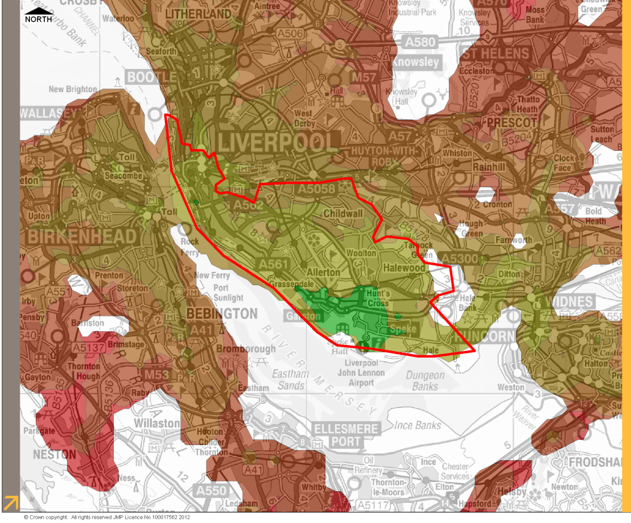
Notes:
Using the accession mapping undertaken to identify areas that could be reached within a reasonable travel time a ‘green zone’ was developed.
The zone sets out postcodes which are precluded from applying for single occupant car park permits for the site although there would be no preclusion for applicants for a car share permit.

Slide 10
Notes:
The new system is an online system which is user lead. Staff apply online for either a single occupant permit or car share permit - anyone with a precluded postcode is immediately directed to the car share section of the system.
The system checks eligibility, matches staff into car share pools and sends a message to the administrator to confirm their permit requirements.

Slide 11
Notes:
Using the travel & share branding travel plan measures have been rolled out to the three main Shop Direct sites at
Speke, Aintree in north Liverpool which is a call centre site and at Shaw in Manchester which is a warehouse and distribution site.

Slide 12
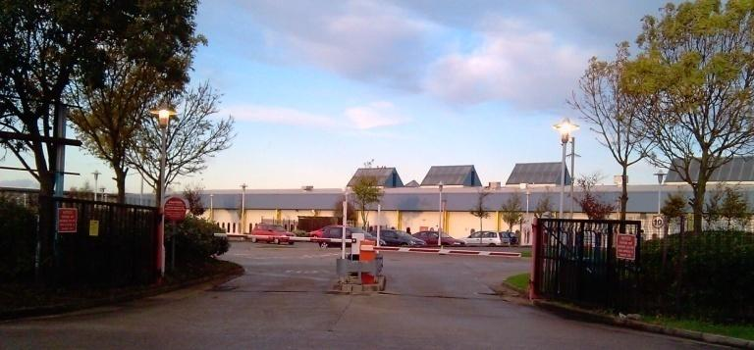
Notes:
Quick bit of background on the two other key sites;
Aintree – call centre site, majority of staff living in the local area, good public transport links
Shaw – warehouse and distribution site, close to new metro line but staff tend to work shifts starting early mornings and finishing late at night . Some issues experienced around recruitment and retention due to accessibility problems.

Slide 13
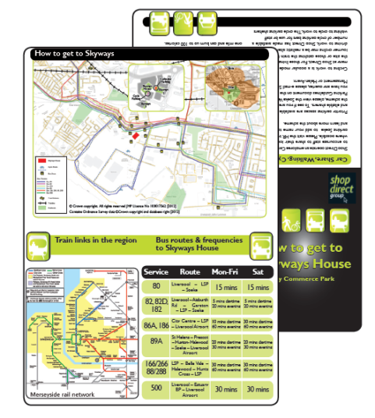
Notes:
As it is important to ensure that both carrots and sticks in place for a successful travel plan a range of measures have been implemented across Shop Direct sites depending on the need of staff.
which include;
A free months public transport pass for new starters
Interest free travel loan
Increased the number of car share spaces to 100
Bike loan scheme at the Shaw site to help with providing accessibility at shift times
Bus taster tickets
Travel roadshow events
Bike maintenance clinics
Led walks and led cycle rides
Cycle purchase scheme
How to get to guides

Slide 15
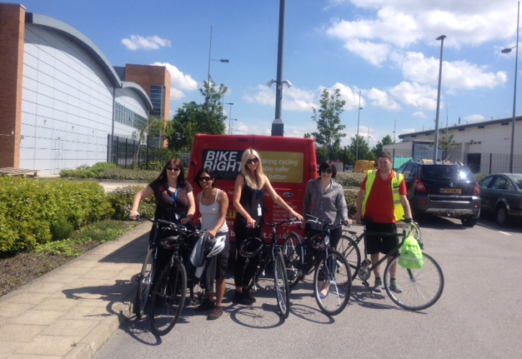

Slide 16
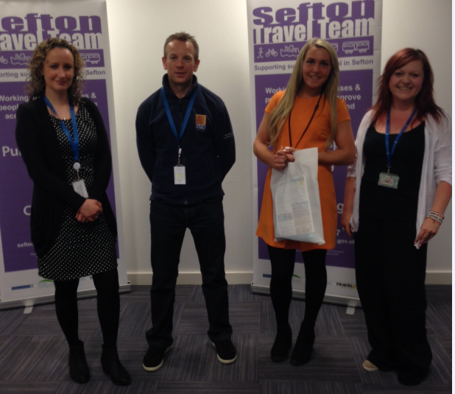
Notes:
Working with partners has been really important and has aided the success of travel plan measures at the sites. Key partners have included;
Merseytravel – received a LSTF grant to increase the size of the bus shelter immediately outside of the site
TfGM -
Local authorities - Sefton Council’s travel team
Local transport operators
Other suppliers – BikeRight, Autism Awarness both provide support for bike maintenance and encouraging cycling on site.

Slide 17
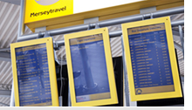
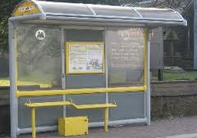
The Year Ahead 2014 - 2015
Notes:
Roll out of car share scheme to other Shop Direct sites
Support for new citybike station in the local area – Merseyside’s version of Boris Bikes
Real time information in main reception areas
Opportunities presented from electric and green vehicles
Review business travel to realise cost and carbon savings
Continue to improve communications and awareness raising

Slide 18
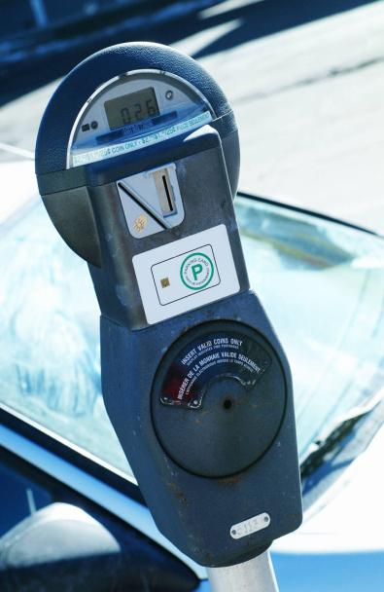
Notes:
Returning to the theme of the presentation there have been a range of economic benefits to Shop Direct in implementing smarter choices measures to their sites.
In terms of to the organisation notable savings have been made through reducing the cost of car parking at the Speke site – previously as mentioned significant costs were paid to local hotels to supply staff with car parking.
In addition the planning consent has enabled Shop Direct to continue to be a significant local employer employing approximately 5000 people in the north west and contributor to the local economy.

Slide 19
Notes:
In terms of the cost savings to the employees 370 members of staff at Speke are now sharing their petrol costs
At Shaw, more staff are able to take up both temporary and permanent positions due to the improved accessibility
At Aintree the focus is on encouraging walking and cycling to work to significantly reduce the cost of travel to employees whilst focusing on health and wellbeing issues.

Slide 20
Donna Gutteridge JMP Consultants
donna.gutteridge@jmp.co.uk
0151 230 1930
www.jmp.co.uk

