Slide 1
Student Hubs: helping more students do more, more effectively, for longer!
Robert Holtom
Environment & Sustainability Coordinator

Slide 2
What does a Hub do?
We help students set up societies, run events, organise fundraisers, volunteer in their local community, raise awareness, run campaigns…to take the lead.
Key areas: social action (e.g. community volunteering), environment & sustainability, human rights & international development, social enterprise, and ethical internships/careers.
The Week, The Series, The Wiki

Slide 3
What’s the structure of a Hub?
Embedded in a university – working alongside/with Student Unions.
Comprised of staff members (e.g. permanent Hub Managers) and a student committee (e.g. president, treasurer, area coordinators), and many many volunteers.

Slide 4
To Hub or not to Hub?
Because “students are the future”, Jonathan Porritt
Because students are great – very passionate and hard working – and they benefit greatly from our years of experience and ideas.
We inform, inspire, connect and support. We are a catalyst to help students achieve more.

Slide 5
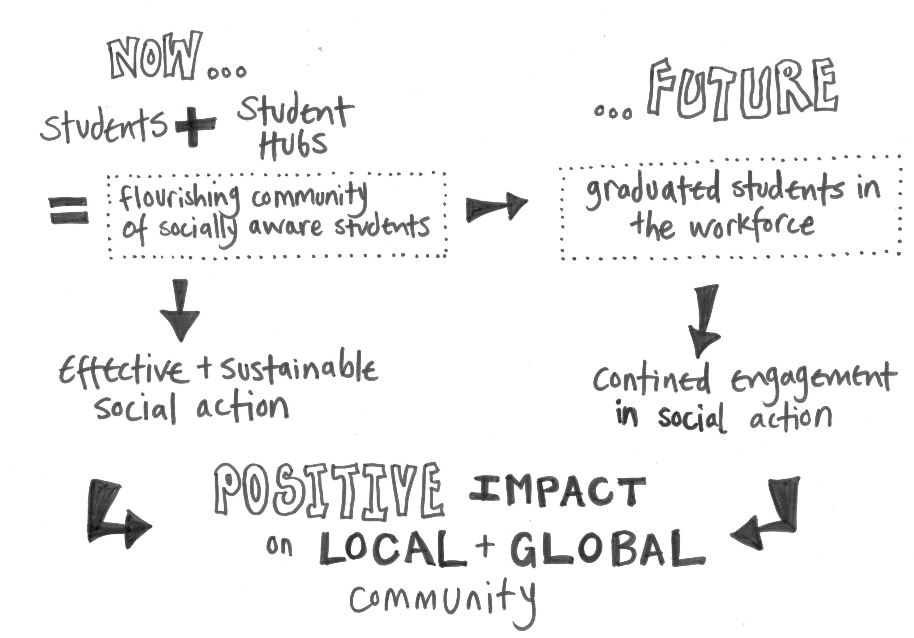
Our Theory of Change

Slide 6
Student Hubs and the Environment

Slide 7
Student Hubs and the Environment
Projects: allotments, CUECS (Cambridge consultancy)
Groups: BUST (food co-op, cycle repair)
Events: Climate of Change Speaker Series, The Series
Conferences: Climate Forums (Oxford, Bristol, Southampton, Warwick, Cambridge)
Campaigns: Energise Cambridge, support UKYCC, People & Planet

Slide 8
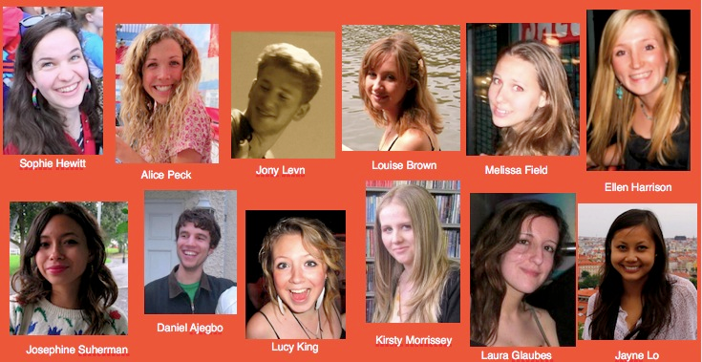
Case study 1: Bristol Hub and University of Bristol

Slide 9
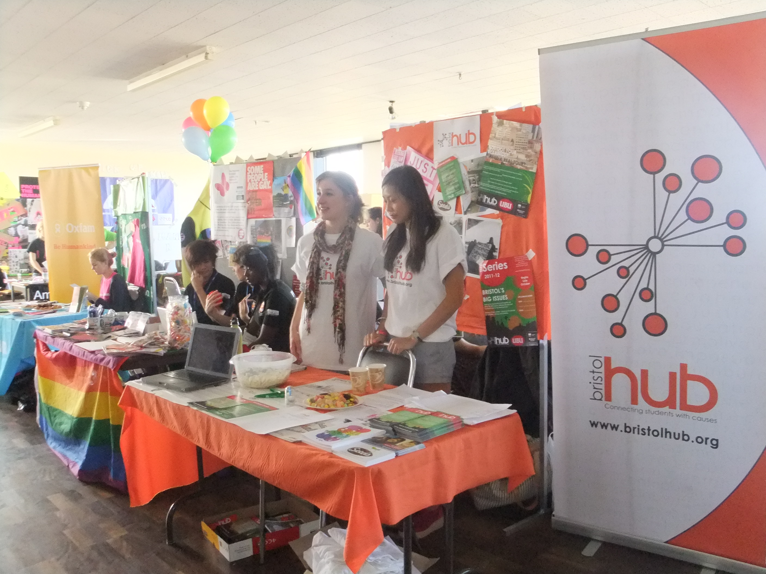
Case study 1: Partnership: Bristol Hub and University of Bristol
Activity Examples:
Environment & Ethics Week
Skills in Sustainability: Carbon & Waste Audit Training including follow-on audits
Climate of Change Speaker Series

Slide 10
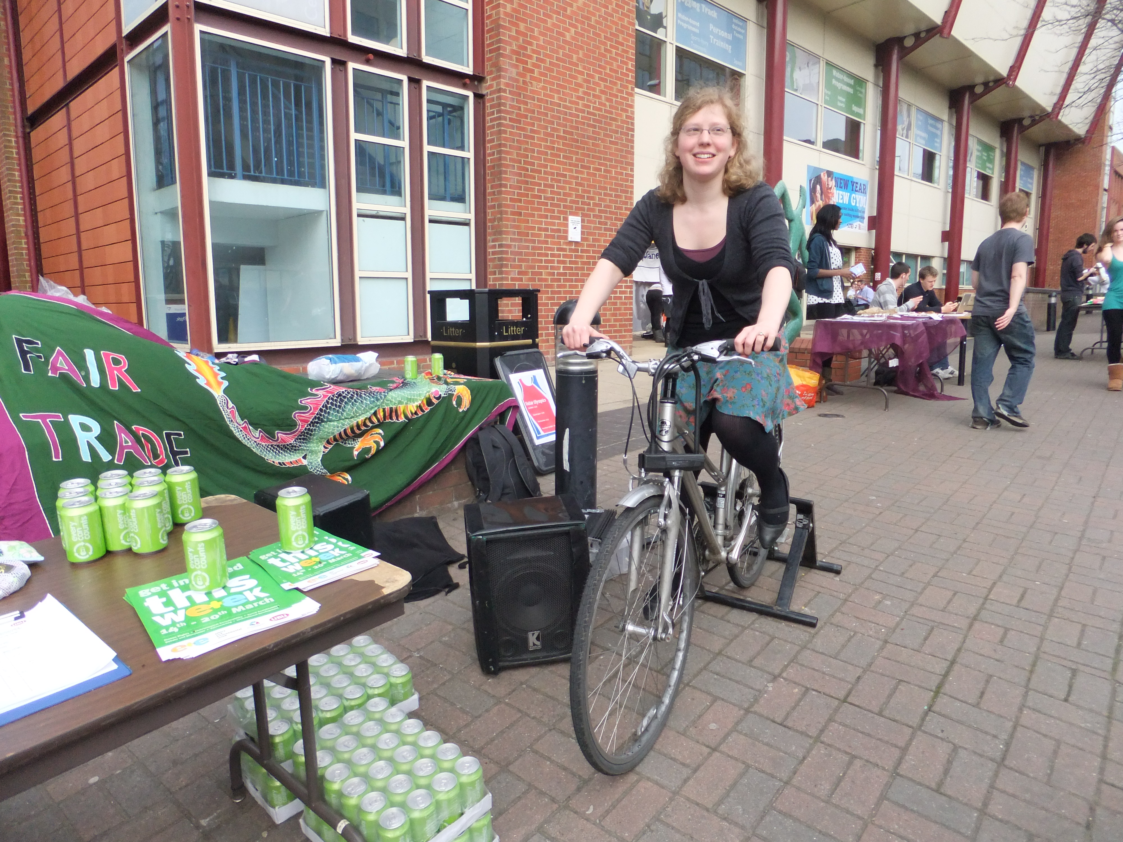
Environment & Ethics Week

Slide 11
Other Bristol Hub activity
Bristol Social Enterprise Conference
Lions Den
Bristol International Development Conference
Ethical careers fair
Bristol University Sustainability Team & Foodcycle Bristol

Slide 12
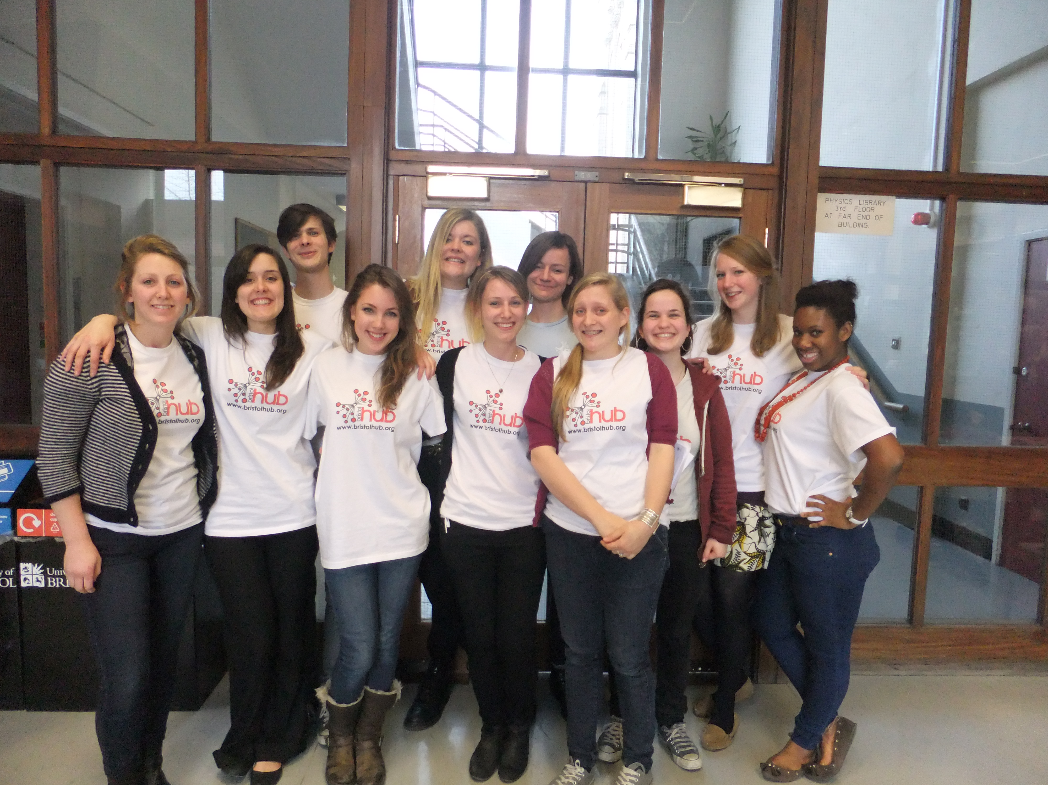
International Development Conference

Slide 13
Case study 1: Plans for the future…
Halls activity:
Help unite the different student societies in order to increase collaboration and reduce duplication of efforts.
Training, e.g. a pilot programme with Schumacher college on environmental education
Future careers – internships with sustainability companies, and companies in Bristol

Slide 14
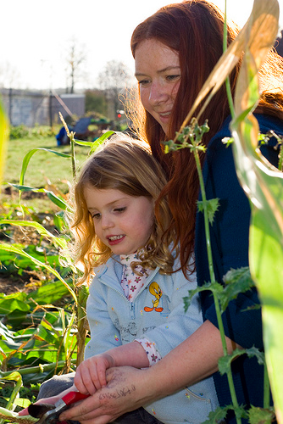
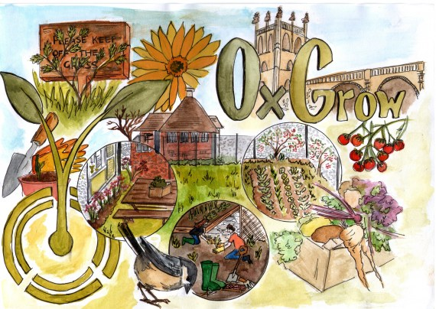
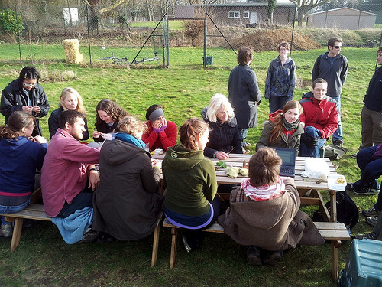
Case study 2: OxGrow

Slide 15
Case study 2: OxGrow
A local, edible community garden
Set up by Oxford University students – a reclaimed Oxford college sports ground – now a teeming, experimental vegetable garden, mini forest, wind powered pavilion…
Open every weekend for everyone – Oxford Uni and Brookes University students, and people from Oxford town.

Slide 16
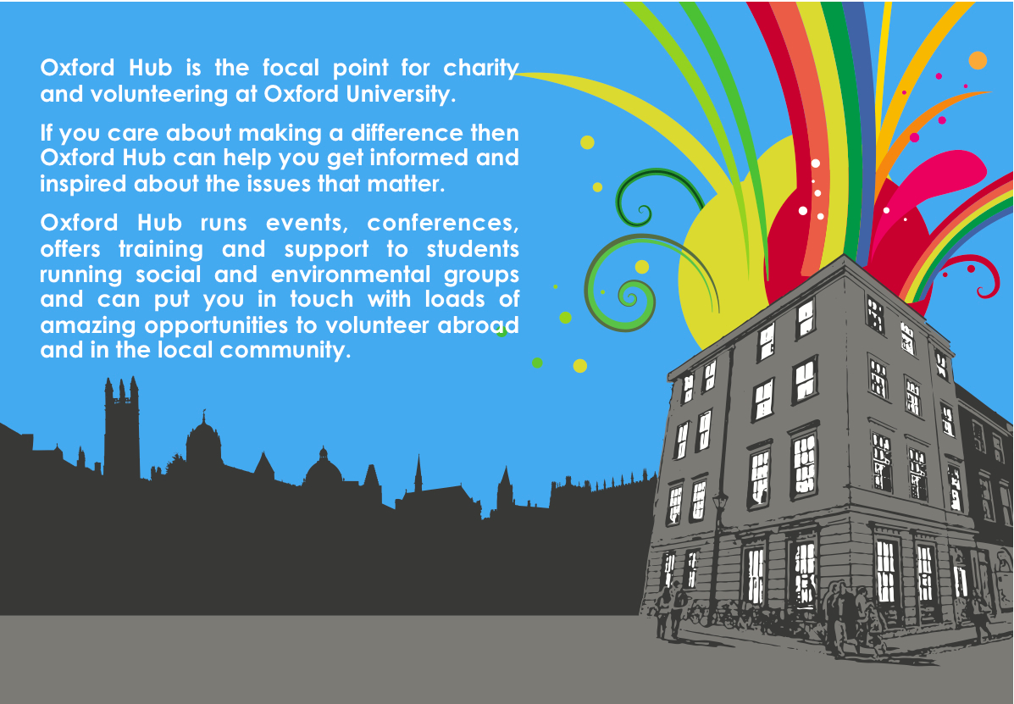
Case study 3: The Turl Street Kitchen

Slide 17
Case study 3: Oxford Hub/The Turl Street Kitchen
A new building in the heart of Oxford!
Contains…a restaurant serving reasonably priced, seasonal and local meals – The Turl Street Kitchen (a Social Enterprise – the profits from the restaurant go upstairs to support the charity).
The Oxford Hub: an events space and lounge for students, local businesses and charities, and lots of office space (currently housing Oxford Hub, Student Hubs, People & Planet, and others)

Slide 18
Case study 3: Oxford Hub/The Turl Street Kitchen
A great place for students to meet and get involved with our work. Benefits member and non-member groups of the Hub – a venue for charity events, film screenings etc.
Students can get involved with the running of the building itself – a sustainability rep, terrace co-design.

Slide 19
Three take home messages
Let students take the lead
Students benefit from our expertise and our collective institutional memory
Students + Staff + Hubs = long term, systemic change!

Slide 20
Thank you! www.studenthubs.org

Slide 21
Your next steps – making the most of your EAUC Membership…
Resources - visit the dedicated behaviour change section on the EAUC resource bank
Networks - join our Embedding Positive Attitudes and Behaviours Community of Practice - for those wanting to identify with the challenges of changing the behaviour of staff and students
Find out more about this group at 5pm today – see programme for details
Recognition - want recognition for your student engagement initiatives – enter the 2012 Green Gown Awards Student initiatives and campaigns category – entries open summer 2012
Measure and improve - sign up to LiFE – www.thelifeindex.org.uk. EAUC Members receive a significant discount
LiFE offers a dedicated ‘student engagement’ framework for implementation
Membership matters at www.eauc.org.uk

