Slide 1


Road transport air pollution:
Health impacts and costs
Huw Brunt
Consultant in Public Health, Public Health Wales
PhD Researcher, University of the West of England
9th Dec 2014

Slide 2
Source: Barton and Grant (2006)

Slide 3
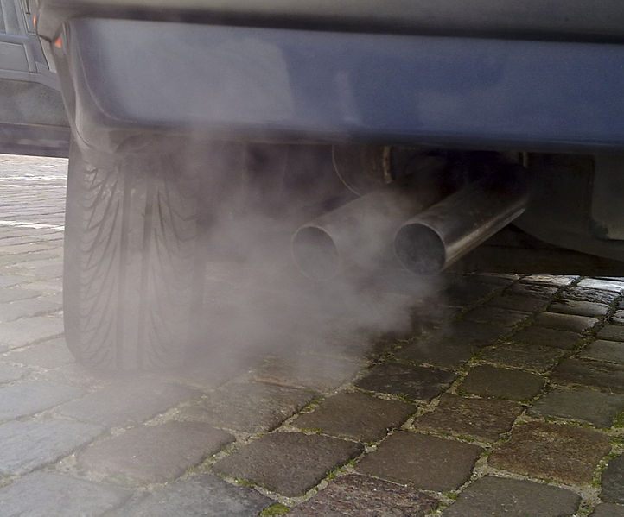
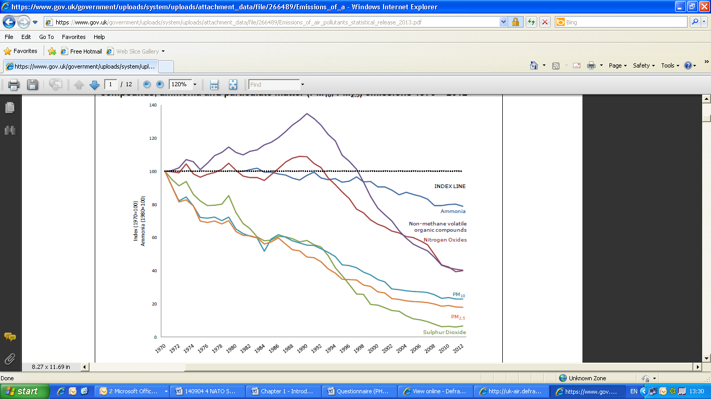
Source: RAC Foundation (2014)
Euro 4 (2005) & 5 (2009)
24% PM₁₀
27% PM_{2.5}
31% NO_{x}
Source: OECD (2014)
Source: Defra (2014)

Slide 4
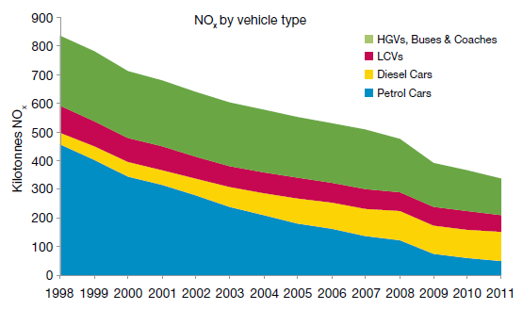

Source: NAEI (2013)
Source: RAC Foundation (2014)

Slide 5
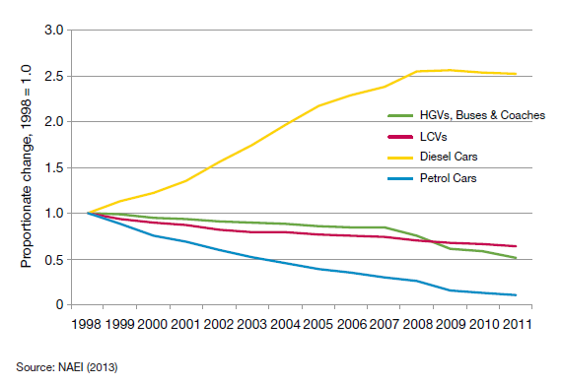
Change in total NOx emissions by vehicle type 1998 to 2011

Slide 6
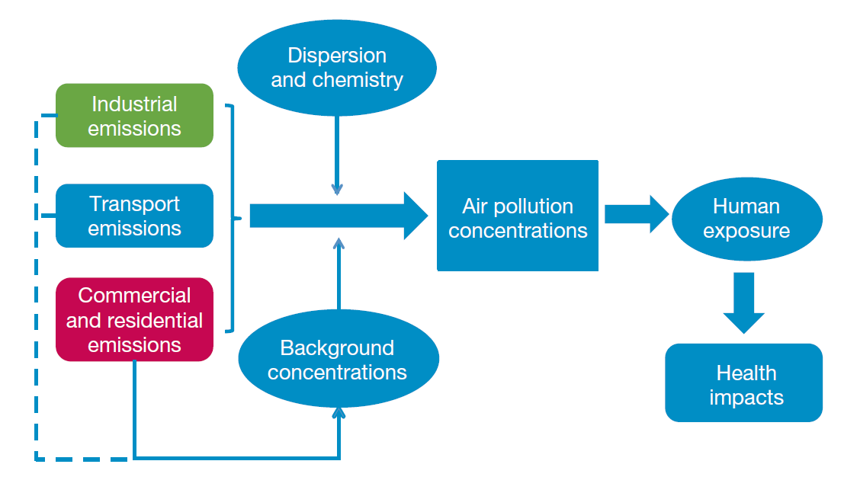
Source: RAC Foundation (2014)

Slide 7
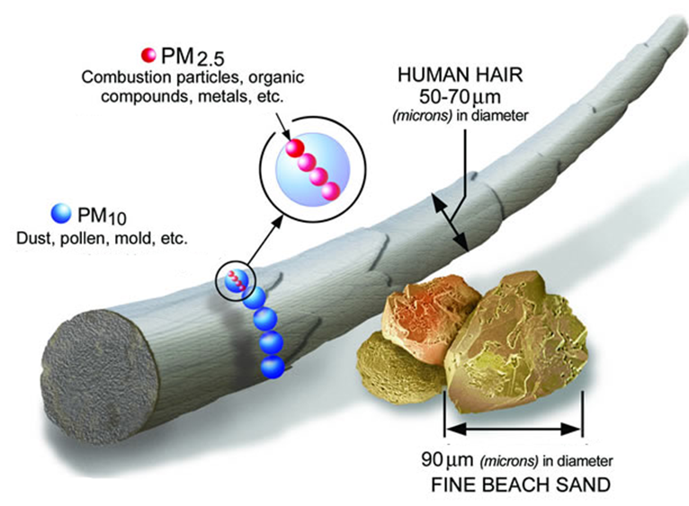

Slide 8
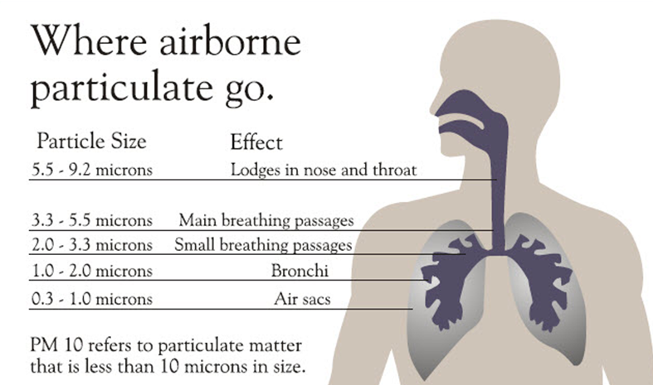

Slide 9
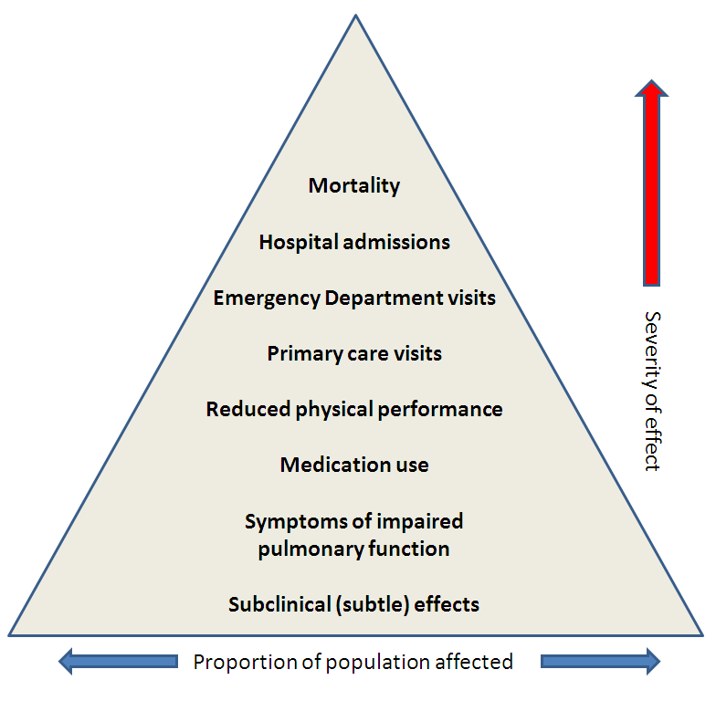

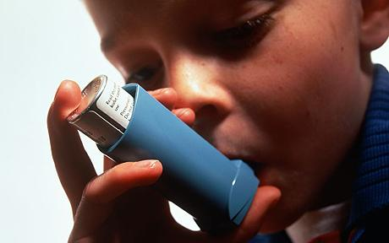
Source: NHS
Source: The Telegraph
Source: Craig et al. (2008)

Slide 10
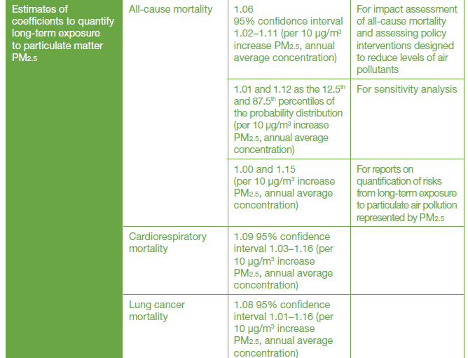
Source: RAC Foundation (2014)

Slide 11
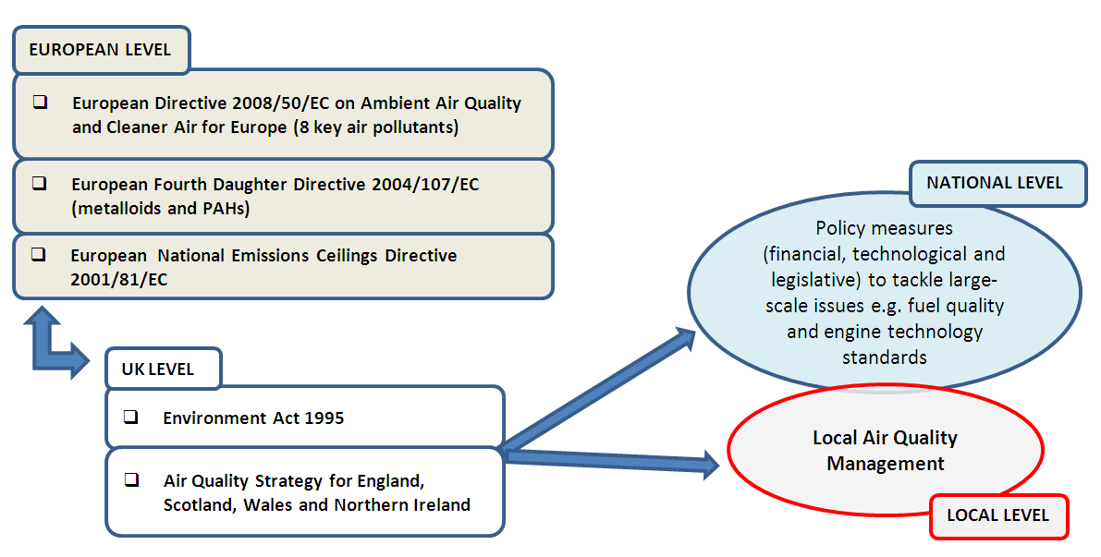

Slide 12
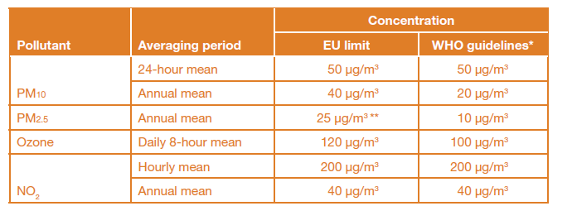
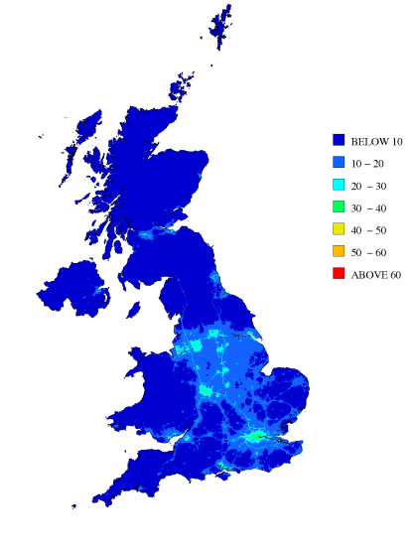
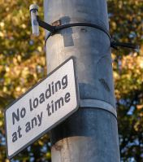
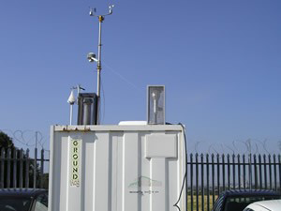
Source: 2008 2008/50/EC, EU (2008)

Slide 13
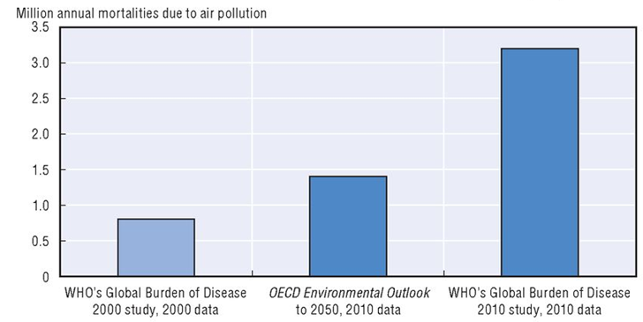
Estimates of deaths from ambient particulate matter pollution
Source: OECD (2014)

Slide 14


Slide 15


Slide 16

EU
€330billion
↓
€940 billion
UK
£9 billion
↓
£19 billion

Slide 17
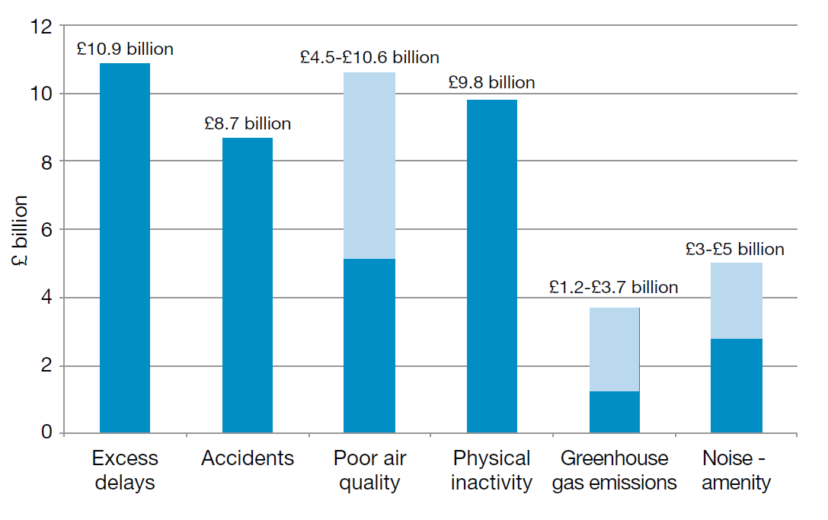
Source: DfT, 2009

Slide 18
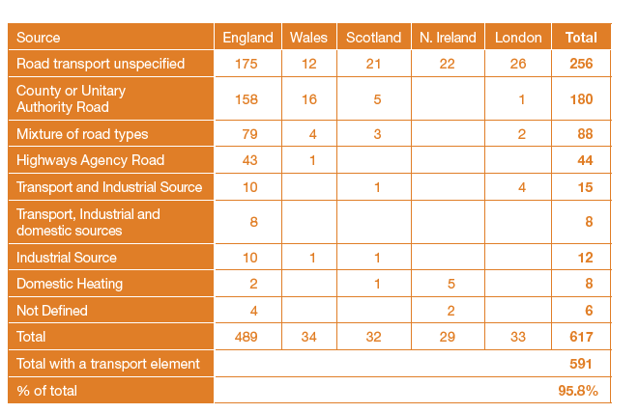
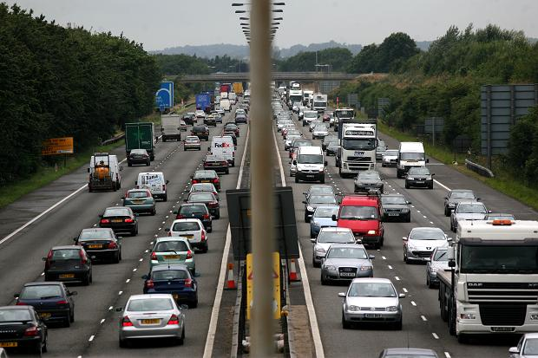
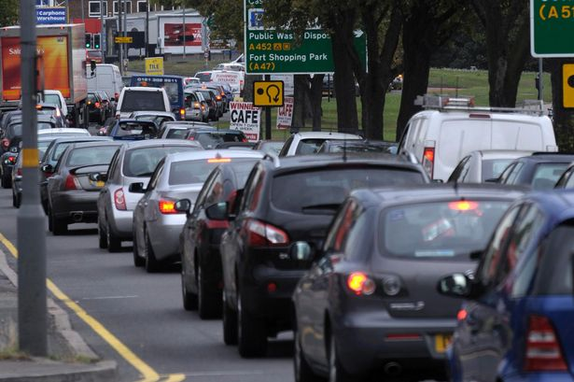
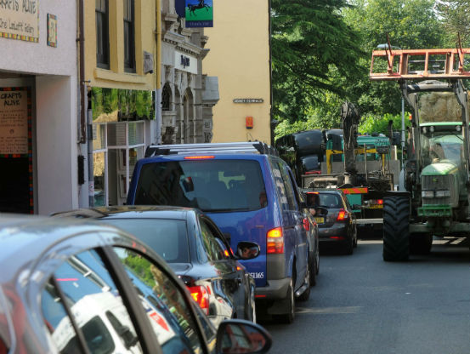
Source: Defra, 2013

Slide 19
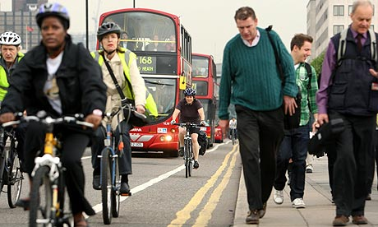
Attributable fraction
Attributable deaths
Years of life lost
Source: The Guardian

Slide 20
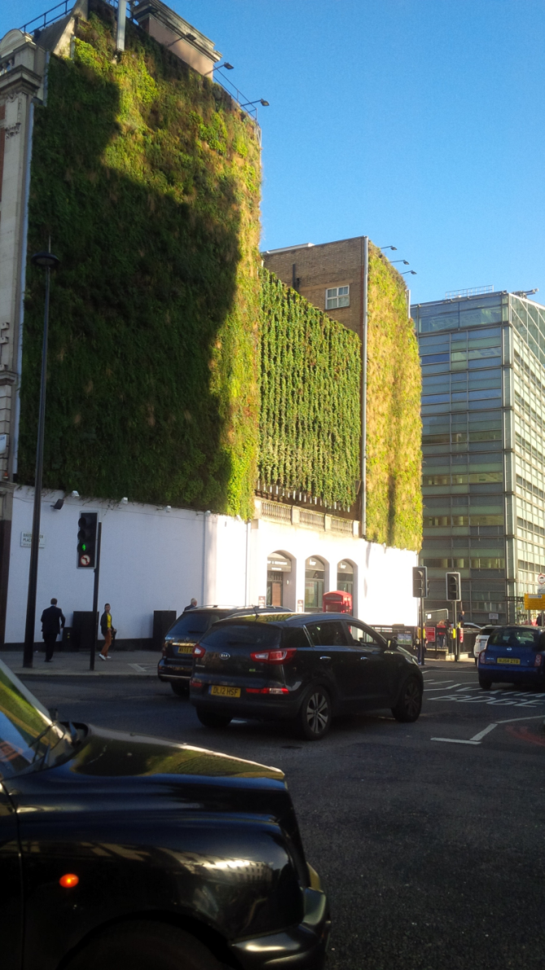
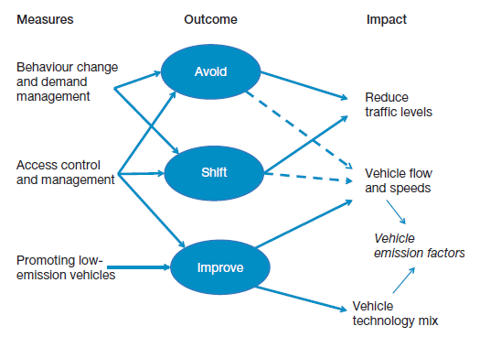
Source: RAC Foundation (2014)

Slide 21
Road transport air pollution:
Health impacts and costs
Huw Brunt
Consultant in Public Health, Public Health Wales
PhD Researcher, University of the West of England
9th Dec 2014

