Slide 1
Scope 3 – Moving Beyond the Estates Office
Karl Letten, De Montfort University
Paul Brockway, Arup
Dr Richard Bull, De Montfort University

Slide 2
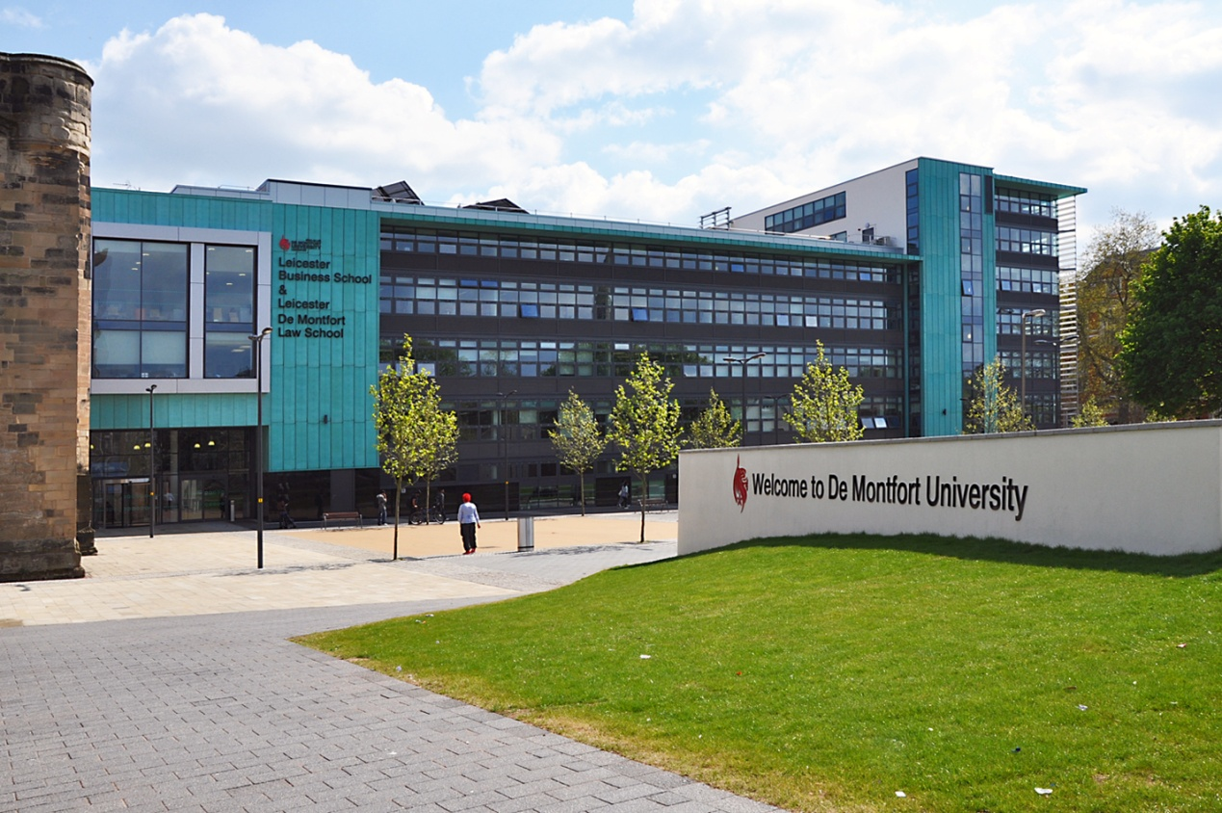
Environmental Association of Universities and College
Scope 3 – Moving Beyond the Estates Office
27th March 2012

Slide 3
Structure and timings [TO BE REMOVED FROM FINAL VERSION!]
Introductions (5 - 10mins) KL
Background to scope 3 emissions (10mins) PB
Terminology around scopes WRI
Experiences from other sectors (NHS, other HEIs).
Policy context (15 mins) KL/PB
Climate Change Bill reduction target
HEFCE carbon reduction target for the sector; SQW work
Carbon Management Plans and CIF2
Scope 3 emissions reports and guidance; HESA consultation
Measuring procurement emissions
Carbon management plans – experiences from Arup???
Discussions around scope 3 (20 mins)
What information do you need?
Who do you need to talk to in your organisation?
How to get them engaged?
What have been your experiences?
Feedback from attendees (10mins)
Recording feedback? Flip chart or notes
PROCO2 tool at DMU (15 – 20mins)
Experiences of measuring procurement related emissions at DMU

Slide 4
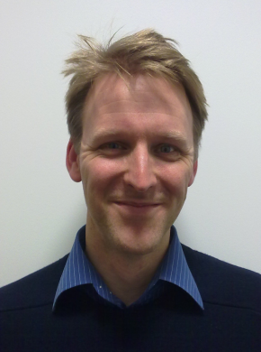
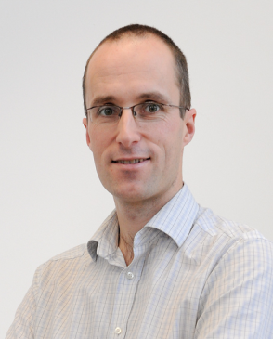
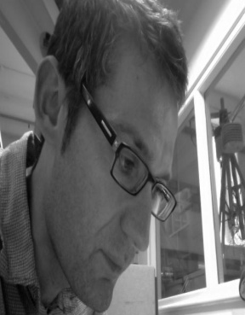
Presenters
Karl Letten, Environmental & Sustainability Officer, Estates, De Montfort University
Paul Brockway, Senior Sustainability Consultant, Arup
Dr Richard Bull, Senior Research Fellow, Institute of Energy & Sustainable Development , De Montfort University
Notes:
We each introduce ourselves:-
Karl Letten, Environmental & Sustainability Officer at DMU, been there for just over 3 years. I’m based in the Estates Department and part of my role is producing the carbon management plan, providing annual update reports on progress of reducing carbon emissions. Our CMP baseline year includes scope 1, 2 and 3 emissions but we currently only have targets for scope 1 and 2.
Paul Brockway
Dr Richard Bull

Slide 5
Content
Introductions – DMU, Arup
Background to scope 3 emissions
Policy context
Discussions around scope 3
Experience of measuring procurement emissions at DMU – PROCO2

Slide 6
De Montfort University (DMU)
Based in Leicester with city centre campus
Approximately 20,000 students and 3000 staff
Includes Institute of Energy & Sustainable Development
Sustainable Development Task Force chaired by Pro VC
Follow us on Twitter @SustainableDMU

Slide 7
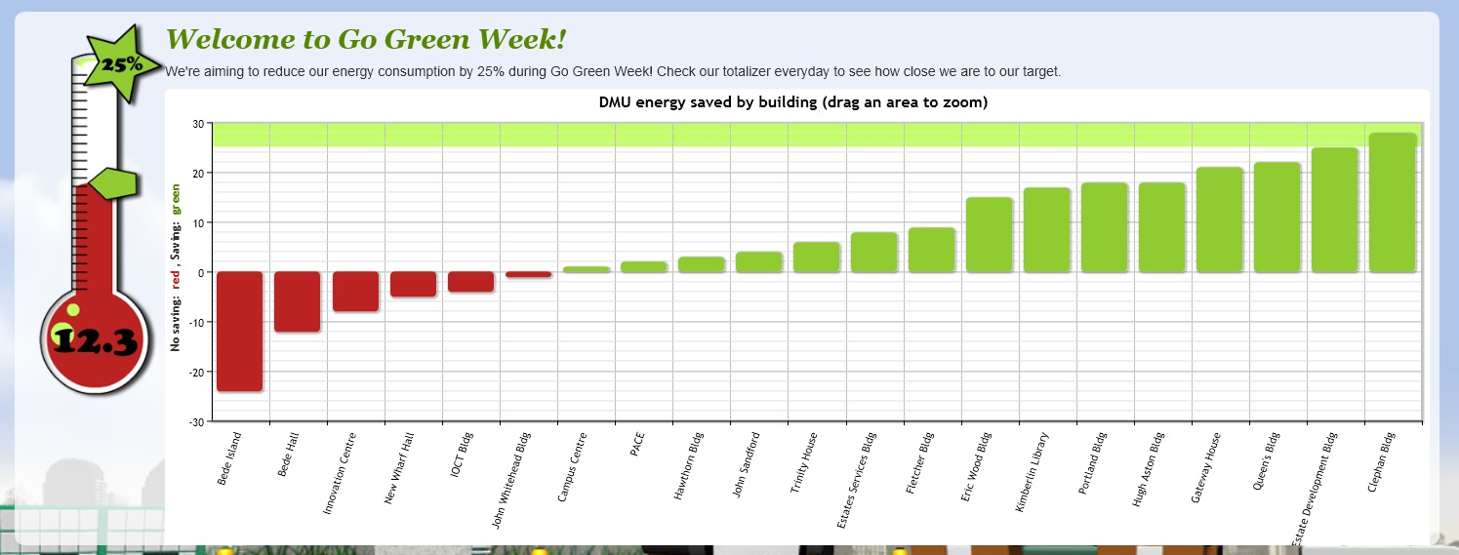
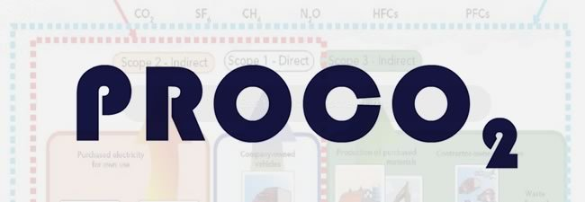
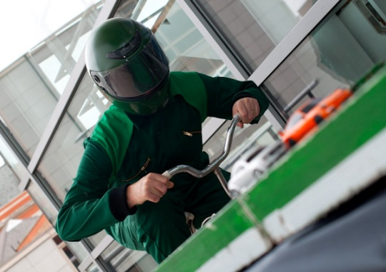

Slide 8
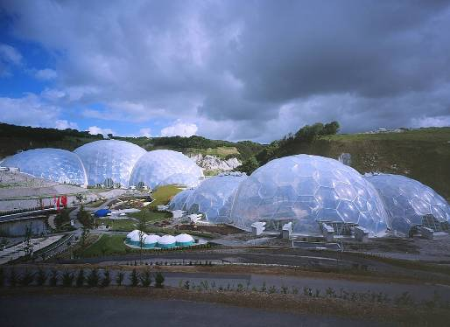
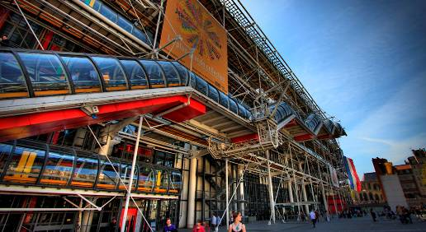
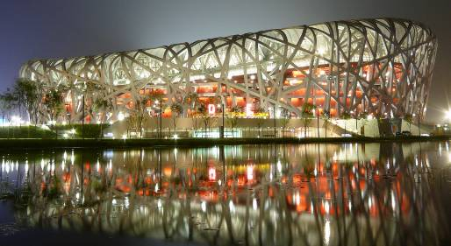
MEP CAPABILITY
THE SUITABILITY OF OUR COMPANY: CAPABILITY & TRACK RECORD
Notes:
Nearly 10,000 people 70 countries in five regions 63 years 11,000 concurrent projects £800m turnover
Trust ownership

Slide 9
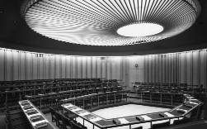
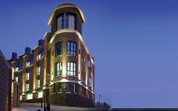
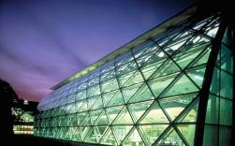
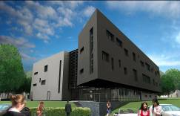
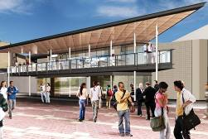
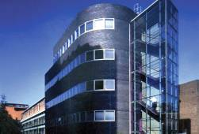
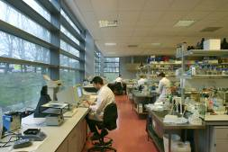
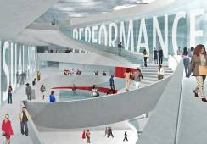
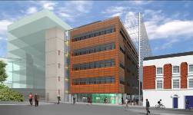
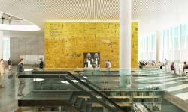
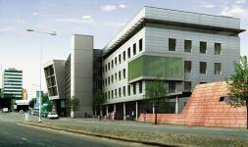
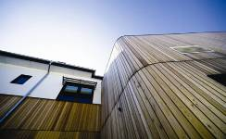
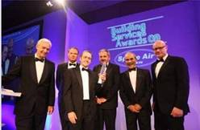
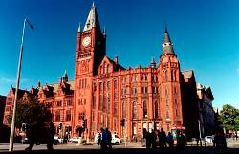
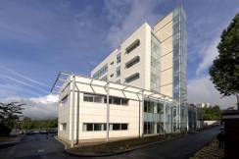
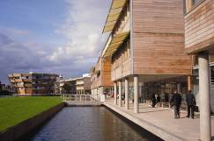
THE SUITABILITY OF OUR COMPANY: BROAD EDUCATION EXPERTISE
Notes:
Wide geographical coverage
Range of specialists
Existing relationships with about half of all UK HEIs
University of Bristol – synthetic chemistry lab building
University of Cambridge
University of Lancaster
University of Warwick
University of Strathclyde
Nottingham Trent University
Salford University
University of Central England, Birmingham
University of Aberdeen
Combined Universities of Cornwall
University of Swansea
University of Liverpool
University of Swansea
University of Nottingham

Slide 10
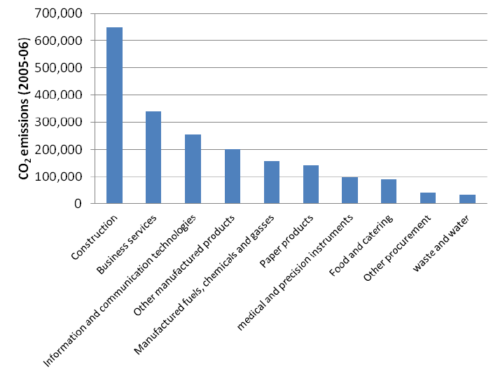
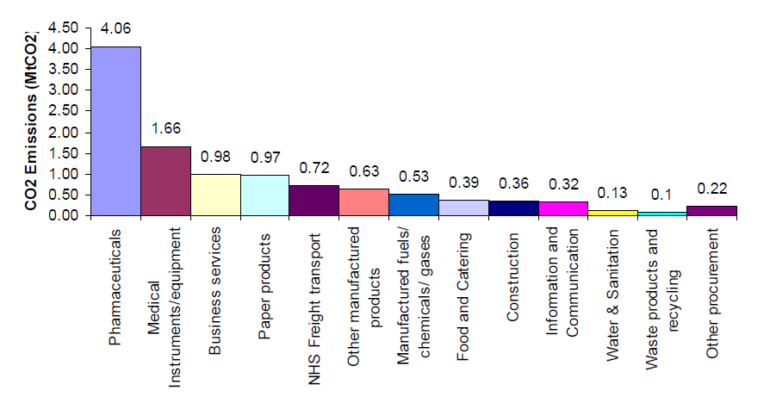
MEP CAPABILITY
UK leading scope 3 experience
The WRI/WBCSD Greenhouse Gas (GHG) Protocol defines 3 categories of carbon emissions:
NHS England
Barts & the London NHS Trust
HEFCE
DMU project
Notes:
Nearly 10,000 people 70 countries in five regions 63 years 11,000 concurrent projects £800m turnover
Trust ownership

Slide 11
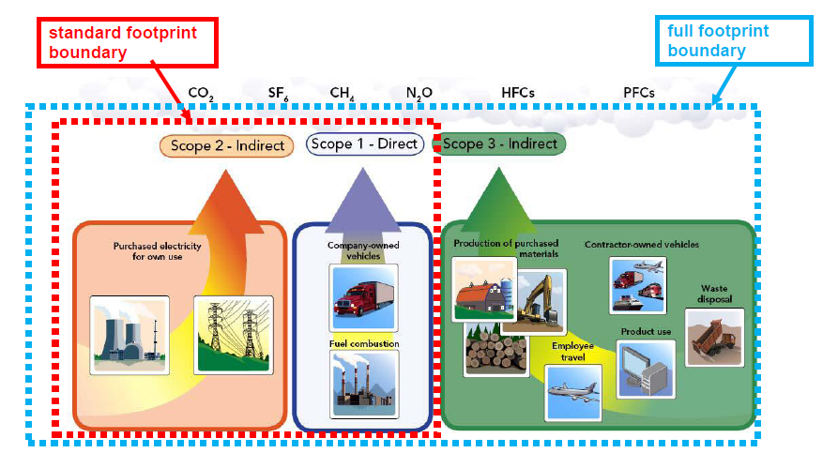
Terminology: GHG Protocol & Scope 1-3 emissions
The WRI/WBCSD Greenhouse Gas (GHG) Protocol defines 3 categories of carbon emissions:
Forum for the Future (2008) Getting to Zero: Defining Corporate Carbon Neutrality
Notes:
World Business Council for Sustainable Development (WBCSD) and the World Resources Institute (WRI)
GHG Protocol
To understand, quantify, and manage greenhouse gas emissions.
Classified GHG emissions from variety of sources or scopes
Scope 3 emissions can represent the largest segment of an organization’s emissions
However, it is the most difficult to measure so it has been largely ignored in carbon footprint calculations and reporting frameworks
There will be increased pressure in the future for companies to report on Scope 3 as the 2011 version of the GHG Protocol will be much more prescriptive about scope 3.

Slide 12
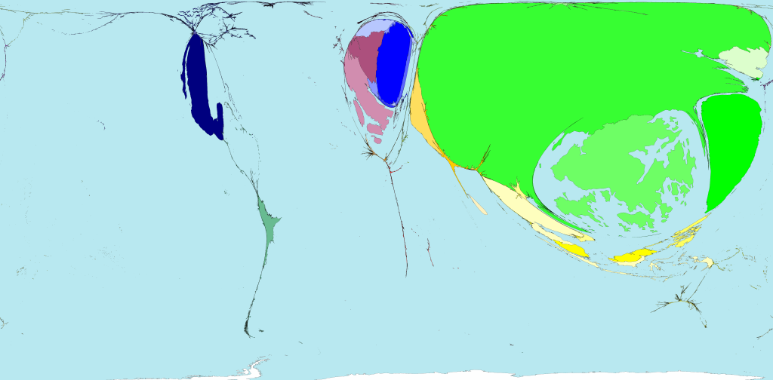
Scope 3 emissions are of global importance: Toy production emissions
China produces most toys and CO₂
Notes:
This illustrates our point:
This is a morphed view of global emissions produced by each country when making Toys
China as we can see produces most emissions

Slide 13
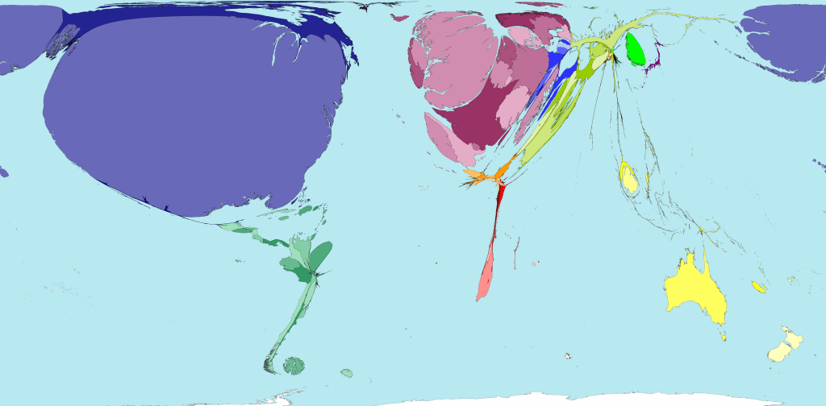
Scope 3 emissions are of global importance: Toy consumption emissions
USA imports most toys and thus CO₂
Notes:
However now we look at the embodied CO2 in the toys purchased in each country:
The USA imports the largest global amount of embodied emissions from Toys
China has very little consumed emissions: it exports most of its production –based emissions

Slide 14
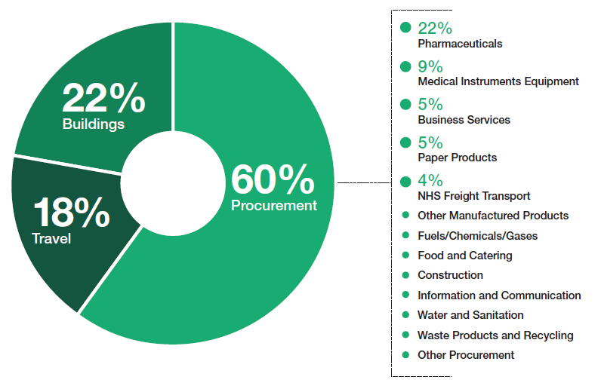
The NHS England study (2008): showed the importance in UK of scope 3
Notes:
Our NHS analysis showed that
60% of emissions were in procurement, eg embodied CO2 in goods & services
Pharmaceuticals (22%) were equal to the entire energy consumption CO2 emissions from the NHS buildings
We also built a scenario modelling tool to test which carbon ‘wedges’ would be most effective at reducing carbon to meet targets
The results were the analytical foundations for the carbon reduction strategy in the NHS

Slide 15
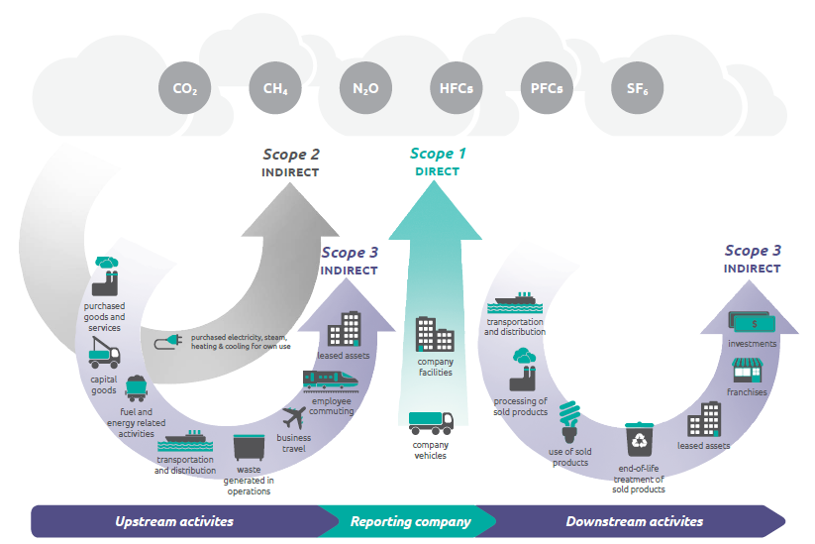
Scope 3 moving on: The new Scope 3 GHG Protocol - October 2011

Slide 16
The corporate lever: The Carbon Disclosure Project
CDP collects climate change information for:
CDP collects information from:
551
Investor Signatories
$71T
AUM represented by CDP’s signatory investors
3,500+
Number of Companies reporting via CDP in 2011
68%
% of FTSE 350 companies reporting via CDP in 2011

Slide 17
Policy context
HEFCE Sustainable Development in Higher Education (2005)
Climate Change Act 2008
Carbon reduction targets enshrined in law
a legally binding target of at least an 80% cut in greenhouse gas emissions by 2050
reduction in emissions of at least 34% by 2020. Both targets are against a 1990 baseline
HEFCE update Strategic Statement on SD in HE 2009
BIS Carbon Reduction Delivery Plan 2010
Carbon reduction target and strategy for higher education in England 2010
reduction scope 1 and 2 emissions of 34 per cent by 2020 and
80 per cent by 2050 against a 1990 baseline
Notes:
BIS Carbon Reduction Delivery Plan 2010 – 43% reduction in scope 1 and 2 sources by 2020 based on a 2005 baseline
Carbon reduction target and strategy for HE 2010 – HEFCE, UUK and Guild HE

Slide 18
Policy context
Linking funding to carbon management
Carbon management and CIF2
HEFCE guidance on measuring scope 3 emissions
Transport
Waste and water
Procurement
Sector wide procurement emissions
Higher Education Statistics Agency (HESA) review of Estates Management Statistics
Introduction of scope 3 reporting for 2012/13

Slide 19
HE sector CO₂ emissions: primary sector breakdown (2005-06)

Slide 20
HE sector CO₂ emissions: scope 1-3 emissions breakdown (2005 – 2006)

Slide 21
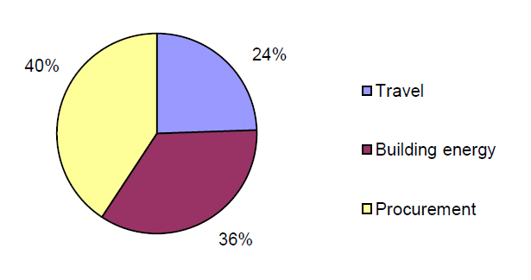
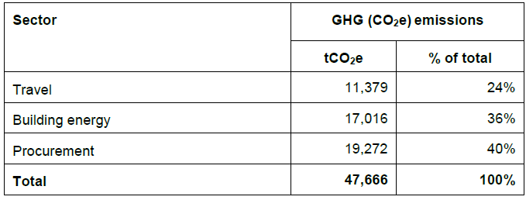
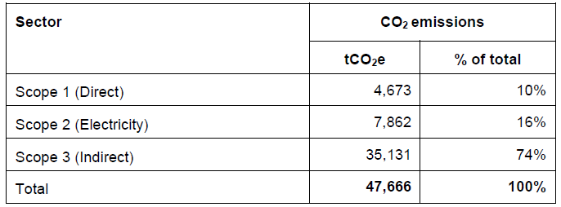
DMU carbon footprint analysis: 2008 (2008-09)

Slide 22
Measuring Procurement Related Emissions
Procurement sizable part of footprint
HEFCE guidance; included in HESA review of EMS
Carbon emissions procurement tool
Purchasing consortium – annual returns
Providing information to HEIs

Slide 23
Carbon Management Plans - DMU
Footprinting study in 2009
Early involvement of stakeholders
Led to higher profile of CMP
Emissions of scope 1 and 2 reducing
Sustainability and Carbon management key theme in strategic plan
Commitment to reduce emissions all scopes
Commitment to carbon budgeting in strategic plan

Slide 25
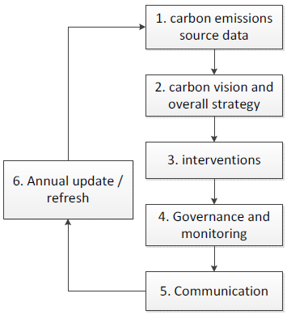
Next steps: carbon cycle feedback
Issues raised with scope 3
Data collection moves outside Estates office
CMP plan and systems cover scope 1 & 2, but now has to cover scope 3
Behavioural change – key aspect for scope 3
Who leads: SD group, estates, environment lead?
Comms: internal & external issues
Who’s does this?

Slide 26
Scope 3 - Group discussions 15-20
Discuss with your neighbour
What information do you need?
Who do you need to talk to in your organisation?
How will you get them engaged?
What have been your experiences?
Potential barriers?

Slide 27
Engaging on Scope 3 Procurement Emissions – PROCO2
Aim: To develop an ICT based decision making tool to enable DMU to reduce scope 3 emissions, notably procurement
Objectives:
Link financial and environmental accounting for procurement in the ICT tool and database
Increase awareness on the environmental impacts of purchasing goods/services and support decision-making towards sustainable procurement
Understand issues of organizational learning and institutional change.
Contribute to the financial and environmental sustainability and resilience of the organization through reducing procurement spend and their associated GHG emissions by reducing consumption.

Slide 28
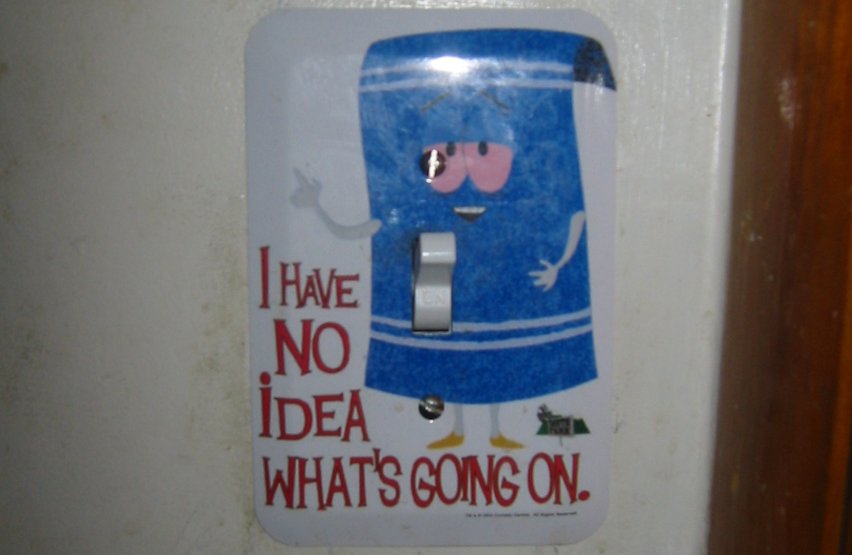

Slide 29
Beyond information provision
There is a need for a different approach- recognising the complexity of user perceptions and understandings (Niemeyer, Petts et al. 2005);
Combining a bottom-up and top-down approach in order to minimise mixed messages (Owens 2000);
The value of public engagement (Burgess and Clark 2009; Ockwell, Whitmarsh et al. 2009).
The importance of context.
Notes:
Central to the notion of publicly displaying a building’s energy performance though is the idea that the provision of information will change the behaviour of those managing and using the building. Hence the proviso that the building is rated and displayed in a poster format that can be displayed in a public part of the building so it is visible, for example the entrance hall.
Yet within the public engagement literature it is widely accepted that mere information-provision is inadequate for behaviour change (Blake 1999), and yet ‘top-down’ communication campaigns both predominate (for example the UK government’s ‘Act on CO₂' campaign) and are advised by those involved in ‘social marketing (Collins, Thomas et al. 2003).’ However, this rarely manifests itself through measurable behaviour change (Lorenzoni, Nicholson-Cole et al. 2007).
As a result, academics have identified the need for a different approach recognising the complexity of user perceptions and understandings (Niemeyer, Petts et al. 2005); the importance of combining a bottom-up and top-down approach in order to minimise mixed messages (Owens 2000); and the value of public engagement (Burgess and Clark 2009; Ockwell, Whitmarsh et al. 2009). It is these three perspectives – recognizing complexity of user-perceptions; a bottom up/top down approach (often manifested through partnership working) and public engagement, that to which we shall return when we consider the role of the municipalities.
Of course whilst the EPBD may just require a DEC in an entrance hall, DISPLAY Campaign is different – issue of audience again.

Slide 30
Staff engagement prior to & during development of the tool (1)
What are the perceived benefits?:
It's simple to use
It allows performance improvements to be monitored across time
Unconvinced whether the tool is sufficient to bring about behavioural change but will help to raise awareness of green issues in procurement
The tool should be used by those who request the purchase in the first place
They liked the capability of the system to compare faculties

Slide 31
Staff engagement prior to & during development of the tool (2)
What could be improved about the tool?
a) The information contained within the tool:
They would ultimately like to be able to compare products and suppliers
Suggestion to explore the availability of data from last year to track performance against for this year
Suggested incorporation of a link from the calculator page to the UNSPCC codes
b) Presentation of data
They would like the reports to show data on the basis of each £ spent as well as total £s spent
They would like to see the carbon figure produced by the calculator to be shown as a RAG status
Could we include a link to explanatory information outlining what the figure produced by the calculator means?
Could the reports highlight what the carbon intensive figure means?
c) Layout / interface
Would it be possible to change the graphs (e.g., explode the bar chart) according to user's preference?
Can the figure produced by the calculator be more obvious? E.g., open up a new window?

Slide 32
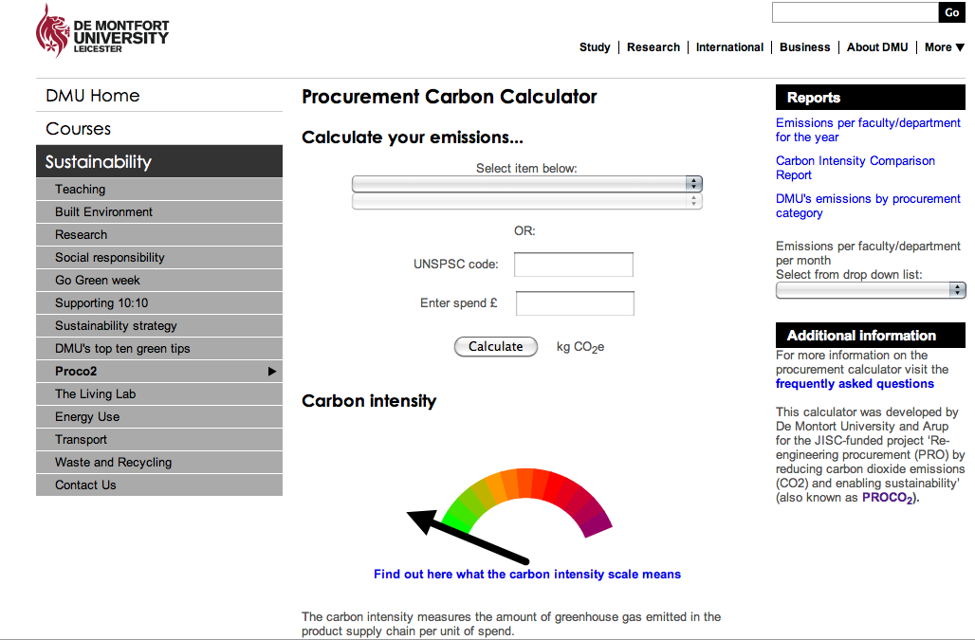

Slide 33
Thank you for listening.
Dr Richard Bull
rbull@dmu.ac.uk
greenview.dmu.ac.uk
Twitter: richbull or greenviewdmu
Karl Letten
kletten@dmu.ac.uk
dmu.ac.uk/sustainability
Twitter: sustainableDMU
Paul Brockway
Paul.brockway@arup.com

Slide 34
Key messages
Scope 3 emissions are a large part of your footprint
Important to engage with colleagues
There is guidance available

Slide 35
Your next steps – making the most of your EAUC Membership…
Resources - visit the EAUC resource bank for guidance from HEFCE on measuring scope 3 carbon emissions
Networks - Join our Transport Planning Network Community of Practice - for College and University travel planning professionals
Find out more about this group at 5pm tomorrow – see programme for details
Recognition - want recognition for your carbon reduction initiatives – enter the 2012 Green Gown Awards carbon reduction category. Entries open summer 2012
Measure and improve - sign up to LiFE – www.thelifeindex.org.uk. EAUC Members receive a significant discount
LiFE offers a dedicated ‘travel and transport’ framework
Membership matters at www.eauc.org.uk

