Slide 1
For a Scholarship of Engagement at University of Dundee
Engaging students with marginalised groups: two case studies
Fernando Fernandes
Tom McConnachie
University of Dundee
Engaging with External Local & Global Communities: Community Engagement & ESD in HE TSN
University of Edinburgh, 16th April 2015

Slide 2
Why should universities engage with inequalities?
It is not only a ‘research subject’
It is a matter of social justice and citizenship
It involves the values we believe and the world we dream with
Universities are a public good
What should be the public role of universities in an unequal society?
What should drive us as academics and citizens?
How can we (in)form professionals and leaders in line with values and ethics for social change?

Slide 3
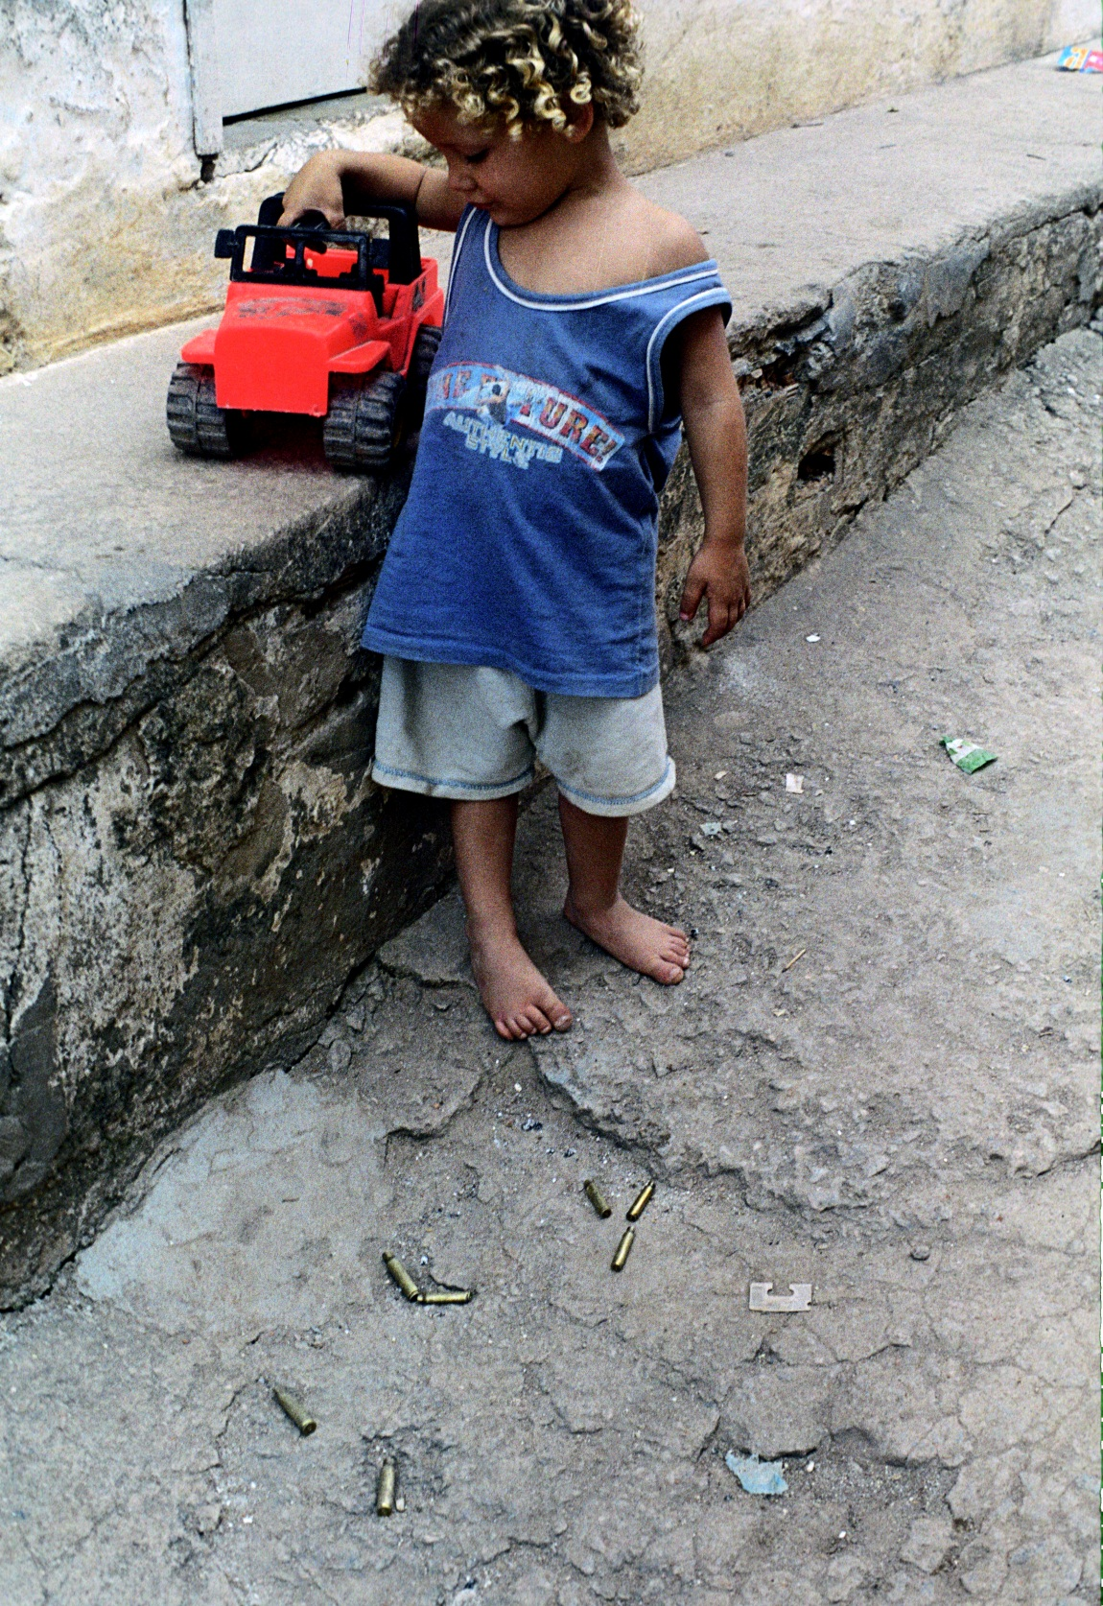
It’s not only a matter of
Motivation
Inspiration
Will to change
But also a matter of
Theoretical capacity
Critical perspective
Method

Slide 4
The Scholarship of Engagement
Engaged researchers start with engaged students
Engagement should be a civic matter
But also part of the Degree – offer opportunities to engage

Slide 5
Creating opportunities for student engagement with marginalised groups
2 case studies at University of Dundee

Slide 6
Case Study 1
Patient Simulated Exercise
College of Medicine, Dentistry and Nursing
University of Dundee

Slide 7
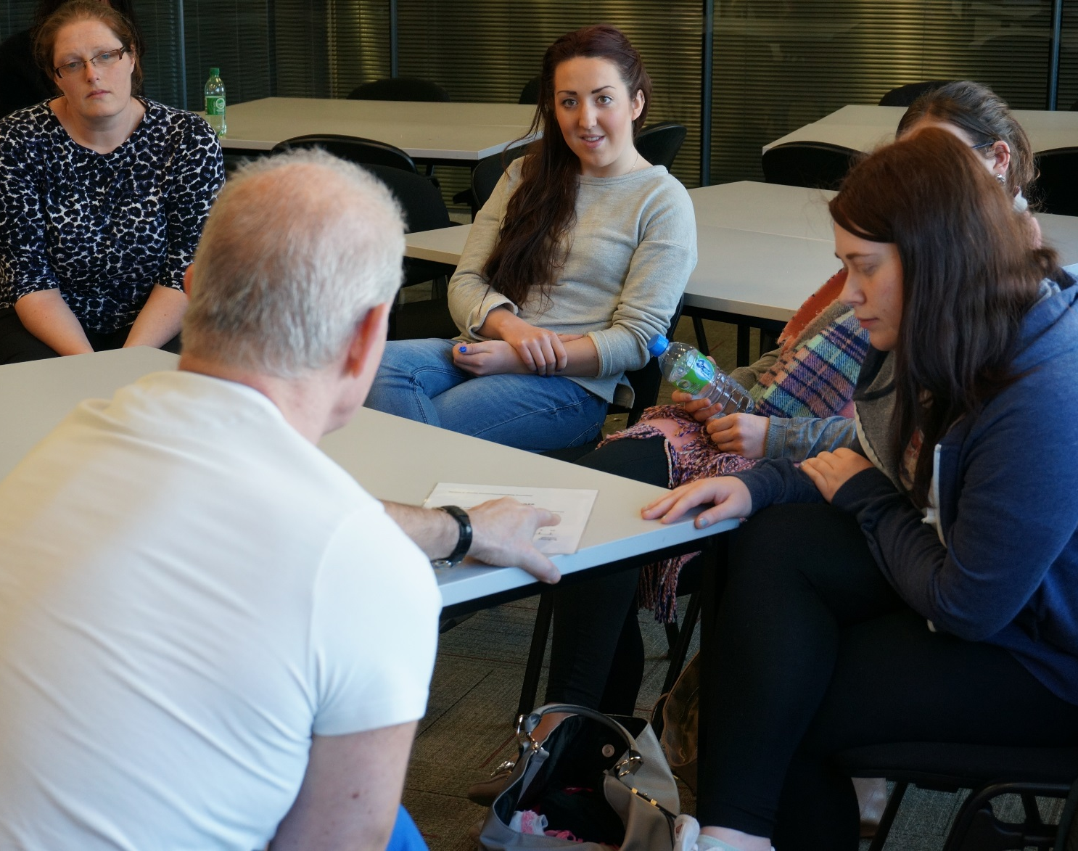
Addressing inter-professional communication and social diversity training
Inter-professional communication and social diversity (including marginalised groups) are key areas for health care training.
The School of Nursing and Midwifery at University of Dundee was pionner in Scotland by developing an innovative communication teaching intervention using prisoners as simulated patients.
This experience is now being shared with Dentistry and Medicine students as part of the Inter-professional Learning Exercise

Slide 8
Patient Simulated Exercise
Carried out by the schools of Nursing, Medicine and Dentistry
Involves prisoners and ethnic minorities as volunteers
Enable students training to address health issues from marginalised groups perspectives
Exercise aims to improve capacity to understand life contexts and to engage and communicate with patients who are from different backgrounds

Slide 9
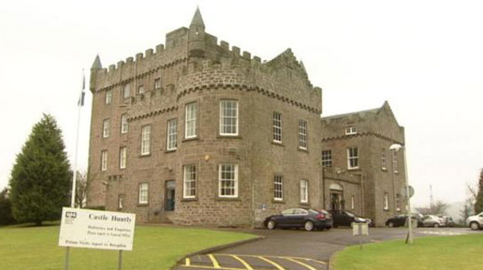

Preparation - recruiting
HMP Castle Huntly - Scottish Prison Service
Dundee International Women’s Centre

Slide 10
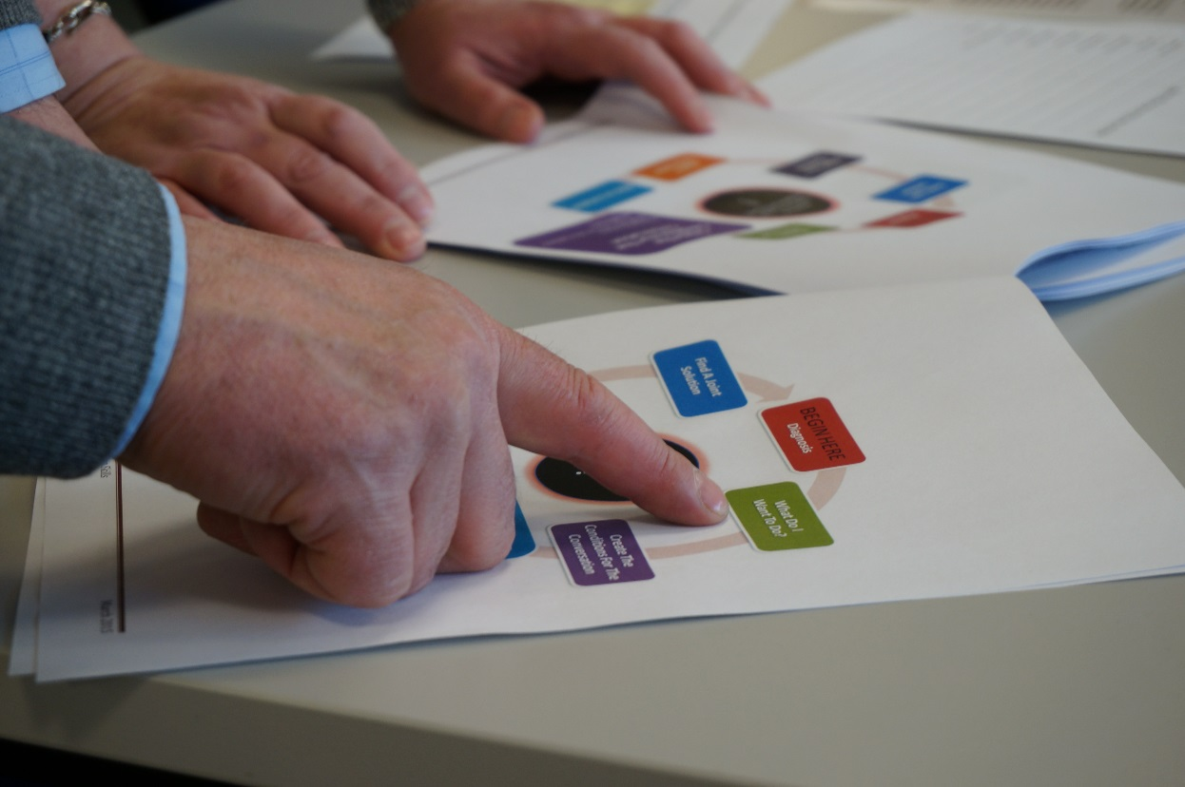
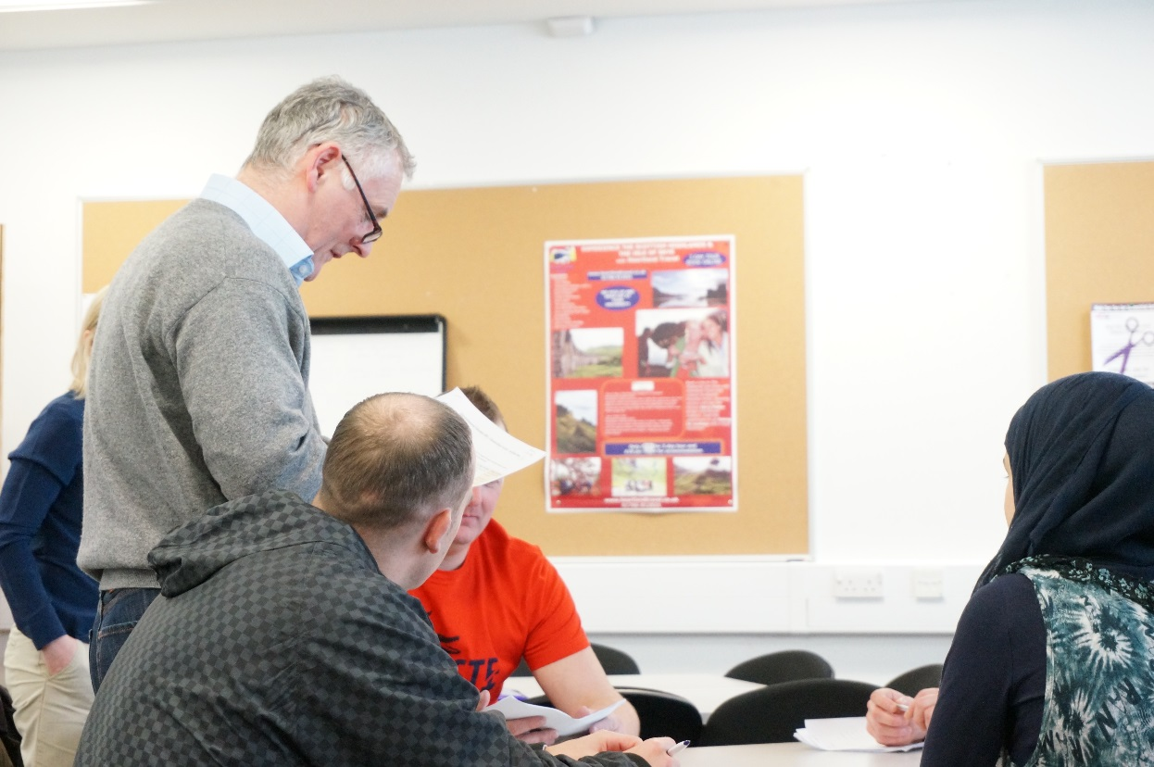
Preparation – the exercise day

Slide 11
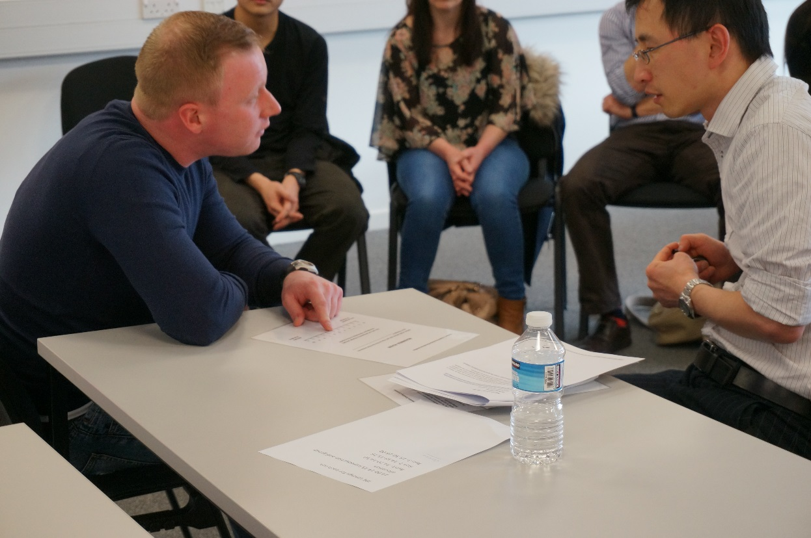
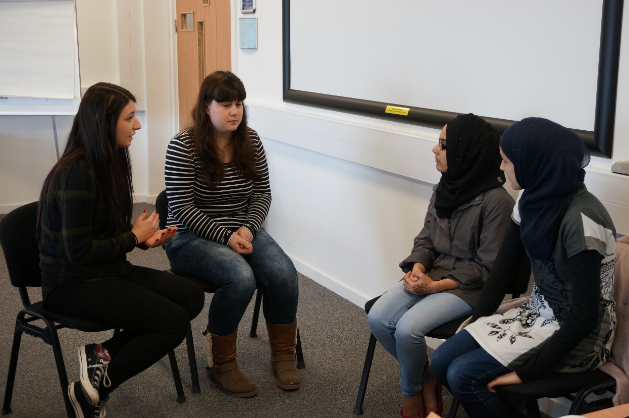
The simulated exercise

Slide 12
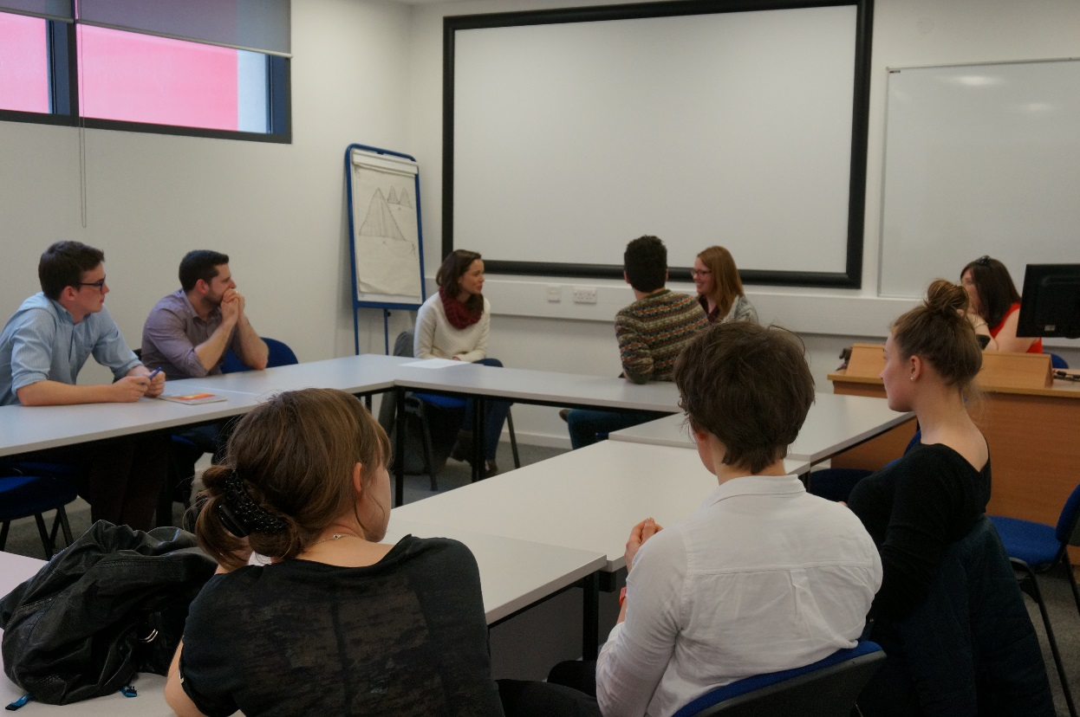
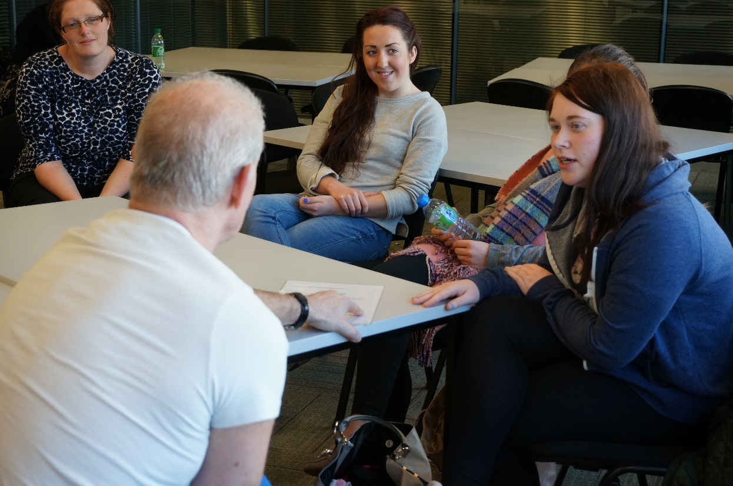
The simulated exercise

Slide 13
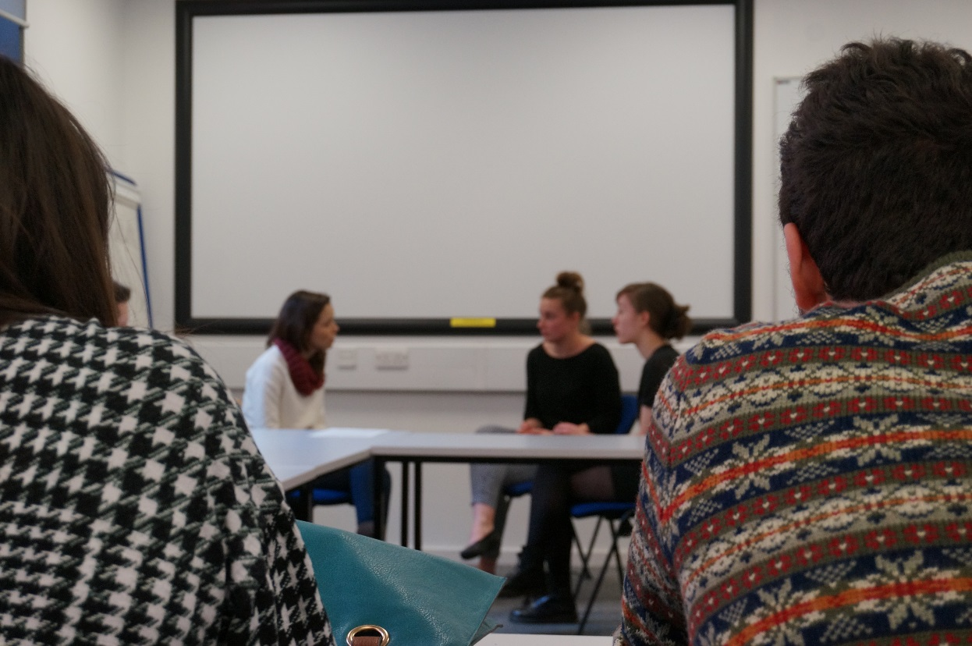
Assessing the exercise
Funded by the Scottish Medical Education Research Consortium
The research aims to investigate and explore the experiences of MDN students working together, and the experiences of inter-professional educators, with a particular focus on their experience with prisoners and minority ethnic groups as simulated patients.

Slide 14
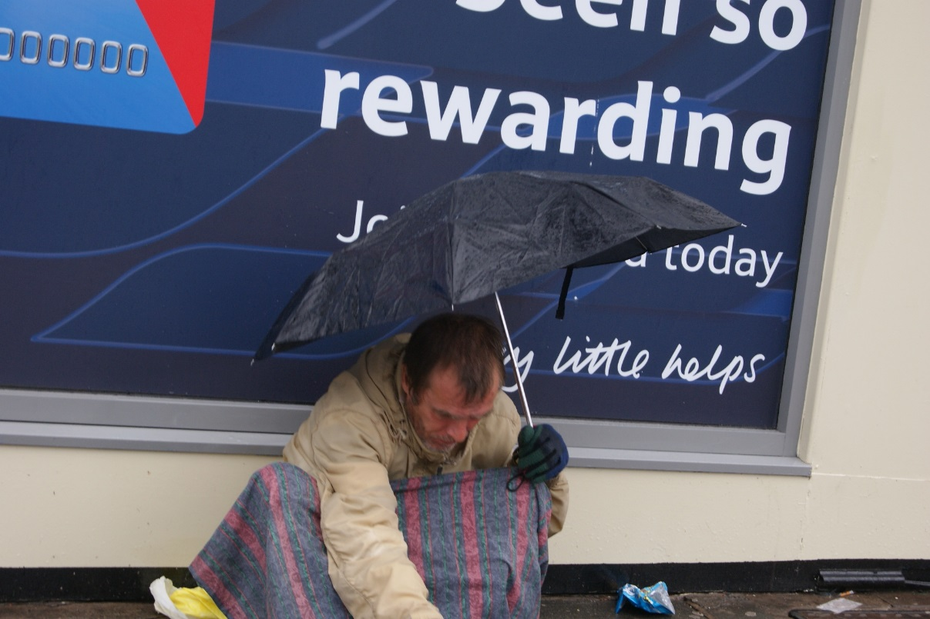
Case Study 2
© Beto Chaves, 2010
The Shared Knowledge Hub
University of Dundee

Slide 15
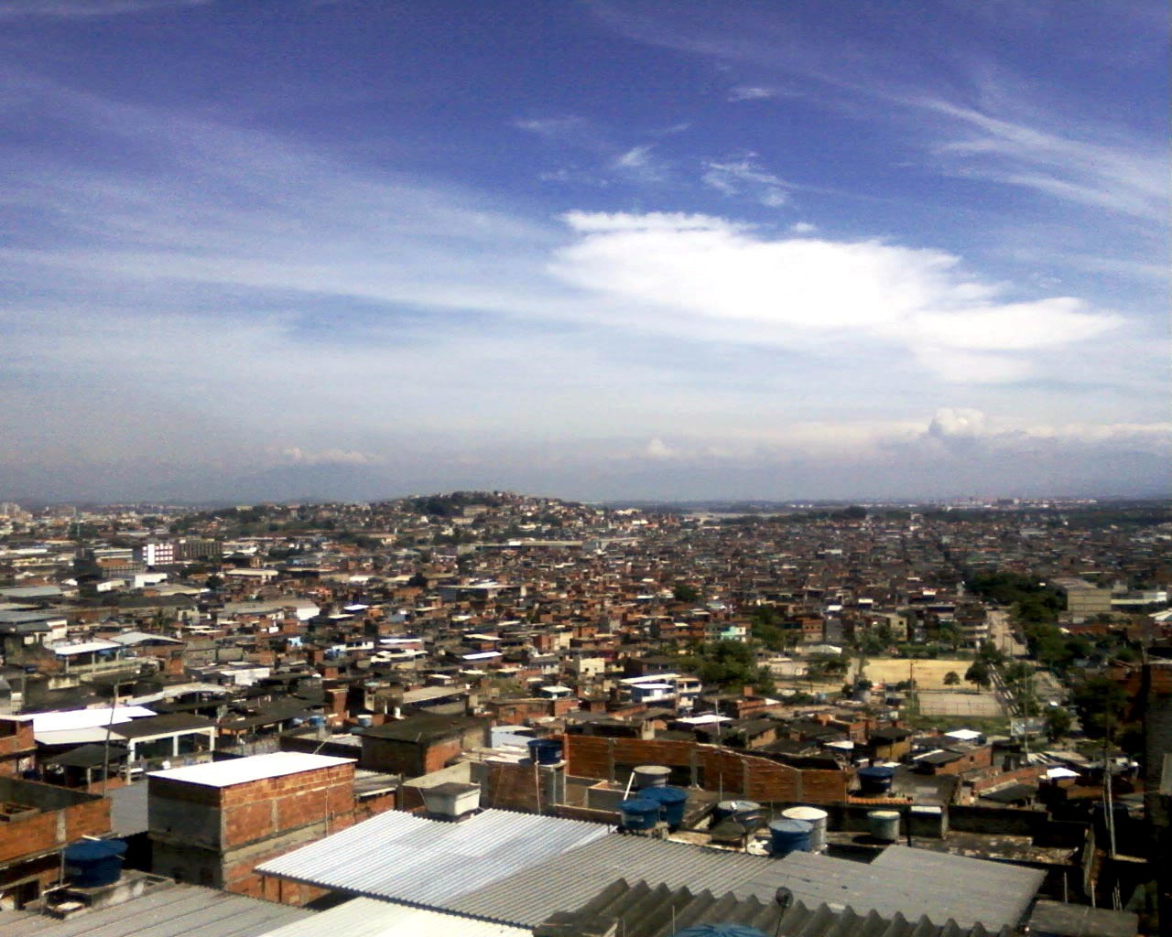
Background
Brazil
University Extension
Social Activism
NGO experience

Slide 16
  We need to create spaces to offer students and staff an opportunity to critically engage with local and global issues
  We need to find ways to democratize science on design, implementation and evaluation of innovative approaches to improve services and reduce inequalities

Slide 17
  On top of this we need a wider framework to coordinate and give a common direction to such initiatives.
  Ideally we should adopt some learnt experiences from ‘university extension’ in search of our own way.

Slide 18
The Shared Knowledge Hub
Aim
Create a knowledge exchange hub that will maximise opportunities for knowledge sharing to produce locally generated, empirically evaluated support services for people who are threatened by or living in homelessness in the city of Dundee.
Objectives
Develop a framework to facilitate joint working between local agencies and organisations working with homelessness, service users, and university students and researchers;
Develop innovative participatory action research projects to inform service development in relation to homelessness;
Inform a future generation of academic researchers and professionals in the broad area of inequalities;
Pilot a knowledge exchange mechanism that can address any spectrum of social issues across communities and to reduce the gap between university, government and community organisations and, citizens;
Expected outcomes
Enhanced students’ communication and problem solving skills as well as confidence and interest to work with destitution and marginalisation in a multidisciplinary environment.
People experiencing destitution and marginalisation more confident to verbalize, reflect, and take action on their issues as part of a critical awareness process
University of Dundee more organically connected with grounded actions to tackle poverty and inequalities in Dundee

Slide 19
The Shared Knowledge Hub

Slide 20
Thanks
Fernando Fernandes
f.l.fernandes@dundee.ac.uk
Thomas McConnachie
t.mcconnachie@dundee.ac.uk

