Slide 1
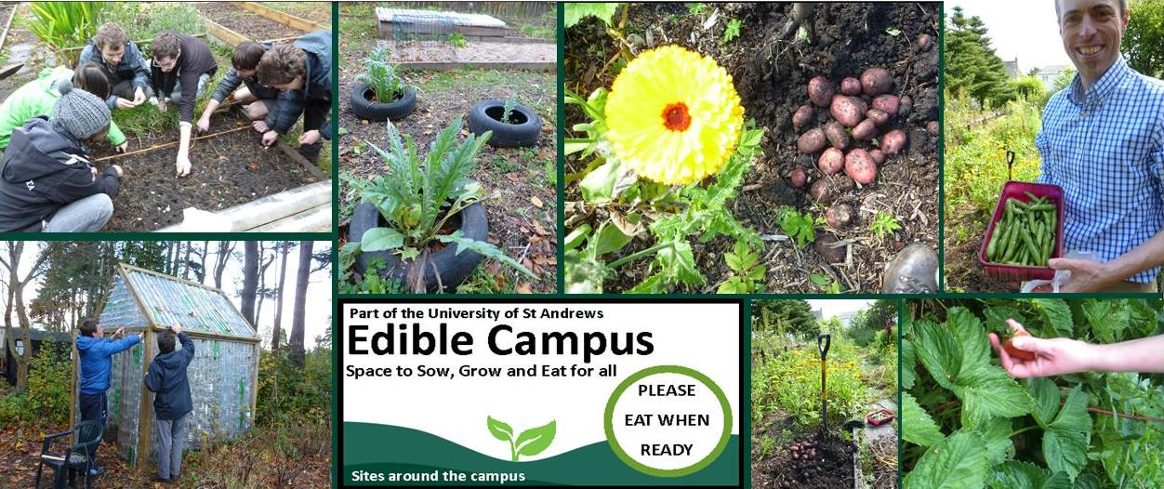
Transition: University of St Andrews – grassroots responses
Rehema White
Sustainable Development

Slide 2
SD – crisis and response?
Transition is part of the response!

Slide 3
Social movements and grassroots responses
Can be seen as collective response
Part of a wider community mobilisation
Particularly in global north a celebration of the (re)affirmation of ‘community’
Is not the only route to community action….

Slide 4
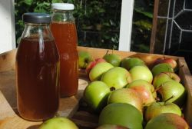
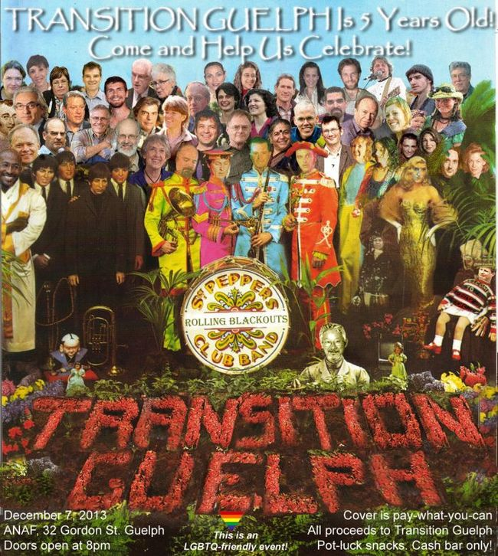
Transition
“Transition Network[‘s] role is to inspire, encourage, connect, support and train communities as they self-organise around the Transition model, creating initiatives that rebuild resilience and reduce CO2 emissions. Ultimately it’s about creating a healthy human culture, one that meets our needs for community, livelihoods and fun. We’re here to support you.”

Slide 5
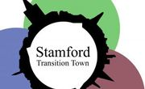
Transition model
Recognises the twin threats of peak oil and fossil fuel depletion
Community led process to help a town/village/neighbourhood become stronger and happier
Over 1000 communities worldwide signed up
Focus on food, transport, energy, heart and soul; also waste, education, housing, arts etc

Slide 6
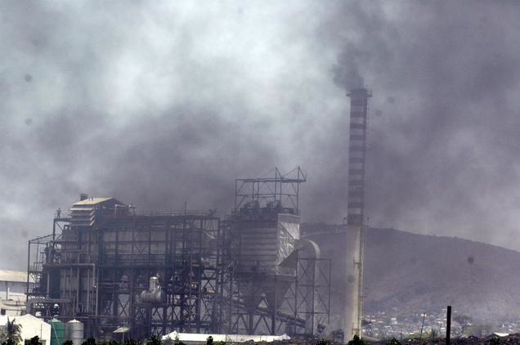
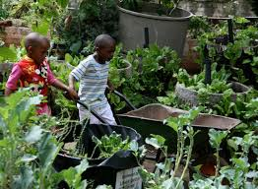
Transition? From To

Slide 7
Transition ingredients
Community engagement
Networking
Celebration and evaluation
Values
Groups
Vision
Re-skilling and practical projects

Slide 8
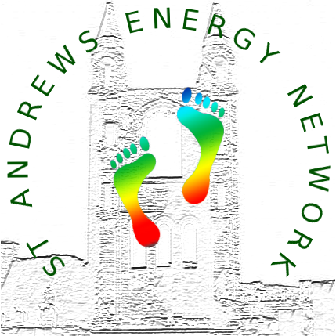
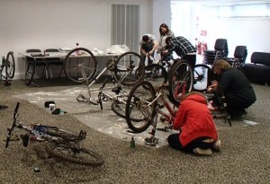
Topics/groups often:
food
energy
community or heart and soul
transport

Slide 9
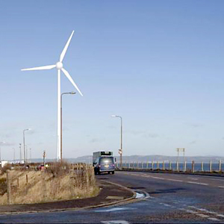
Examples of Transition initiatives
Portobello Transition Town

Slide 10
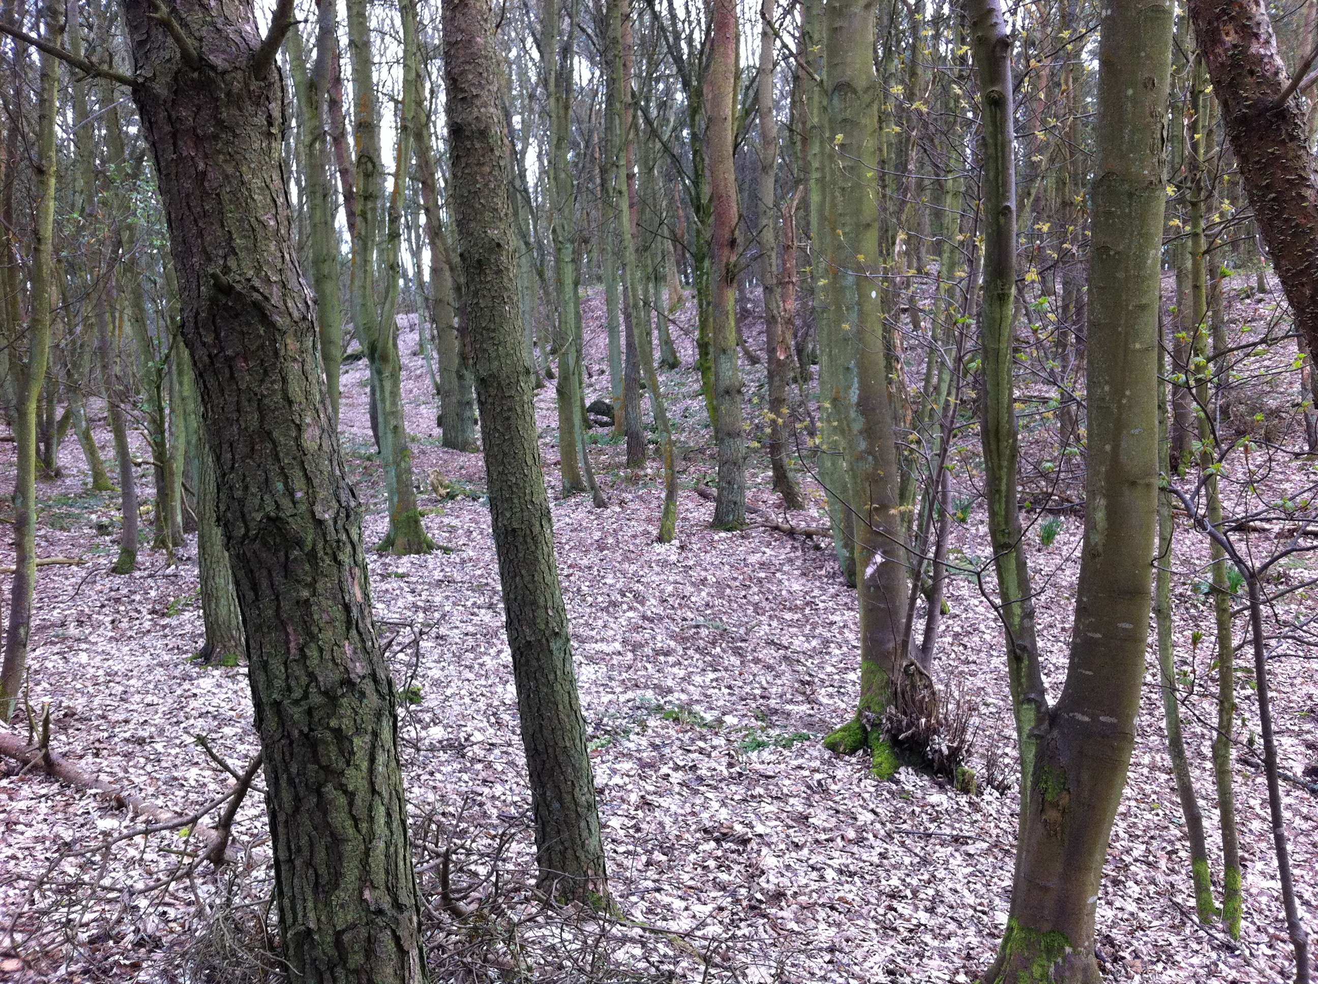
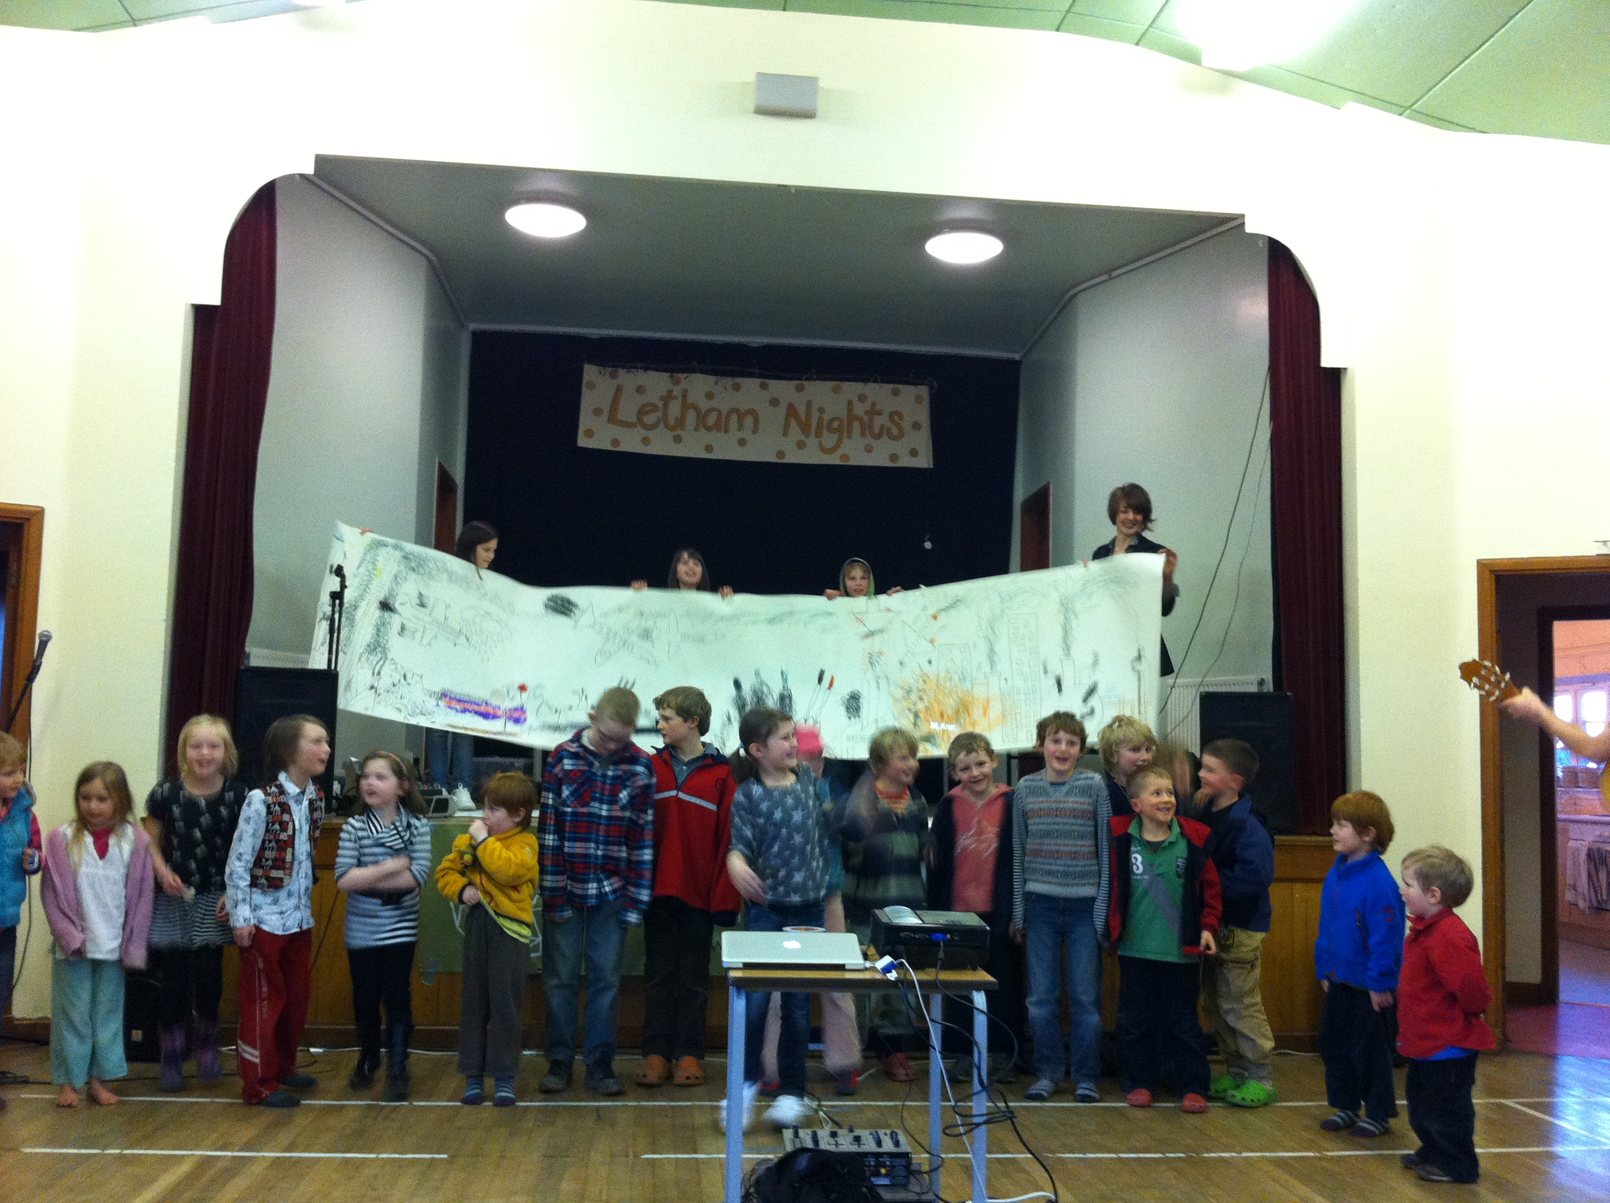
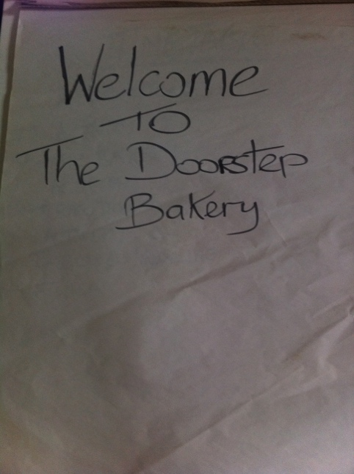
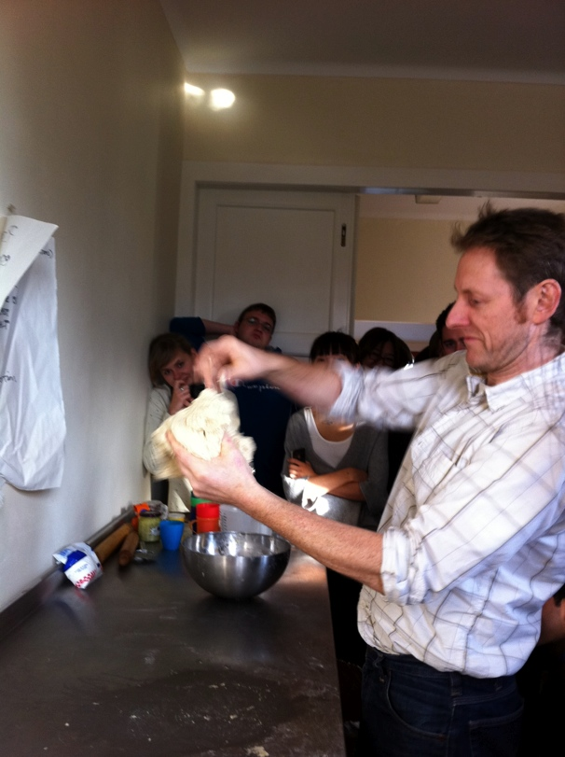
Examples of Transition initiatives
North Howe Transition Toun

Slide 11
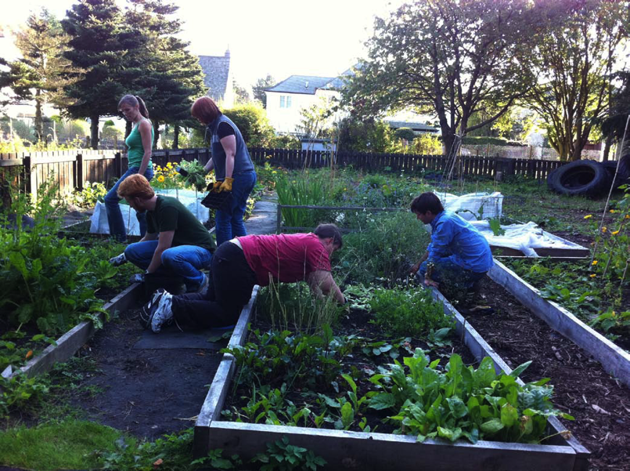
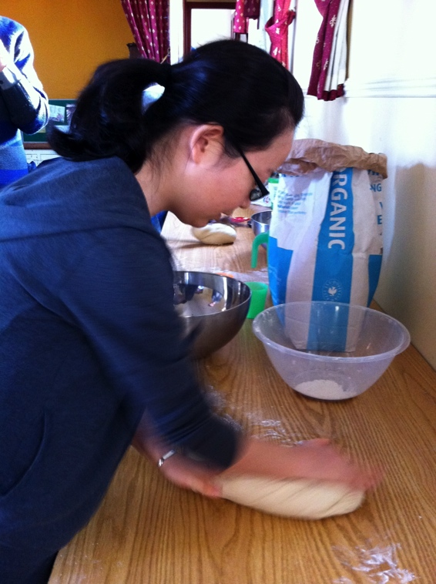
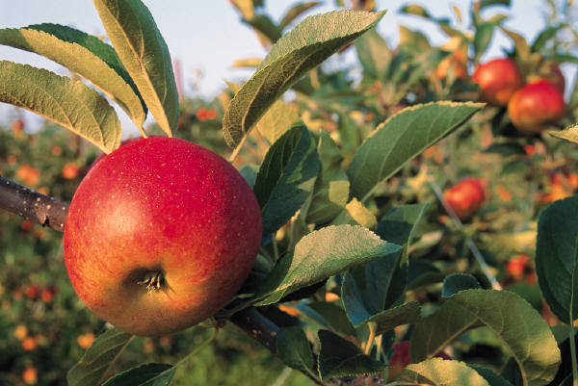
Example: Transition University of St Andrews
Notes:
Growing
Cooking and sharing food – llnks to vegan soc, fine dining
Veg bag scheme
Food policy and food waste

