Slide 1
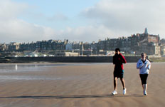
ESD at University of St Andrews
Rehema White

Slide 2
contents
‘academic excellence’
SD Programme
Other aspects of SD at the University
Future plans

Slide 3
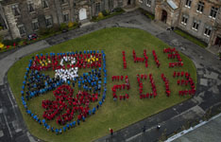
‘Academic excellence’
Small, ancient university
Promotes research
Easier to tackle through notion of ‘critical reflection’ than ‘curriculum’
Wide scope for SD (explicitly not just environmental)

Slide 4
The overall goal of the SD Programme is to enable students to critically interrogate the principles, practice and plurality of sustainable development and so to contribute to the evolution of innovative, interdisciplinary thinking and action in this area.

Slide 5
Principles of degree
Critical interrogation of what “Sustainable Development” is or might be
Interdisciplinarity
‘Transformative’ rather than ‘transmissive’ education
Academia as if the world matters!
Maintaining local focus and global perspective
A unique approach to education for sustainable development

Slide 6
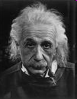
1. Critical interrogation
“We can’t solve problems by using the same kind of thinking we used when we created them”
Albert Einstein

Slide 7
2. Interdisciplinarity:
Schools contributing to teaching
Biological Sciences
Management
Economics and Finance
International Relations
Film Studies, Philosophy and Social Anthropology
Geography and Geosciences (coordinator)
Chemistry
Divinity
Mathematics and Statistics
Medicine
History
External experts
Estates

Slide 8
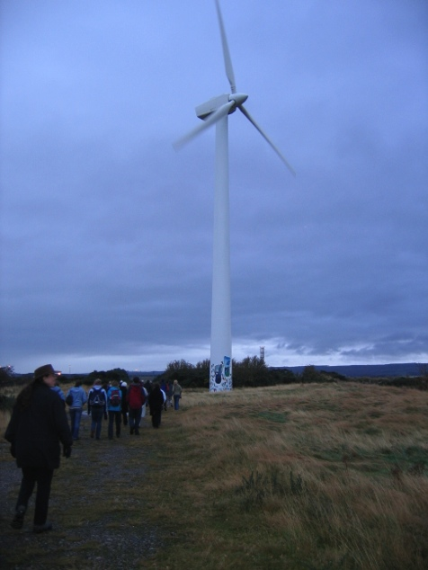
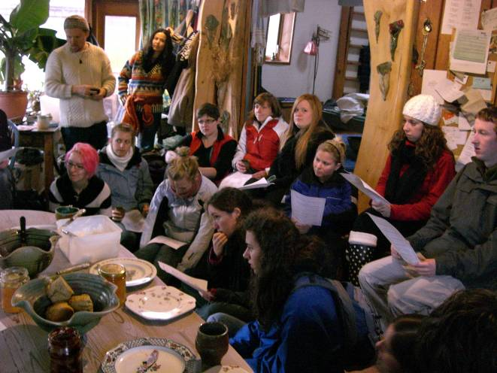
3. Transformative approaches – diversity of skills built
External linkages
Group work
Educational display
Careers support
Essays
Marketing
Fieldtrips
Dissertation
Visiting speakers
Independent research
Debate
Exams
Reports
Presentations
Popular articles
Time management
Reflective assignments

Slide 9
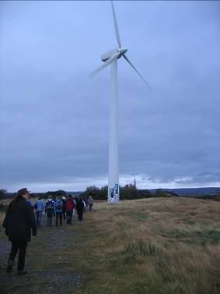
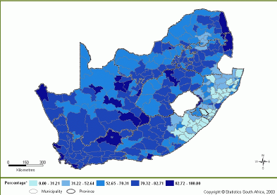
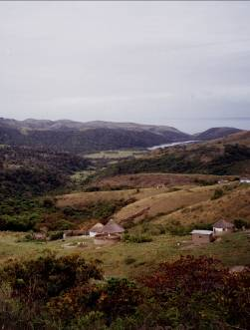
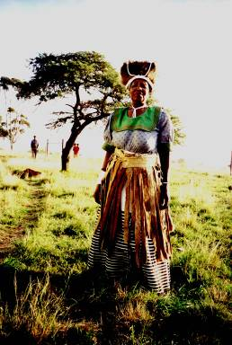
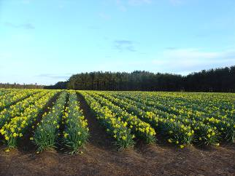
4. Academia as if the world matters: Contemporary issues framework
Priority areas (from DEFRA):
Sustainable production and consumption
Natural resource protection and environmental enhancement
Building sustainable communities
Climate change and energy
Cross cutting themes:
Research and education
Policy, decision making and governance
Changing behaviour
Values, philosophies and ethics
Gender and equity

Slide 10
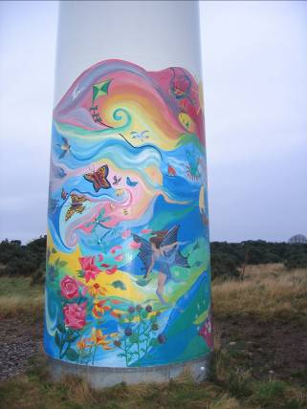
UN’s five priority areas for environment:
Water and sanitation
Energy
Health
Agriculture
Biodiversity
Now UN has strong emphasis on climate change
Sustainable development goals being established to replace MDG

Slide 11
5. Local focus-global perspective
Think global-act locally..
Examples: HIV Aids in Ethiopia European Water Framework Directive UK Sustainable Development Indicators Scotland’s Sustainable Development Commission Fife Council Waste Management
University of St Andrews (integrating teaching, practice, research and community)
Global
Global
National
National
Regional
Local

Slide 12
SD Programme
Established legitimacy for ESD
Established relationships and discourse
Provided a forum for those interested
Enabled us to develop principles and process
BUT
Slowed uptake elsewhere?

Slide 13
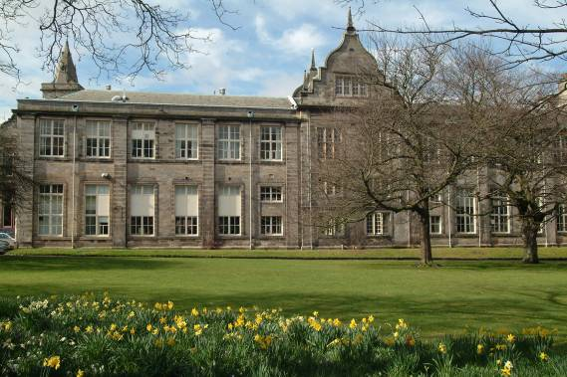
University of St Andrews
Other aspects of sustainability
SD Undergraduate Programme:
Interdisciplinary curriculum
Research: St Andrews Sustainability Institute (SASI)
Estates: Sustainable Development Strategy
Postgraduate teaching: MSc and PhD
Student groups and initiatives
Senior Management: A University Goal; SDWG
Wider community: Local authority, community etc
Transition: University of St Andrews

Slide 14
University ‘community’
SD enthusiasts
SD governance and structures
Community
Sustainability action
The virtuous cycle of sustainability action
within a University
White and Harder (2013)
Notes:
The growth of community has enhanced sustainability action which in turn has further contributed to community. Hence shows how community can be a route to sustainability. requires both grassroots individual enthusiasts (not formal champions) plus support from formal structures and senior management. This is a classics engagement of top down/bottom up.

Slide 15
ESD in Green week
Everyone encouraged to think about how to incorporate a case study, example or theme that relates to SD
BUT
Interpreted as environmental
Tends to be focused on curriculum rather than pedagogy

Slide 16
Future plans
SD Working Group has begun engagement from above
Transition: University of St Andrews is pushing unofficial engagement
Research debate has intensified again
Plans to create an action plan with SMART targets to strengthen ESD amongst other sustainability goals
BUT
Not all academics or managers want ESD!
Fear of loss of academic freedom / imposition of ideology

Slide 17
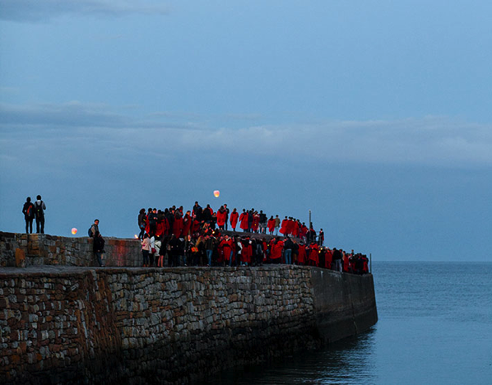
Conclusions
Academic excellence has forced us to use academic rigour in implementing ESD
SD Programme has been a good way for us to begin, but we now need to move to wider ESD
We are strengthened by sustainability activity across the University

