Slide 1
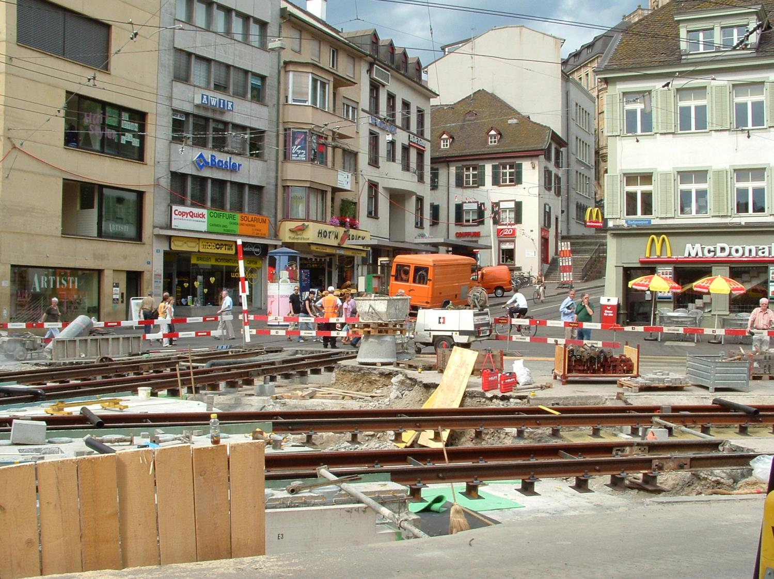
Does Transport Really Benefit the Economy?
Dr Steve Melia
Senior Lecturer, Transport & Planning

Slide 2
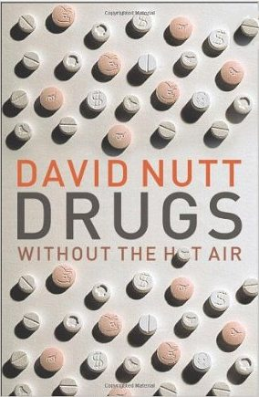
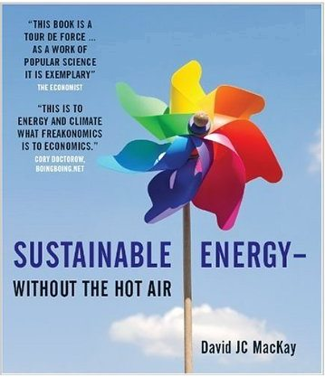
Urban Transport Without the Hot Air
by Steve Melia
www.uit.co.uk
To be published May 2015 by UIT Cambridge
Notes:
Extension of the Public Transportation Network (PTN)
Promoting cycle traffic
Traffic restraint
Channeling indivdual motorized vehicle traffic
Parking space management

Slide 3
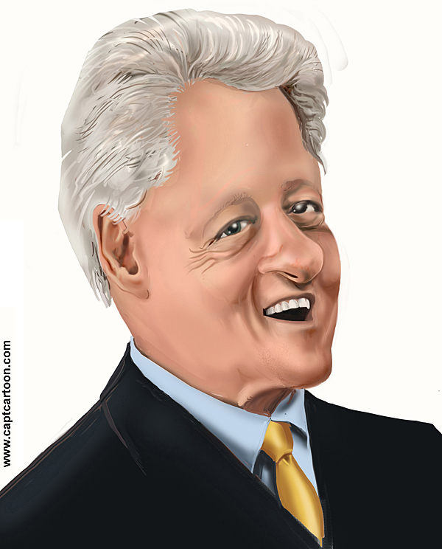
NOT
^

Slide 4
The Claims:
Transport causes an increase in economic activity
The monetised costs and benefits of transport investment mean that it represents ‘good value for money’

Slide 5
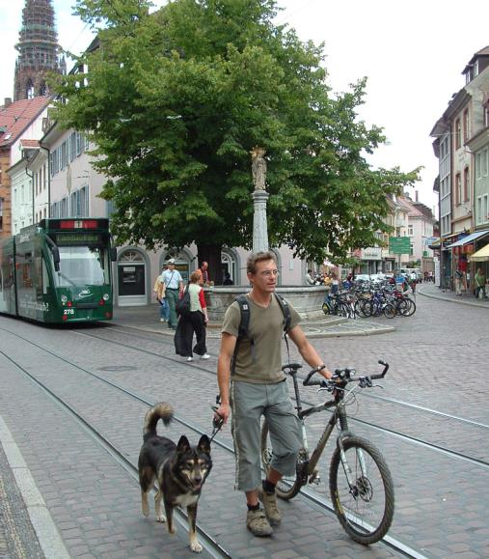
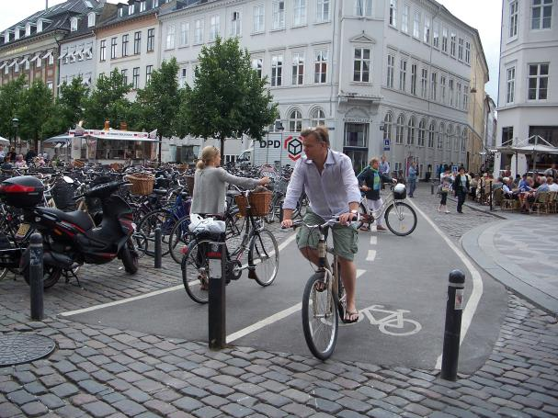
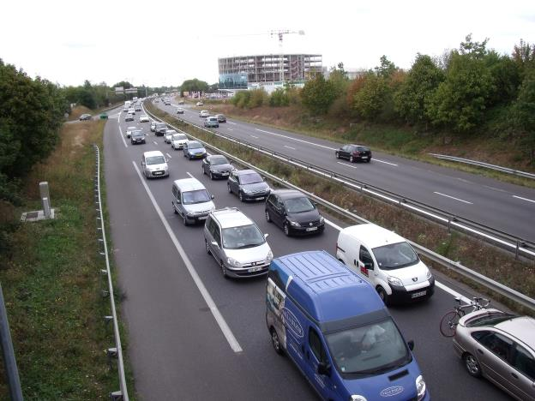
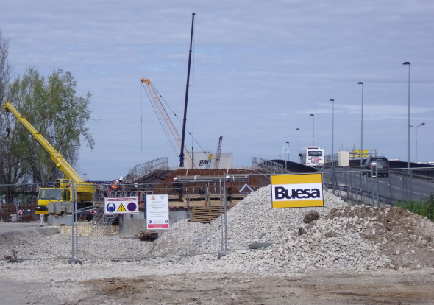
Invest for sustainability or business as usual?

Slide 6
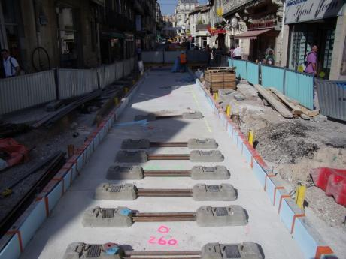
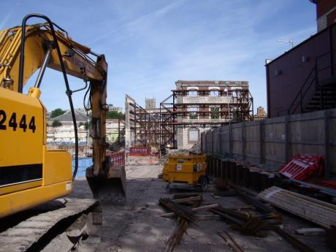
Transport causes an increase in economic activity
Transport infrastructure
Development
What causes what?

Slide 7
What does the evidence show?
Weak positive relationship between transport spending and GDP (stronger when comparisons made with developing countries)
No robust evidence on what causes what
Transport investment can move economic activity (inwards and outwards)
Local effects are greater than overall national effect (if any)
Positive relationship between road congestion and GDP

Slide 8
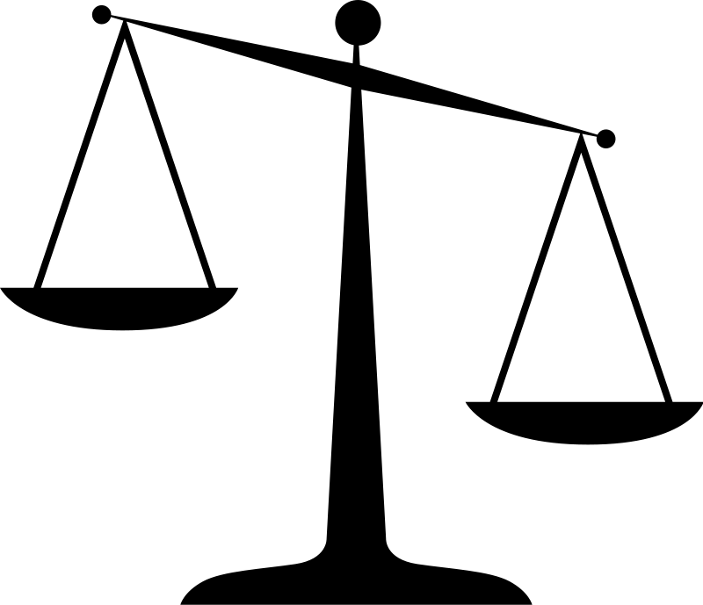
Cost Benefit Analysis
Direct
Monetised
Direct
Monetised
COSTS
BENEFITS

Slide 9
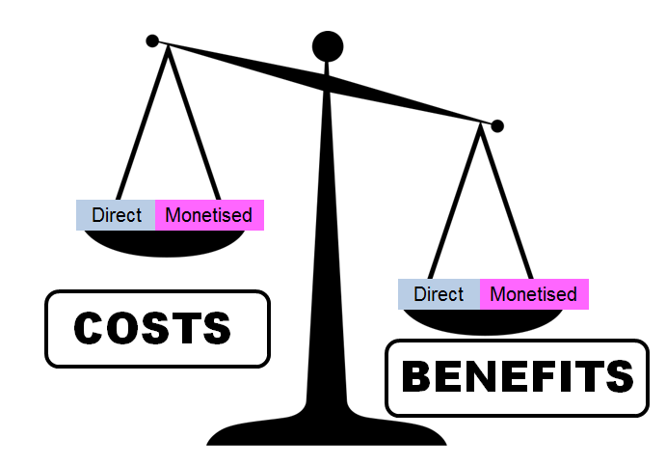
Assumptions behind CBA
The benefit to society equals the sum of the benefit to all individuals (and companies)
The value of the environment (or anything else) is equal to what people alive today are willing to pay for the benefits they get from it

Slide 10
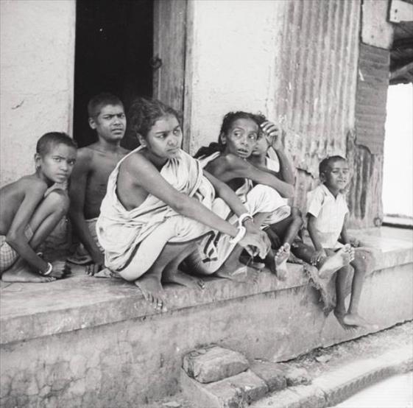
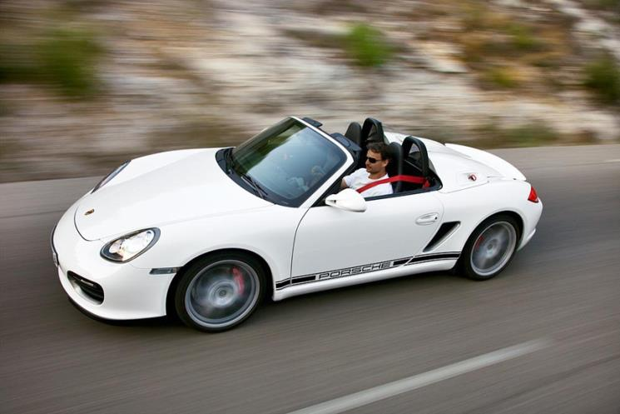
Is ‘Society’ Better Off or Worse Off?
Change
£300 Better off
£200 Worse off
Household A
Household B
Notes:
Refer back to previous lecture on welfare economics

Slide 11
A monetised opinion:
Tested through ‘willingness to pay’ experiments
Discounted to produce a ‘Present Value’
Aggregated across the economy
=
?
A monetised opinion

Slide 12
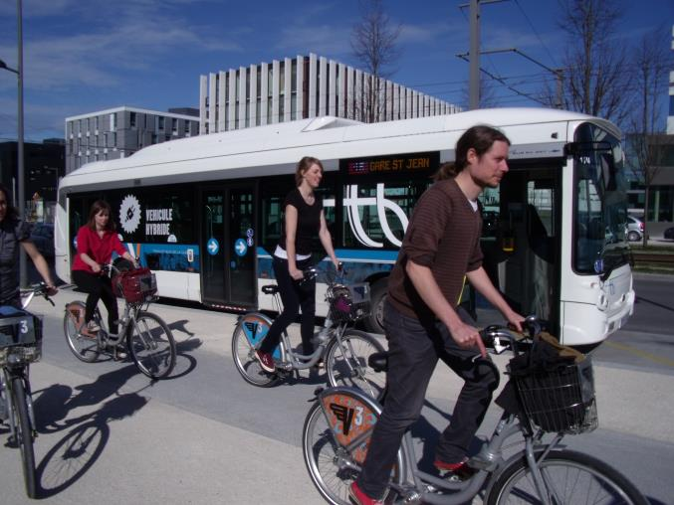
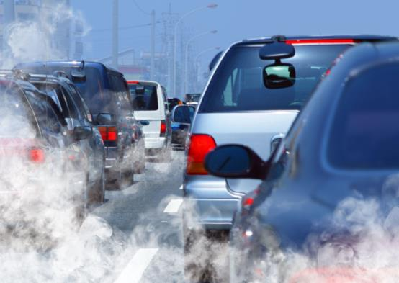
Benefits of Sustainable Transport and Traffic Restraint?
Local Air quality
Health
Climate change
Notes:
Refer back to previous lecture on welfare economics

Slide 13
Conclusions?
If it works in transport terms, the economy will look after itself
Sustainable transport is worth promoting for more valid and more important reasons
Play the politicians’ spurious system if you have to, but:
Let’s avoid ‘believing our own propaganda’

