Slide 1
BREEAM UK New Construction 2014 Key updates from 2011 version
Key contact:
Sarah McCarrick, Senior Consultant BRE Global
- From her presentation to EAUC Annual Conference held at Nottingham Trent University, May 2014 [updated]

Slide 2
BREEAM UK New Construction (NC) - scheme update
UK BREEAM 2011 version updated to 2014 version:
Changes to Regulations: Part L 2013 / Section 6 2013
Accounting for new / updated standards e.g. new Standards for Sustainable Drainage systems (SuDs)
CEN / TC350 European Standards: further alignment with relevant metrics / indicators
Maintain recognition and reward for ‘Best Practice’ in sustainable construction
Feedback from network of assessors, clients and other stakeholders, What’s working / not working in BREEAM
Notes:
Part L 2013 came into effect in April this year.
TC 350 Sustainability of Construction Works – suite of European standards produced for the assessing sustainability of construction products and built environment

Slide 3
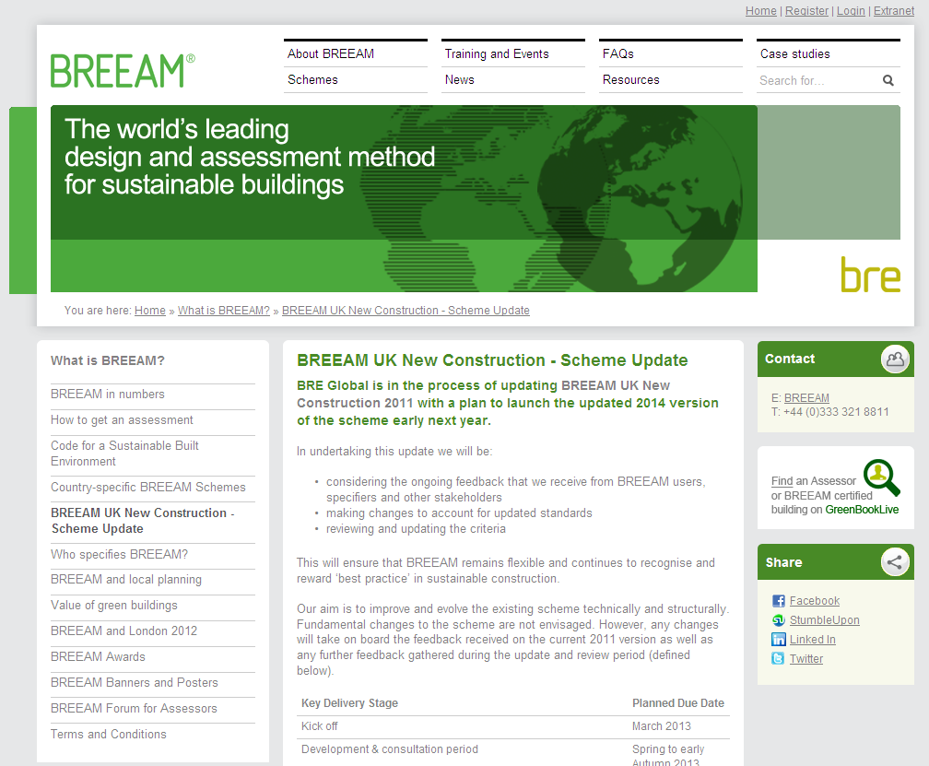
BREEAM NC update – key steps
1. External Consultation Ph 1
Consultation: Mar-Oct 2013
Two surveys on 2011 scheme
Stakeholder workshops e.g. UK Green Building Co, BSRIA, CPA, CIBSE
2. Feb 2014: Draft published
3. External Consultation Ph 2
Consultation: Feb – Mar 2014
www.breeam.org/2014

Slide 4
Technical Update Mainly small changes – some revised weightings

Slide 5
Key technical changes for NC 2014
Management
Now aligned with procurement process. New issue headings are:
Project Brief & Design
LCC & Service Life Planning
Responsible Construction practices
Construction & Handover
Aftercare
Project Brief & Design
Sustainability Champion replaces Accredited Professional

Slide 6
LCC & Service Life Planning
New credit for reporting on project costs
Visual Comfort
Alternative option for daylight calculation: average illuminance & min. illuminance
Thermal Comfort
New credit relating to adaptation to climate change
Safety and Security
Security Needs Assessment replaces Secured by Design related criteria
Health & Wellbeing
Notes:
Security Needs Assessment(SNA)
The project and site specific assessment of security needs, including: 1.
A visual audit of the site and surroundings, identifying environmental cues and features pertinent to the security of the proposed development,
2.
Formal consultation with relevant stakeholders, including the local ALO, CPDA & CTSA (as applicable), in order to obtain a summary of crime and disorder issues in the immediate vicinity of the proposed development
3.
Identify risks specific to the proposed, likely or potential use of the building(s),
4.
Identify risks specific to the proposed, likely or potential user groups of the building(s),
5.
Identify any detrimental effects the development may have on the existing community. The purpose of the assessment is to inform stakeholder decision making and allow the identification and evaluation of security recommendations and solutions.

Slide 7
Reduction of Energy use and CO₂ Emissions
Energy Performance Rating credits now calculated on building regulations of country where building is located
[Under BREEAM 2011 the Part L 2010 Notional Building was used as baseline for ALL buildings assessed under BREEAM NC, regardless of their UK country location]
Number of available credits reduced from 15 to 12
[Reflects tightening of building regs with respect to operational energy consumption from regulated fittings / systems and therefore shifting of importance (and weighting) of impacts in BREEAM]
Notes:
BREEAM Excellent – we now refer to Part L 2013. Whilst the target figure is slightly lower for Excellent than for 2011 because of the new building regs the reality will be that it will be slightly harder to achieve Excellent minimum. How much harder depends on building type but probably at worst 9% harder. Producing a guidance note to supplement manual – publicly available – to explain methodology and what the requirements mean. Encourage reference to it once published.

Slide 8
Reduction of Energy Use and CO₂ Emissions
Minimum standards adapted. CO₂ requirement removed
Low Carbon Design (replaces ENE 04 LZC issue)
LZC percentage carbon reduction targets removed
LZC feasibility study & free cooling credits retained
New credit for passive design
Energy Efficient Laboratory Systems
Revised criteria now relating to efficient design
No longer applicable to schools
Notes:
5 credits for Excellent, slightly lower min standard energy performance ratio
Labs – greater emphasis on consultation of what is needed to ensure right sizing of services systems, avoid over specification of systems

Slide 9
Proximity to Amenities
Now grouped into ‘core’ amenities and ‘additional’ amenities
Clarifications e.g. ‘access to cash’ not ‘cash machine’
Cyclist facilities
Revised assessment criteria layout
Large buildings / rural requirements reviewed (reductions for some scenarios)

Slide 10
No major changes for:
Water Leak Detection
Issue restructured. Content broadly the same
Water Efficient Equipment
Rationalised to focus on ‘unregulated water’ rather than specific aspects of e.g. irrigation & vehicle wash
Notes:
Unregulated – not used for domestic purposes e.g. irrigation, vehicle wash

Slide 11
Responsible Sourcing of Materials
Revised scoring and tier levels
Designing for Durability & Resilience
Change from Designing for Robustness
New requirement relating to material degradation e.g. corrosion, rotting, discolouration
New Issue: Material Efficiency
Aim: to recognise and encourage measures to optimise material efficiency to minimise environmental impact of material use and waste
Notes:
Material efficiency - using fewer materials, reusing existing demolition/strip-out materials and, where appropriate, procuring materials with higher levels of recycled content It may also include the adoption of alternative means of design/construction that result in lower materials usage and lower wastage levels including off-site manufacture and use of pre-assembled service pods.

Slide 12
No major changes
Construction Waste Management
Reviewed resource efficiency benchmarks but no change
Terminology amended: “Resource Management Plans” replace “Site Waste Management Plans”
Recycled Aggregates
Benchmarks updated
Notes:
Agg benchmarks – some harder, some easier, some same. No 30km requirement for sourcing secondary agg. No exemp req.

Slide 13
Functional Adaptability – New Issue
Aim: To recognise and encourage measures taken to accommodate future changes of use over its lifespan
Including:
internal environment to accommodate changes in working practices
the internal physical space and external shell to accommodate change in use
Design for ease of replacement of all major plant within the life of the building
Ability for major refurbishment, inc replacing façade

Slide 14
Land Use and Ecology Category
Review informed by Steering Group of ecology experts
Clarifications and movement of criteria
First stage of wider review beyond the scope of 2014

Slide 15
No major changes
Impact of Refrigerants
New standards incorporated (BS EN 378: 2008)
Clarifications to automated shutdown criteria
NO_{x} Emissions
Reviewed but no change in NO_{x} levels

Slide 16
BREEAM NC 2014: New Weightings
Environmental Section | 2011 Weighting | 2014 Weighting
Management | 12% | 12%
Health and Wellbeing | 15% | 15%
Energy | 19% | 15%
Transport | 8% | 9%
Water | 6% | 7%
Materials | 12.5% | 13.5%
Waste | 7.5% | 8.5%
Land Use and Ecology | 10% | 10%
Pollution | 10% | 10%
Recognition of regulatory improvements on energy performance
Recalculation of Energy section / adjustment of Environmental section weightings accordingly

Slide 17
BREEAM NC 2014 went live 27 May
Operational update underway
e.g. website, assessment tools, training courses etc.

Slide 18
For further information contact: Sarah McCarrick, Senior Consultant BRE Global Phone 01904 567784 mccarricks@bre.co.uk

