Slide 1
'Activist Learning': Supporting student learning through sustainability action
Dr Zoe Robinson (and Dr Sherilyn MacGregor), Sophie Bessant, Keele University
Nicholas Goodman, Change Agents
Roy Morgan-Wood, Leicester College
EAUC 28th March 2012

Slide 2
What’s this session all about?
Encouraging and supporting student-led sustainability projects & making space for sustainability in the curriculum
Case studies from HE and FE
Keele University
Leicester College & Change Agents UK
Sharing experiences/projects/learning at other institutions
You...
Notes:
Outcomes of session

Slide 3
Some questions to explore
What is ‘best practice’ in supporting student-led projects?
What are the implications to HE/FE of this student-led, action-orientated pedagogical approach to sustainability?
How can we best embed sustainability into teaching?
What is our own vision of sustainability? How shared is this across the institution?
Sustainability skills, graduate attributes, skills of a Change Agent, transition skills, skills for 21st Century, sustainability literate – same meat, different gravy?

Slide 4
Possible session outcomes
Shared experiences of supporting student projects and embedding sustainability in the curriculum
Advice on supporting student projects and embedding sustainability in the curriculum
Bring together combined experiences – collaborative report/paper/toolkit?

Slide 5
What do we mean by ‘Activist Learning’?
How do we as educators enable students to gain the kinds of skills needed to bring about transformative social change towards sustainability in their own universities and wider communities?
Educational approach which advocates action for sustainability linking courses and action
Students use their academic learning to inform action in the world with the aim of bringing about positive social, political and cultural change
Notes:
There is increasing pressure on universities to improve their sustainability performance. This has recently shifted emphasis from Estates-based ‘environmental management’ to a more holistic approach emphasising bringing Education for Sustainability (EfS; also referred to as Education for Sustainable Development - ESD) into the curriculum and making a culture of sustainability part of the student experience.
Concurrently, there is an increasing sector-wide emphasis on graduate employability, and the development of visionary statements about the ‘attributes’ that will be achieved by graduates during their time at university, through curriculum and co-curriculum opportunities. There is also clearly demand for graduates to be equipped with sustainability skills, from employers (see BITC, 2010) and from the students themselves (Bone and Agombar, 2011).
Encouraging activism likely to be controversial
Beyond preparing them for employment, how can we produce graduates who are genuinely ‘Change Agents’ and ready to ‘be the change they want to see in the world’?
‘activist learning’ can be defined as an intentional strategy for generating knowledge, understanding and skills through engagement and leadership in community activism. Through ‘activist learning’ students learn through educational experiences which make tangible links between their course content, their own values, and ‘real world’ issues, while they try to enact positive change. The expectation (or hope) is that they will

Slide 6
We know all the drivers….:
Pressure to improve sustainability in HE and FE
Links to other agendas - graduate employability
Student and employer demand for ‘sustainability skills’
Notes:
There is increasing pressure on universities to improve their sustainability performance. This has recently shifted emphasis from Estates-based ‘environmental management’ to a more holistic approach emphasising bringing Education for Sustainability (EfS; also referred to as Education for Sustainable Development - ESD) into the curriculum and making a culture of sustainability part of the student experience.
Concurrently, there is an increasing sector-wide emphasis on graduate employability, and the development of visionary statements about the ‘attributes’ that will be achieved by graduates during their time at university, through curriculum and co-curriculum opportunities. There is also clearly demand for graduates to be equipped with sustainability skills, from employers (see BITC, 2010) and from the students themselves (Bone and Agombar, 2011).
Encouraging activism likely to be controversial
Beyond preparing them for employment, how can we produce graduates who are genuinely ‘Change Agents’ and ready to ‘be the change they want to see in the world’?
6

Slide 7
The case studies

Slide 8
Keele University: The Sustainable Student House Initiative
4 students from the BSc Environment and Sustainability programme
Lobbied to turn a University student house into an ‘exemplar of sustainable student living’
Desire to:
‘live what they are learning’
Inspire other students
The curriculum is important in bringing together like-minded students to catalyse change, and providing route of staff support
Notes:
Sustainability students – motivated to make change and infleucne others
Inspired by a residential field course at the Centre for Alternative Technology (CAT) and frustrated by the limitations of campus accommodation, they announced that they wanted the opportunity to ‘live what they are learning’ and become exemplars of sustainable student living.
Opportunity to explore more sustainable living

Slide 9
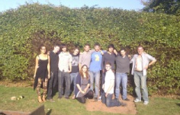
The project
Standard 1960s bungalow
‘Sustainability’ measures inside and out
Vegetable garden
Energy saving appliances etc
Making house a ‘learning tool’ to provide training for students about to live off campus
Wide dissemination – Twitter, blog, student mag…
Significant staff involvement to help steer and manage the longevity of the project

Slide 10
Some of the challenges
Logistical challenges – the length and timing of the ‘student year’
Student enthusiasm > practical knowhow
Multiple demands on student time
Managing expectations about rate of progress
Balancing staff-student relationship beyond the conventional academic relationship
The public vs private – students’ lives not just a university project
Impact on the project of Estates and Accommodation processes and procedures
The effect of normal student activity on the project’s reputation?
Notes:
Managing other staffs expectations
The amount of knowledge required to take on a multi-faceted and high-profile project was underestimated by the students and there was naivety as to how change can be enacted, for example the need to engage in constant negotiation with the University in order to carry out activities in the bungalow’s grounds.
the SSH project deviated from the more conventional staff-student relationship in a strictly academic setting. Maintaining a boundary between the project as educational and related to the course on the one hand and as the students’ everyday lives on the other – between the public and the private, in other words -has been a challenge throughout
Although this relationship needs careful and sensitive management, and balancing between independence and external steer
Respecting the students’ lives – can’t pressurise to do things
Estates/accom normal stuff – groups of students around, a mess, not happy being used in this way
University barriers – ie a house can’t have bikes in etc
Naievety
Proivate and professional – they do student things – does this reflect badly

Slide 11
What we’ve learnt….
Have realistic expectations
Be sensitive to their lives as students
The need to support students to become ‘change agents’ - getting what you want….
The need for a contract - to lay out expectations
Need for staff involvement to manage University relationships

Slide 12
What they’ve learnt…
Enacting change is not as simple as the desire to see it happen
The range of different stakeholders involved in any change process and the range of different perspectives
The need to negotiate with different stakeholders
The amount of research and decision making to underpin action….
For example….

Slide 13
A simple job?....
Growing your own vegetables might seem a simple enough task…
Factors controlling design of vegetable garden and
Design of raised beds
Sourcing of materials
Transport of materials
Planting times….

Slide 14
Other skills….
Lobbying, negotiation, persuasion – working with people constructively
Public speaking – big, high profile events and media
Grant writing and funding
Awareness of barriers to implementing change, and how to overcome them
More skills than could even be achieved through core academic activities

Slide 15
Longer-term impact?
Too early to establish real impacts but…
become a hub for like-minded students with the potential to catalyse larger-scale future change
catalysed genuine student-led engagement with the sustainability agenda
Estates and accommodation working together with staff and students – in place for further future holistic, integrated sustainability changes
The future – new students (and from different degree programmes) and possibly new properties
‘Activist learning’ is student-led, but requires substantial academic support and steering.

Slide 16
Case study: Leicester College & Change Agents

Slide 17
Embedding Sustainability into Teacher Education
Roy Morgan Wood – Leicester College
Nick Goodman – Change Agents UK
Funded by…

Slide 18
The recipe…..
20 trainee teachers
12 weeks (one session a week)
Enthusiasm and passion
Over 12 different disciplines
10 themes of sustainability
Linked to assessment
A dash of Hard Rain
Funded by…

Slide 19
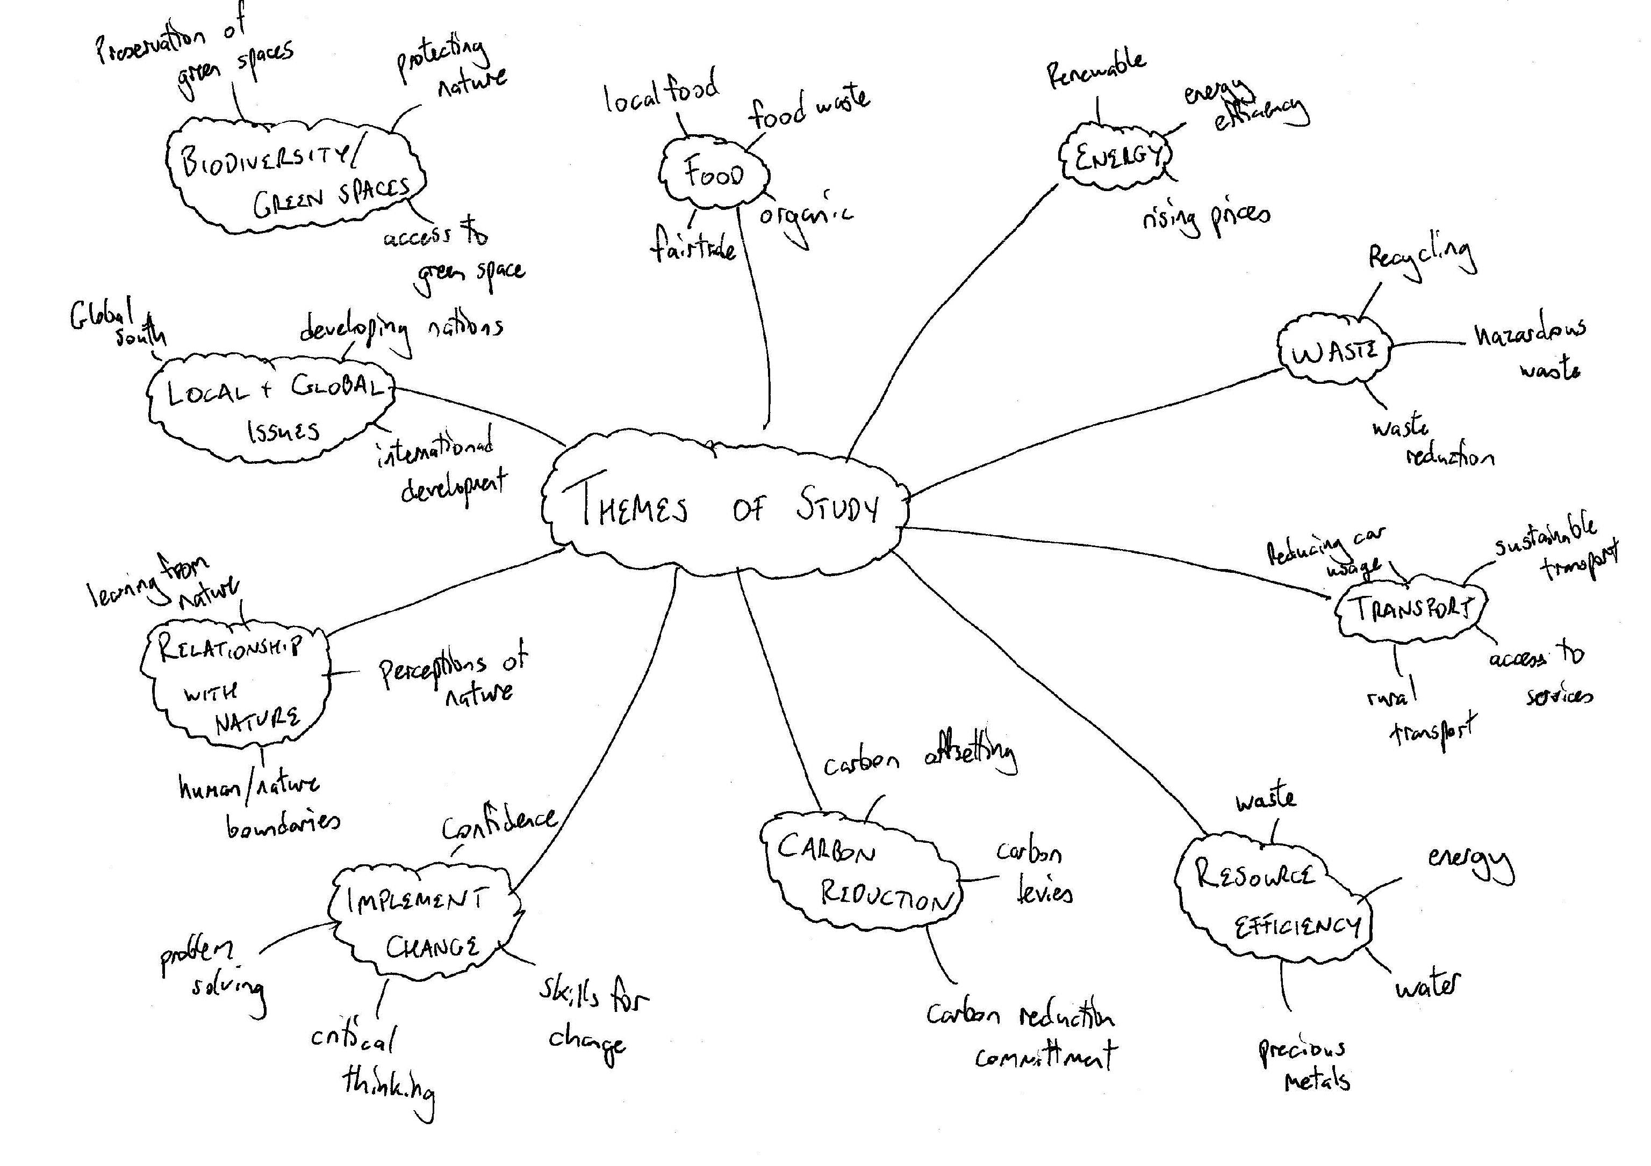
Funded by…

Slide 20
To create…..
20 individual lesson plans
Tried and tested lessons
Teachers more confident to teach sustainability
Some key learning points
Some fantastic examples…
“These sessions have completely changed how I view the world” – a participant

Slide 21
What have we learnt?
Working in FE is a challenge!!!
Narrow perception of sustainability
Good knowledge, lack of confidence
Teaching vs. Discussion
Potential for embedding sustainability - scope
Funded by…

Slide 22
What’s next?
Here today….
All 20 lesson plans online
Share learning with others – Regional Sustainability Ambassadors
Teachers have greater confidence
Level 1 and 2 in sustainability
Already asked back!
Your ideas and thoughts

Slide 23
Your stories…..

Slide 24
Discussion of key questions
What is ‘best practice’ in supporting student-led projects?
What are the implications to HE/FE of this student-led, action-orientated pedagogical approach to sustainability?
How can we best embed sustainability into teaching?
What is our own vision of sustainability? How shared is this across the institution?
Sustainability skills, graduate attributes, skills of a Change Agent, transition skills, skills for 21st Century, sustainability literate – same meat, different gravy?

Slide 25
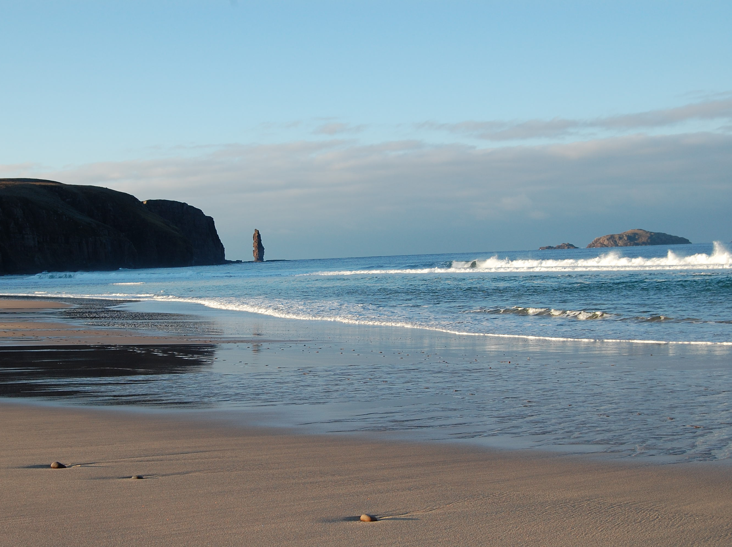
Summary
Importance of the curriculum to inspire students, bringing like-minded students together, catalysing change
Synergies with other agendas – ie Graduate Attributes
Implications to HE/FE – provide opportunities, bring students together, support structure for students
What are ‘Sustainability skills’? People skills, research skills, values, drive, sustainability ‘knowledge’

Slide 26
Outcomes: sharing best practice in supporting student-led activism?
Notes:
Leave contact details…(form – names, institutions, email)
Get back to people in May

Slide 27
Thank you for your time !
Notes:
27
27

Slide 28
Your next steps – making the most of your EAUC Membership…
Resources - visit the EAUC resource bank for lots of resources
Networks - Join our Embedding Positive Attitudes and Behaviours Community of Practice - for those wanting to identify with the challenges of changing the behaviour of staff and students
Find out more about this group at 5pm tomorrow – see programme for details
Recognition - want recognition for your student engagement initiatives – enter the 2012 Green Gown Awards behaviour change category. Entries open summer 2012
Measure and improve - sign up to LiFE www.thelifeindex.org.uk. EAUC Members receive a significant discount
LiFE offers a dedicated ‘student engagement’ framework
Membership matters at www.eauc.org.uk

