Slide 1
Gloucestershire
Access to Opportunities Project
Sarah Fish (Atkins)
and Cliff Jones (Go Travel Solutions)
December 2014
Notes:
Introduction to who we are and our topic

Slide 2
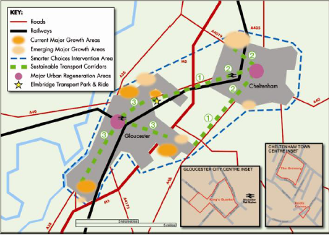
Notes:
Where we are working and about Thinktravel, encouraging people to “think” and just helped secure an additional £900,000 based on RWC

Slide 3
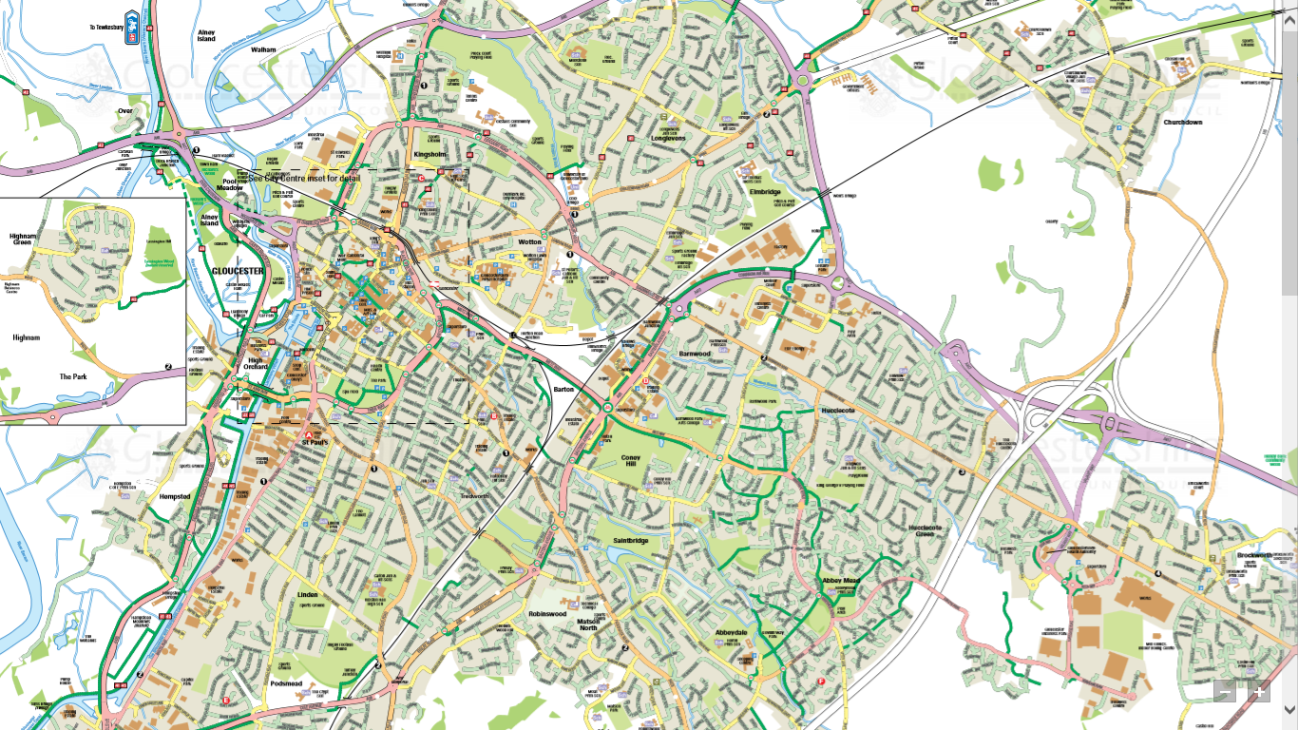
Notes:
As part of the work we are doing we have developed a range of resources….

Slide 4
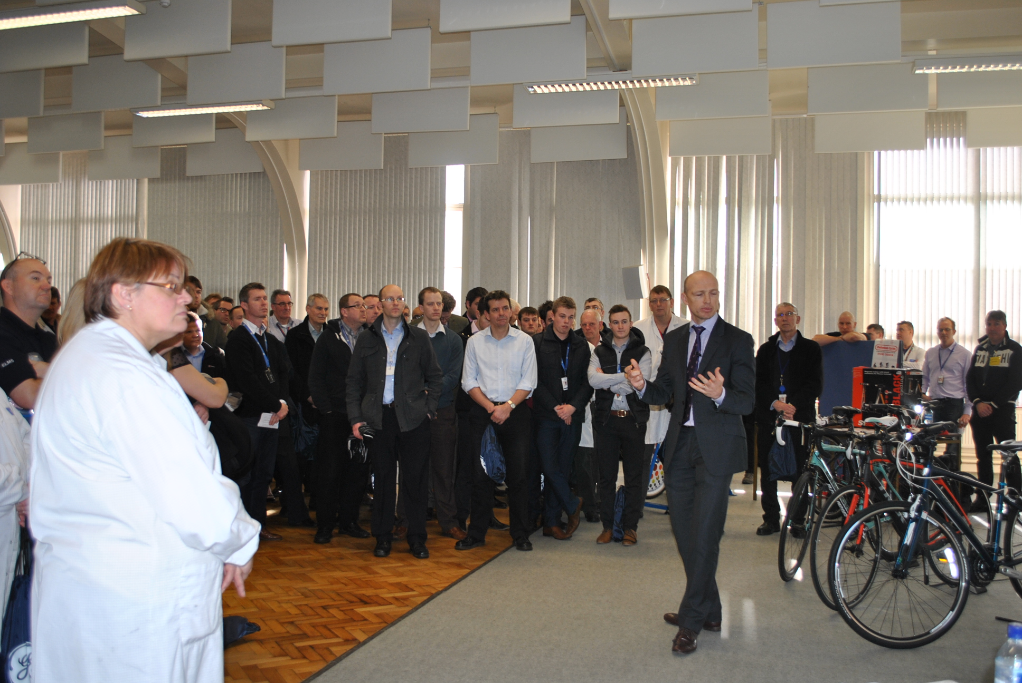
Notes:
Workplace engagement started with an events package such as this one at GE Aviation with organised large talks to staff –with World Cup Winning rugby players in attendance…..

Slide 5
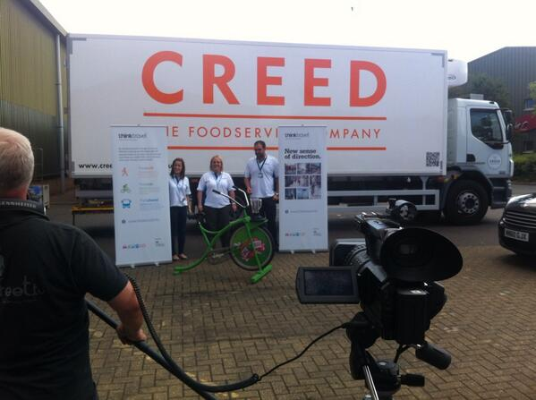
Notes:
Also included the fun…..with TV cameras, smoothie bikes, driving simulators

Slide 6
Notes:
Work engagement – progressed to offering mentoring and coaching, helping organisations put systems in place to help potential employees get to them. Putting together packs and also helping employers develop their own induction packs for people being interviewed and new staff

Slide 7
Notes:
Took that one step further, working with the following organisations….

Slide 8
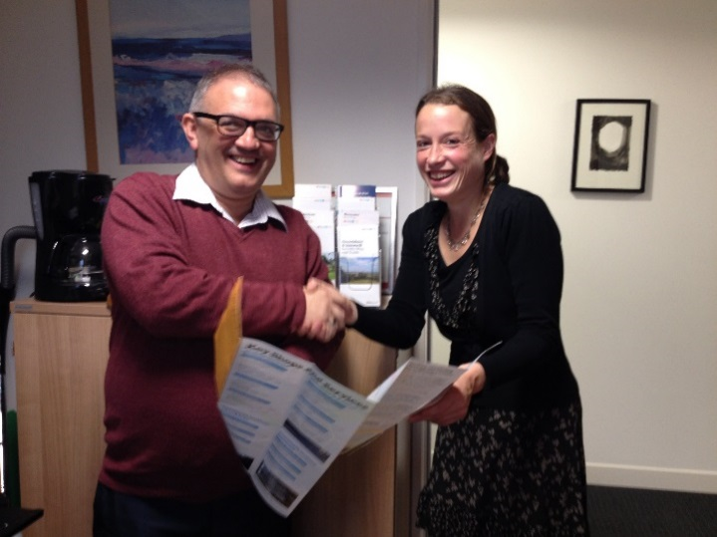
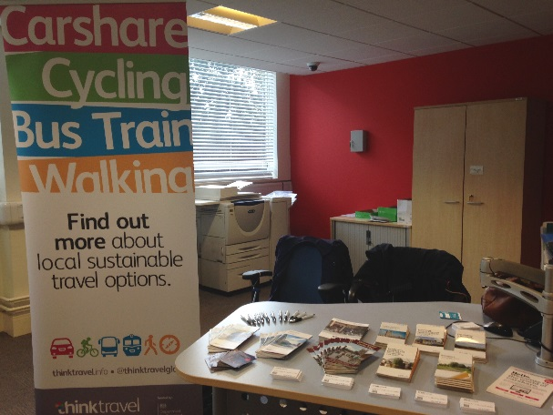
Notes:
What we are doing as part of the job seekers “Pathways to Work” programme……1:1 engagement

Slide 9
Notes:
Also training sessions for employment agency training staff

Slide 10
Notes:
We even helped develop a bike loan scheme specifically aimed at those seeking employment – job seekers are being referred to this programme – which will run at least for the next five years

Slide 11
Notes:
GLOUCESTER AND TEWKESBURY BOROUGH ptp PROGRAMME 2014
32,500 HOUSEHOLDS
CONSORTIUM OF 3 specialist SMEs successfully bid

Slide 12
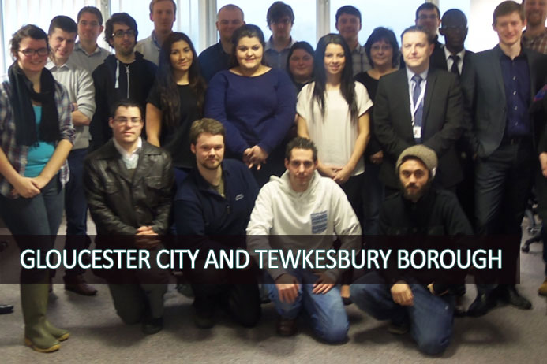
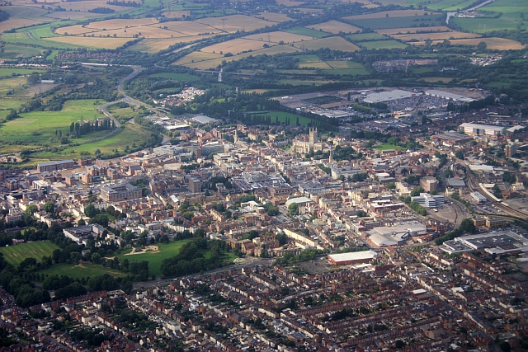
Notes:
Bid focused on localism and community
Staffed from local pool of unemployed and supported living candidates through referral partners LearnDirect/TCV/Salvation Army Opportunity Plus
Weeks training focusing on PTP skills and Customer Service

Slide 13
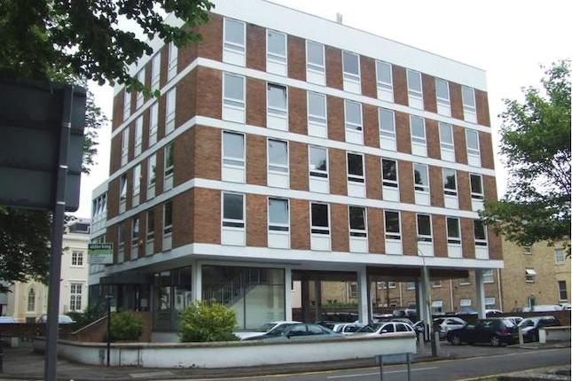
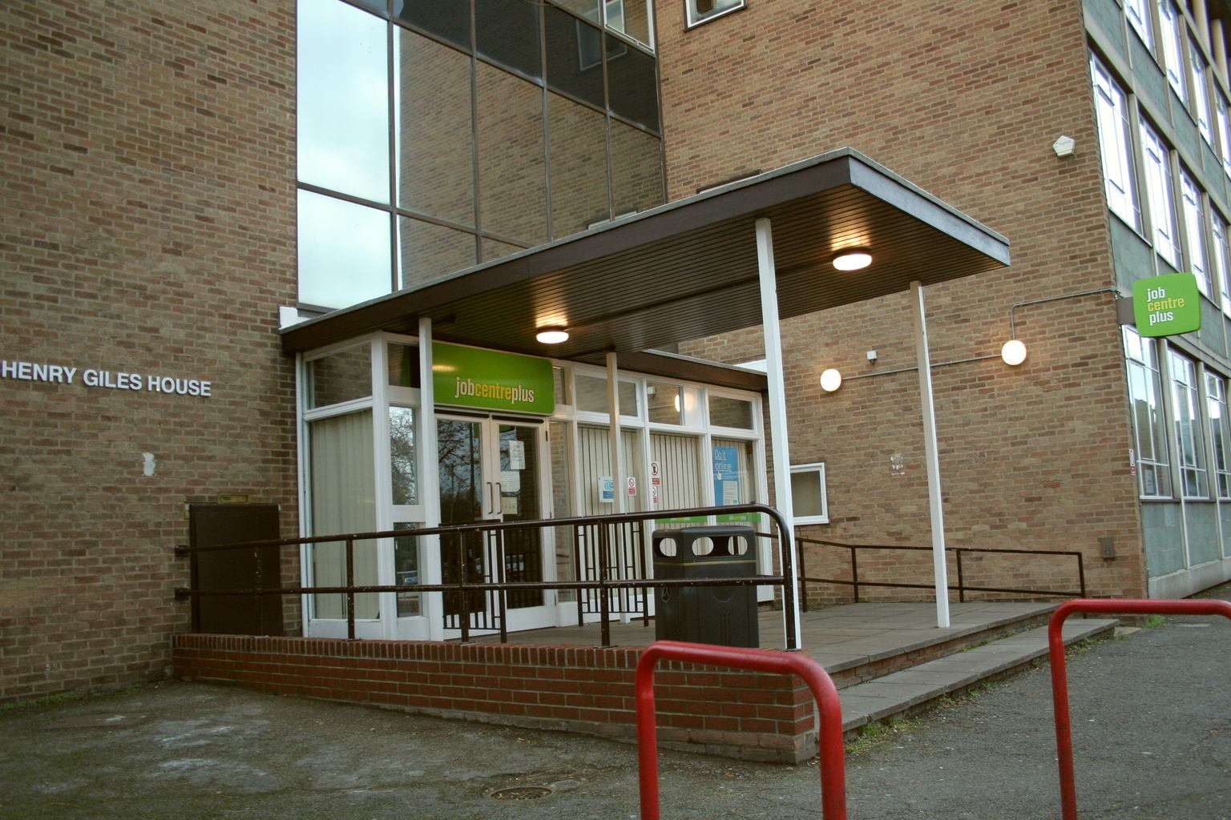
Notes:
Trained ptp travel advisors used to staff Atkins access to opportunities programme
Understand local public transport choices
Understand pressures of seeking work first hand
‘one team’ approach

Slide 14
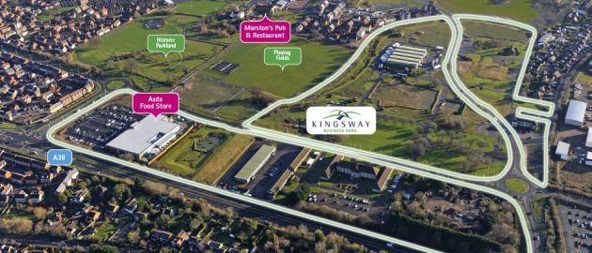
Notes:
Staff have also been ‘cross sold’ to conduct PTP on local new build developments maximising our investment in staff – and maximised their earning potential
Have achieved up to 52% participation in new build – first occupancy residences

Slide 15
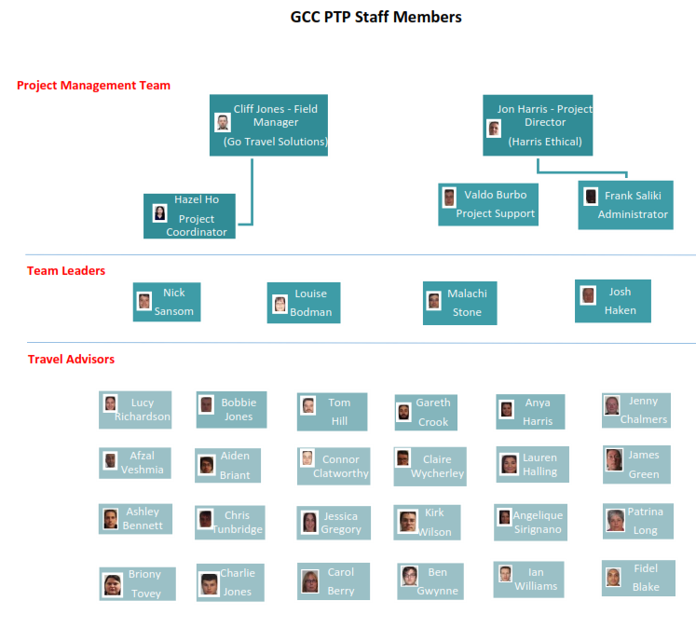
Notes:
Joiners and leavers
At it’s peak the programme employed 28
Of that figure 25% went onto employment elsewhere directly after leaving the project
I have had the pleasure of writing 8 references – so far
6 individuals still on books

Slide 16
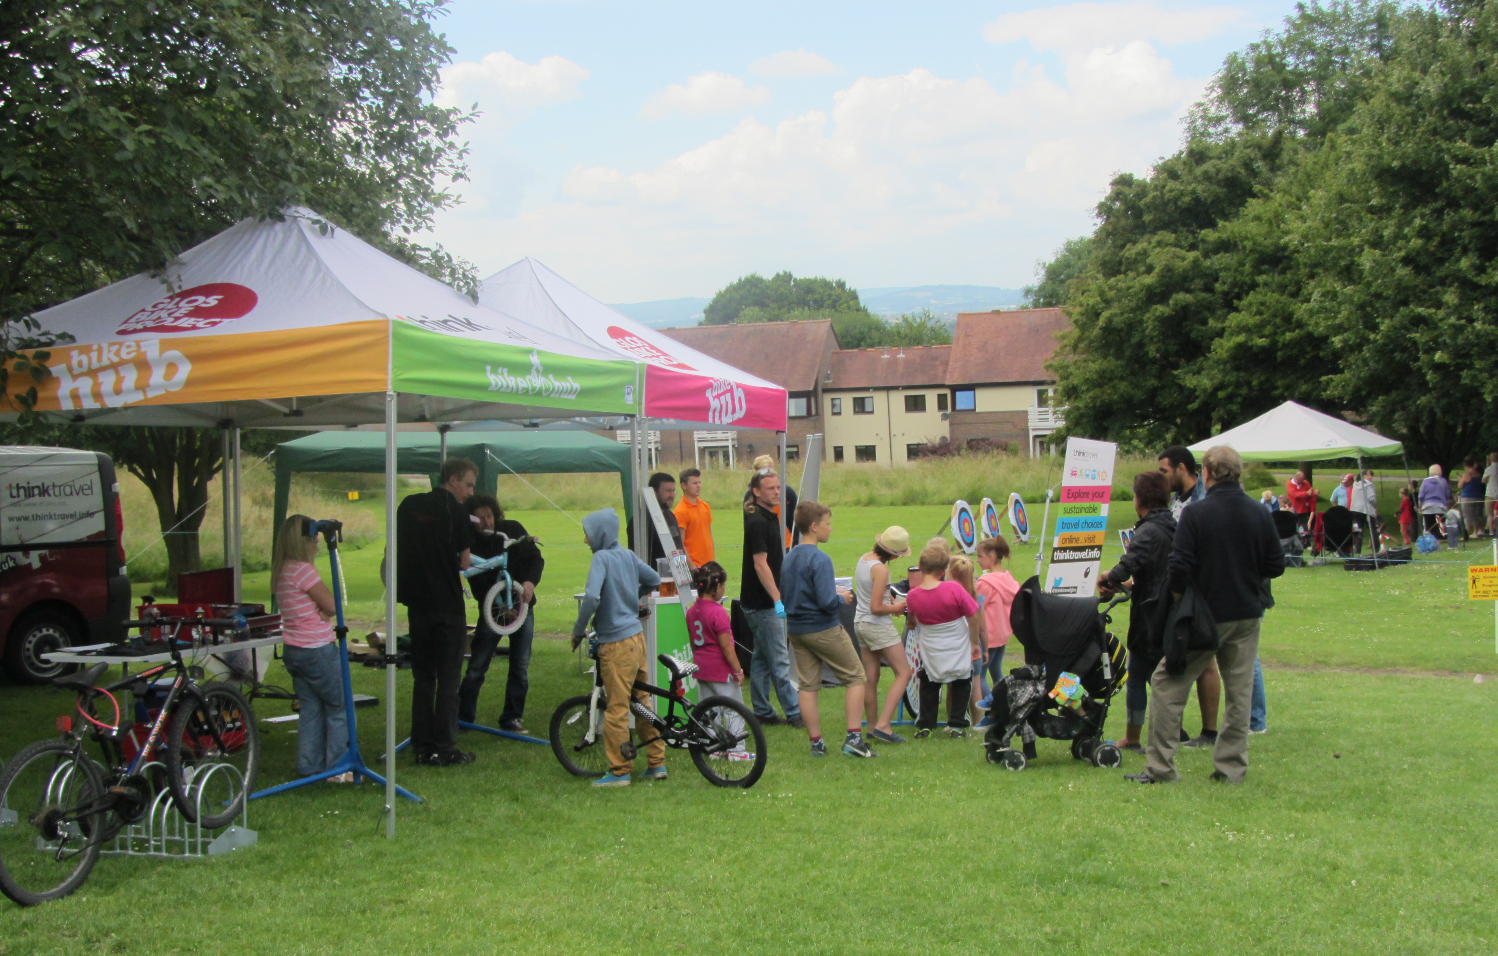
Notes:
Assets accrued as part of the 2014 programme, together with the skill pool of remaining advisers are being incorporated into a new CIC organisation.
It’s purpose – to unlock further funding potential, to keep people working, to maintain skills, to offer a PTP/consultation service to Private Enterprise (statutory undertakers/developers) and Local Government moving forward.

Slide 17
Notes:
‘Stronger Together’
Diverse teams of professionals from many different organisations/sectors working together to provide the best services to strong and worthwhile projects
All three sectors (private/public/third) diverse organisations – (Atkins, GTS, ITP, HE) and partners (GBP/TCV/LD/SA)
One team philosophy – not ‘shutting out’ competitors/being secretive – adds huge value project to project – across 2014 LSTF programme year

Slide 18
£
£
£
Notes:
Triple benefit principle;
*£1 spent to achieve project aims
Leads to
*£1 spent in local supply chain (stimulates local economy and secures employment locally)
Plus
*£1 in the pockets of local work force – with local knowledge and insights
Additionally
*they spend their wages in local shops – further stimulation of the local economy!!

Slide 19
OR
Notes:
Fear of Change?
Or bold new way forward?
Power of SME specialism and Social Enterprise working with Global Corporate players
The Power of People.

Slide 20
Thank you for listening….
Sarah Fish – Atkins
029 2035 8086 / 07812 237 461
sarah.fish@atkinsglobal.com
Cliff Jones – Go Travel Solutions
07807 820 318
cliff.jones@go-travel-solutions.com

