Slide 1
Education for Sustainable Development Topic Support Network in the Scottish Higher Education sector 6 December 2013
Betsy King
Development Manager
Learning for Sustainability Scotland

Slide 2
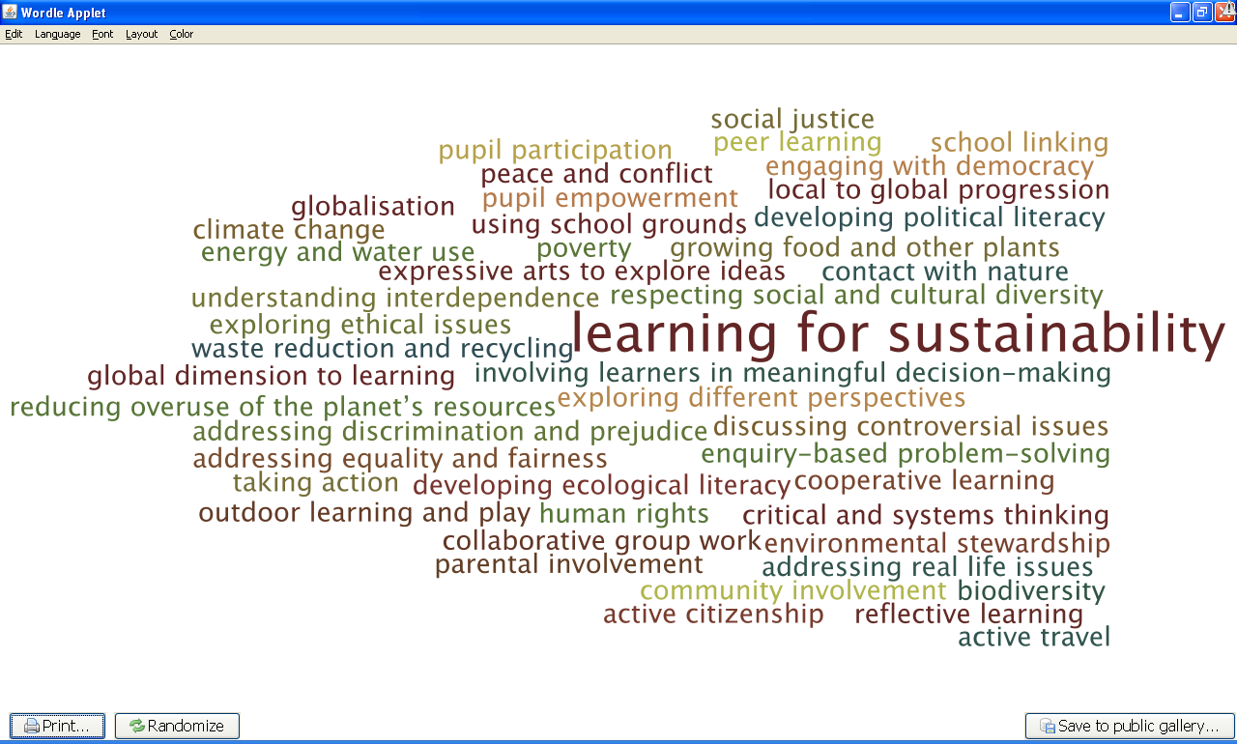

Slide 3
ESD – some key policy developments in Scotland
2005-14 United Nations Decade of ESD
2008 Learning for our Future Action Plan
2009 Climate Change (Scotland) Act
2010 Learning for Change Action Plan
2011 SNP commitment to explore ‘One Planet Schools’
2012 Learning for Sustainability report
2013 Ministerial commitment to an entitlement to LfS for all pupils

Slide 4
Professional Standards for Educators
‘General Teaching Council for Scotland (GTCS) 2013
Learning for Sustainability has been embedded within the Standards to support teachers in actively embracing and promoting principles and practices of sustainability in all aspects of their work.’
GTCS 2013, The Standards for Registration p.3; The Standard for Career-Long Professional Learning p.3; The Standards for Leadership and Management p. 3

Slide 5
The Scottish Government’s Learning for Sustainability Implementation Group 2014
all learners should have an entitlement to Learning for Sustainability;
every practitioner, school and education leader should demonstrate Learning for Sustainability in their practice;
every school should have a whole school approach to Learning for Sustainability that is robust, demonstrable, evaluated and supported by leadership at all levels;
school buildings, grounds and policies should support Learning for Sustainability;
a strategic national approach to supporting Learning for Sustainability should be established.

Slide 6
A UN University Regional Centre of Expertise in ESD for Scotland- update
Dec 2012 Application accepted by UNU
Feb 2013 Forum and Business Team
June 2013 Staff Team Abi Cornwall and October 2013Morag Watson, Betsy King with Director, Prof Pete Higgins University of Edinburgh
Oct 2013 AGM and Steering Group election. Chair: Rehema White
Nov 2013 Conference and opening

Slide 7
A UN University Regional Centre of Expertise in ESD for Scotland- update
Vision
Our vision is for Learning for Sustainability to infuse the whole of Scottish society, building our capacity to contribute to sustainability – locally, nationally and globally.

Slide 8
A UN University Regional Centre of Expertise in ESD for Scotland- update
Mission
Our mission is to work co-operatively to harness the transformative potential of Learning for Sustainability to support a sustainable world: where people and communities value and are engaged with the natural environment; societies are inclusive and equitable; and a vibrant economy contributes to flourishing ecosystems and social justice.

Slide 9
A UN University Regional Centre of Expertise in ESD for Scotland- update
Objectives
Identifying and sharing existing knowledge, expertise and lessons learned
Actively generating new knowledge and approaches
Undertaking monitoring, evaluating, international comparison and gap analysis of progress
Providing advice to practitioners, policy- and decision-makers
Sharing our learning internationally as part of the UNU RCE Network.
Ensuring the long-term future of Learning for Sustainability Scotland.

Slide 10
A UN University Regional Centre of Expertise in ESD for Scotland- governance
Wider society
Learning for Sustainability Scotland’s Members
Steering Group
8 elected members
Plus reps from all Task Groups Secretariat
Chair, selected by members
Task groups

Slide 11
A UN University Regional Centre of Expertise in ESD for Scotland- Task Groups
Current (with research focus)
Common Cause: Action Learning Programme
Mapping LfS in Scotland
In development
Connection to Nature
LfS in the GTCS Standards
?????? Other opportunities ??????
Wider Society
Learning for Sustainability Scotland’s Members
Steering Group
8 eleted members
Plus reps from all Task Groups
Chair, selected by members
Secretariat

