Slide 1
University and College Land for Carbon

Slide 2
Purpose of this document
The EAUC was awarded funding from the Natural Environment Investment Ready Fund (NEIRF) by the Environment Agency to deliver the Universities and Colleges Land for Carbon project. This is a resource created from that project.
This is a template presentation for you to use to communicate across your institution about developing a woodland to create Woodland Carbon Credits
You can edit this presentation to your needs and branding but please credit EAUC as the source of information

Slide 3
What is the University and College Land for Carbon
The EAUC was awarded funding from the Natural Environment Investment Ready Fund (NEIRF) by the Environment Agency to deliver the Universities and Colleges Land for Carbon project.
It aims to use institution’s land to develop Woodland Carbon Code (WCC) credits .
The WCC is a verified UK-government-backed credit to help institutions achieve their net-zero targets through carbon sequestration.
The carbon credit can be used to offset institutions’ residual emissions or can be traded on the carbon market via the Carbon Coalition.

Slide 4
What is the Woodland Carbon Code (WCC)
The WCC is the only way of generating carbon credit through UK woodland creation.
The quality assurance standard and generates high integrity, independently verified carbon units.
Backed by the government, the forest industry and carbon market experts,
It is currently the only UK carbon code to be endorsed by the International Carbon Reduction and offsetting alliance (ICROA).
The code allows organisations to reduce their net emissions, claim carbon neutrality and assists with institutions’ routes to Net Zero by 2050.
A low-risk form of offsetting project.

Slide 5
The Objectives
Develop a sector-wide framework that aligns with the Forestry Standard and Woodland Carbon Code requirements
Use staff expertise and students to collect and monitor data to gain practical green skills
Optimise biodiversity
Provide wider community benefits to staff, students and the general public
Develop a market assessment and financial models using institutions data

Slide 6
Woodland Carbon Code Requirements
Project site must show proof of ownership or tenancy.
Project time will be estimated over 2 to 3 years to complete.
The minimum size to be eligible for woodland is half a hectare and 20 meters in width.
A defined project time commitment between 40 to 100-year.
Project must be register with the WCC.
Suitable site which has not been wooded on in the last 25 years and not over peat depth requirements.
Compliance with UK Forestry Standard. & Woodland Carbon Code.
Be validated within three years of registration and maintain verification for the duration of the project.
Institution must apply a resource to manage the project.

Slide 7
Woodland Carbon Code (WCC) Requirements
Must show proof of ownership or tenancy of the site
The minimum size to be eligible for woodland is half a hectare (0.5) and 20 meters in width
A defined project time commitment between 40 to 100-year
Project must register with the WCC
Suitable site which has not been wooded on in the last 25 years and not over peat depth requirements
Must be compliant with UK Forestry Standard & Woodland Carbon Code
Be validated within three years of registration and maintain verification for the duration of the project
Institution has to have resources to manage the project

Slide 8
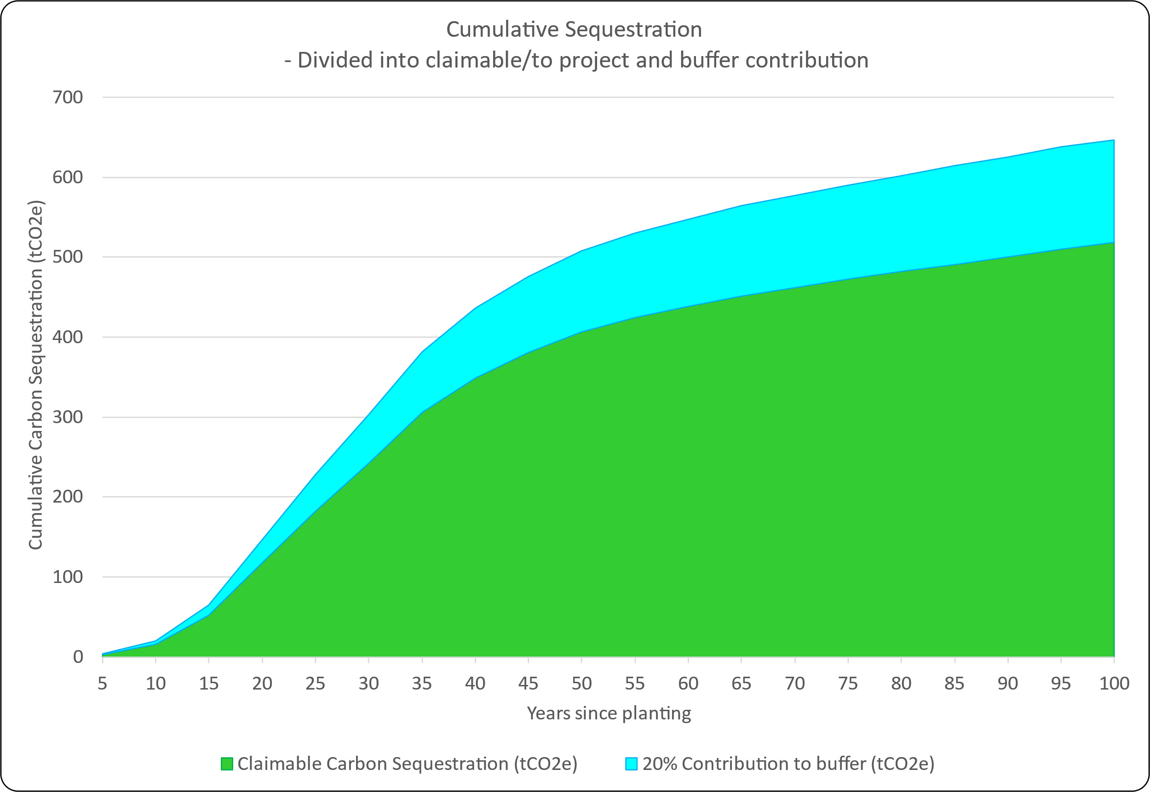
Carbon Sequestration
Carbon Sequestration is capturing, removal and storage of carbon dioxide (CO₂). A method for removing carbon from the atmosphere
An average project can sequester 450 tonnes of carbon per hectare over 50 years, claiming 450 carbon credits, costing over £35,000 (hybrid scenario).
Carbon credits will become a financial investment due to high demand and limited supply. You can generate your own carbon credits through WCC.
Planting on your land now can help you achieve net-zero more cost-effectively by generating carbon credits through sequestration.
Figure 1. Carbon sequestration curve of mixed native woodland (taken from Woodland Carbon Code Carbon Calculator)
https://www.statista.com/statistics/1284060/forecast-carbon-offset-prices-by-scenario/

Slide 9
Grants and Funding Support
A list of funding and grants support to apply for institutions to support the delivery of woodland creation as well as planning and design planning to support the Woodland Carbon Code Credits. For further details on grants and funding,
Woodland Creation Planning Grant (WCPG)
England Woodland Creation Offer (EWCO)
Urban Tree Challenge Fund
Community Forest – Trees for Climate
The Woodland Trust – Schools and communities
The National Highway’s - Tree Planting Scheme, the Net-Zero Highways Plan
Earthwatch Europe – Tiny Forest

Slide 10
Institutional Guidance
A sector-specific guidance for developing Woodland Carbon Code Credits and the requirements from the UK Forestry standard in one document
A brief for higher and further education institutions on the key, high-level requirements and project phases
For large-scale and small-scale projects
Outlines steps for project initiation, ecological site assessment, financial modelling, engaging stakeholders and governance structures
Includes:
Project requirement checklist and task checklist
Documentation list
An overview of the key project stages and considerations
Project governance
Barriers and challenges

Slide 11
Institutional Guidance
1. Consideration: site choice, funding, eligibility, requirements, land ownership
2. Identify stakeholders, surveys, site characteristics, project governance
3. Undertake the necessary design concept plan and project documents, including stakeholder engagement log
4. Produce the final woodland creation design plan
4. On-going woodland monitoring and verification with WCC
Notes:
The development of a WCC project is broken down into 5 stages.
It highlights the importance of ecological understanding, environmental impact assessment, and community integration for effective project execution.

Slide 12
Financial Modelling Tool
A user guide to use the Financial Modelling Tool to forecast financial flows associated with a woodland creation project over time
The Financial Modelling Tool is designed to cater to the specific needs of woodland carbon projects
Provides an overview of the spreadsheet and its functionalities
Assess the economic viability and potential return on investment for the woodland project
The value of WCC units have an expectation that pricing will increase in the long term as demand for carbon credits increases

Slide 13
Financial Modelling Tool
Includes Data Entry, Cashflow, Results, and cost and income data
Assumes fixed prices for WCC units when modelling long term cashflow forecasts
Uses the three pricing scenarios from the UK government to predict long term value generation from WCC projects
Compare to the cashflow forecast generated to understand the potential value creation above and beyond the fixed price cashflow model
These figures are only estimates
Carbon price forecasting to help developers understand potential value of the WCC units beyond the current market value

Slide 14
Carbon Credits Markets & Pricing
By developing carbon credits, you can apply them to offset your carbon target. As the trees grows, more carbon they will sequester each year, providing a cost-effective method of reducing carbon emissions until 50 years.
This is crucial as demand for carbon credits will surpass supply, making it imperative to initiate the development of WCC credits now to attain your net-zero target.
 | 2030 | 2050
Voluntary Market Scenario (low) | £8.70 | £38.00
Hybrid Scenario | £38.00 | £78.50
SBTi Scenario (high) | £177.60 | £95.20
Carbon Markets = The market for obtaining and trading carbon credits/certificates in order to prevent or reduce greenhouse gas emissions (GHG).
1 Carbon Credit = 1 carbon tonne removed from the atmosphere
Carbon Coalition can trade your carbon credits through the Carbon Coalition

Slide 15
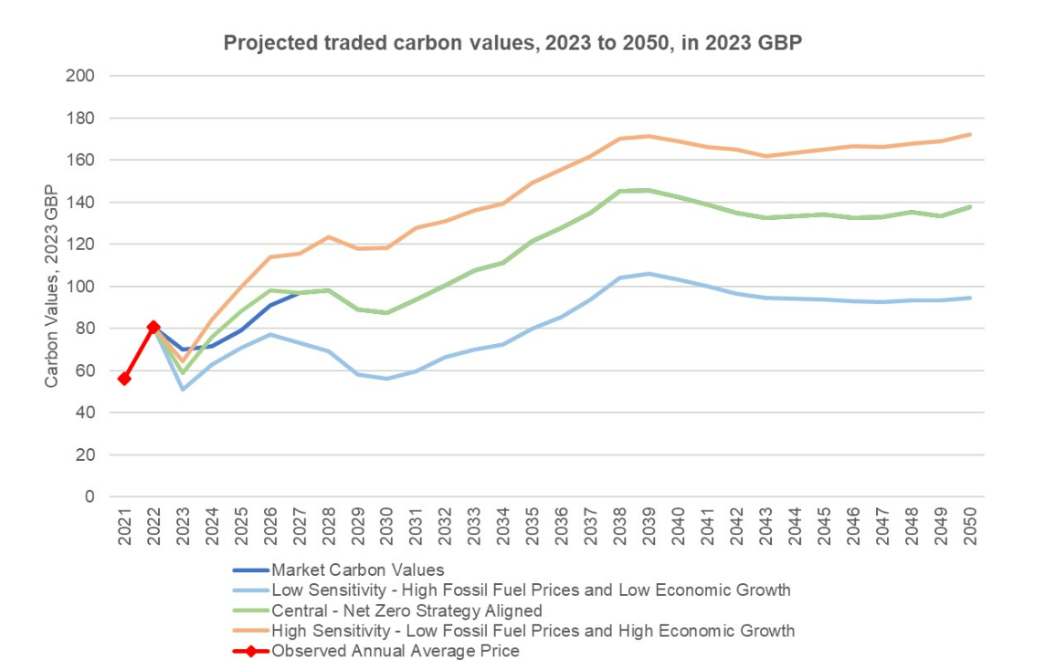
Carbon credit price forecasting

Slide 16
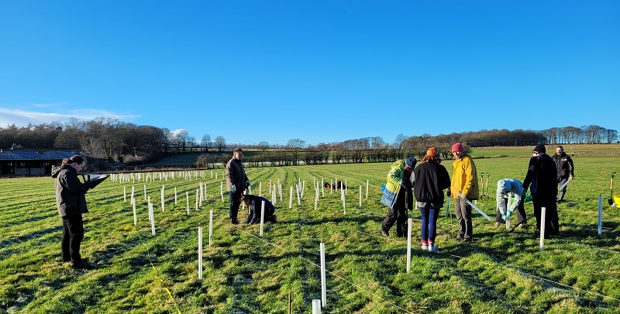
University of Leeds: Gair Wood
The University of Leeds established a woodland creation initiative at Gair, which aligned with the University of Leeds Climate Plan. The project encompassed 66 thousand trees planted across a 36-hectare site, including land set aside for natural tree recruitment from local seed sources and 0.9 kilometres of new hedging.
Providing biodiversity benefits and public access
Opportunities to the local community to engage with nature
Undergraduate and postgraduate students will conduct research project
The carbon capture will contribute to University’s target of reaching net zero

Slide 17
Supporting Resources
Resources | Description
Institutional Guidance | A sector specific guidance on developing a Woodland Carbon Code project
Financial Modelling Tool | A guide to understanding the financial forecast of a woodland creation project
Business Case | An overview of the benefits and risks associated with developing a WCC project
Grants and Funding Support | A list of grants and funding opportunities to develop a woodland and tree planting for the sector
Presentation template | A template presentation for institutions to use to present to their wider teams about woodland creation and carbon codes
Case Study | A case study from the University of Leeds and Gair Wood
Glossary | An glossary to understand key terminology in offsetting

Slide 18
More information
University’s and Colleges Land for Carbon Project and Resources
https://www.eauc.org.uk/university_and_college_land_for_carbon
NEIRF Funding
https://www.gov.uk/government/news/50-projects-receive-up-to-100000-each-to-boost-investment-in-nature
Woodland Carbon Code
https://woodlandcarboncode.org.uk/
Contact us at jnguyen@eauc.org.uk

