Slide 1
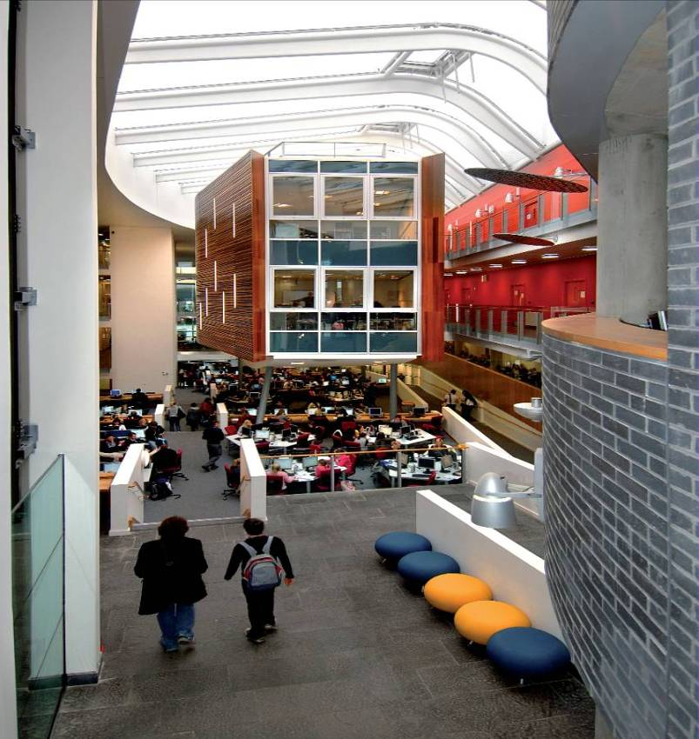
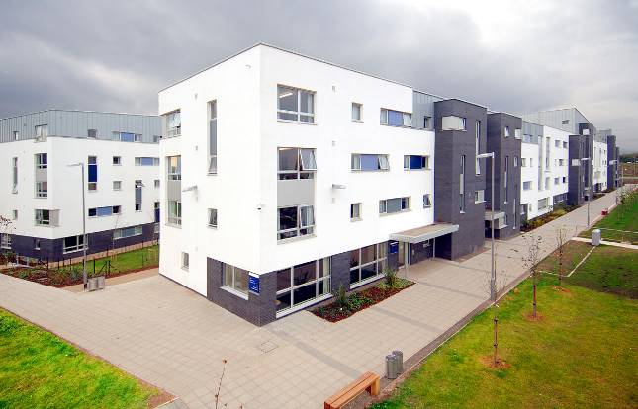
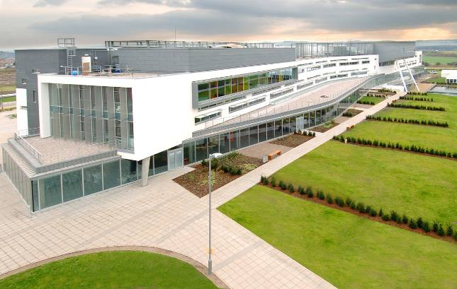
Queen Margaret University – The Sustainable Campus
Steve Scott - Director of Campus Services
Notes:
Presentation will focus upon QMU’s recent campus development
Relevant Case study for today:-
Exemplar Sustainable Estate
BREEAM/CeeQual/Envest/GreenGown
ICT Key to delivery of Sustainable development
Would not have achieved without ICT
Many others aspects of project aim relied on ICT
Space reduction
Business change
ICT/Estates Continue to work together
Estates and ICT combined function
Sustainable development ongoing

Slide 2
Context

Slide 3
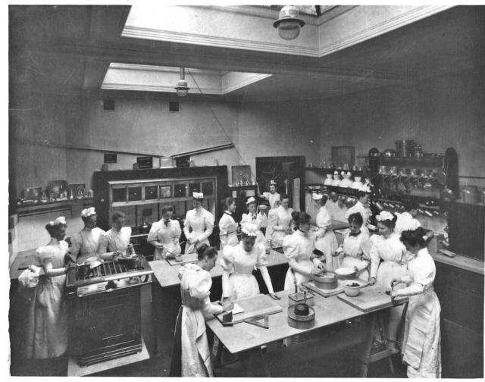
The University
university of 5000 students and 550 staff
applied health sciences, drama and business
originally the Edinburgh
School of Cookery and
Domestic Science; 1875
Queen Margaret College
in 1970s
Queen Margaret University
College in 1990s
full university title in 2007
cookery class, late 1880s

Slide 4
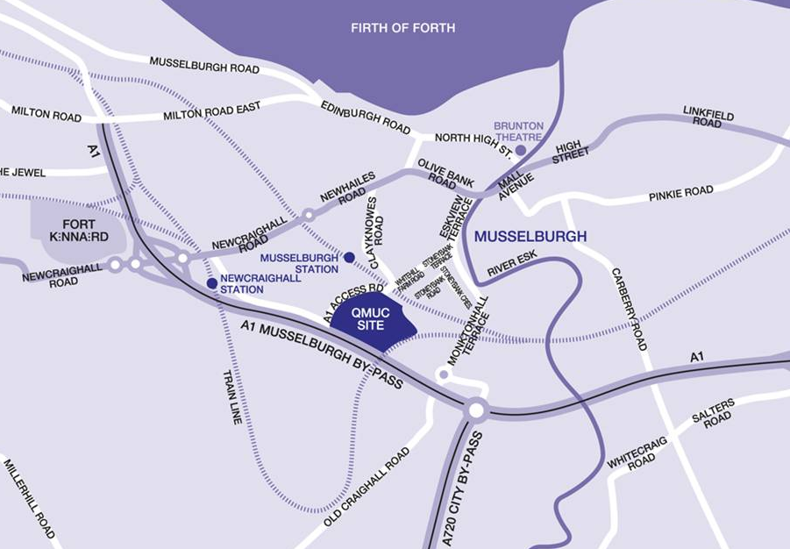
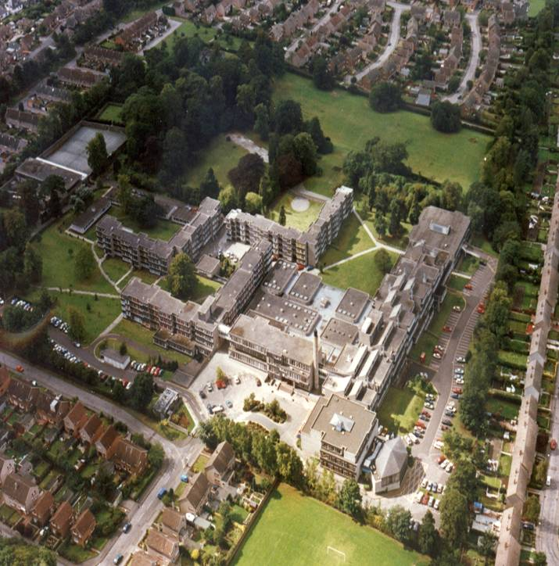
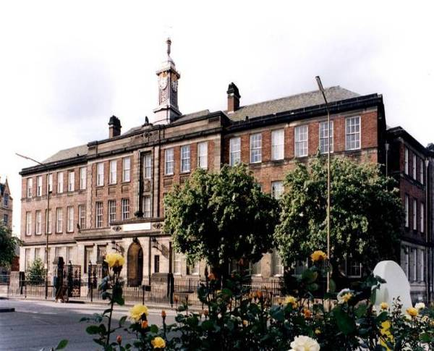
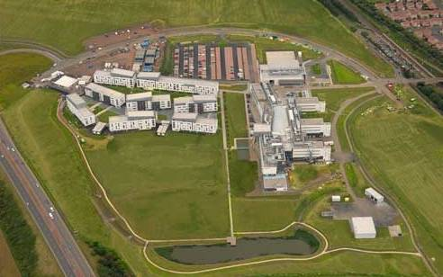
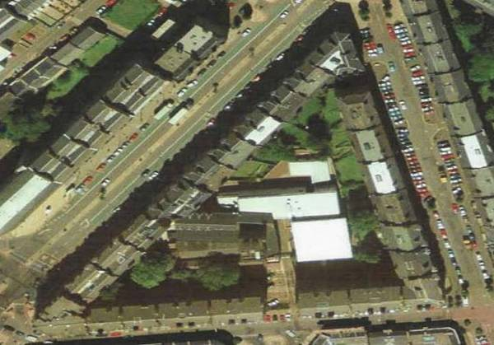
Relocation
Notes:
Estate Context
Old - new

Slide 5
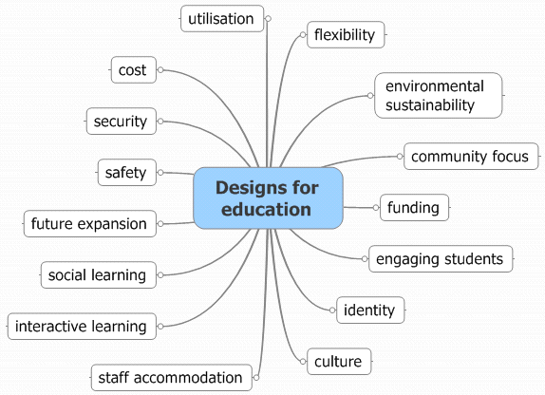
Brief
Notes:
Brief
Sustainability BUT
Extensive change management
Business change
Sustainability - in the mix
Key driver – space

Slide 6
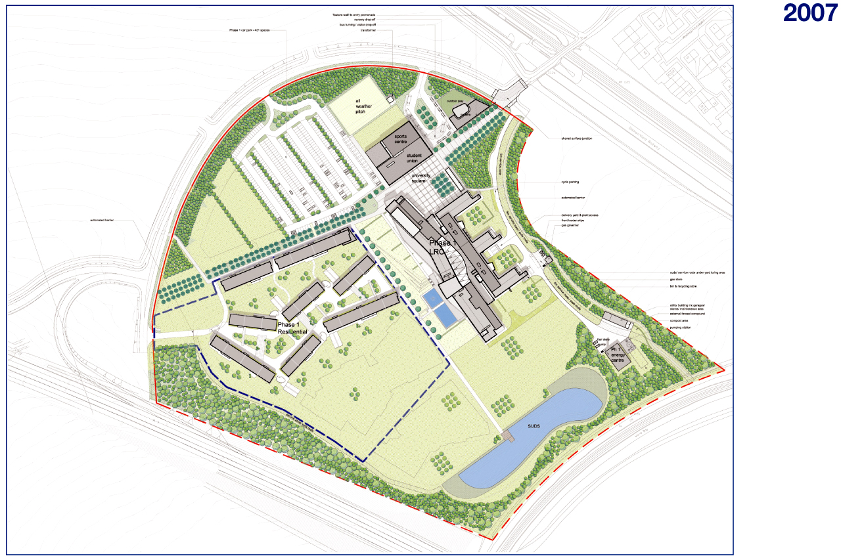
Masterplan
Notes:
Identification of key parts

Slide 7
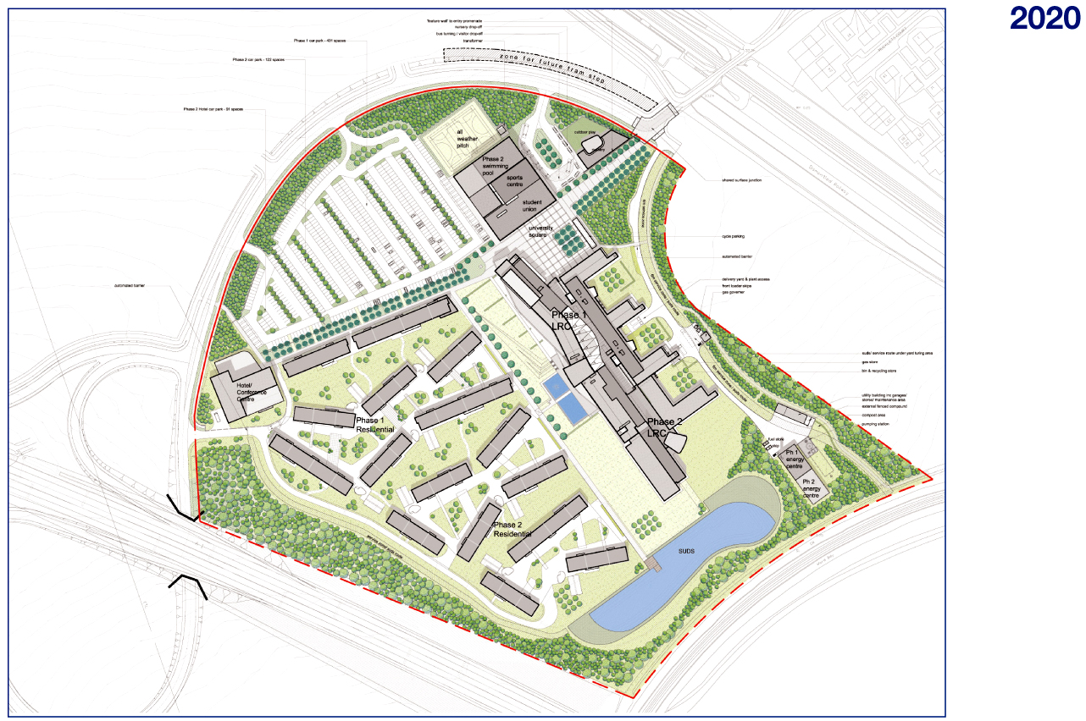
Masterplan
Notes:
Identification of growth and flexibility

Slide 8
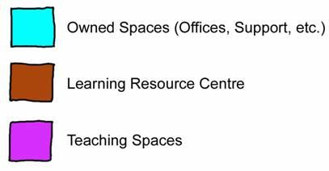
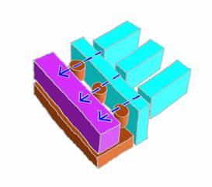
Design Concept
Notes:
Simple approach
Component parts idenitifed
Interraction of component parts
LRC as heart
Access through LRC

Slide 9
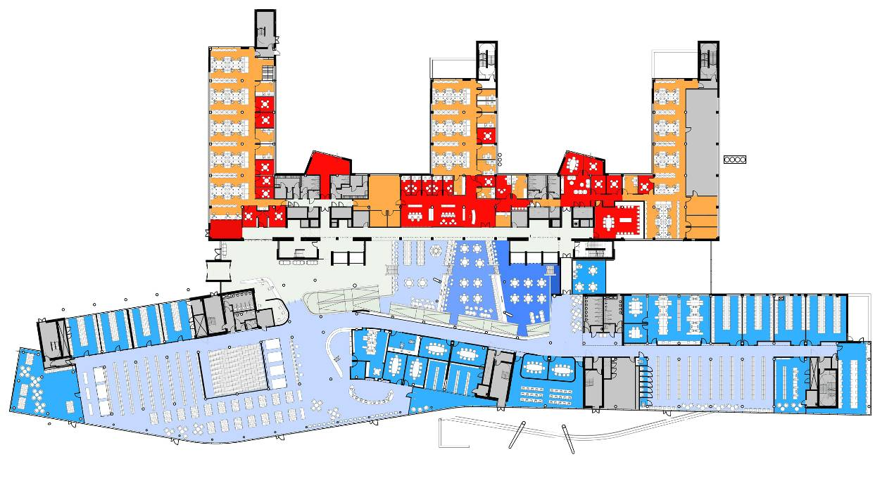
Learning Resource Centre
Consolidated base for Student Centred learning
No taught classes
Central location “heart” of building
Varied environment
study spaces (1:5)
Secure and non secure

Slide 10
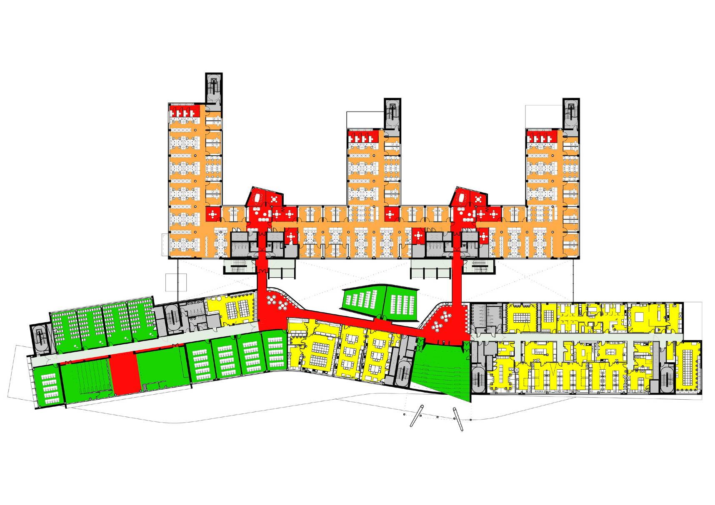
Other Accommodation
Offices
Teaching

Slide 11
Sustainability

Slide 12
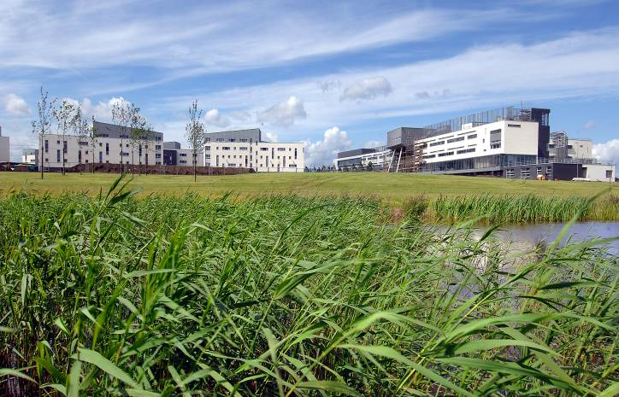
Sustainability - Strategy
Holistic
  avoid gimmicks where add expense and cost
  get basics right
  balance cost benefits with any additional costs (no additional sustainability budget)
  design sustainability in
Vision Statement - ” to develop a sustainable community for learning and life “
Emphasise Sustainability throughout process
  specialist sub consultant - GAIA
  consultant selection
  contractor selection
  monitoring regime
Key target areas
  low Carbon footprint
  biodiversity and a quality external environment
  Indoor air quality and Daylight
  water management
  Green travel plan
Notes:
Developed with project
Integrated with ICT and space
BOLD ITEMS – would not have been possible without ICT

Slide 13
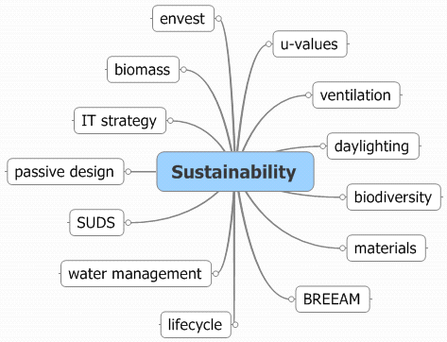
Brief

Slide 14
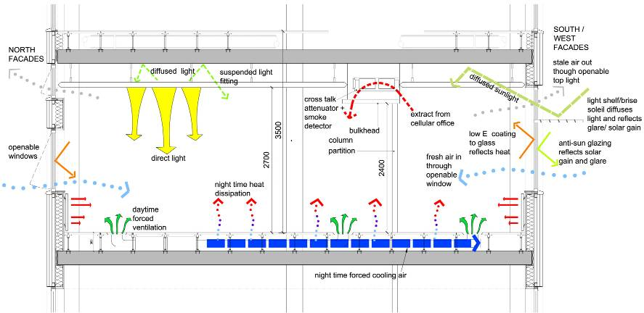
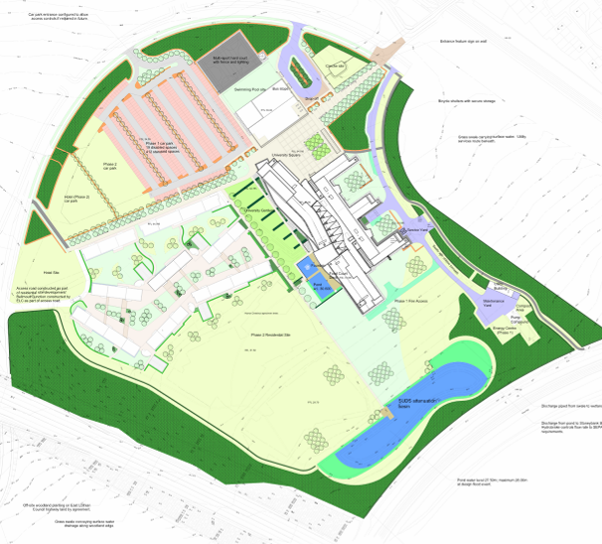

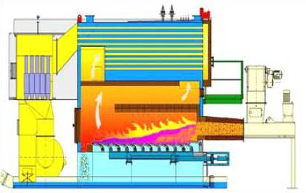
Measures

Slide 15
ICT Contribution

Slide 16
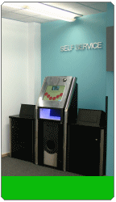

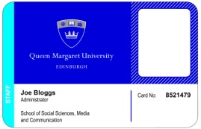
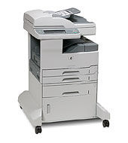
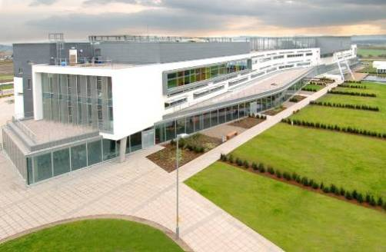
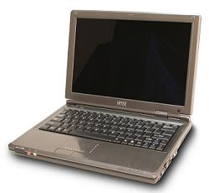
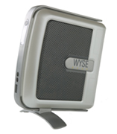
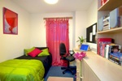
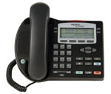
technology
AV & VC
smartcards
RFID self-issue
wireless & TC laptops
print, copy and scan
thin-client
VoIP
halls
Notes:
Part of an over-arching IT strategy developed out of the work of Re:Locate
Print strategy
- centralised print system
- accounting
- smartcard authentication and release
- single print queue, multiple release points
VoIP
- log in anywhere
- access to address books and access privileges from any phone
- transfer a call to a meeting/workroom
Wireless
- primarily to facilitate QM desktop access in locations without terminals
- in all locations of academic building (except teaching rooms by design)
- students own facilities or better still a thin-client laptop
Smartcards
- underpin authentication and access
- print release
- cashless purchasing

Slide 18
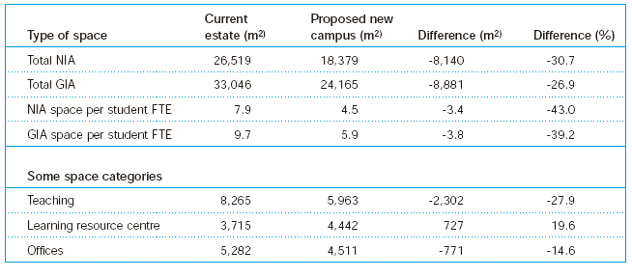
space efficiency
significant reduction in total net internal area…
..except Library & IT

Slide 19
Technology

Slide 20
Thin-client
A thin-client is a client computer in a client-server architecture network which depends primarily on the central server for processing activities, and mainly focuses on conveying input and output between the user and the remote server. In contrast, a thick or fat client does as much processing as possible and passes only data for communications and storage to the server.
Definition courtesy of Wikipedia

Slide 21

power consumption figures
Description | PC | thin-client
power | 100W | 15W
server component | 0 | 7W
total | 100W | 22W
yearly consumption | 438kWh | 96kWh
yearly cost | £52.56 | £11.52
CO₂ for year | 235.206kg | 51.552kg
*actual measured values

Slide 22
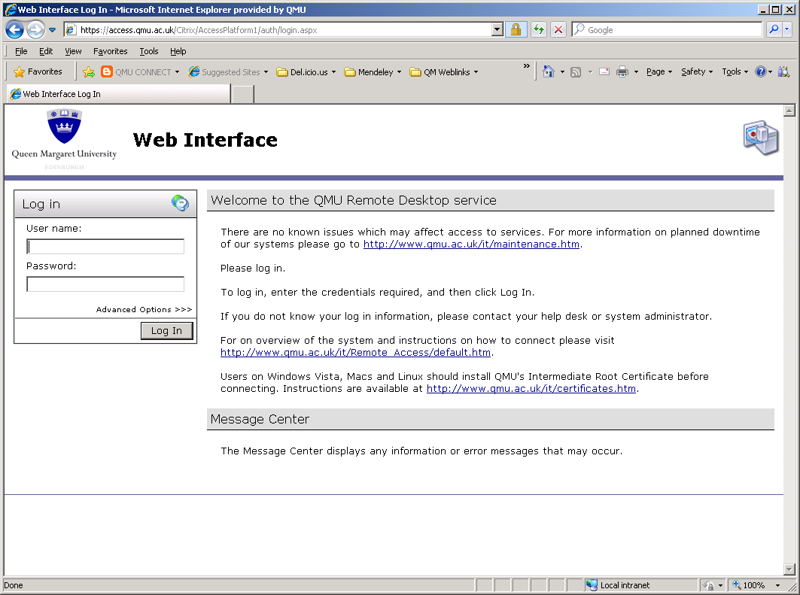
Remote Access
greatly improved the flexibility of work practice
support distance learning
travel to campus
up to 300 simultaneous connections
over 80 countries
facilitates international collaborations

Slide 23
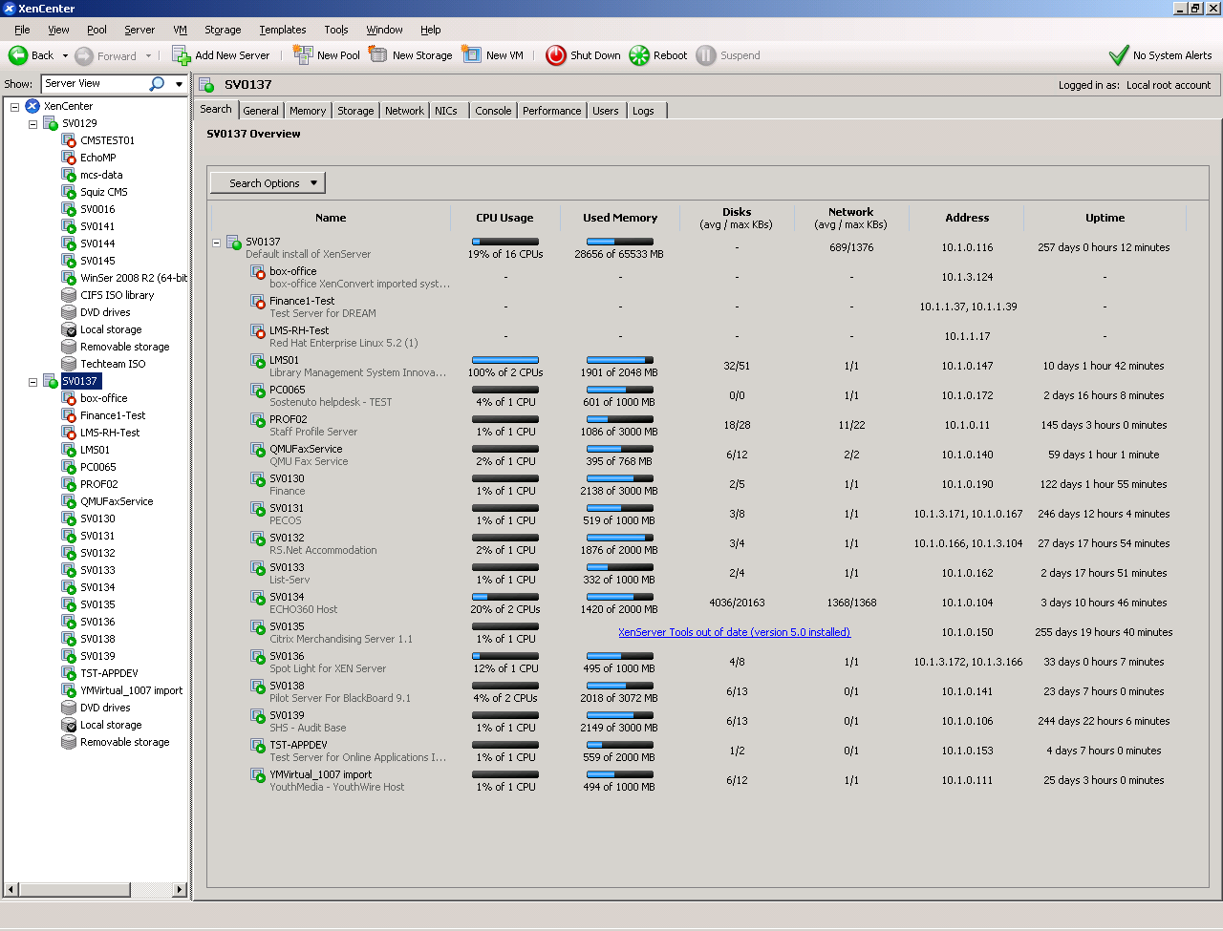
Server Virtualisation
Citrix XenServer
HP DL580
16 Xeon Processors
64Gb RAM
1Tb local storage

Slide 24

efficiencies
20:1 virtualisation ratio
average 60% reduction in hardware costs
£35k savings on hardware
39000 kWh/year, ~£5k savings on energy per fully loaded host
server embodied energy

Slide 25
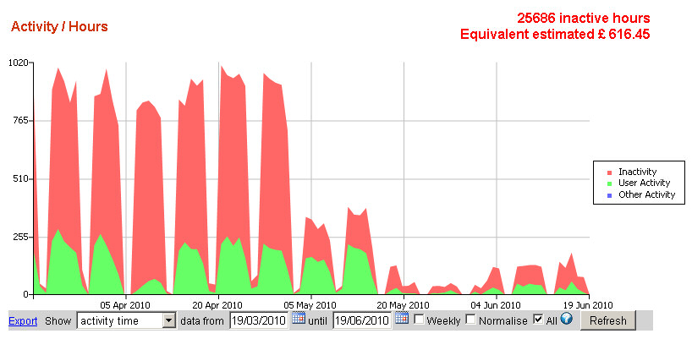
power-down
PCs and terminals
saving of nearly 100000kWh per year, ~£12k
Ergo Powerman for PCs
bespoke app for WYSE terminals
ROI < 3 months
PCs now powered only 9% of the day

Slide 26
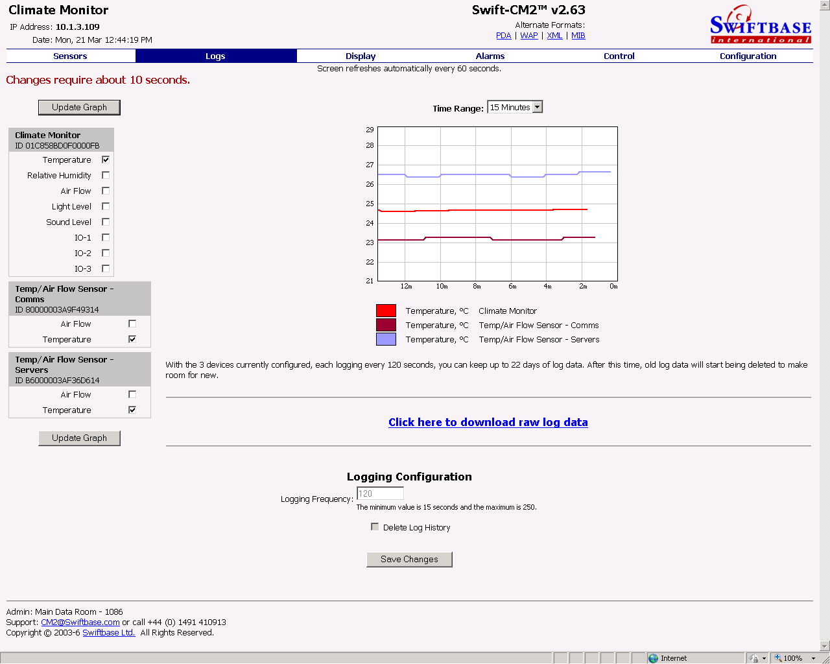
Data Room Temperature
commissioned at 18C in 2007
increased gradually to 25C in 2010
will increase further as equipment allows
27C? 30C?
4% energy savings per degree

Slide 27
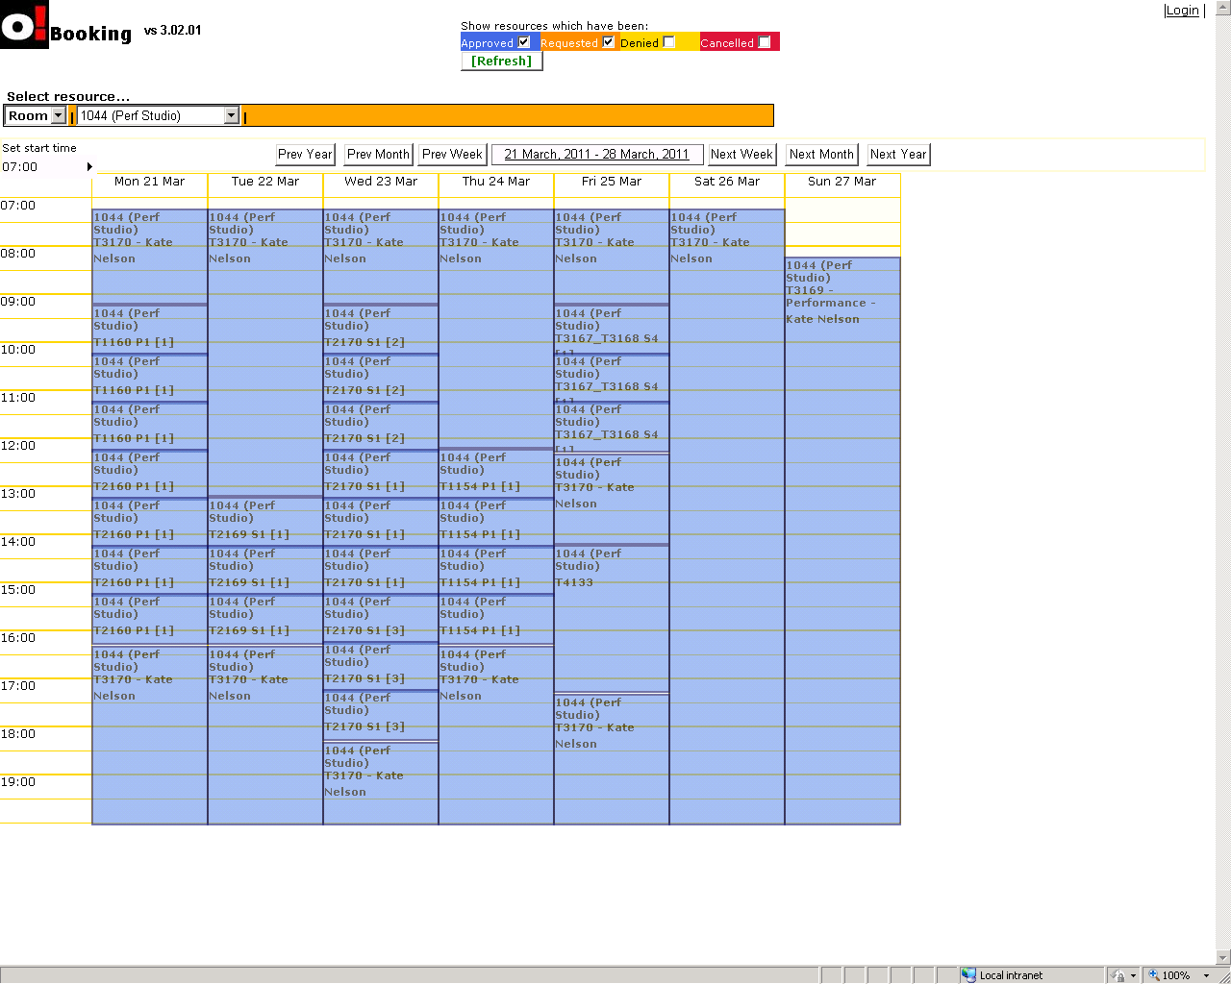
Timetable Software
efficient, centralised scheduling
no local ownership
room utilisation of over 40%
in turn allows the building size and accommodation to be minimised

Slide 28
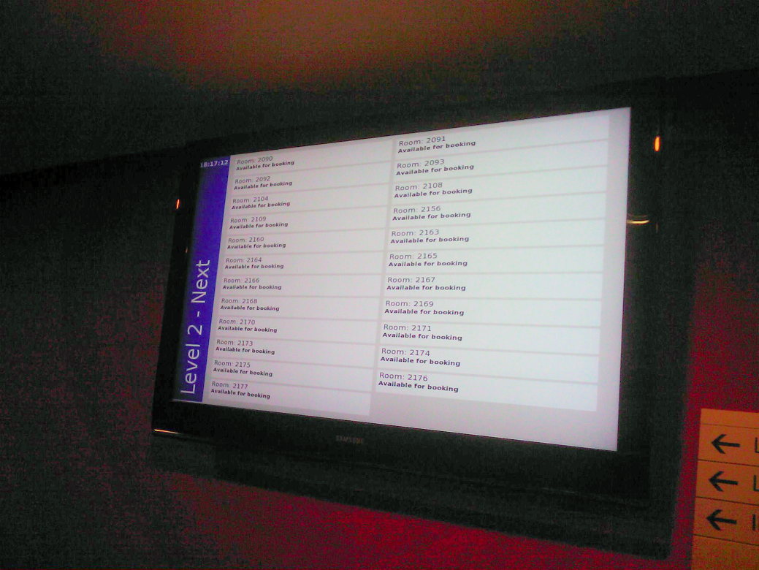
Room Info Screens
remove the need to print room bookings or timetable info
allows for the greatest flexibility in dynamic updating of room information
data available over web too

Slide 29
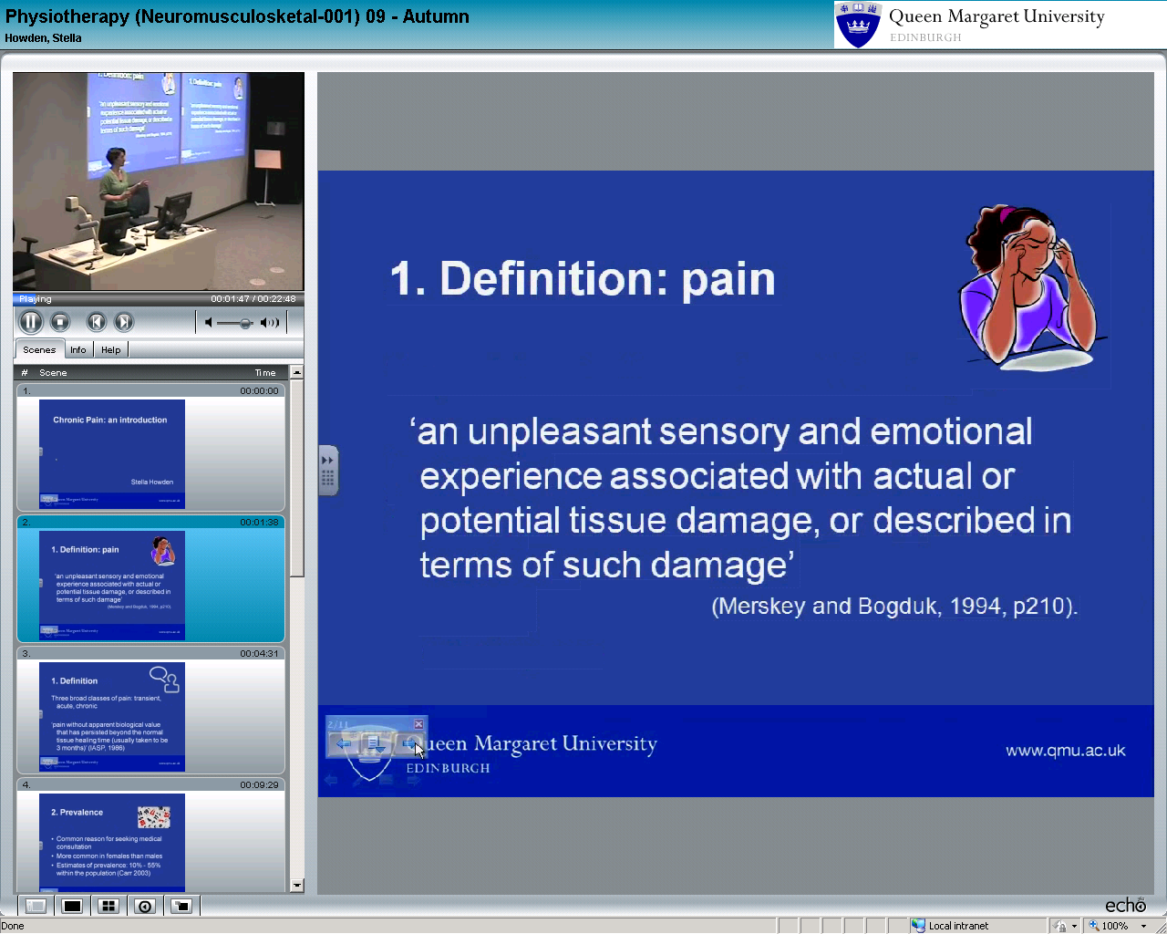
Lecture Capture
echo360 & Smartboard recordings
all rooms on campus covered
flexibility and efficiency in space usage as academic events can be recorded once and delivered many times
web, VLE and iTunesU

Slide 30
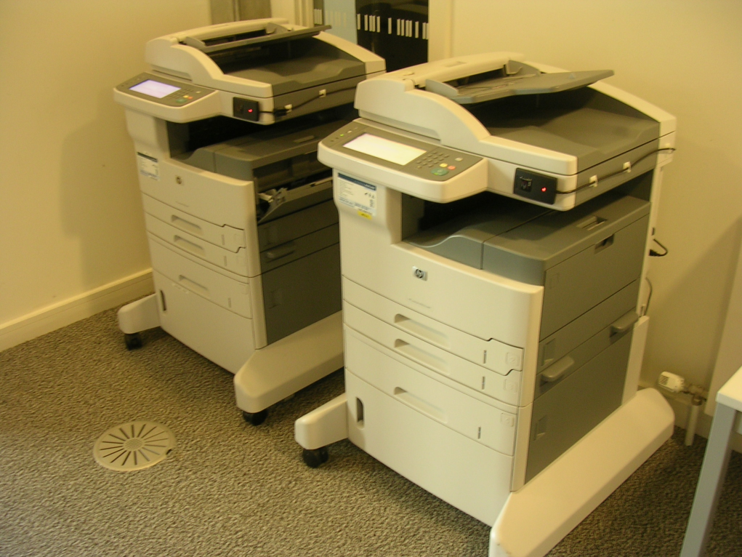
Printing and Imaging
250+ mixed, unmanaged devices
Replaced by 45 MFDs in 2007
only 13000 kWh/year energy savings
~£100k savings in print costs
??? in other efficiencies like toner management and support

Slide 31
Outcomes
&
Next?

Slide 32
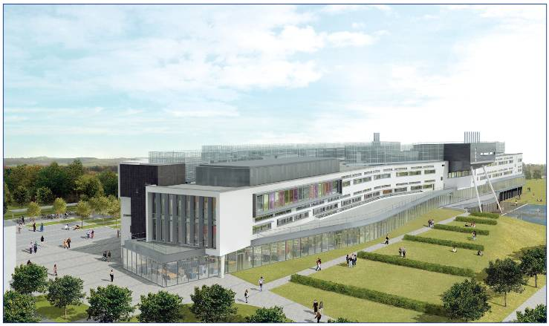
complete University transformation
benchmark in UK HE for Space Efficiency
benchmark in UK for Sustainability
  BREEAM – highest scoring HE in UK
Case Study for IT influence in work methods
Case Study for Modern learning spaces
  Awards
  Energy Consumption down by 36%
  Carbon Emissions down by 38%
Carbon Emissions /student FTE – 516kg CO2
Notes:
Notional energy emissions (kg CO₂) per student FTE (D4) C13

Slide 33
Climate Change Action Plan - Carbon Emissions
Notes:
Focus on carbon – recognisable
38% reduction in emissions old to new
5 year plan to do that and more again
Energy and carbon plan - 50 plus items
Already achieved most of year 1 items

Slide 34
2004 – the olden days
SusteIT ICT Footprinting Tool
Breakdown of ICT Energy Use by Category
Category | Total Energy Kwh/y | % | Total CO₂ kg/y
HPC | 0 | 0% | 0
Servers | 226,665 | 23% | 121724
PCs | 579,224 | 58% | 311055
Networks | 80,154 | 8% | 43044
Telephony | 59,480 | 6% | 31942
Imaging | 43,239 | 4% | 23220
AV | 7,682 | 1% | 4125
TOTAL ICT ENERGY & CARBON | 996,443 | 100% | 535,110

Slide 35
2007 – after thin-client
SusteIT ICT Footprinting Tool
Breakdown of ICT Energy Use by Category
Category | Total Energy Kwh/y | % | Total CO₂ kg/y
HPC | 0 | 0% | 0
Servers | 336,824 | 40% | 180881
PCs | 292,353 | 35% | 157000
Networks | 80,154 | 10% | 43044
Telephony | 59,480 | 7% | 31942
Imaging | 30,029 | 4% | 16126
AV | 41,324 | 5% | 22192
TOTAL ICT ENERGY & CARBON | 840,165 | 100% | 451,185

Slide 36
2010 – where we are now
SusteIT ICT Footprinting Tool
Breakdown of ICT Energy Use by Category
Category | Total Energy Kwh/y | % | Total CO₂ kg/y
HPC | 7,529 | 1% | 4043
Servers | 261,269 | 41% | 140307
PCs | 161,412 | 25% | 86682
Networks | 80,154 | 13% | 43044
Telephony | 59,480 | 9% | 31942
Imaging | 30,029 | 5% | 16126
AV | 41,324 | 6% | 22192
TOTAL ICT ENERGY & CARBON | 641,198 | 100% | 344,336

Slide 37
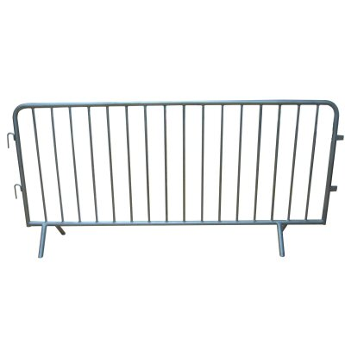
challenges and barriers
change management
communication
technology, easy – people, hard
NIMBY
perceptions and misconceptions
…but the technology is seen as enabling

Slide 38

Notes:
Beyond thin client
Plus
Green business
Scottish Green awards

Slide 39

Estate and Information Strategy
unify the campus and the information provision
formally ratify the dependencies on each other
enshrine spending dependencies
key: enable ease of access to information to drive the business

