Slide 1
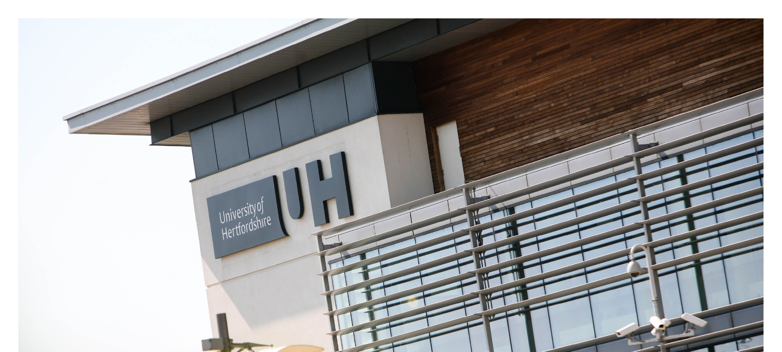






Reduction And Re-use of Energy in
Institutional Data Centres (RARE-IDC)
Steve Bowes-Phipps, Data Centre Manager University of Hertfordshire
http://rare-idc.herts.ac.uk

Slide 2

Reduction And Re-use of Energy in
Institutional Data Centres (RARE-IDC)
Reduction and Re-use of Energy in Institutional Data Centres (RARE-IDC)
  Data Centre Leaders Award Winner 2010
    “Innovation in a Micro-Data Centre”
  2011 Uptime Institute Green Enterprise IT AwardTM Winner
    “Innovation in a Smaller Data Centre <1000 sq ft”
  2010 Met with “Participant” status demonstrating compliance with the EU Code of Conduct for Data Centres
  Winner of Green Gown Awards 2011

Slide 3
Reduction And Re-use of Energy in
Institutional Data Centres (RARE-IDC)
Overview
Background
Approach
Constraints and Design
Results
Successful Outcomes
Learning
Completing the Green Gown App
Q&A

Slide 4



Reduction And Re-use of Energy in
Institutional Data Centres (RARE-IDC)
Background to the RARE-IDC project
Refurbishment of one of two main 75m² Data Centres for the University
Funding had already been allocated in order to overcome several legacy risks
We share many issues with other Public Sector institutions
Sector leader in environmental management – consistently ranked in the
top ten of the People and Planet Green League
Joint Information Systems Committee (JISC) funding brought new constraints and new objectives:
  “An exemplar of a Green Data Centre for the HE/FE Sector”
  “A model for other institutions to follow and learn from”
  “Meet the business need with capacity, resilience and economy for at least ten years”

Slide 5
Reduction And Re-use of Energy in
Institutional Data Centres (RARE-IDC)
Background to the RARE-IDC project
What were the benefits?
  National and international prestige and enhancing this University’s reputation for pioneering development.
  Lower energy bills – not just in the Data Centre itself
  Applying the techniques and technologies to other facilities across campus
  Increased green skills within UH
  Knowledge sharing with other institutions working on similar or mutually beneficial schemes

Slide 6
Reduction And Re-use of Energy in
Institutional Data Centres (RARE-IDC)
Approach
Mitigated the risks with the existing facility by moving into a temporary room
Bolstered our skills in best practices, cutting-edge sustainable technologies and thought leadership on reducing the carbon impact of Data Centres
Opted for a tender process that included “Design and Build”.
Design & Build Contract
  “Open process”
  Large No. Of responses, difficult to compare
  I.T.T. must reflect the exact deliverables
  Must be able to challenge the responses
  Supplier has ownership of design
  Fixed cost
Pre-Qualification Questionnaire (PQQ) help to reduce No. of appropriate responses
The Invitation to Tender (I.T.T)
  Included Best Practices (EU Code of Conduct for Data Centres)
  British & International Standards (TIA942)

Slide 7
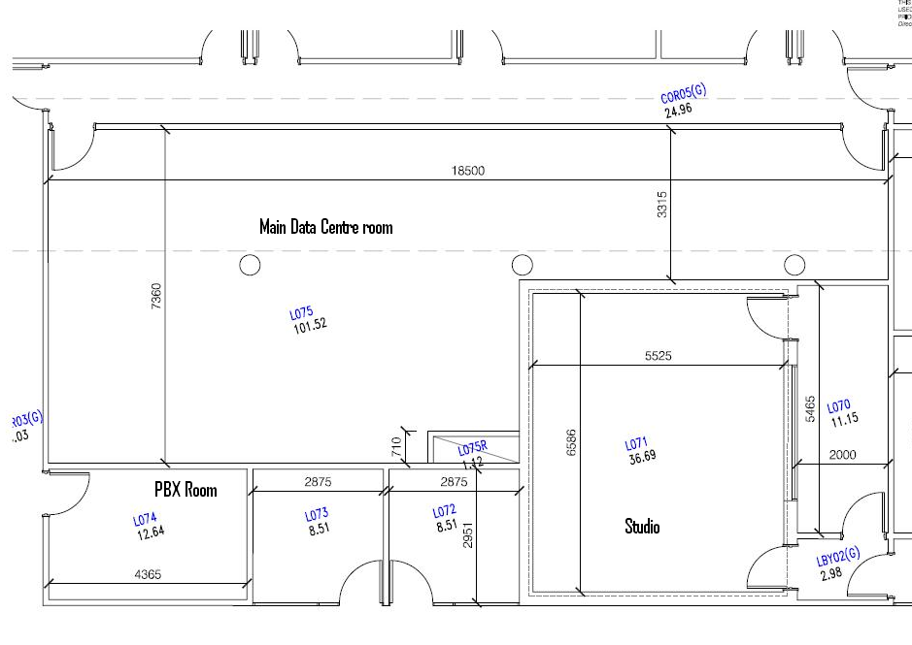
Reduction And Re-use of Energy in
Institutional Data Centres (RARE-IDC)
Constraints
Pillars
Riser
Capacity
Contamination from work areas
Overhead bulkhead
Lack of under floor capacity (only 250mm)
Legacy incorrect (and dangerous) power cabling
Limited plant space
Restricted external build space
“Meet-Me” point for all network cabling
No external walls

Slide 8
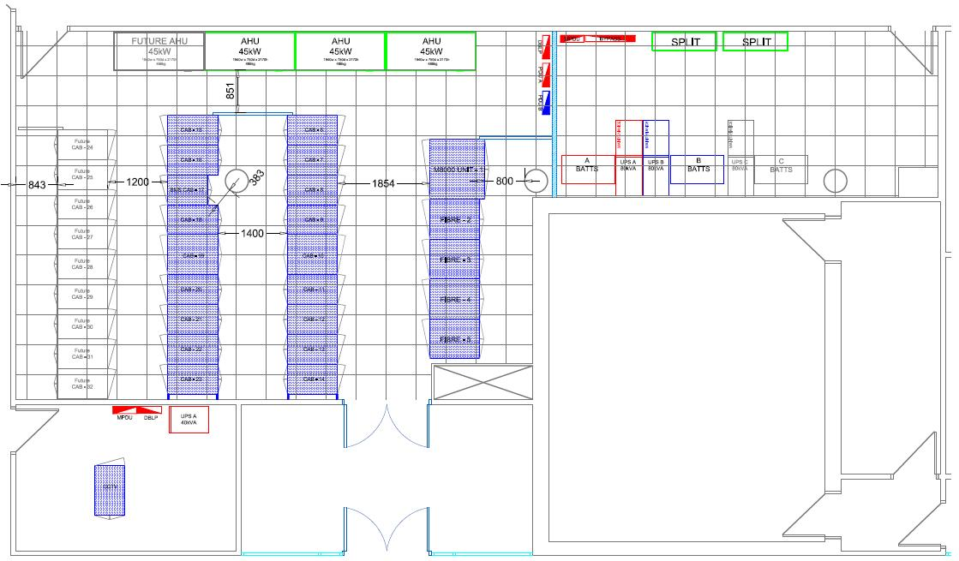
Reduction And Re-use of Energy in
Institutional Data Centres (RARE-IDC)
New Data Centre Design

Slide 9
Reduction And Re-use of Energy in
Institutional Data Centres (RARE-IDC)
Results

Slide 10
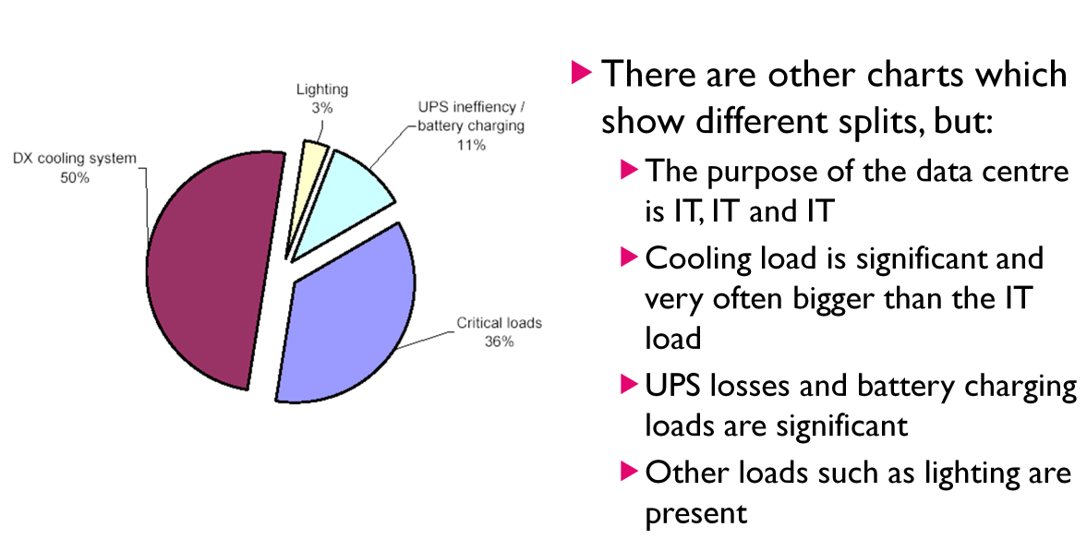
Reduction And Re-use of Energy in
Institutional Data Centres (RARE-IDC)
Breakdown of Original Energy Requirements
PUE Approximated at 2.2
IT Load at 45%
Cooling System taking up 42% of total
    Power
Electrical usage significant at 13%

Slide 11
Reduction And Re-use of Energy in
Institutional Data Centres (RARE-IDC)
Breakdown of UH Data Centre Energy Requirements
PUE Now down to 1.19_{L2,MD} – 1.33_{L2,MD}
Target = 1.22
Actual = 1.26_{L2,MD}
IT Load increased from 45% to 80%
Cooling usage decreased
from 42% to 19%
Electrical usage decreased
from 13% to 1%
(UPS losses and lighting, etc.)

Slide 12
Reduction And Re-use of Energy in
Institutional Data Centres (RARE-IDC)
Successful Outcomes
  Capability of project to act as an exemplar to the wider market in relation to the issues of the smaller centre
    Refurbishment not new Build
    Re-use of some Equipment
    “Free Air” Cooling for 86% of the year (based on local weather conditions)
    Increase in capacity of 69% & a 55% reduction in the carbon footprint of the Data Centre
    Operational cost savings of £186,000 per annum (inc Carbon cost £12/Tonne CO2)
    Using a contained Hot Aisle configuration, waste heat is recycled into the building’s hot water supply
    Our pathfinder project enables others to follow our success and apply the lessons we’ve learned along the way
    The first University in Europe to achieve compliance against the EU Code of Conduct for Data Centres
    Working with JISC to further EC-wide knowledge-sharing through the e-infranet project

Slide 13
Reduction And Re-use of Energy in
Institutional Data Centres (RARE-IDC)
Learning
Size doesn’t matter!
  Treat the project the same as any other
  Learn from others
  EU Code of Conduct for Data Centres (http://bit.ly/h4FA7)
Realising that not all DC providers are the same
  Involve your provider as partner
  Don’t be afraid to challenge
Cultural changes that breed success
  Work closely with Estates
  Embedding sustainable processes and technology
  Remember the four M’s – Meter, Monitor, Maintain and Manage
Dissemination of outcomes
  Blog http://rare-idc.blogs.herts.ac.uk/

Slide 14
Completing the Green Gown Award App
Breaking it down
Application is in two stages
Stage 1
  Summary
  The Initiative
  The Benefits
  Significance For The Sector
Stage 2
  Summary
  The Initiative
  The Benefits
  Significance For The Sector

Slide 15
Completing the Green Gown Award App
Focus on your strengths
Limited space in each section in Stage 1
  Encapsulate key points
  Include real-life benefits, not just projections
Stage 2 Allows for greater detail
  Highlight benefits in paragraphs
  Include a chart or diagram, if relevant
  Significance For The Sector is the key section
  How has your project benefitted other HE/FE institutions?
  Presented a Case Study? Use hyperlinks to back up your presence in the sector

Slide 16
Benefits

Slide 17
SftSector

Slide 18
Reduction And Re-use of Energy in
Institutional Data Centres (RARE-IDC)
Completing the Green Gown Award App
Thank You
Any Questions?

Slide 19

Your next steps – making the most of your EAUC Membership…
Now you’ve learned how to win… you need to enter! Want recognition for your sustainability excellence, enter the 2012 Green Gown Awards behaviour change category. Entries open in summer 2012
  Categories mentioned in this session were:
  Sustainable procurement
  Green ICT
  Space Efficiency
Learn more about previous winners and highly commended entries on the EAUC resource bank – here you’ll find lots of 2012 case studies and videos
Membership matters at www.eauc.org.uk

