Slide 1
Smart Network, Smarter Choices
Business Park Engagement Pilot
Helen Osborn, Business & Employers Team Centro
Rhian Lewis, JMP Consultants
Notes:
HO

Slide 2
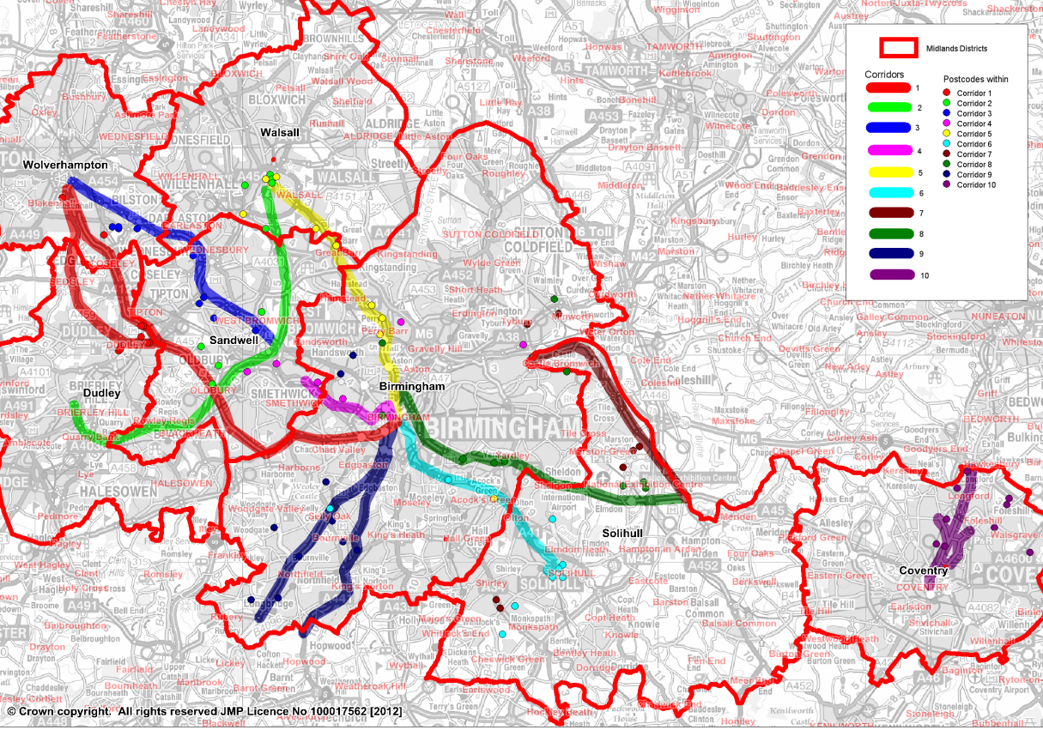
Notes:
HO
In 2013 Centro in conjunction with the West Midlands Local Authorities, and JMP Consultants, started engaging with businesses and business parks as part of our LSTF programme, called ‘Smart Network, Smarter Choices’. We had an ambitious target of providing Travel Plans for 196 business sites, including 70 business parks and industrial estates, based near 10 key congested corridors in the West Midlands.

Slide 3
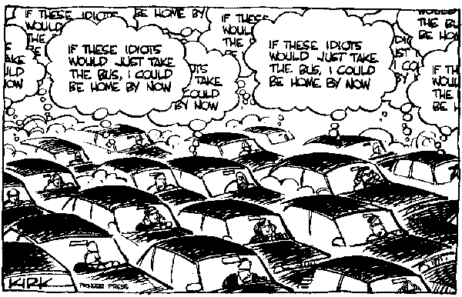
Notes:
HO
The key objectives of the SNSC programme were to help support economic growth and the environment, by improving travel options for all, including access to jobs, and reducing congestion which is costly to the economy.
Business Parks were deemed to be an important focus of the programme because these sites are often a significant cause of traffic congestion and major employment sites. By focusing on them we would get more ‘bang from our buck’ from our LSTF investment, by promoting sustainable travel options to large volumes of businesses and their existing and potential workforce.
The impact of this work, and it’s economic benefits, are being monitored by Centro’s Market Intelligence team as part of their wider outcomes monitoring activity for Department for Transport.

Slide 4
Notes:
HO
We set out trying to meet with our 70 Business Parks and Industrial Estates, to promote our Travel Plan offer and a range of active travel and public transport incentives and activities.
We soon discovered this was an up-hill battle!
Key challenges we faced were that many sites didn’t have a dedicated managing agent, some were comprised of small manufacturing companies that were hard to engage with, and many sites were located in areas with very limited access to sustainable travel routes or services.
By September 2013 only 4 Business Parks had signed up to the programme, so we knew we had to change our approach.

Slide 5
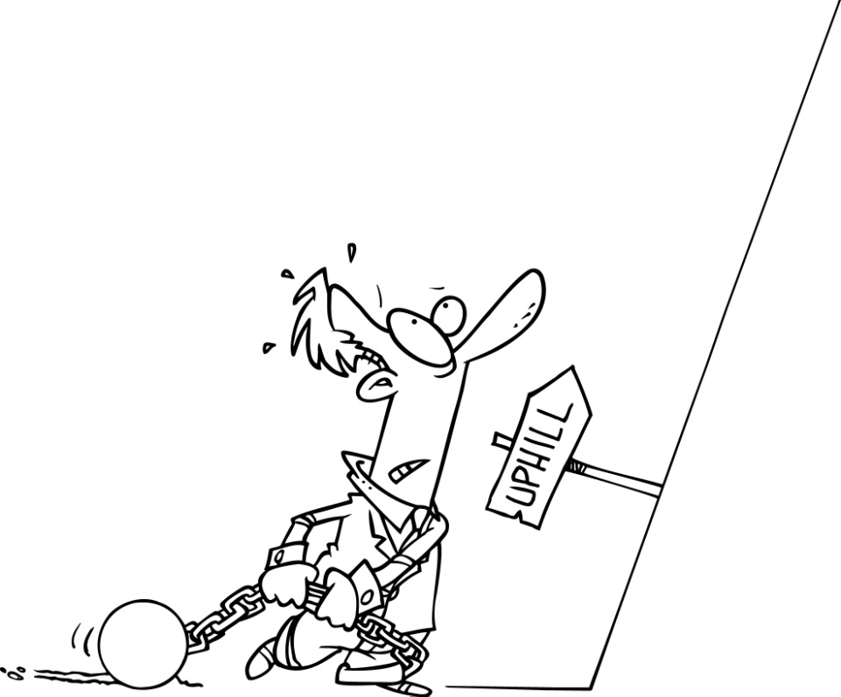
Notes:
HO
Key challenges we faced were that many sites didn’t have a dedicated managing agent, some were comprised of small manufacturing companies that were hard to engage with, and many sites were located in areas with very limited access to sustainable travel routes or services.
By September 2013 only 4 Business Parks had signed up to the programme, so we knew we had to change our approach.

Slide 6
Notes:
HO
We changed our approach and decided to reduce our targets, and separate business park activity as ‘pilot’ to test and learn from different approaches, so we could better understand how to work with these sites.
Our Business Park list was refined down to 20 key sites based on local knowledge, and included a mixture of small and large scale sites, distributed across the seven Local Authority areas of the West Midlands.

Slide 7
Notes:
HO
Through this pilot project we identified 3 key different methods for working with different types of Business Parks and Industrial Estates.
These three approaches were an Area Travel Plan approach, and Anchor Site approach and targeting with Employee Promotions.
Rhian is going to talk through how we implemented these 3 methods, using a case study for each of the 3 approaches.

Slide 8
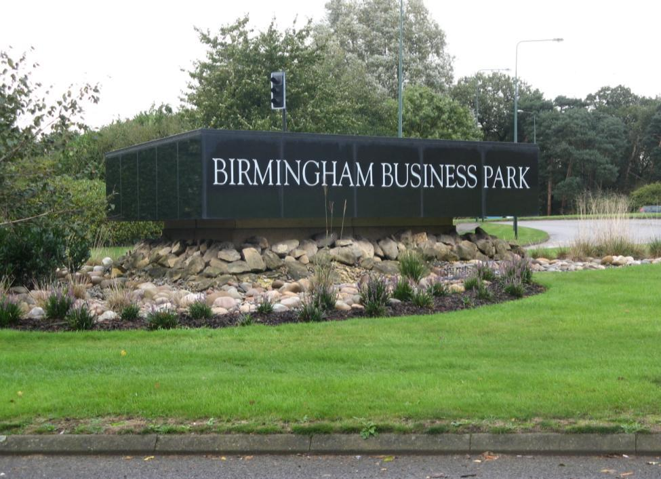
Notes:
Contacted via event/directly?
Central Managing Agent – Goodman (doesn’t manage all the units)
Signed-up (didn’t have parking issues). Already had Liftshare for park (so already had sustainable travel issues). Wants to improve the public transport access to the site. Part of her job – making it sound attractive for new businesses to come to the park. Wants to assure people that there are travel options.
Managing agent has email distribution list for whole site (not got a central website)
Distributed survey to her contacts.
Event on site. She publicised it well. For the size of the park, quite difficult to get lots of people going to the event. Decided to do packs of information out to each business – get fed down to organisations.
We did the packs, she has distributed them.
Applied for the Grant – lighting along the path from the site to the main road (shared use footpath). Working closely with her on improving public transport to the site – looking at getting buses onto the site. Tell her about any changes to bus times so she can feed it through to all the businesses on the site. Have applied for seating (for bus stops). Looked into cycle parking but didn’t go ahead with that.
Provided carousels/leaflet stands in the cafe – cycling offer and PT offer.
Promoted the ticketing offer at the event and in the packs.
Priority to disseminate information to the businesses.
Relocating there: West Midlands Housing and Data Controls and Services are relocating there next year. Erica’s kept some of the packs to new employers before they move onto the site.
Future ideas to get more of a ‘group’ within the Business Park when new employers are in (e.g. DCS). Next year – can provide more tailored action plans to the individual businesses and invite them to meet with us.

Slide 9
Notes:
Contacted via event/directly?
Central Managing Agent – Goodman (doesn’t manage all the units)
Signed-up (didn’t have parking issues). Already had Liftshare for park (so already had sustainable travel issues). Wants to improve the public transport access to the site. Part of her job – making it sound attractive for new businesses to come to the park. Wants to assure people that there are travel options.
Managing agent has email distribution list for whole site (not got a central website)
Distributed survey to her contacts.
Event on site. She publicised it well. For the size of the park, quite difficult to get lots of people going to the event. Decided to do packs of information out to each business – get fed down to organisations.
We did the packs, she has distributed them.
Applied for the Grant – lighting along the path from the site to the main road (shared use footpath). Working closely with her on improving public transport to the site – looking at getting buses onto the site. Tell her about any changes to bus times so she can feed it through to all the businesses on the site. Have applied for seating (for bus stops). Looked into cycle parking but didn’t go ahead with that.
Provided carousels/leaflet stands in the cafe – cycling offer and PT offer.
Promoted the ticketing offer at the event and in the packs.
Priority to disseminate information to the businesses.
Relocating there: West Midlands Housing and Data Controls and Services are relocating there next year. Erica’s kept some of the packs to new employers before they move onto the site.
Future ideas to get more of a ‘group’ within the Business Park when new employers are in (e.g. DCS). Next year – can provide more tailored action plans to the individual businesses and invite them to meet with us.

Slide 10
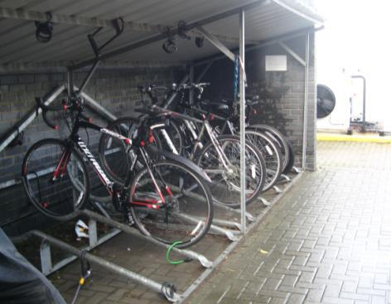
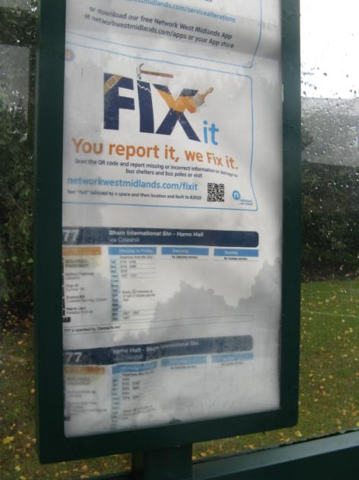
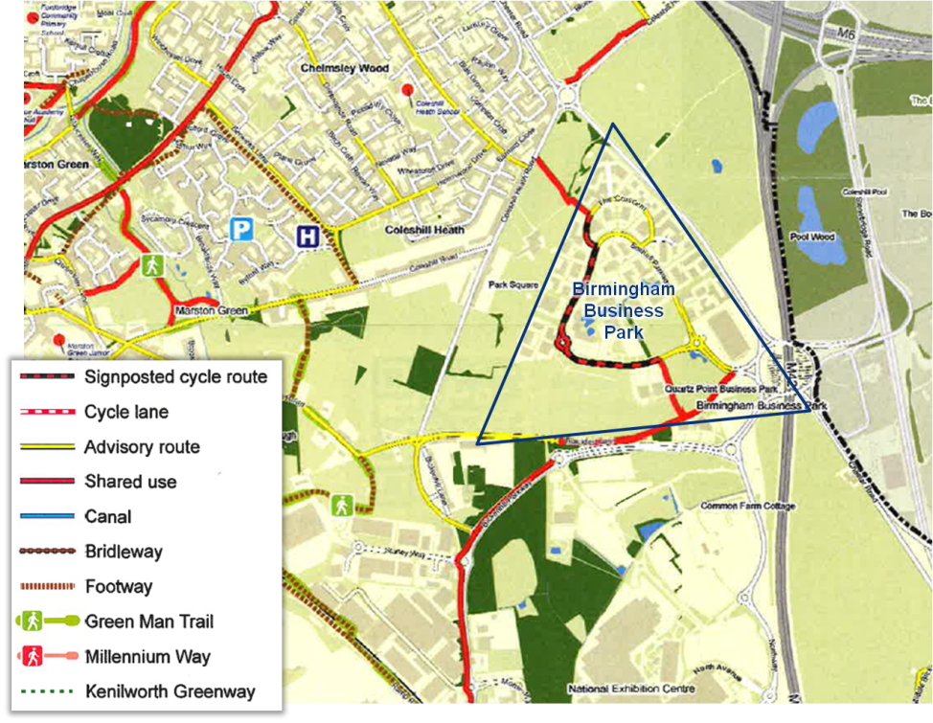
Notes:
Contacted via event/directly?
Central Managing Agent – Goodman (doesn’t manage all the units)
Signed-up (didn’t have parking issues). Already had Liftshare for park (so already had sustainable travel issues). Wants to improve the public transport access to the site. Part of her job – making it sound attractive for new businesses to come to the park. Wants to assure people that there are travel options.
Managing agent has email distribution list for whole site (not got a central website)
Distributed survey to her contacts.
Event on site. She publicised it well. For the size of the park, quite difficult to get lots of people going to the event. Decided to do packs of information out to each business – get fed down to organisations.
We did the packs, she has distributed them.
Applied for the Grant – lighting along the path from the site to the main road (shared use footpath). Working closely with her on improving public transport to the site – looking at getting buses onto the site. Tell her about any changes to bus times so she can feed it through to all the businesses on the site. Have applied for seating (for bus stops). Looked into cycle parking but didn’t go ahead with that.
Provided carousels/leaflet stands in the cafe – cycling offer and PT offer.
Promoted the ticketing offer at the event and in the packs.
Priority to disseminate information to the businesses.
Relocating there: West Midlands Housing and Data Controls and Services are relocating there next year. Erica’s kept some of the packs to new employers before they move onto the site.
Future ideas to get more of a ‘group’ within the Business Park when new employers are in (e.g. DCS). Next year – can provide more tailored action plans to the individual businesses and invite them to meet with us.

Slide 11
Notes:
Contacted via event/directly?
Central Managing Agent – Goodman (doesn’t manage all the units)
Signed-up (didn’t have parking issues). Already had Liftshare for park (so already had sustainable travel issues). Wants to improve the public transport access to the site. Part of her job – making it sound attractive for new businesses to come to the park. Wants to assure people that there are travel options.
Managing agent has email distribution list for whole site (not got a central website)
Distributed survey to her contacts.
Event on site. She publicised it well. For the size of the park, quite difficult to get lots of people going to the event. Decided to do packs of information out to each business – get fed down to organisations.
We did the packs, she has distributed them.
Applied for the Grant – lighting along the path from the site to the main road (shared use footpath). Working closely with her on improving public transport to the site – looking at getting buses onto the site. Tell her about any changes to bus times so she can feed it through to all the businesses on the site. Have applied for seating (for bus stops). Looked into cycle parking but didn’t go ahead with that.
Provided carousels/leaflet stands in the cafe – cycling offer and PT offer.
Promoted the ticketing offer at the event and in the packs.
Priority to disseminate information to the businesses.
Relocating there: West Midlands Housing and Data Controls and Services are relocating there next year. Erica’s kept some of the packs to new employers before they move onto the site.
Future ideas to get more of a ‘group’ within the Business Park when new employers are in (e.g. DCS). Next year – can provide more tailored action plans to the individual businesses and invite them to meet with us.

Slide 12
Notes:
Example:
Kings Norton Business Centre
Went initially to a company on the site – no luck
Managed by a property management company – approached them centrally to get them engaged
Few lines of communication
Three companies responded well to surveys
Adopting the largest as an anchor site (Equiniti)
Supporting the other two companies that completed surveys
Issuing employee promotions at the surrounding sites
Equiniti produced a Travel Plan
Have issued tickets about try before you buy offer

Slide 13
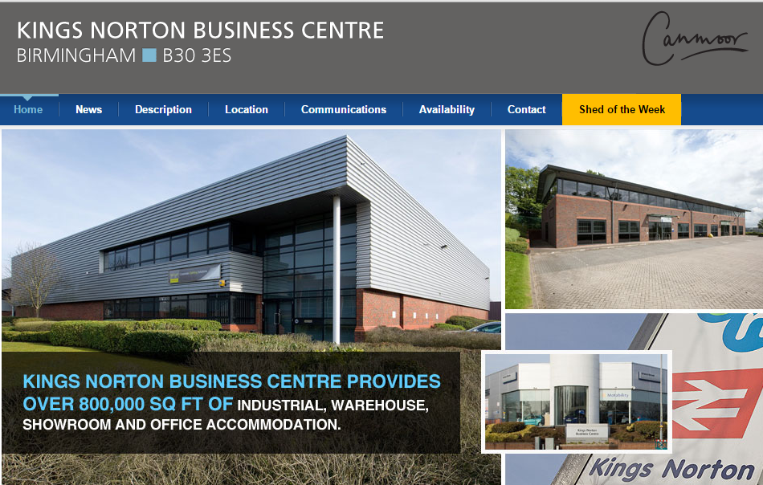
Notes:
Example:
Kings Norton Business Centre
Went initially to a company on the site – no luck
Managed by a property management company – approached them centrally to get them engaged
Few lines of communication
Three companies responded well to surveys
Adopting the largest as an anchor site (Equiniti)
Supporting the other two companies that completed surveys
Issuing employee promotions at the surrounding sites
Equiniti produced a Travel Plan
Have issued tickets about try before you buy offer

Slide 14
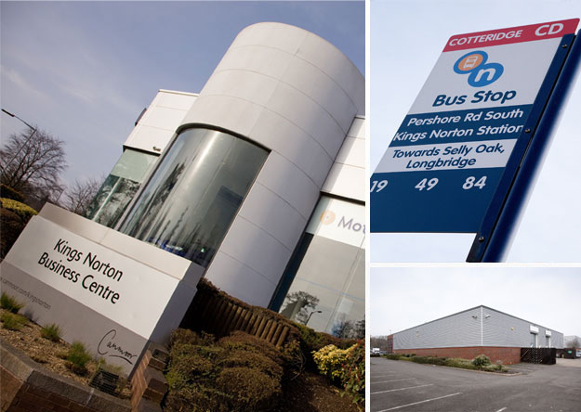
Notes:
Example:
Kings Norton Business Centre
Went initially to a company on the site – no luck
Managed by a property management company – approached them centrally to get them engaged
Few lines of communication
Three companies responded well to surveys
Adopting the largest as an anchor site (Equiniti)
Supporting the other two companies that completed surveys
Issuing employee promotions at the surrounding sites
Equiniti produced a Travel Plan
Have issued tickets about try before you buy offer

Slide 15
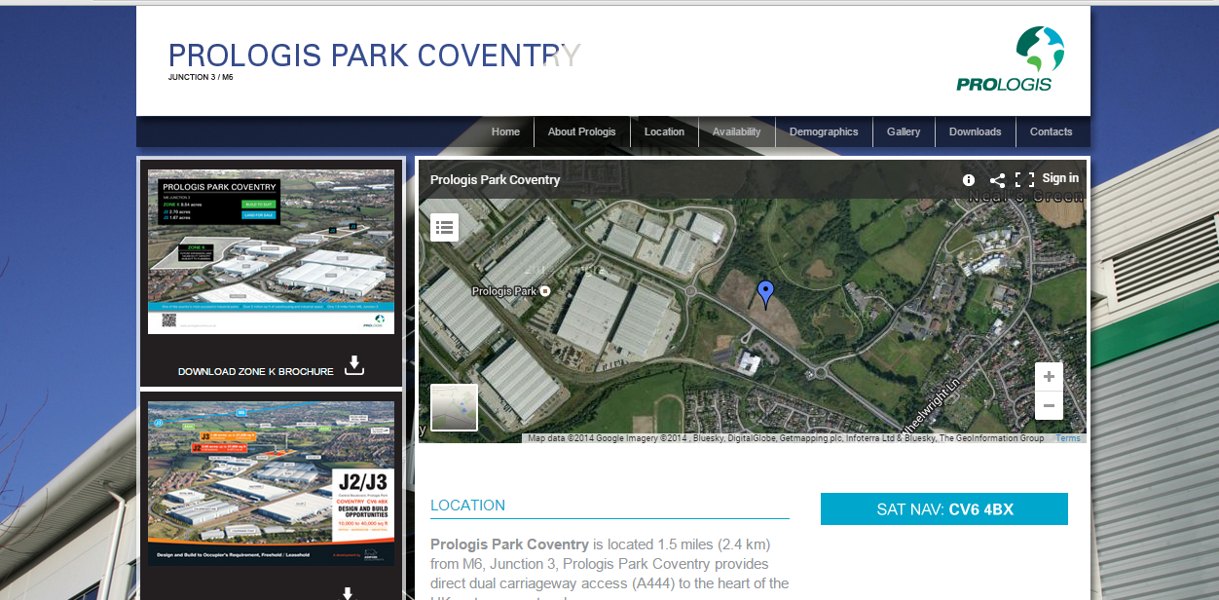
Notes:
Employee Promotions
Prologis Business Park.
Tried to engage with individual companies on this site with no luck.

Slide 16
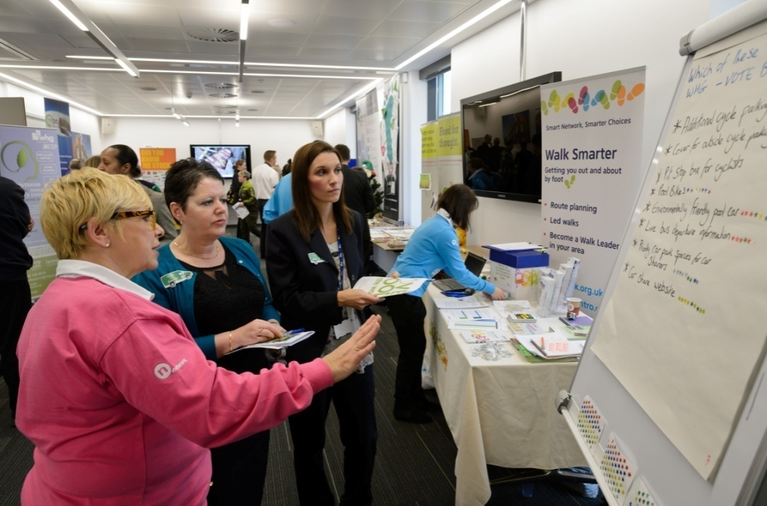
Notes:
Employee Promotions
Prologis Business Park.
Tried to engage with individual companies on this site with no luck.

Slide 17
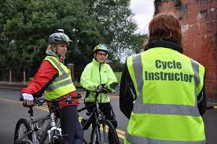
Notes:
Employee Promotions
Prologis Business Park.
Tried to engage with individual companies on this site with no luck.

Slide 18
Notes:
HO
As we are still in the middle of our engagement activity with Business Parks, it is too early to report full results.
However, in terms of lessons learnt from our work, we have found that it is easiest to engage with sites that have managing agents to liaise with us, to act as a communication channel with the businesses on the site and to provide longevity to our work.
The Area Travel Plan approach is the best approach in being able to effectively monitor the outcomes of our work. By setting and monitoring targets for the site it can help us see impact on car trips, which has a knock on effect to congestion, which will impact on the economic benefits of our programme. It also provides a legacy for our work, helping to ensure longer-term take up of sustainable travel measures. This provides a better return on our investment and helps sites provide sustainable access to jobs in the longer term.
The Employee Promotions approach is good for being able to work with sites that don’t want a Travel Plan, but is problematic as only outputs (e.g. Cycle training taken up) can be monitored (as opposed to outcomes) and activity is short-term. We are therefore more reliant on other monitoring work, such as surveying of participants and local residents to see if activity has led to travel behaviour change and other benefits such as improved perception of access to jobs.

Slide 19
Notes:
HO
It also provides a legacy for our work, helping to ensure longer-term take up of sustainable travel measures. This provides a better return on our investment and helps sites provide sustainable access to jobs in the longer term.
The Employee Promotions approach is good for being able to work with sites that don’t want a Travel Plan, but is problematic as only outputs (e.g. Cycle training taken up) can be monitored (as opposed to outcomes) and activity is short-term. We are therefore more reliant on other monitoring work, such as surveying of participants and local residents to see if activity has led to travel behaviour change and other benefits such as improved perception of access to jobs.

Slide 20
Any questions?
helenosborn@centro.org.uk
rhian.lewis@jmp.co.uk

