Slide 2
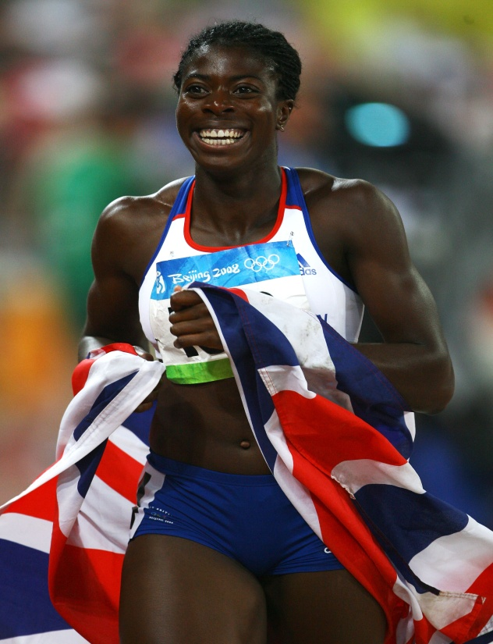
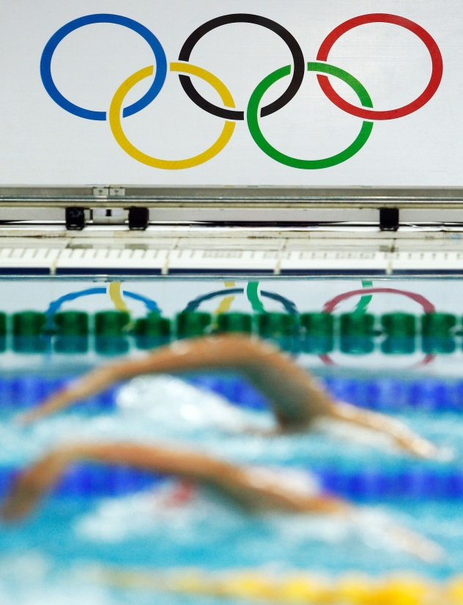
The Olympic Games - the world’s biggest event
205 countries
5,000 Olympic Family
17,800 athletes & team officials
22,000 media
8 million tickets sold
The Paralympic Games - two weeks later
147 countries
1,000 Paralympic Family
4,000 athletes & team officials
4,000 media
2 million tickets sold
100,000 workforce including volunteers 4 billion global
audience
Notes:
I hope that showed you some of the challenges we face – the scale of the games is extraordinary and we are building the first new urban park in London in 150 years.

Slide 3
London 2012 Delivery Structure
IOC
BOA
LOCOG
GLA
Olympic
Board
Olympic
Delivery
Authority
LOCOG
GOVT
Infrastructure
Design & Construction
Transport

Slide 4
Challenge – Olympic Park, April 2006
Notes:
The challenges faced
Was important to put the size of the contribution against the scale of the challenge faced
ODA inherited site that had suffered from generational neglect
Tasked with delivering a construction programme twice the size of Terminal 5 in half the time
Cynicism about the UK’s ability to deliver this programme

Slide 5
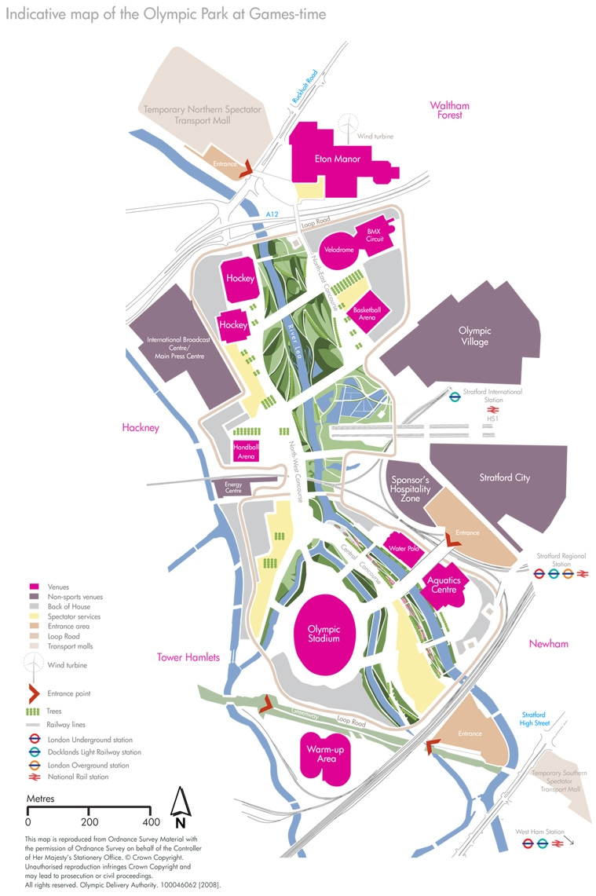

Slide 6
Delivery Structure
ODA
Contract
Delivery Partner
Management
T1C
T1C
T1C
T1C
T1C
T2C
T2C
T2C
T2C
T2C

Slide 7
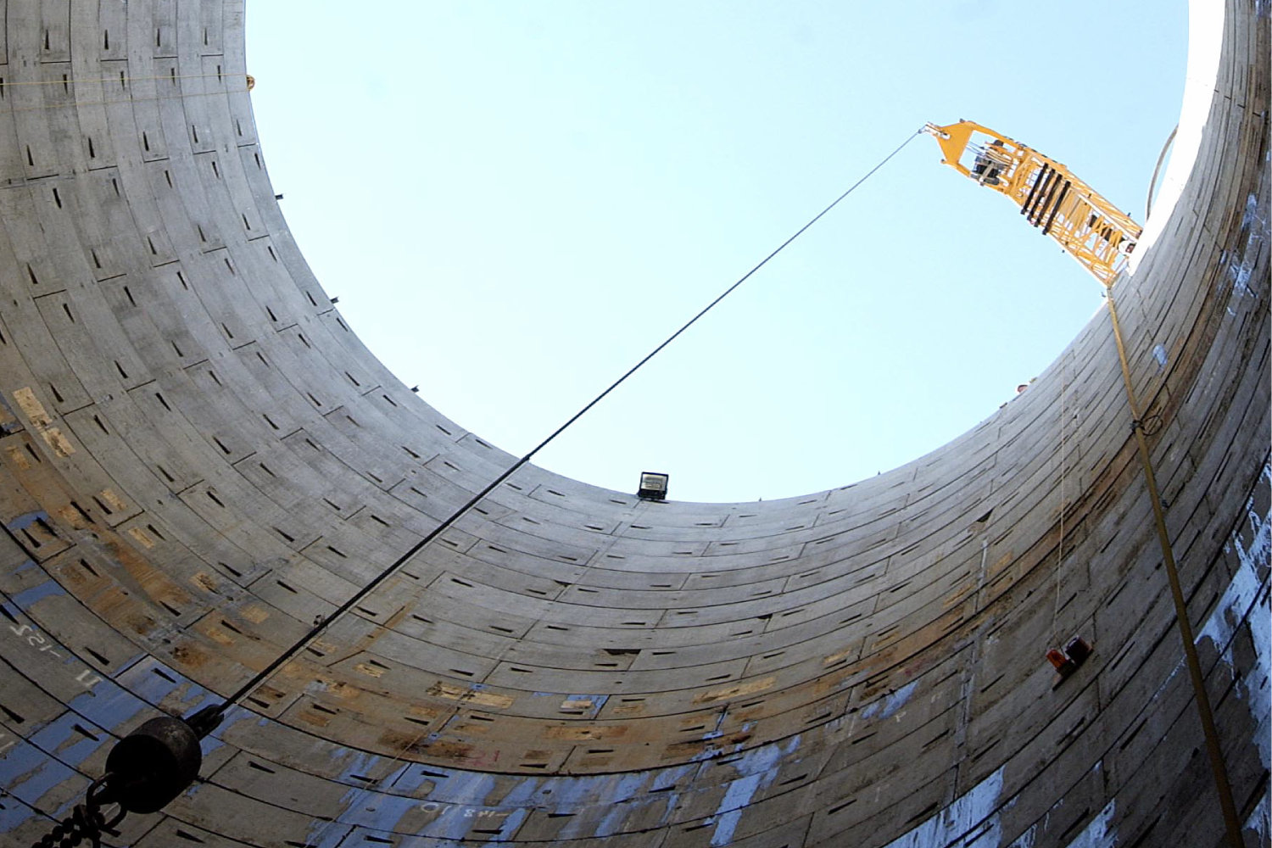
Powerlines Project
Notes:
Our first major project
The power for the Olympic Park has been switched underground and the 52 electricity pylons that previously dominated the landscape have been removed. There are now 6km of tunnels below the Olympic park and they run 30 metres deep below the surface. The tunnels were finished on time in 2008 200km of electrical cables were installed – enough to stretch from London to Nottingham. This project was completed on time and on budget.

Slide 8
Demolition and Remediation
Notes:
We started by submitting the largest planning application in European history, whilst simultaneously demolishing, cleaning and clearing the site
The soil on site was contaminated and we began a process of clearing the land and cleaning the soil on site, rather than taking the contaminated soil away.

Slide 9
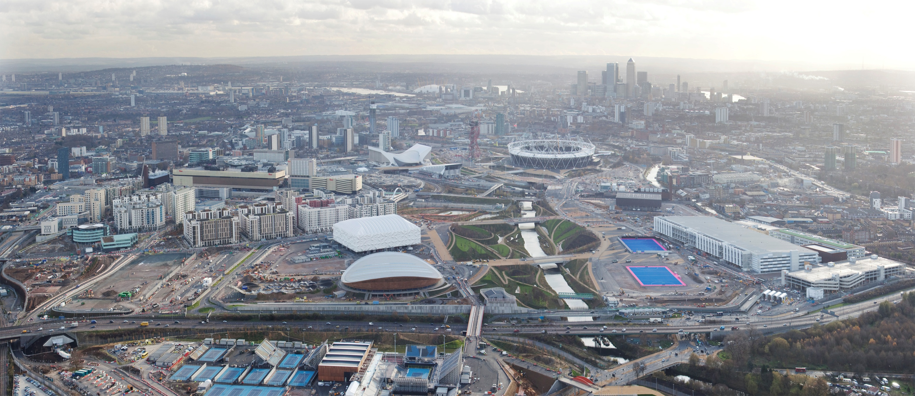
Change – Olympic Park, December 2011
Notes:
The change
Fast forward to the present and the construction programme is 88% complete
The Olympic Park is transforming and dominating the East London skyline

Slide 10
Greenwich Arena

Slide 11
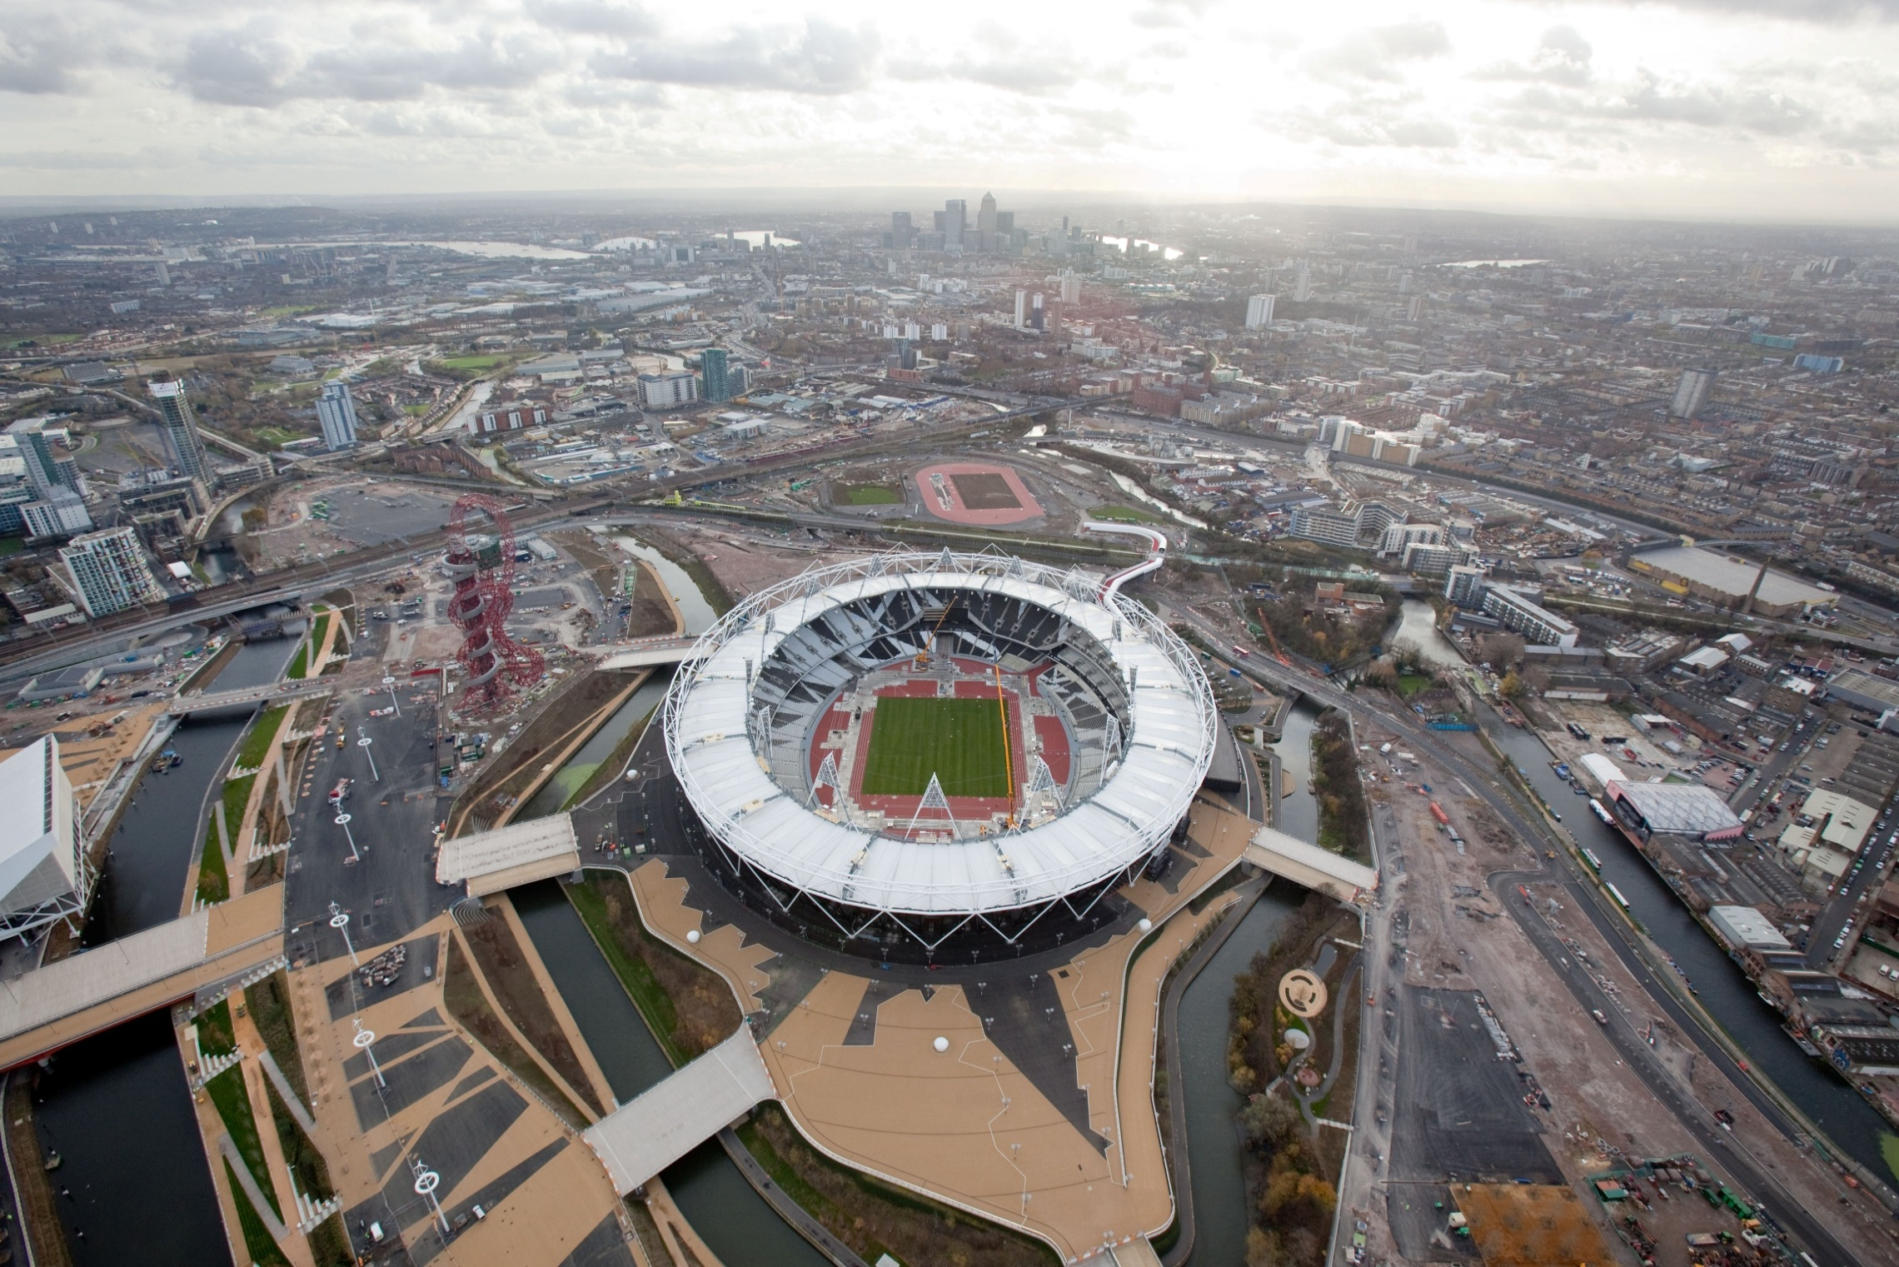
Olympic Stadium

Slide 13
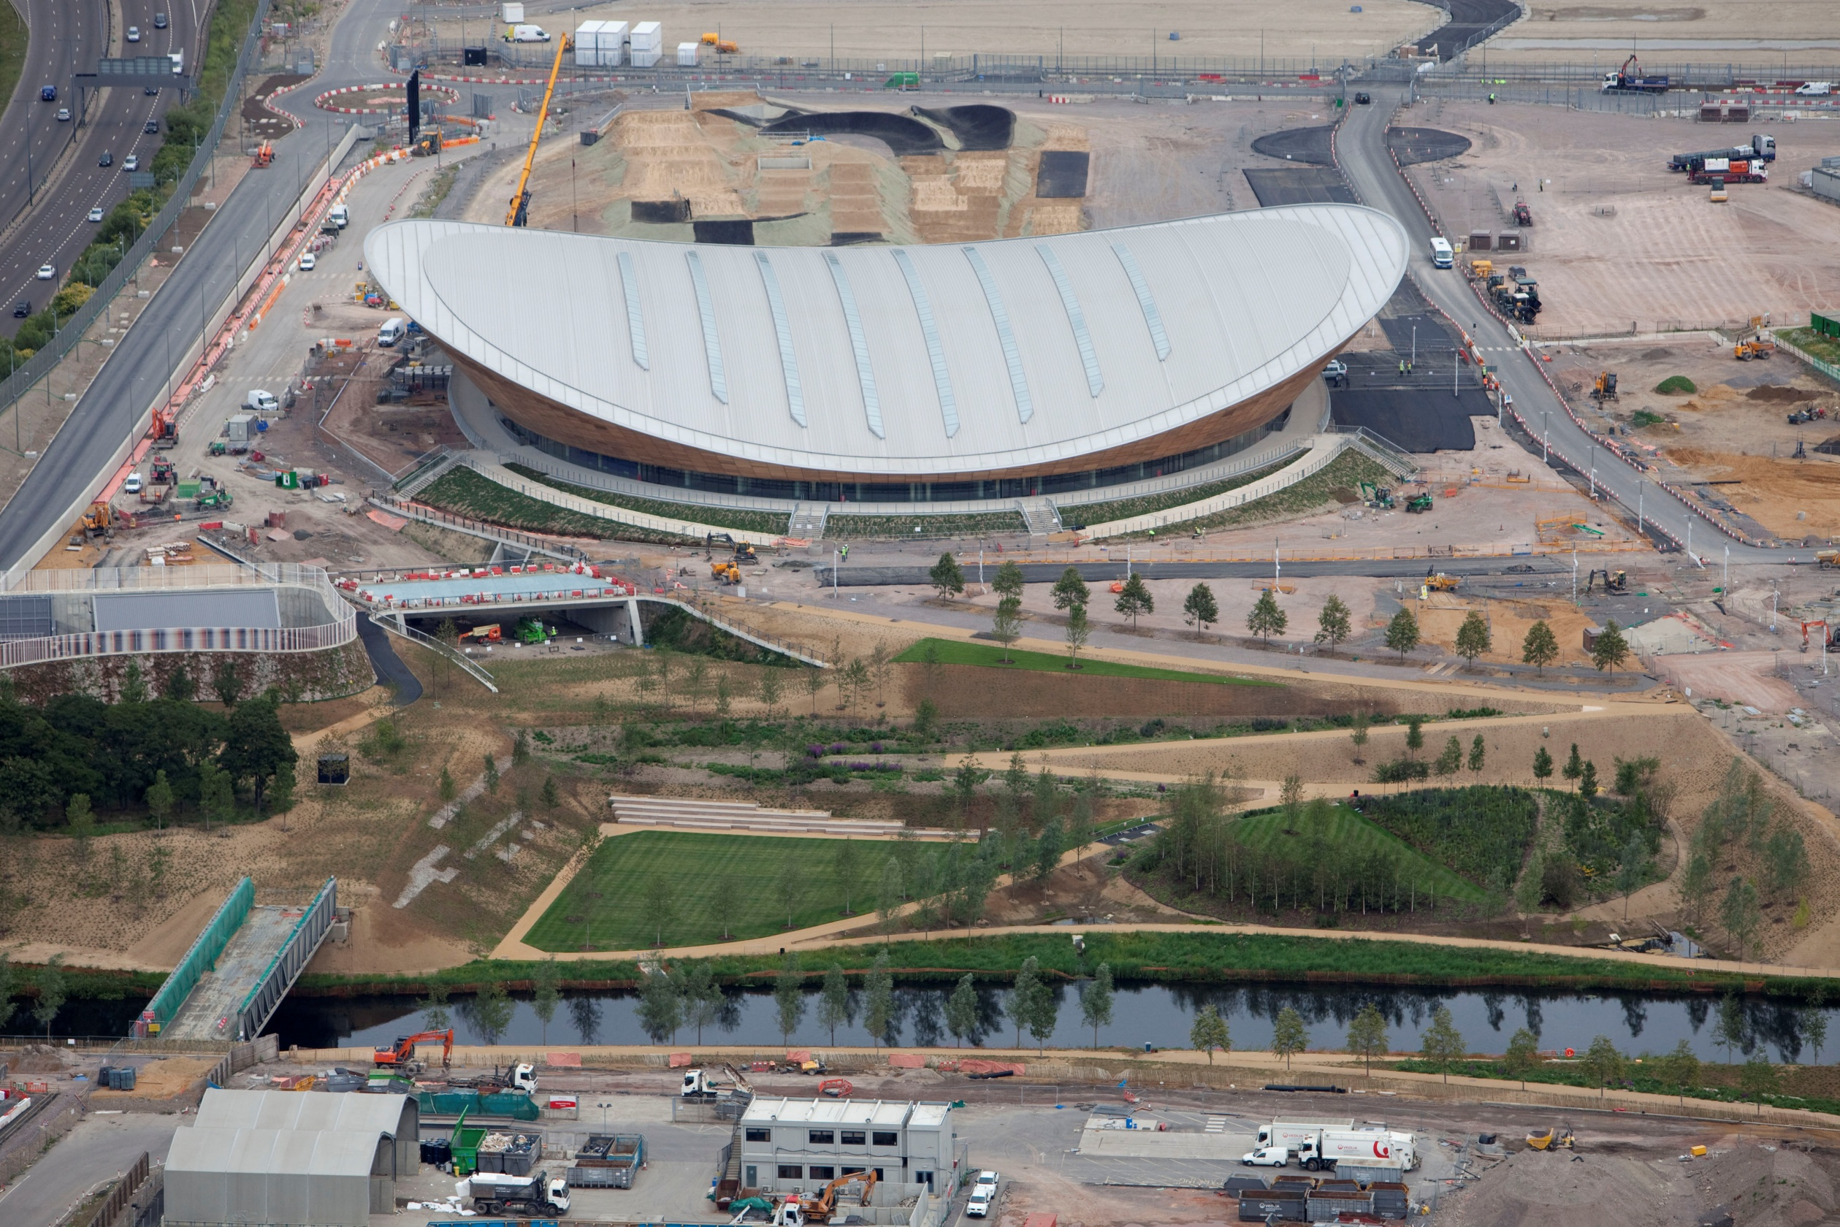
Velodrome
Notes:
Venue Complete
Strategically placed roof lights reduce on the need for artificial light . Almost 100% naturally ventilated
Designed to reduce water consumption by 44% through low use water fittings (to a comparable facility)
Rainwater harvesting for toilet flushing and landscape irrigation - captures and uses about half of the rainwater that falls on the roof
Light-weight venue design lowers carbon footprint

Slide 15
Aquatics

Slide 18
Basketball

Slide 19
Handball

Slide 20
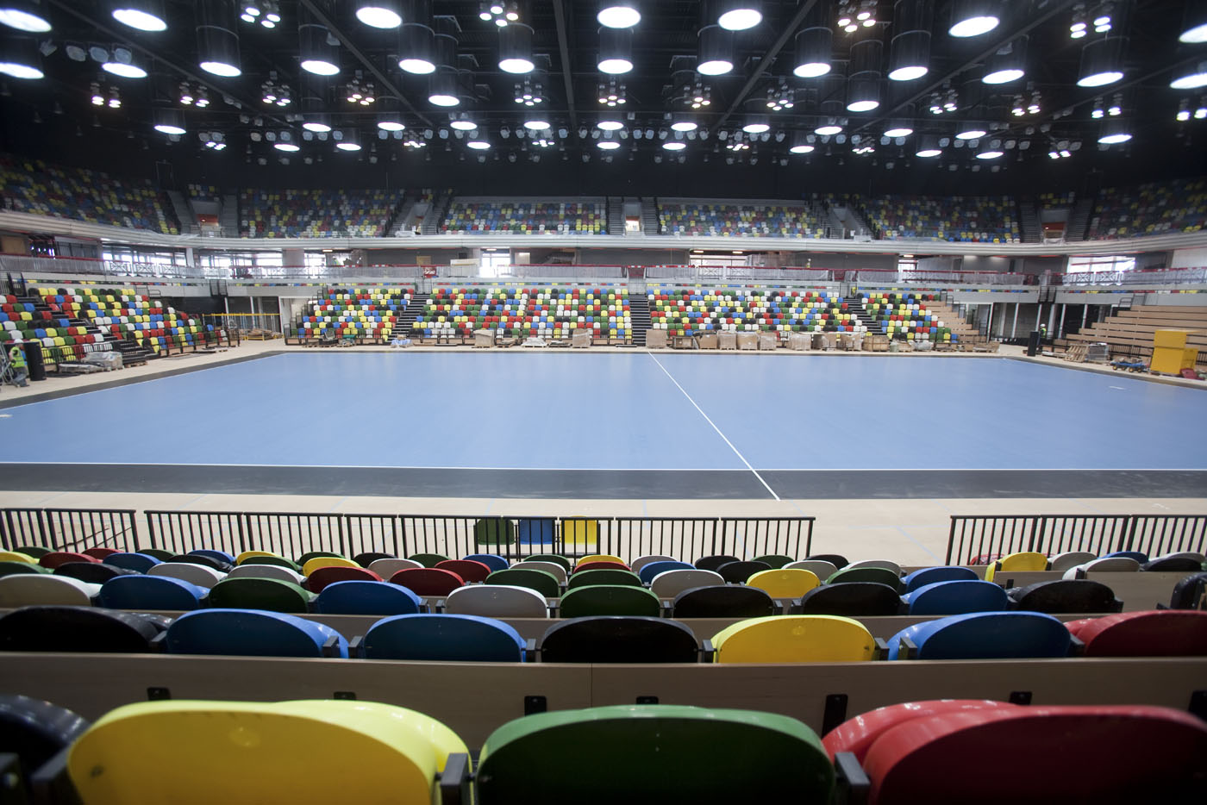

Slide 21
Broxbourne White Water Canoe Centre

Slide 22
IBC/MPC

Slide 24
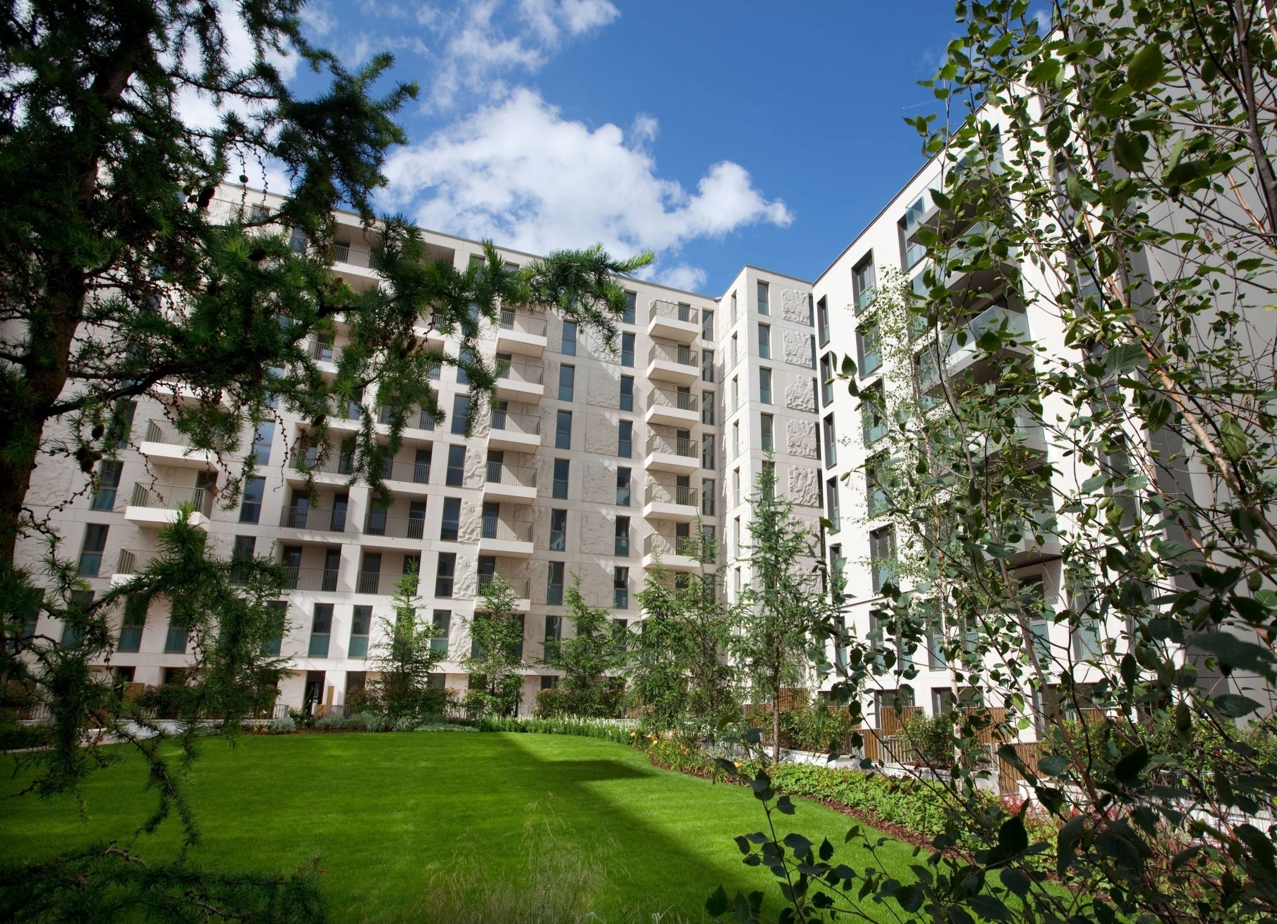

Slide 26
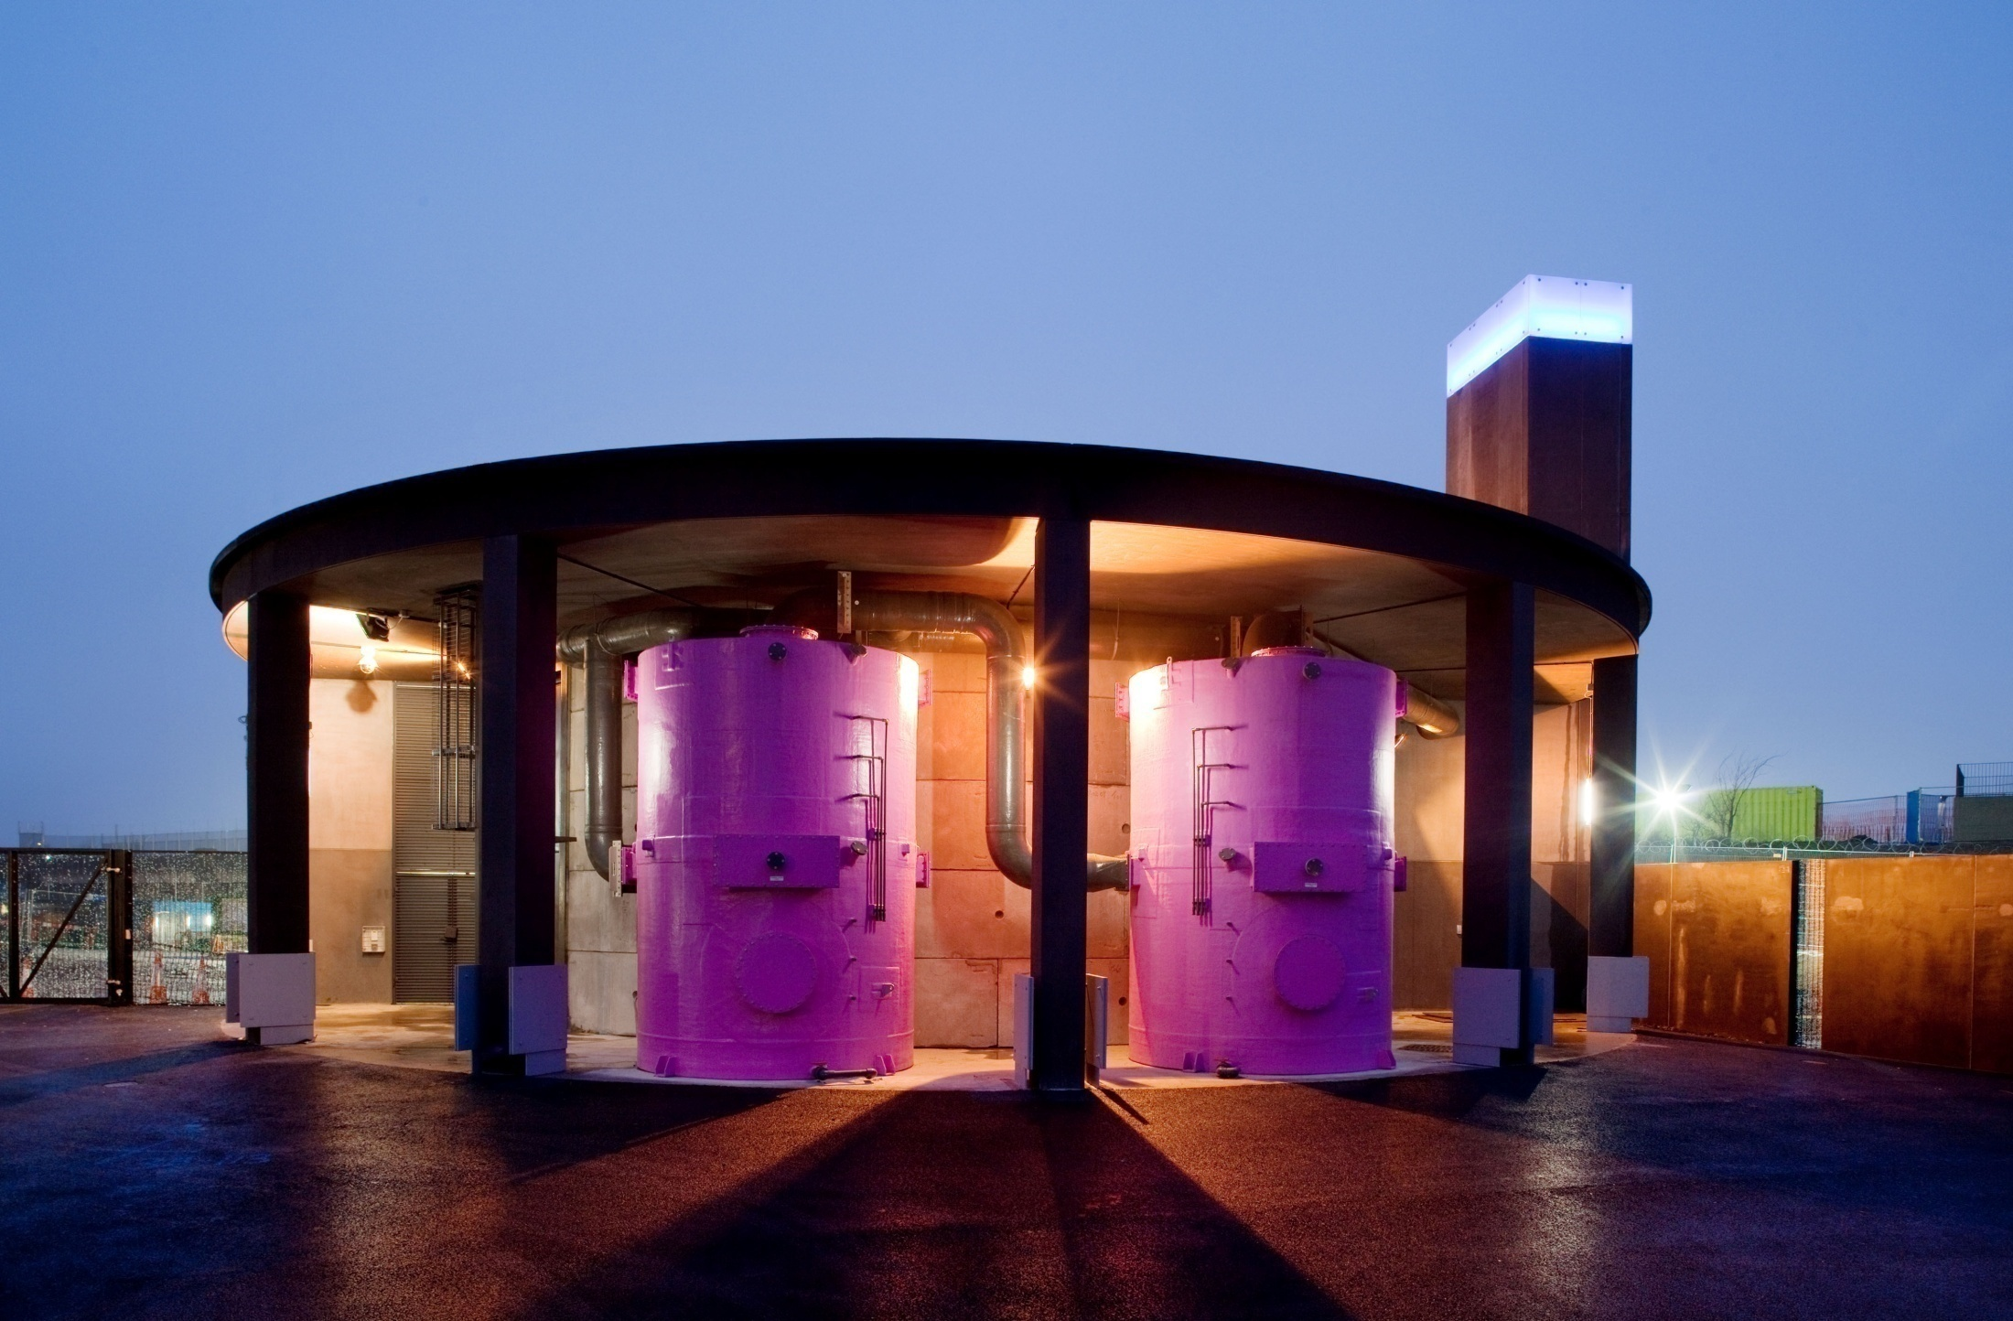
Utilities

Slide 27
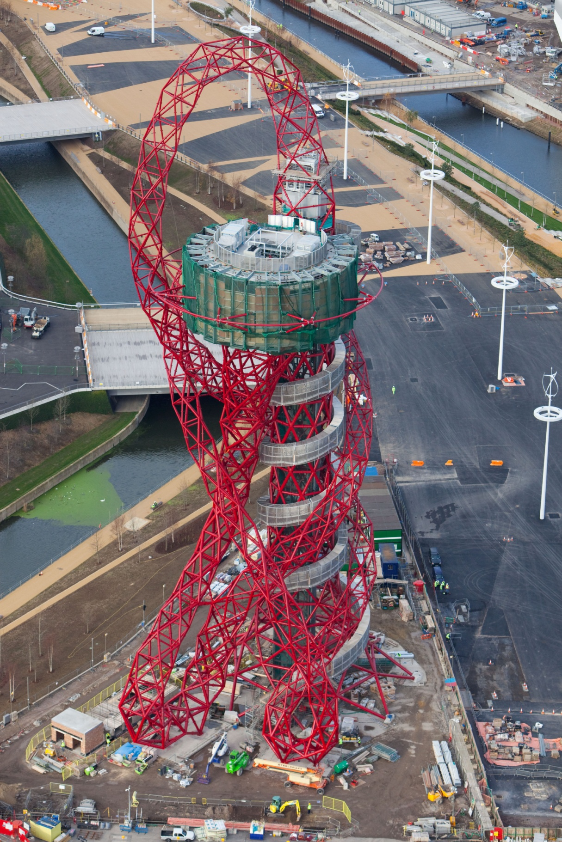
The ArcelorMittal Orbit

Slide 28
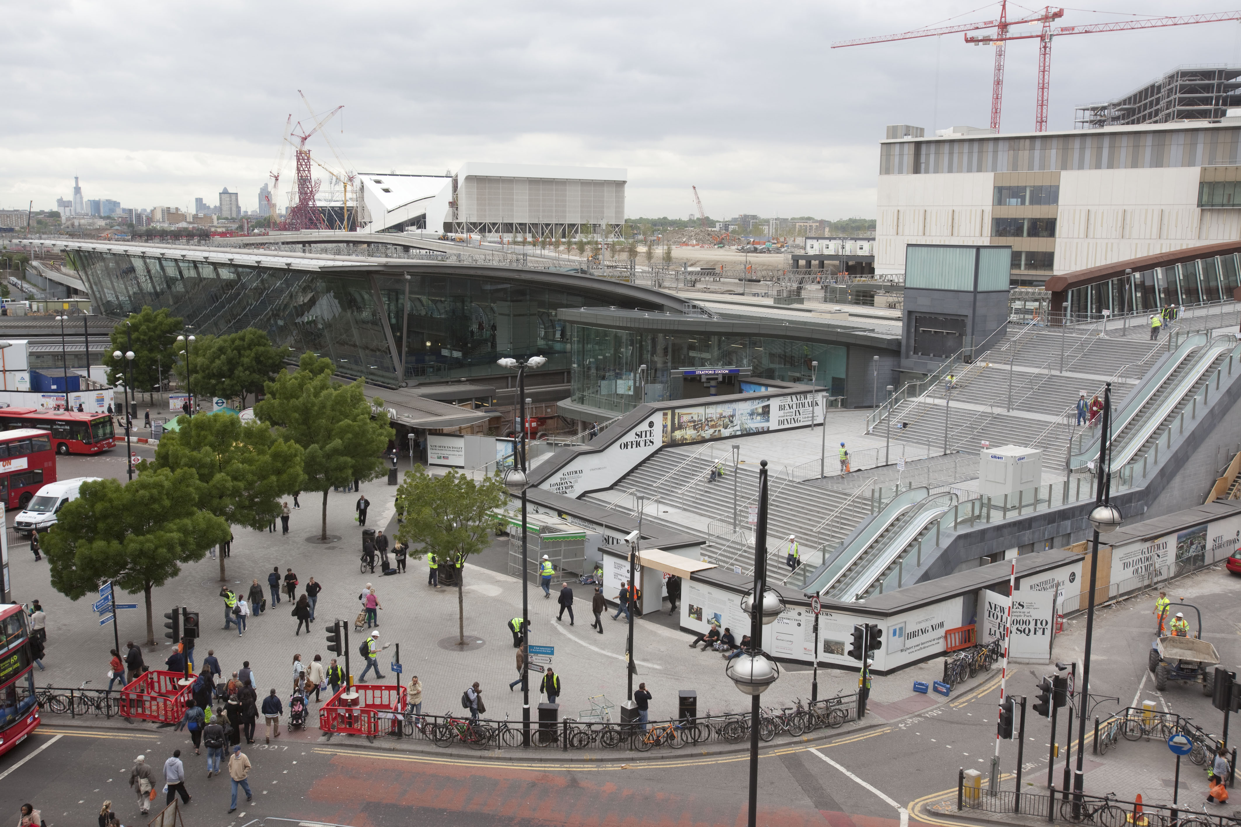
Stratford Regional Station

Slide 29
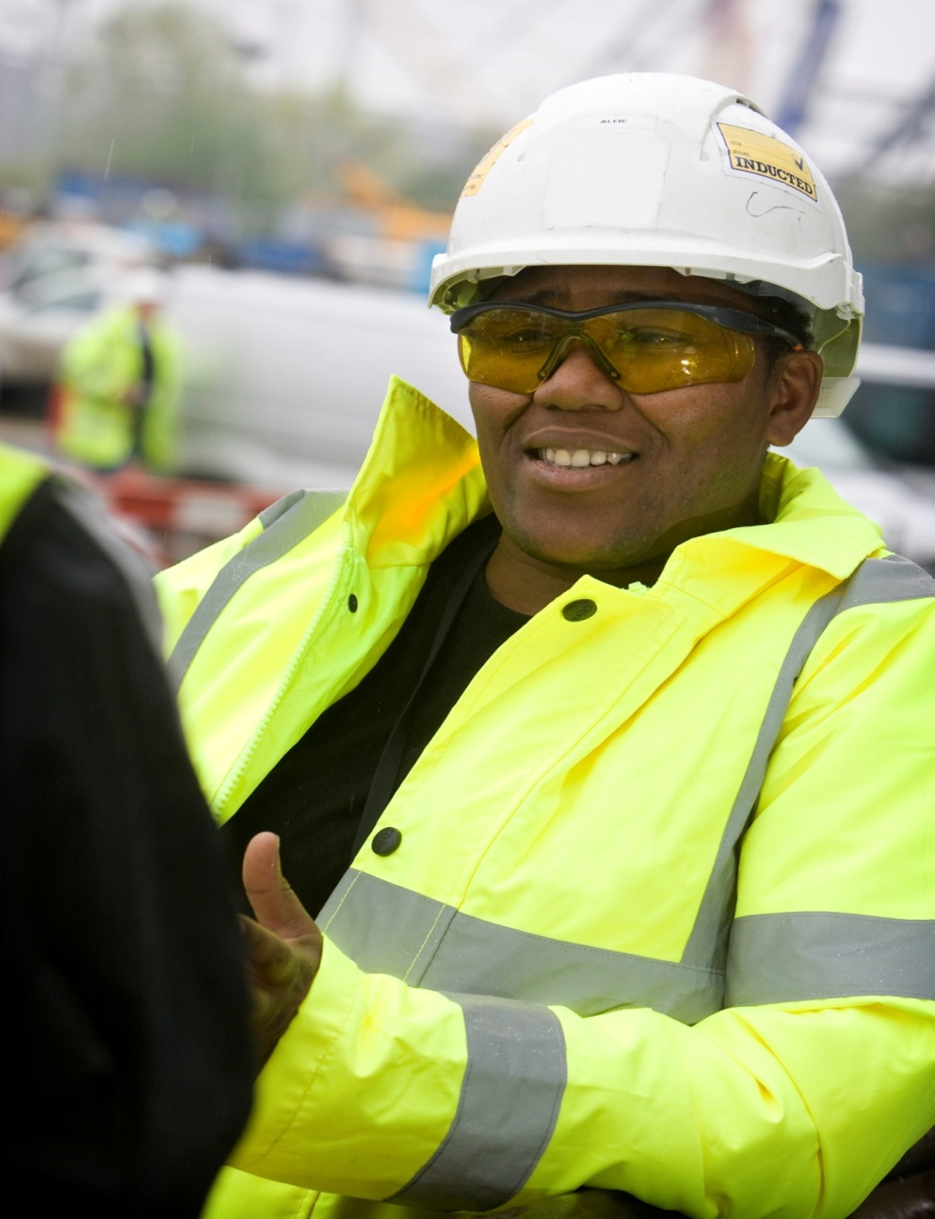
Employment – creating job & training opportunities
40,000 - have worked on the Olympic Park and Olympic Village during the Big Build phase of the project
25% - approximately one in five people are from the five Host boroughs – Greenwich, Hackney, Newham, Tower Hamlets, Waltham Forest
13 % - Previously unemployed
457 - apprentices have worked on the project

Slide 30
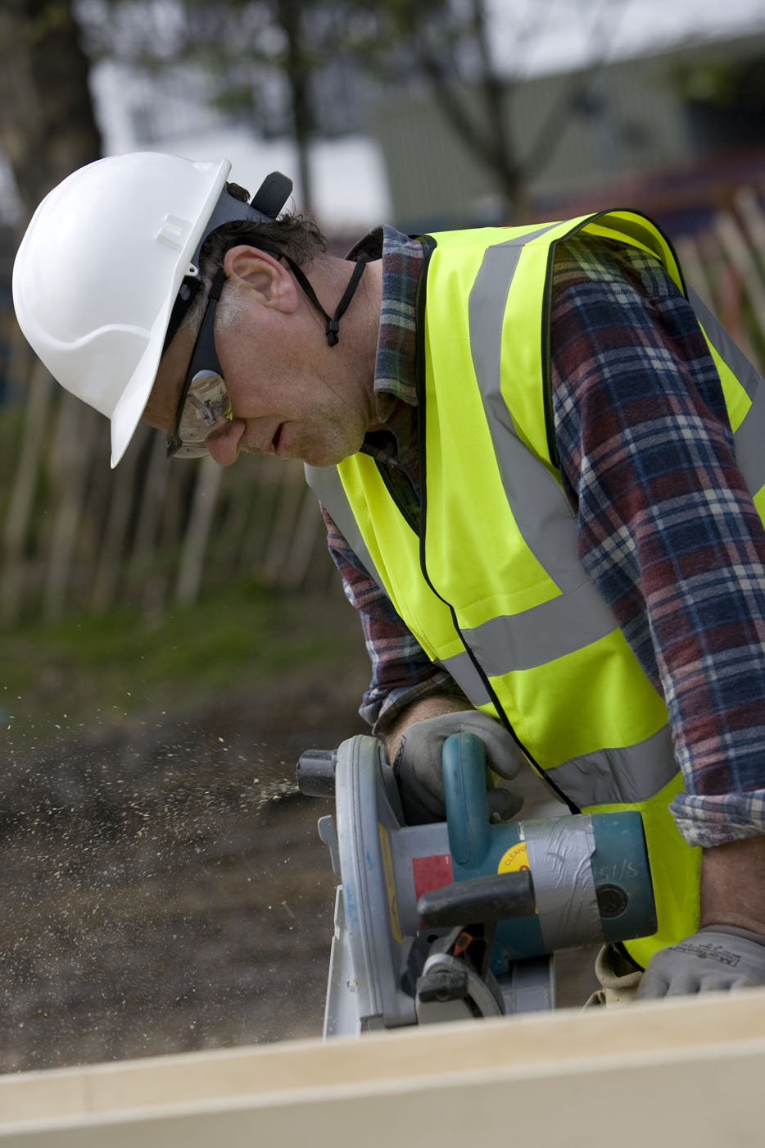
Health and Safety
The ODA has achieved health and safety record better than industry average since start of project
The Olympic Park has an on-site medical centre with health checks for every worker.
70 million hours worked and 24 million hours without RIDDOR reportable incident
Accident Frequency Rate (AFR) since commencement of project is 0.17, well below the industry average
Education and health promotion campaigns are run across the site

Slide 31
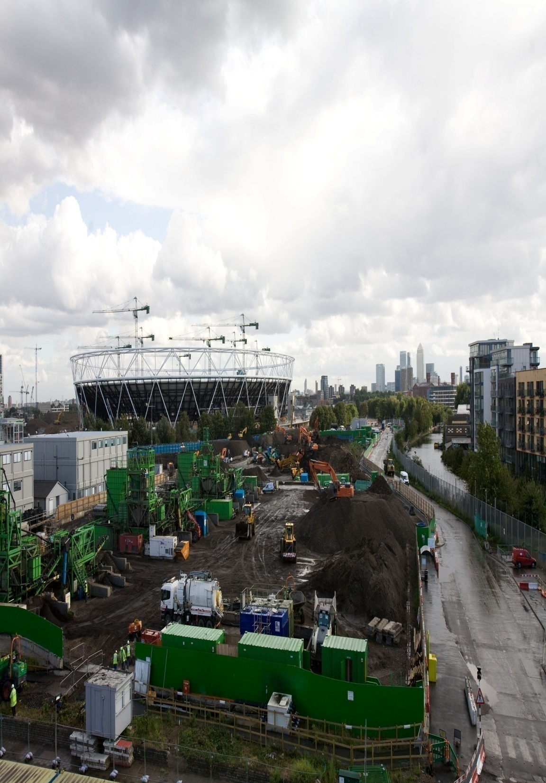
Sustainability
75p in every £1 spent on long-term regeneration of the area
50% of construction materials delivered to the Olympic Park by rail or water.
90% of demolition materials from site reclaimed for re-use of recycling
100% timber for sustainable sources
58% Potable water reduction

Slide 32
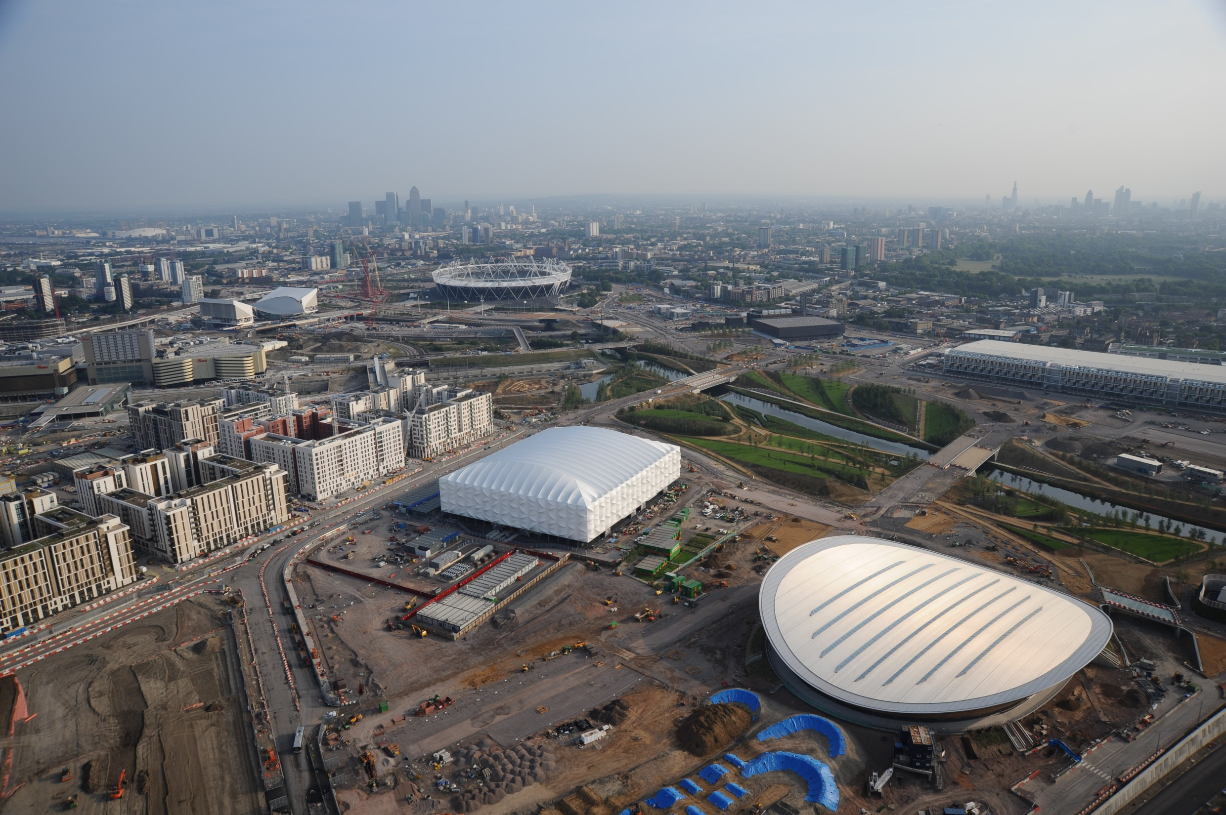

Slide 33
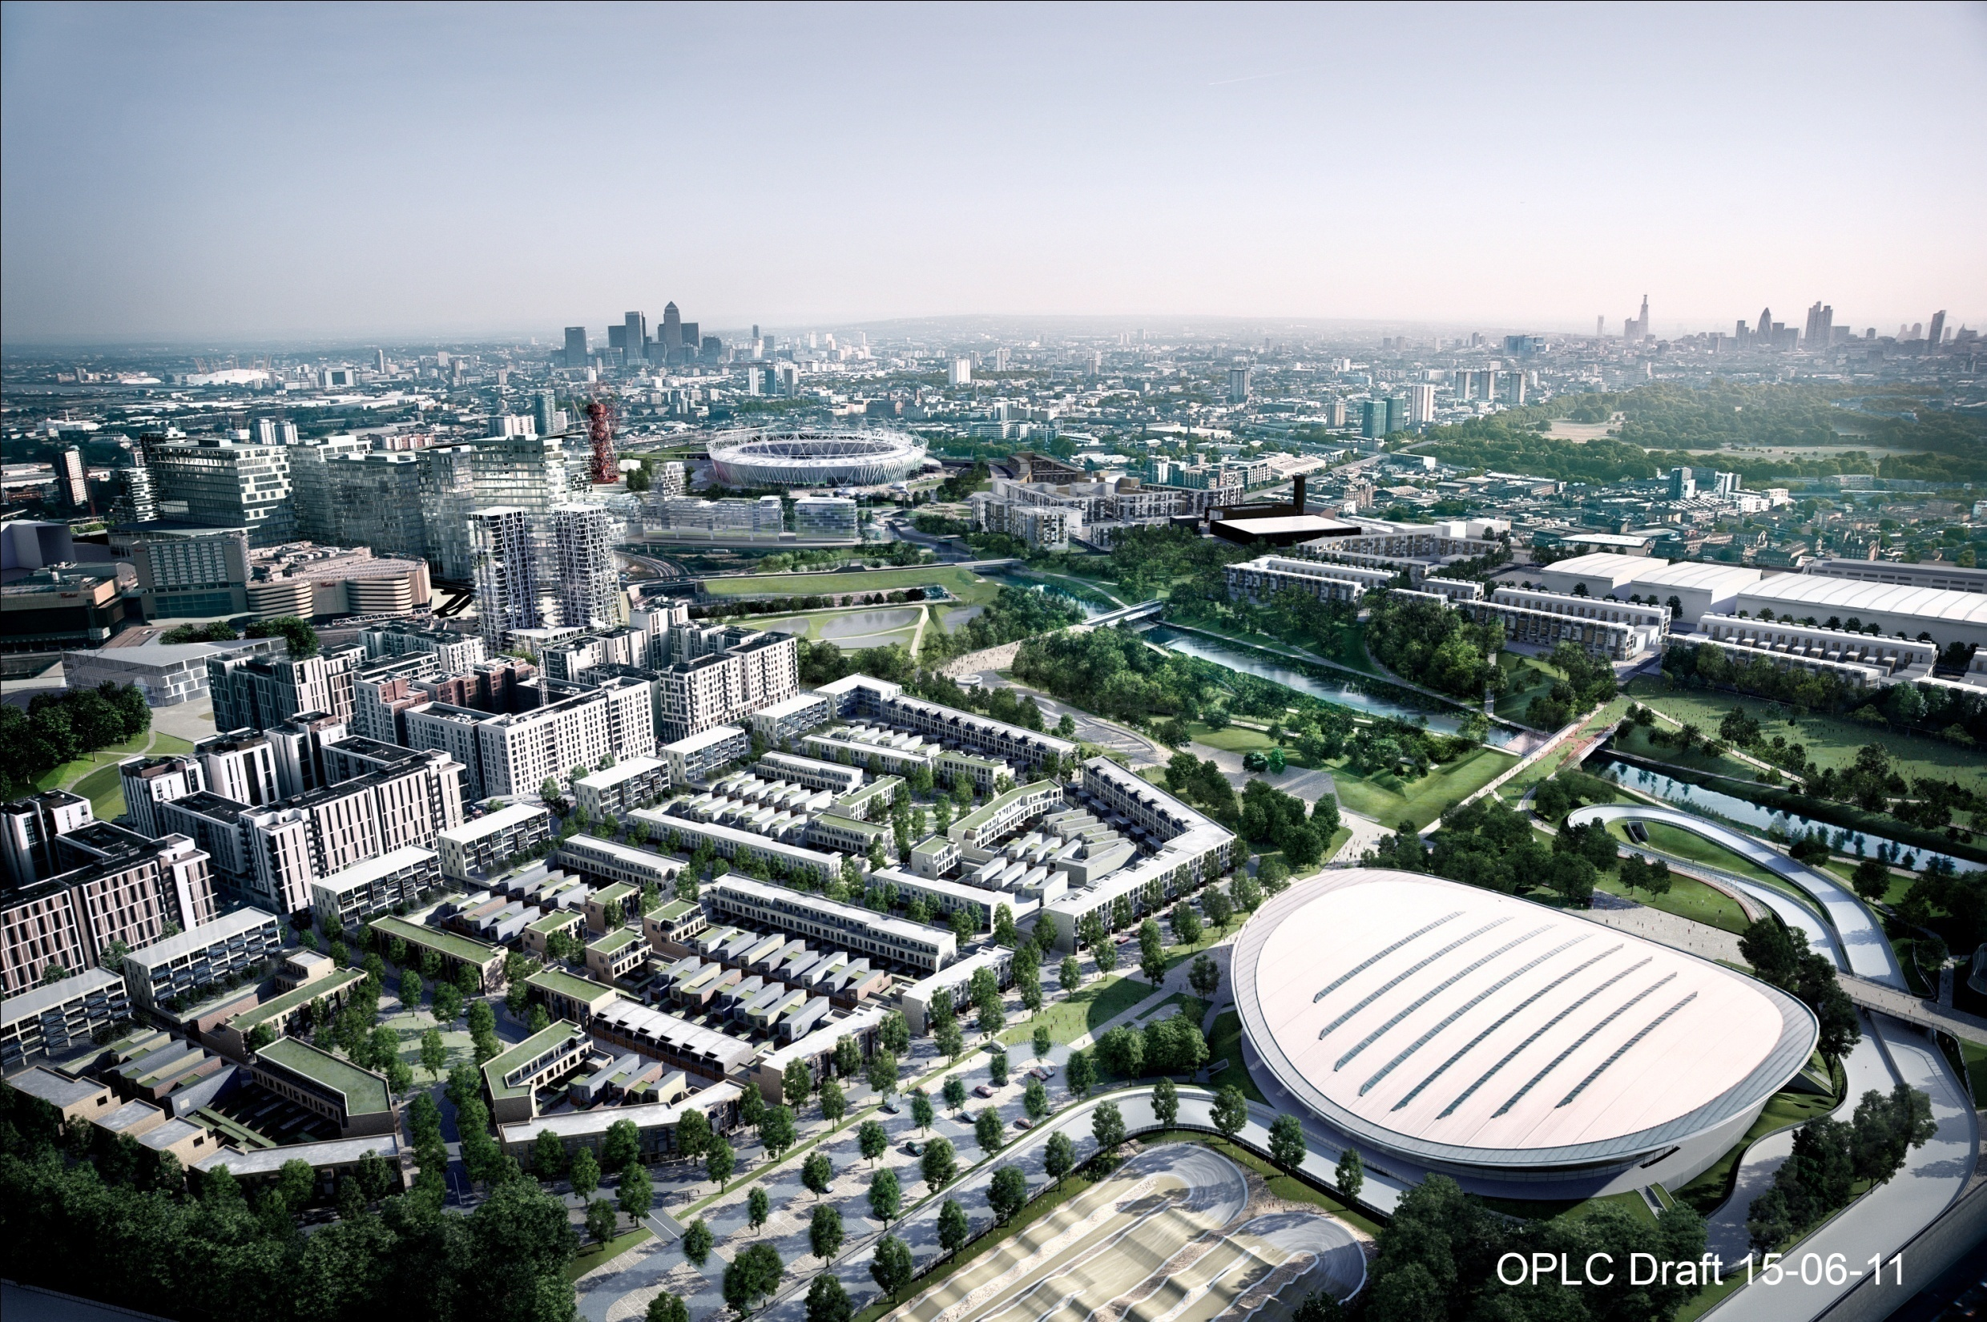
Notes:
This is the challenge – to provide infrastructure that meets both the Games and legacy requirements as cheaply as possible, with as little change as possible between the two.

Slide 34
Success Factors
Cross party political support
A fixed deadline
Early attention to Governance structures
A sensible budget
Clear client leadership
Rigorous approach to programme control and change management
Strong assurance and risk management

Slide 35
2012
LOCOG took over the Olympic Park on the 10th January 2012
ICT installations
Camera installations
Ceremony rehearsals
Sponsor pavilions
Catering / back of house
Signage, venue overlay
Complete landscaping
Spectator facilities
Test events

