Slide 1
The Royal Northern College of Music A Case Study
Dean Griffiths
Estates Services Manager

Slide 2
The College
Our Building
Founded in 1882
Existing building completed in 1973
Extended to current form in 2003
UK Conservatoire - Centre of Excellence in Teaching and Learning (CETL)
18.5K Sqm
2 buildings – Main & Library
Currently 650 students from 54 nations
Energy bill £355K per annum

Slide 3
A common dilemma
The tussle between the money, the goal and the environment
Demands are ever increasing
Government funding pressure
More buildings
Energy costs that keep rising
Carbon reduction commitments – 20% by 2012, 80% by 2050
EU directives and legislative penalties
At the same time
Budgets that are fixed ….or falling
Efficiency and savings plans need to be implemented

Slide 4
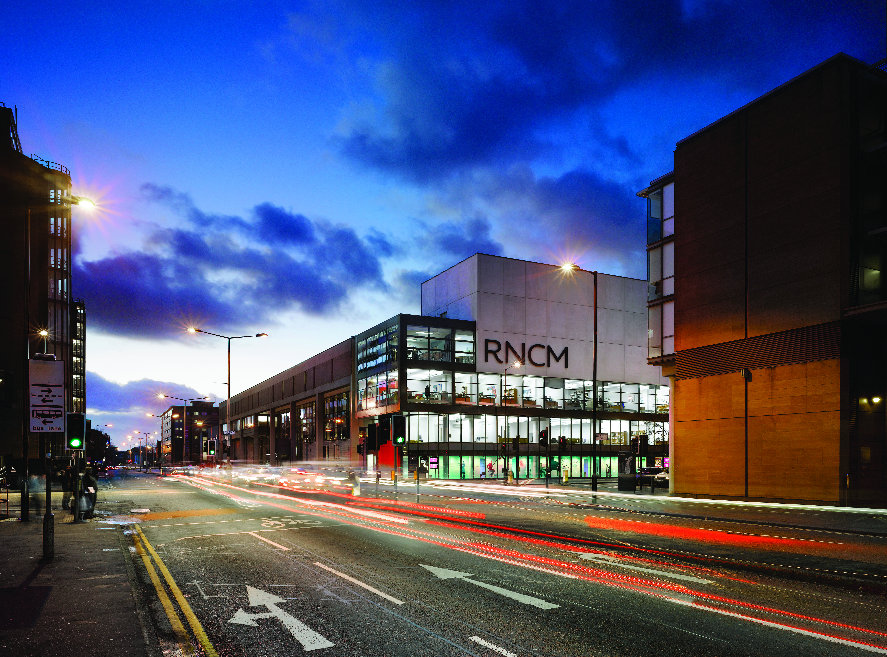
Our objectives
Reduce carbon emissions
Acquire future proof
technologies and systems
Get a fair deal from the
supplier
Achieve a good payback
from the investment

Slide 5
Seeking Expertise
Looked into partners used previously
Utilised valuable business relationship
Asked for opinions and advice
Recommended to have an Audit

Slide 6
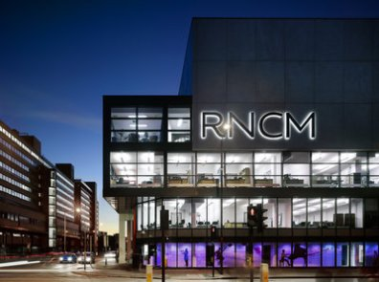
Lights on…. No one home

Slide 7
Areas identified….
BMS rationalisation and re-programming
Variable speed drives
Inverter controls
Mix of sensors – occupancy, daylight and thermal
Timers
Lagging
AM&T – electricity, gas and water
Voltage optimisation
Energy optimisation maintenance programme
What could we do …. Where did we need help?

Slide 8
Finding a supplier
Competitive tendering used
Cost was main criteria
Schneider Electric were chosen

Slide 9
How did we fund
Schneider Electric Finance
*Assumes energy cost inflation of 7% p a

Slide 10
Significant benefits
Increased control over the building systems
Improved energy budget control
Released capital
Enhanced public reputation
Improved students’ use of the building
Provided the tools to monitor energy performance
Has, and will continue to, let us investigate further improvement opportunities
We are reaping the rewards, energy consumption has been reduced with an improved DECC rating

Slide 11
Our students are passionate about sustainability and so are we…
Grotbags recycling scheme
WEEE directive recycling
Facilities helpdesk
Environmental working group
Newsletter

Slide 12
Thoughts to take away…
Good relationships with your suppliers is key
Encourage your team to know your building
Customers matter…
remember who pays the bills

Slide 13
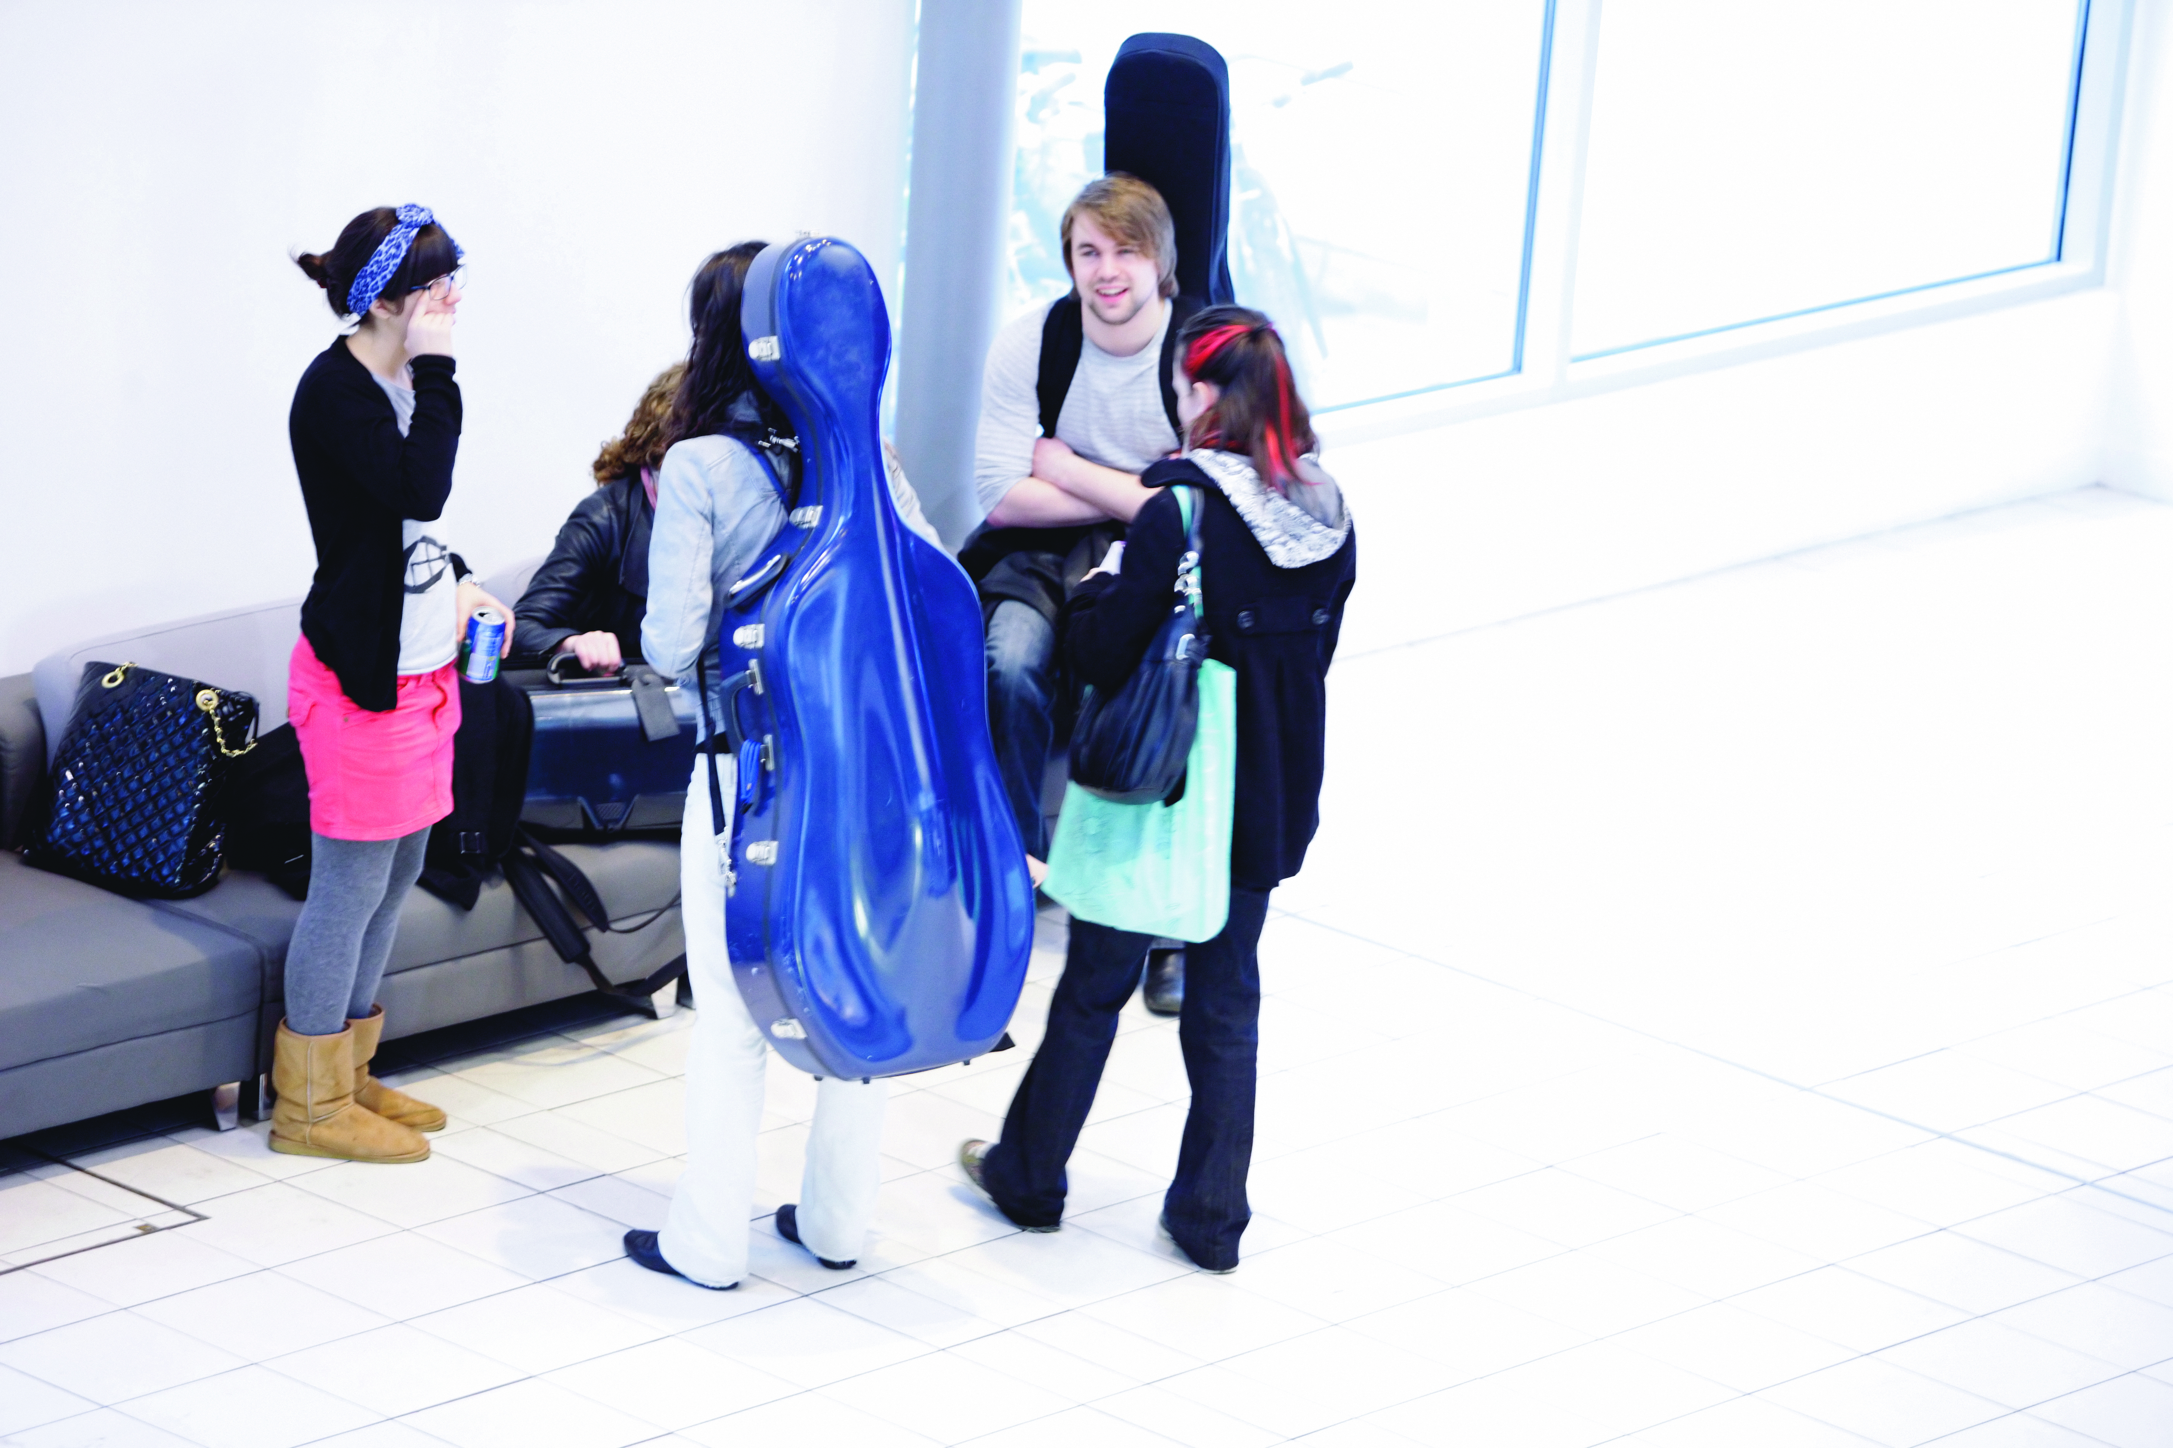
And number 4...
Seek feedback….
from everyone that uses the building

Slide 14
And those that don’t

Slide 15
Your next steps – making the most of your EAUC Membership…
Resources
visit the dedicated carbon EAUC resource bank sections
visit the carbon reduction section of SORTED – the online resource for sustainability in the Learning and Skills sector
Networks - join our Carbon Intensive Research Colleges and Universities Community of Practice - for Colleges and Universities that undertake carbon intensive research
Find out more about this group at 5pm tomorrow– see programme for details
Recognition - want recognition for your carbon reduction initiatives – enter the 2012 Green Gown Awards carbon reduction category. Entries open summer 2012
Measure and improve - sign up to LiFE – www.thelifeindex.org.uk. EAUC Members receive a significant discount
LiFE offers dedicated ‘resource efficiency and waste’ and ‘utilities’ frameworks for implementation
Membership matters at www.eauc.org.uk

