Slide 1
Revolving Green Fund
Joanna Simpson – HEFCE
Katy Boom –University of Worcester
Jonathan Mills – University of Lancaster

Slide 2
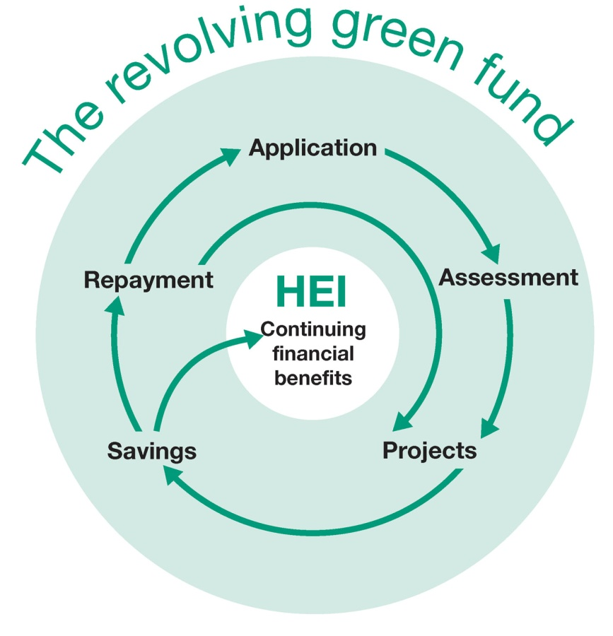

Revolving Green Fund
Recoverable grants for carbon reduction projects
Proven technologies and innovative projects
RGF 1
£30 million; 59 institutions funded
Estimated annual savings of 8.6% by 2020
RGF2
£11 million; 27 institutions funded

Slide 3
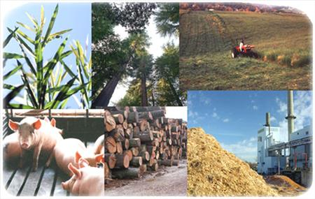
Transformational fund
Harper Adams University College
Anaerobic digestion using farm and food waste
University of East Anglia
Biomass gasification CHP
University of Lancaster
Wind turbine
Notes:
3

Slide 4
Exemplary retrofit projects
University of Bradford
Improve energy efficiency of a library – ‘E’ rating to ‘A’ rating
University of Derby
Light Emitting Diode (LED) lighting throughout campus
University of Exeter
Retrofit 1960s building with 12 types of technology
University of Plymouth
Integrated ICT and Building Energy Management System to control all energy using devices

Slide 5
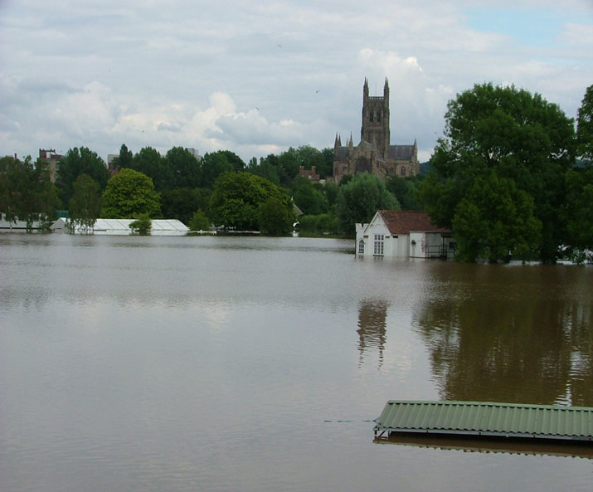
Worcester
West Midlands
Population 95,000, located on the River Severn, and an area about to go into drought!

Slide 6
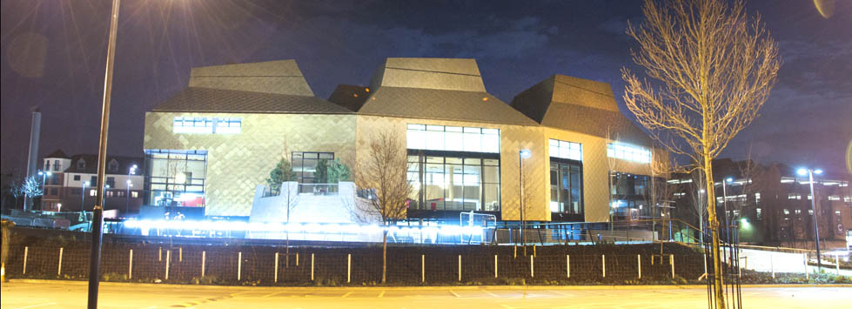
University of Worcester
One of the fastest growing Universities in the UK
University’s estate increased by 54% -from 44,498 to 68,369 sqm
Student numbers continue to rise up 15% last year
10,000 students and 1,000 staff

Slide 7
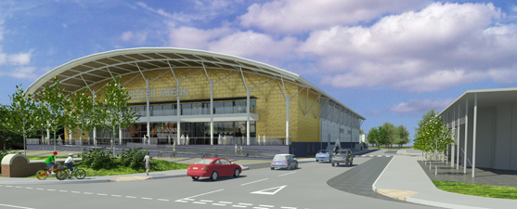
3 major sites all within 20 minutes walk
Further expansion – 2,000 seat sports arena

Slide 8
47 acre science and enterprise park

Slide 9
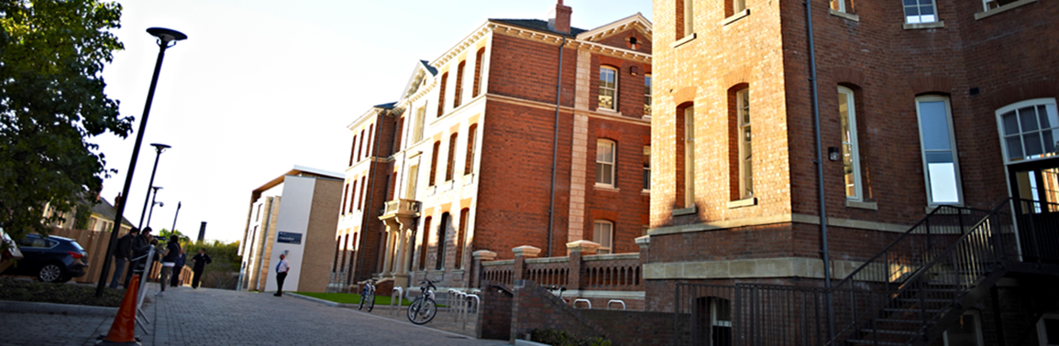
Revolving Green Fund 2 small-scale energy efficiency programme £71,663
Evaporative Cooling - £23,986
Airtightness – £47,677 ~4 buildings

Slide 10
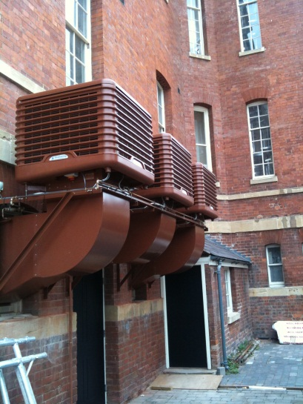
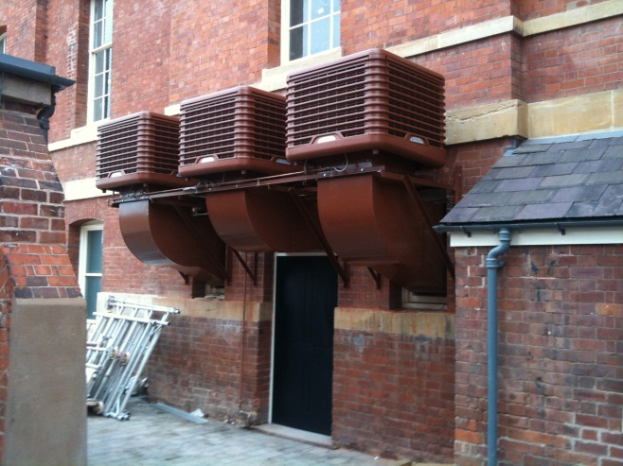
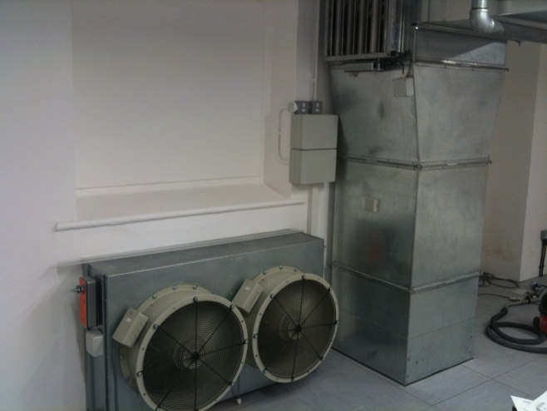
Evaporative Cooling
Upgrade cooling in a suite of rooms used for teaching and conferences
Designed to be configured as either one large space or up to 3 smaller spaces
Numerous complaints from occupants due to overheating especially when set up as three
separate spaces for teaching large groups

Slide 11
Evaporative Cooling- what is it?
A replacement for air conditioning using ‘wetted’ external air to reduce it’s temperature. This humid air lowers temperatures by around 9 degrees.
Running costs for evaporative cooling are a fraction of air conditioning running costs typically a 1.5KW motor provides over 40KW of cooling, compared to over 15KW of electricity for conventional air conditioning to generate the same amount of cooling.

Slide 12
Facts and Figures slide
Project cost (£) £23,986
Predicted annual carbon savings (tCO2) 41.93
Predicted annual financial savings (£) 5,214
Technical payback period² (years) 4.60
²Technical payback is a simple calculation of project cost divided by financial savings.
Lifetime cost of carbon³ (£/tCO2 LT) 69.70
³The lifetime cost of carbon is the lifetime carbon savings of an energy saving measure
and is calculated using the project capital cost, the annual carbon saving and the relevant
persistence factor (these change for different technology types). The calculation is lifetime cost
of carbon (£/tCO2 LT) = Project cost / (Annual tonnes of CO2 saved x technology persistence factor).
Further information on calculating the lifetime cost of carbon is available in the frequently asked questions. Persistence factor used for calculating lifetime costs CO2 8.21

Slide 13
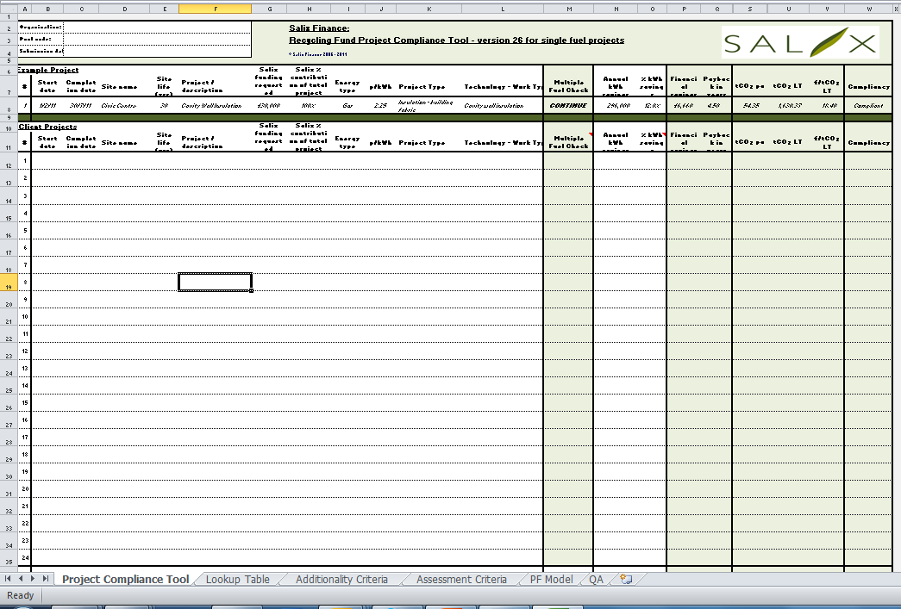

Slide 14
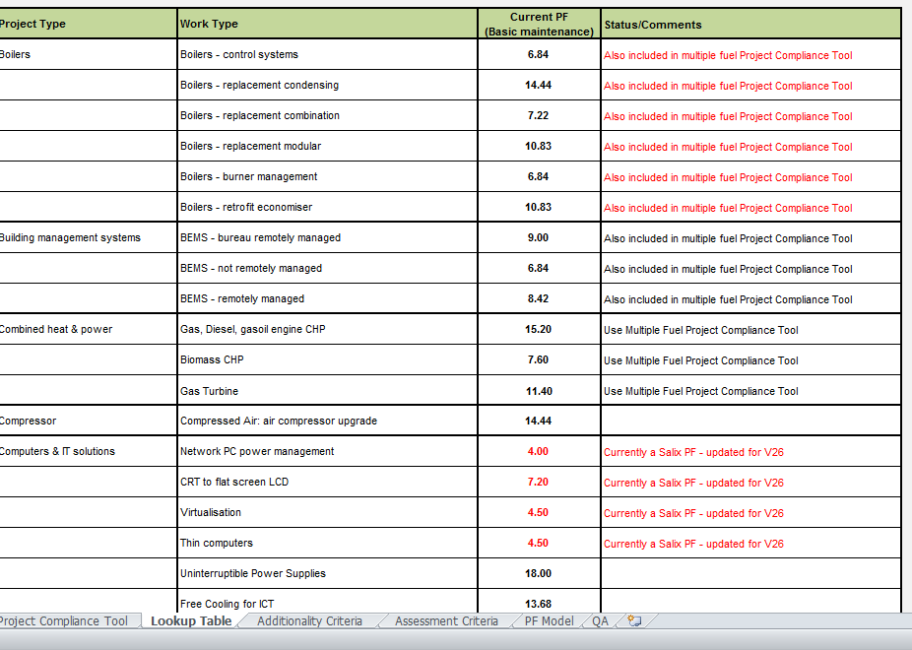

Slide 15
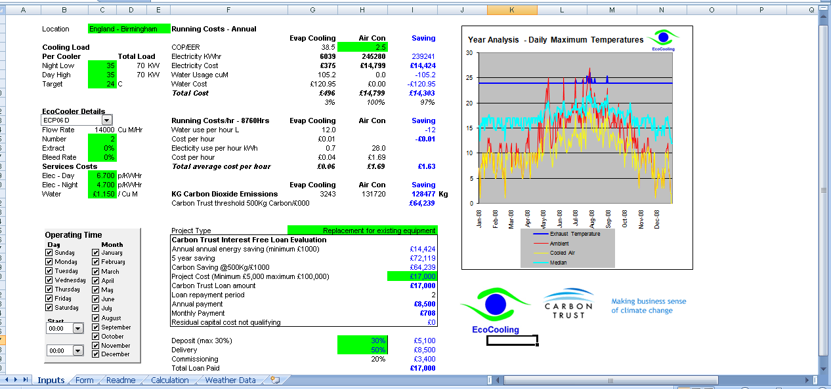
Checking assumptions

Slide 16
Air Tightness
Unintended air leakage happens from gaps in door sets and window seals and from old builders work holes etc.
Sealing and draught proofing works: 4 buildings;
one residential (built 1978), 2 single storey 1947 academic buildings, and a library with a newer built extension.

Slide 17
Second Facts and Figures slide
Project cost (£) 47,677
Predicted annual carbon savings (tCO2) 61.17
Predicted annual financial savings (£) 8,587
Technical payback period² (years) 5.75
²Technical payback is a simple calculation of project cost divided by financial savings.
Lifetime cost of carbon³ (£/tCO2 LT) 41.76
³The lifetime cost of carbon is the lifetime carbon savings of an energy saving measure
and is calculated using the project capital cost, the annual carbon saving and the relevant
persistence factor (these change for different technology types). The calculation is lifetime cost
of carbon (£/tCO2 LT) = Project cost / (Annual tonnes of CO2 saved x technology persistence factor).
Persistence factor used for calculating lifetime costs CO2 29.25

Slide 18
Assumptions
Since the surveys were carried out some refurbishment of Bredon has taken place so this project has been scaled back.
Each building has been calculated separately giving a range of pay back periods from 5.04, 5.10, 5.65 and 7.20, the average 5.75 has been used.
The total project cost, is comprised of £18,000 for Bredon - 4116 sqm, £16,710 for Woodbury - 3449 sqm, £4,967 for Chandler 1219 sqm and £8,000 for Pierson 2960 sqm.
The predicted annual financial and carbon savings are the totals for all 4 projects.
The lifetime cost of carbon is the average for all four projects. Energy price for gas is 2.60 p/kWh.

Slide 19
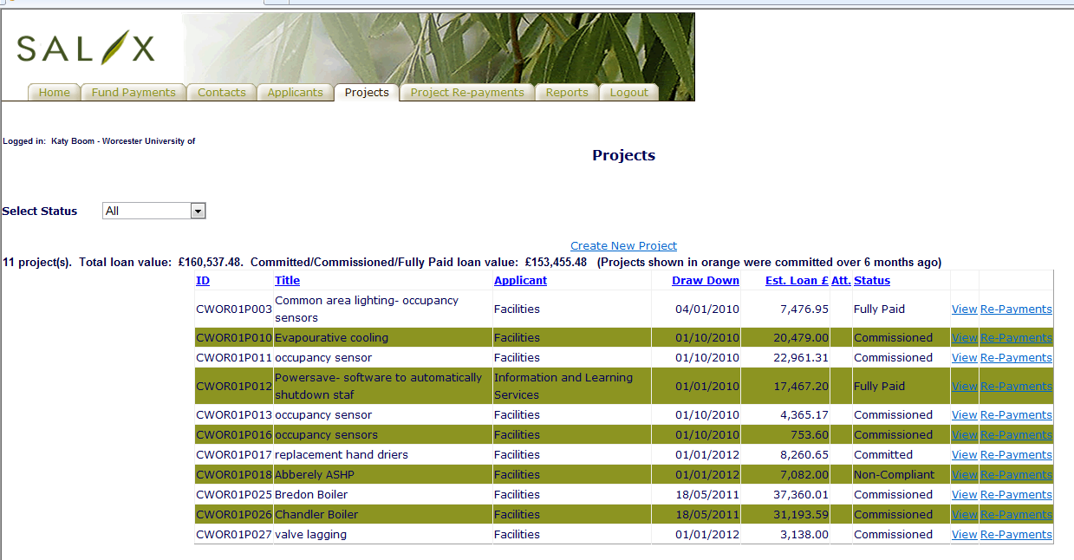
RGF1

Slide 20
Top Tips
Keep well informed
Know your estate
Make friends
Keep a pipeline of potential projects
Keep up with changes in persistence factors/new technologies
Know when your energy contracts change, projects may become compliant

Slide 21

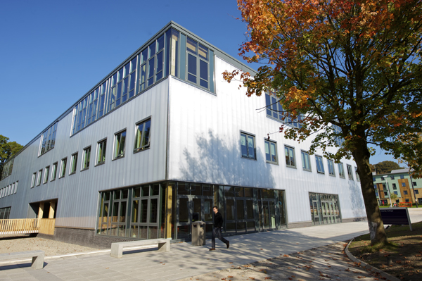
Energy Supply Projects
– Lessons from success in RGF1 and RGF2
Jonathan Mills
Carbon, Environment & Sustainability Manager
Lancaster University

Slide 22
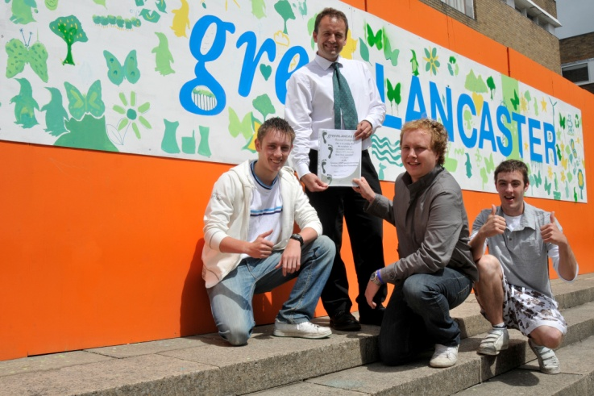
RGF1 & RGF 2 Projects
RGF1 – Transformational Fund
Lancaster University Wind turbine Project
RGF2 – Small Scale Energy Efficiency Programme
Biomass Boiler Project

Slide 23
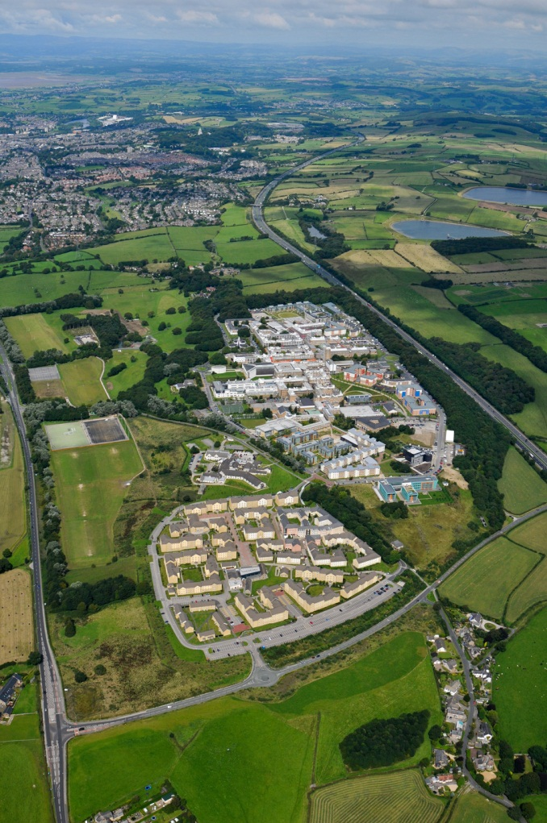
RGF1 – Lancaster University Wind Turbine Project
2.2MW Wind Turbine
Carbon savings 1,800tCO2/annum
Connected to LU network
Cut carbon emissions 10%
Location - Hazelrigg

Slide 24
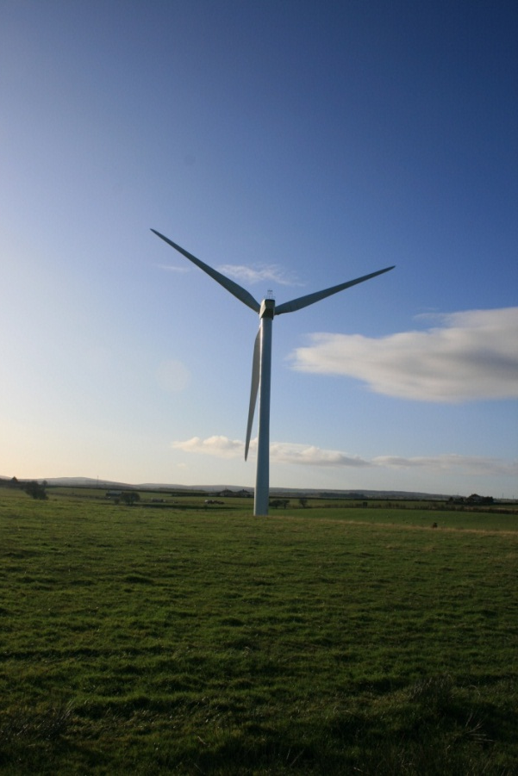
RGF1 – Lancaster University Wind Turbine Project
2007-2008 Feasibility works
Sept-Dec 2008 RGF1 application
April 2009 – Transformation fund award
Autumn 2009 EIA, consultation, planning
Jan 2010 Planning application submitted
May 2010 Planning application rejected
Autumn 2010 new planning application submitted

Slide 25
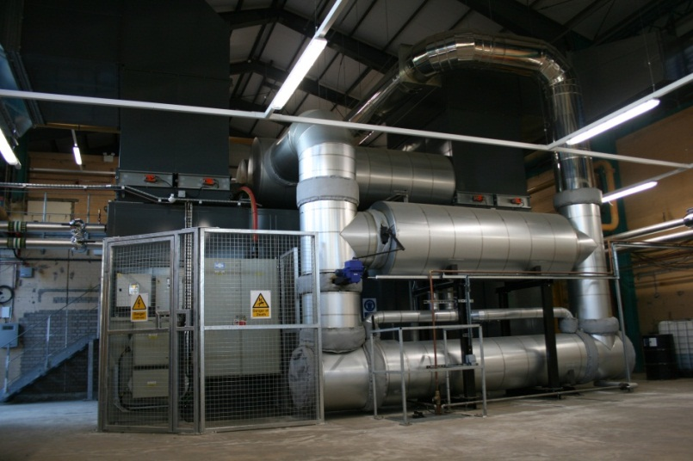
RGF1 – Lancaster University Wind Turbine Project
May 2011Planning permission obtained
Nov 2011 end of judicial review
Feb 2012 turbine ordered
April 2012 Groundworks
December 2012 turbine
in place

Slide 26
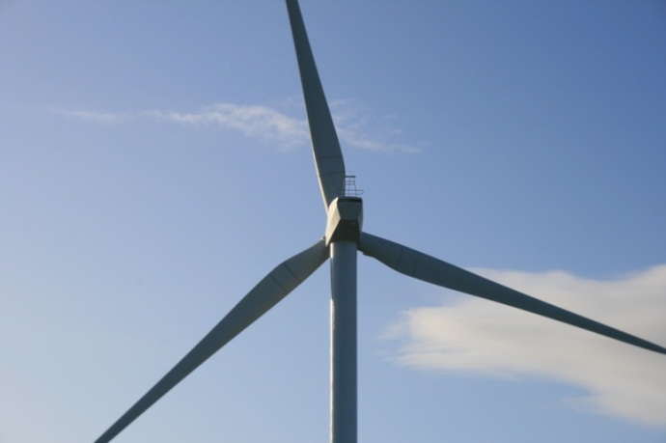
RGF1 – Lancaster University Wind Turbine Project
Lessons from Application
Thorough preparation essential
Senior management commitment
Significant feasibility studies necessary
On-going support from HEFCE
Will take much longer
than you think!

Slide 27
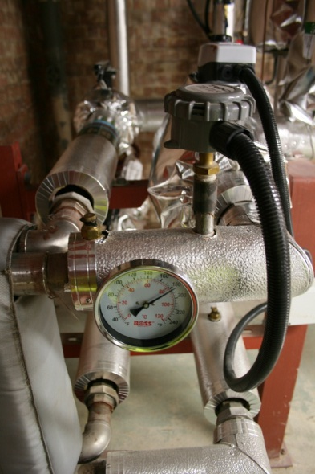
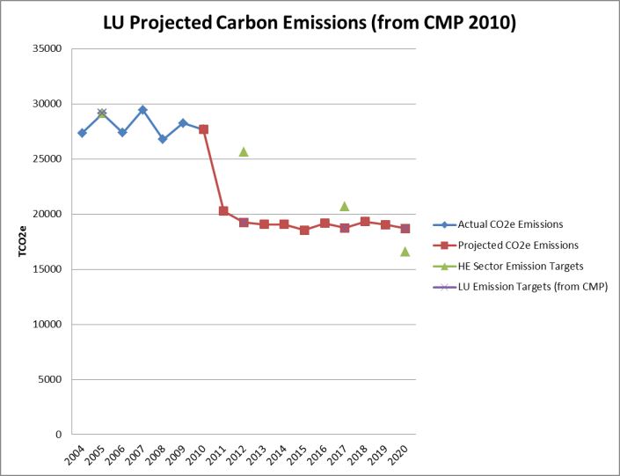
RGF1 – Lancaster University Wind Turbine Project
Lessons from Application
Commitment to carbon reduction – CMP
Payback, lifetime cost of carbon
Project team internal and external
Detailed cost assessments
Project risk assessments
Demonstration of cost control & programme management
Benefits for sector?

Slide 28
RGF2 – Biomass Boiler Project
1.0MW Biomass Boiler
Carbon savings 1,000tCO2/annum
Connected to LU district heating network
Located in ‘energy centre’
To be used for winter baseload and summer hot water supply

Slide 29
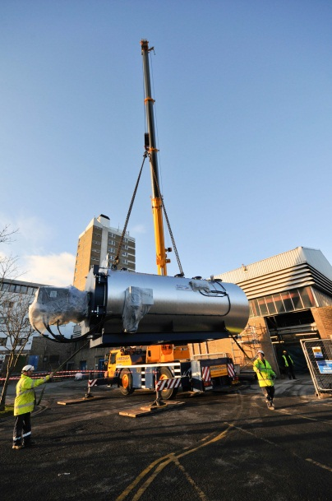
RGF2 – Biomass Boiler Project
Biomass boiler part of SEIS & CMP, but no capital funding identified.
Space & connections in energy centre
Oct 2011 RGF2 Application
Jan 2012 RGF2 award & project start
Mar 2012 – tendering
Dec 2012 – Installed and operational!

Slide 30
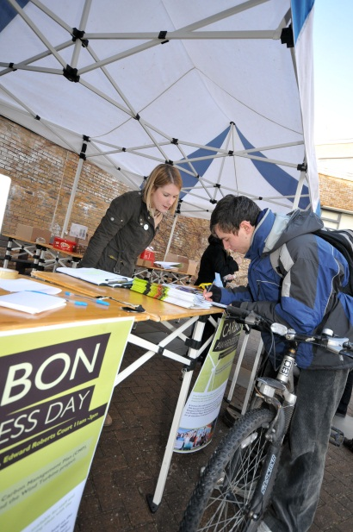
RGF2 – Biomass Boiler Project
Lessons from Application
Institutional commitment to carbon reduction – CMP, senior management, resources?
Project clearly part of CMP programme?
Carbon & energy savings realistic?
Lifetime cost of carbon calculated correctly?
Capital costs? Payback period? Check criteria

Slide 31
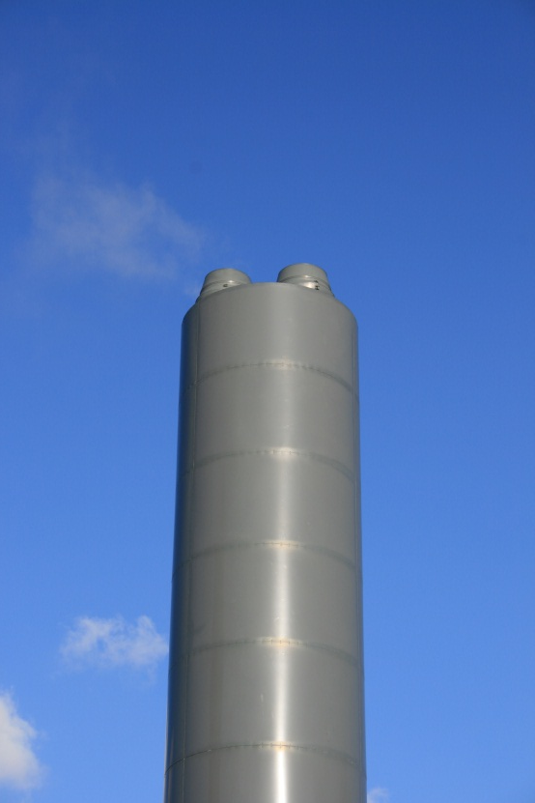
RGF2 – Biomass Boiler Project
Lessons from Application
Project team experience & resource – (internal and external)
Project programme management – agreed timings, resource?
Project risk assessed and understood.
Check all relevant criteria for your application!!!

Slide 32
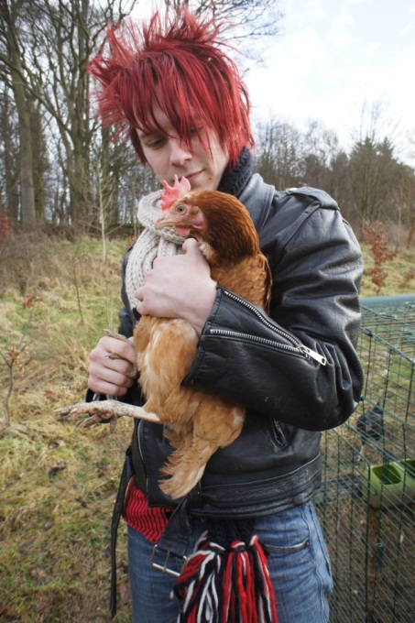
RGF1 & RGF 2 – Summary Lessons Learnt?
Get Projects in pipeline (small and big)
Undertake early feasibility studies
Ensure you have strong CMP & integrate projects into CMP.
Ensure carbon & energy saving calcs correct
You will need good: capital costs, project team, project programme, project risks assessment!

Slide 33
Identification/Pipeline of projects
Carbon savings and link to CMP
Utility unit prices

Slide 34
Your next steps – making the most of your EAUC Membership…
Resources - visit the EAUC resource bank for a vast range of policies, case studies and insight guides
Recognition - want recognition for your sustainability initiatives - enter the 2012 Green Gown Awards. Entries open summer 2012 across 14 categories!
Networks -
  we have many EAUC Communities of Practice to help you to learn and share about specific topics
  You can also join our Member-wide JISCmail group – got a burning question? Members are there to help! Visit the EAUC desk to find out more and sign up!
Measure and improve - sign up to LiFE www.thelifeindex.org.uk for whole institution improvement and engagement. EAUC Members receive a significant discount
Membership matters at www.eauc.org.uk

