Slide 1
Shared Services: how to get the most out of a partnership approach
Dr Neil Smith, University of Southampton
Mat Jane, Winchester University

Slide 2
Partnership Working with …
Notes:
Introduction
Mat Jane – Energy and Environment Manager at the University of Winchester
Going to talk about our energy and carbon management programme and give you some example of some of the projects undertaken in the last 12 months

Slide 3
Agenda
Introduction
Aims
SCAG overview
Syndicate session 1: What kind of services already share or could share?
Syndicate session 2: In 5 or 6 regional groups – identify opportunities for shared services/partnerships & identify who should be involved
Action plans
Closing remarks
Notes:
SLOWLY
Bearing in mind this is the first full year of implementation of energy efficiency projects We have had some pretty good results
we have reduced electrical consumption on every campus and overall have achieved a reduction of just over 5%
Electricity costs have also reduced drastically, around £200,000 through retendering the contracts and energy efficiency
Whilst we have concentrated on electrical projects, through replacing some of the boilers and insulation we have also achieved a reduction in gas consumption of 2.5%.

Slide 4
Aims
To inform EAUC members about SCAG partnership
To identify opportunities to share services or form partnerships
To prepare action plans
Notes:
SLOWLY
Bearing in mind this is the first full year of implementation of energy efficiency projects We have had some pretty good results
we have reduced electrical consumption on every campus and overall have achieved a reduction of just over 5%
Electricity costs have also reduced drastically, around £200,000 through retendering the contracts and energy efficiency
Whilst we have concentrated on electrical projects, through replacing some of the boilers and insulation we have also achieved a reduction in gas consumption of 2.5%.

Slide 5
Partnership Working with …
Notes:
Introduction
Mat Jane – Energy and Environment Manager at the University of Winchester
Going to talk about our energy and carbon management programme and give you some example of some of the projects undertaken in the last 12 months

Slide 6
South Coast Affinity Group (SCAG)
Formed in 2008
Partnership involving five Universities (Southampton, Winchester, Bournemouth, Solent & Portsmouth)
5 year recycling contract
Weight data
Mixed recycling
Other waste services (WEEE, Skips etc)
Notes:
SLOWLY
Bearing in mind this is the first full year of implementation of energy efficiency projects We have had some pretty good results
we have reduced electrical consumption on every campus and overall have achieved a reduction of just over 5%
Electricity costs have also reduced drastically, around £200,000 through retendering the contracts and energy efficiency
Whilst we have concentrated on electrical projects, through replacing some of the boilers and insulation we have also achieved a reduction in gas consumption of 2.5%.

Slide 7
Aims
Divert waste from landfill and increase recycling rates
Improve partnership of organisations
Better data quality and management
Reduce number of waste contractors at each institution
Increase purchasing power of individual institutions
Notes:
SLOWLY
Bearing in mind this is the first full year of implementation of energy efficiency projects We have had some pretty good results
we have reduced electrical consumption on every campus and overall have achieved a reduction of just over 5%
Electricity costs have also reduced drastically, around £200,000 through retendering the contracts and energy efficiency
Whilst we have concentrated on electrical projects, through replacing some of the boilers and insulation we have also achieved a reduction in gas consumption of 2.5%.

Slide 8
New contract
Started January 2009 for 5 years with optional extension to 7 depending on contractor performance
£1m annual contract value
Full Pay-by-Weight contract in place
Each bin has individual ID chips
Reports by individual bin each month
Co-mingled recycling collections
glass, paper, cardboard, tetra-pak, all plastics, cans
Monthly contractor operational meetings with each individual institution
Quarterly joint meetings with contractor to discuss contractual issues and performance
Notes:
SLOWLY
Bearing in mind this is the first full year of implementation of energy efficiency projects We have had some pretty good results
we have reduced electrical consumption on every campus and overall have achieved a reduction of just over 5%
Electricity costs have also reduced drastically, around £200,000 through retendering the contracts and energy efficiency
Whilst we have concentrated on electrical projects, through replacing some of the boilers and insulation we have also achieved a reduction in gas consumption of 2.5%.

Slide 9
Southampton
2005 – Pay by weight contract.
2006 – Paper recycling. Infrastructure changes.
2007 – Cans & plastic bottle recycling. Halls research project.
1st waste audit.
2008 – SCAG & recycling contract.
2009 – Mixed recycling.
2010 – Food collection. All C&D waste data.
2011 – Roll out of food collection & calculating
carbon emissions
2012 – Two bin scheme
Produce about 1,700t per annum
Recycling rate – 46%; 38% recyclables in landfill waste!
Notes:
SLOWLY
Bearing in mind this is the first full year of implementation of energy efficiency projects We have had some pretty good results
we have reduced electrical consumption on every campus and overall have achieved a reduction of just over 5%
Electricity costs have also reduced drastically, around £200,000 through retendering the contracts and energy efficiency
Whilst we have concentrated on electrical projects, through replacing some of the boilers and insulation we have also achieved a reduction in gas consumption of 2.5%.

Slide 10
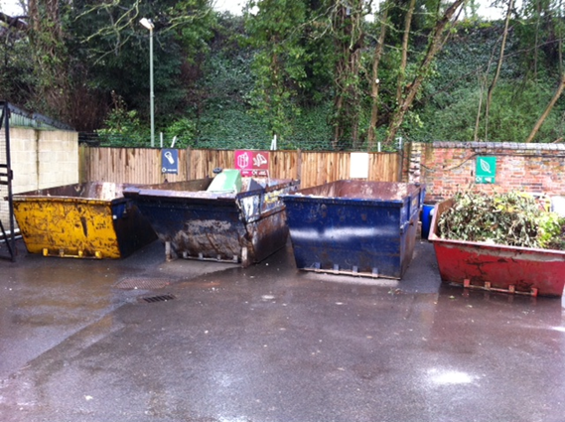
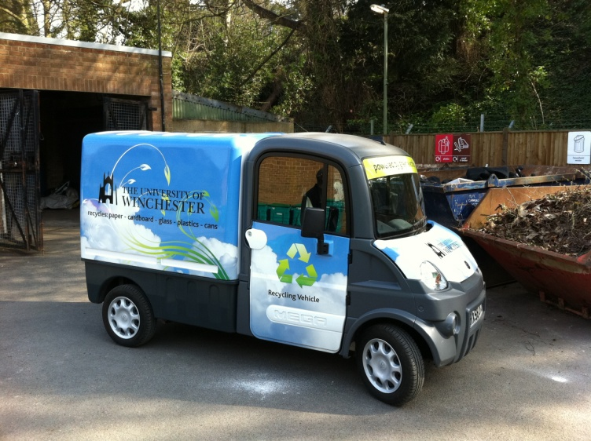
Winchester
1 contractor managing all wastes
Huge increase in recycling – now c.60% by weight up from 14% by volume
Working together with larger institutions has led to significant cost savings and weight with contractor
Large investment in recycling facilities, collection vehicles and waste compound made with savings on contract cost
Notes:
SLOWLY
Bearing in mind this is the first full year of implementation of energy efficiency projects We have had some pretty good results
we have reduced electrical consumption on every campus and overall have achieved a reduction of just over 5%
Electricity costs have also reduced drastically, around £200,000 through retendering the contracts and energy efficiency
Whilst we have concentrated on electrical projects, through replacing some of the boilers and insulation we have also achieved a reduction in gas consumption of 2.5%.

Slide 11
Results
Working together has helped hold the contractor to account
3,816 tonnes of waste recycled per annum across SCAG
Cash savings for the consortium of £370,000
Reduction of carbon emissions of 4,000 t
Southern Central Environment Managers Group formed (SCEMG) 2010
Notes:
SLOWLY
Bearing in mind this is the first full year of implementation of energy efficiency projects We have had some pretty good results
we have reduced electrical consumption on every campus and overall have achieved a reduction of just over 5%
Electricity costs have also reduced drastically, around £200,000 through retendering the contracts and energy efficiency
Whilst we have concentrated on electrical projects, through replacing some of the boilers and insulation we have also achieved a reduction in gas consumption of 2.5%.

Slide 12
The next steps
Arts College Bournemouth has signed up to the contract
Food waste collections underway at all SCAG member sites
Joint marketing strategy to increase recycling in halls
Working with contractor to provide more robust scope 3 emissions
Out of SCAG a new consultancy framework for building services procurement has been created using the same model
Notes:
SLOWLY
Bearing in mind this is the first full year of implementation of energy efficiency projects We have had some pretty good results
we have reduced electrical consumption on every campus and overall have achieved a reduction of just over 5%
Electricity costs have also reduced drastically, around £200,000 through retendering the contracts and energy efficiency
Whilst we have concentrated on electrical projects, through replacing some of the boilers and insulation we have also achieved a reduction in gas consumption of 2.5%.

Slide 13
Questions?
Notes:
Introduction
Mat Jane – Energy and Environment Manager at the University of Winchester
Going to talk about our energy and carbon management programme and give you some example of some of the projects undertaken in the last 12 months

Slide 14
Syndicate Session 1
In your groups please discuss:
What kind of services already share or could share?
Time available: 15 minutes
Please use the flip chart to record your discussion & be prepared to feedback to the rest of the groups
Notes:
SLOWLY
Bearing in mind this is the first full year of implementation of energy efficiency projects We have had some pretty good results
we have reduced electrical consumption on every campus and overall have achieved a reduction of just over 5%
Electricity costs have also reduced drastically, around £200,000 through retendering the contracts and energy efficiency
Whilst we have concentrated on electrical projects, through replacing some of the boilers and insulation we have also achieved a reduction in gas consumption of 2.5%.

Slide 15
Syndicate Session 2
In Regional groups:
What shared services/partnerships could be explored & who should be involved
Time available: 15 minutes
Please use the flip chart to record your discussion & be prepared to feedback to the rest of the groups
Notes:
SLOWLY
Bearing in mind this is the first full year of implementation of energy efficiency projects We have had some pretty good results
we have reduced electrical consumption on every campus and overall have achieved a reduction of just over 5%
Electricity costs have also reduced drastically, around £200,000 through retendering the contracts and energy efficiency
Whilst we have concentrated on electrical projects, through replacing some of the boilers and insulation we have also achieved a reduction in gas consumption of 2.5%.

Slide 16
Syndicate Session 2
What contracts up for renewal & timeframe?
Any large procurement projects looming?
Areas to consider:
Estates, Halls, Energy, Waste, Transport, Food etc
What does buying consortium offer (or not)?
National companies providing local services
Notes:
SLOWLY
Bearing in mind this is the first full year of implementation of energy efficiency projects We have had some pretty good results
we have reduced electrical consumption on every campus and overall have achieved a reduction of just over 5%
Electricity costs have also reduced drastically, around £200,000 through retendering the contracts and energy efficiency
Whilst we have concentrated on electrical projects, through replacing some of the boilers and insulation we have also achieved a reduction in gas consumption of 2.5%.

Slide 17
Action Plans
Please identify up to three points you wish to action/follow up on your return to your institution
Notes:
SLOWLY
Bearing in mind this is the first full year of implementation of energy efficiency projects We have had some pretty good results
we have reduced electrical consumption on every campus and overall have achieved a reduction of just over 5%
Electricity costs have also reduced drastically, around £200,000 through retendering the contracts and energy efficiency
Whilst we have concentrated on electrical projects, through replacing some of the boilers and insulation we have also achieved a reduction in gas consumption of 2.5%.

Slide 18
Working together does deliver significant benefits
Partnership is greater than the sum of its parts
More opportunities to share services/partnership working
More information on SCAG is available!

Slide 19
Your next steps – making the most of your EAUC Membership…
Resources - visit the dedicated waste and procurement EAUC resource bank sections
Recognition - want recognition for your waste and partnership initiatives - enter the 2012 Green Gown Awards sustainable procurement category. Entries open summer 2012
New for 2012 – enter the shared services category
Measure and improve - sign up to LiFE – www.thelifeindex.org.uk. EAUC Members receive a significant discount
LiFE offers dedicated ‘community and public engagement’ and ‘resource efficiency and waste’ frameworks
Membership matters at www.eauc.org.uk

