Slide 1
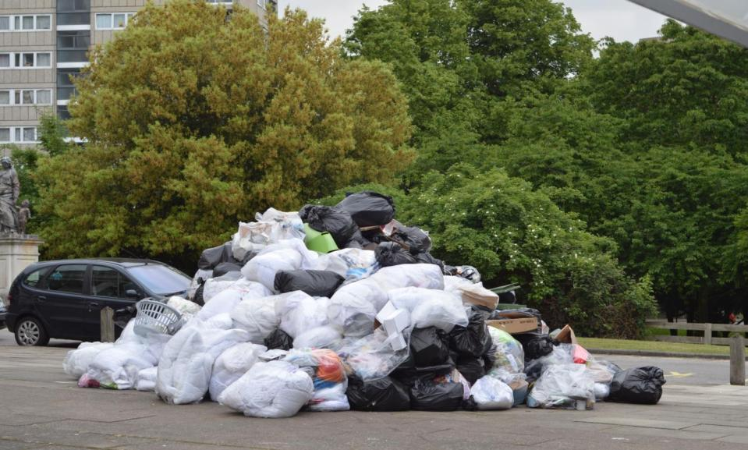
This is Rubbish!

Slide 2
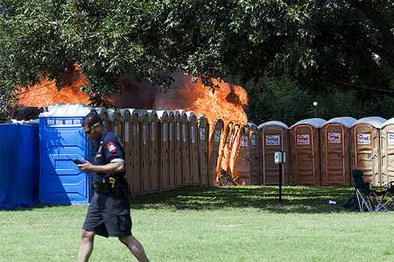
Toilets and Fire!

Slide 3

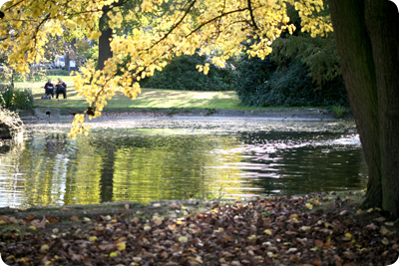
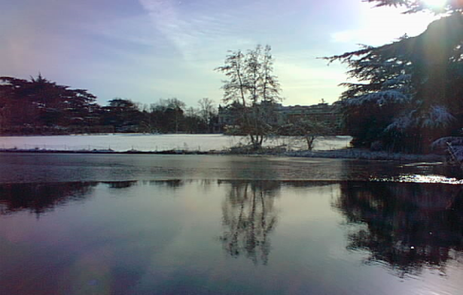

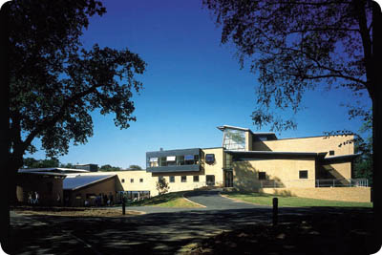
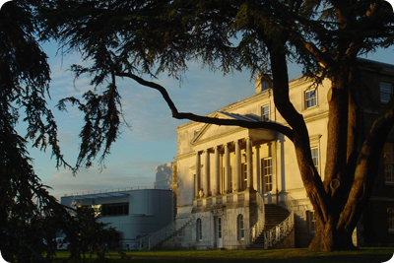
LUEG EMS Group Meeting
11th June 2013

Slide 4

Outline Programme
10.15 – 11.15 Environmental Training at Roehampton [Jonathan Horner]
11.30 – 12.15 e-Learning Project Update [Stephanie Chesters & Emma Laycock]
13.15 – 14.00 Biodiversity Projects at Roehampton to finish with a brief tour of some key project sites [Jonathan Horner]

Slide 5


Slide 6
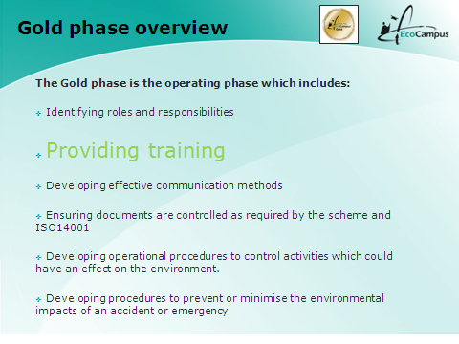
EcoCampus Gold

Slide 7
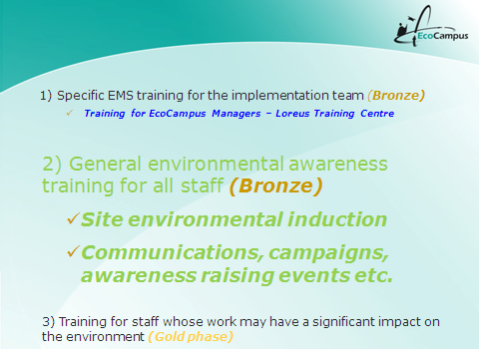
Required Training

Slide 8
Environmental Awareness Induction Training
What do you think should be included in Environmental Induction Training?

Slide 9
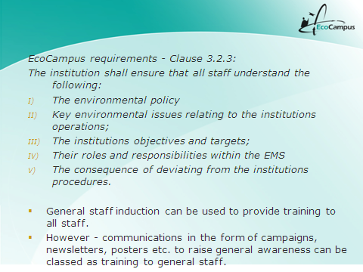
Environmental Awareness Induction Training

Slide 10






Environmental Awareness Induction Training
1)
2)
3)

Slide 11
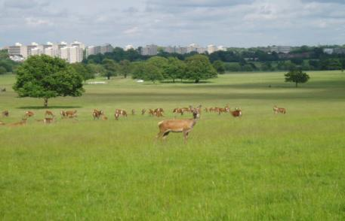
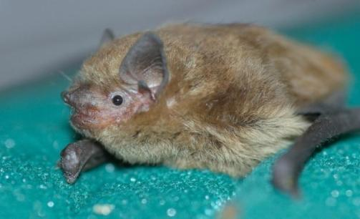

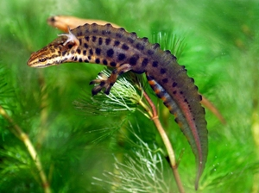
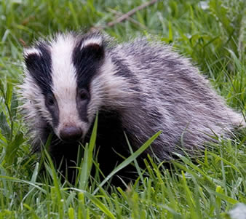
Environmental Champions Training Day February
6th February 2013

Slide 12
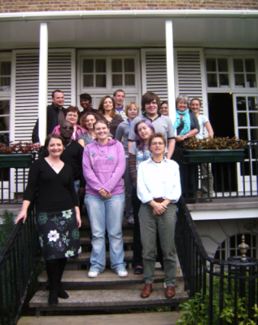

Staff and Student Environmental Champions
Promote local sustainability
Advise colleagues on good environmental practice
Communicate through Environmental Forum
Get involved in and support some exciting environmental projects
Do as little or as much as you feel able to!

Slide 13
Objectives
To briefly outline some key concepts and drivers to emphasise why we all need to take action to reduce our environmental impacts
To highlight some of the many environmental initiatives and projects at the University, including Environmental Champions and Green Impact
To consider ways in which you and your Department could contribute to reducing the University’s environmental impacts and costs

Slide 14

CIEH Level 2 Award in
Environmental Principles
and Best Practice
Name of trainer: Jonathan Horner

Slide 15
Sessions 1–8
1. Environmental impacts and sustainability
2. Understanding environmental aspects
3. Principles of environmental law
4. Energy use and carbon management
5. Resource efficiency and waste minimisation
6. Water management
7. Pollution prevention and emergency planning
8. Environmental management systems

Slide 17

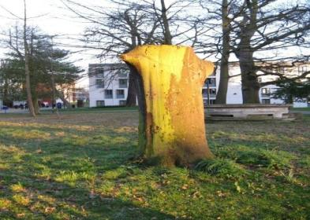
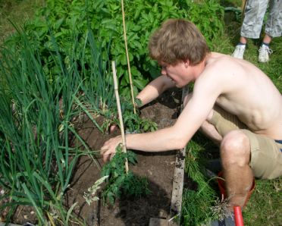


Environmental
Champion Projects

Slide 18
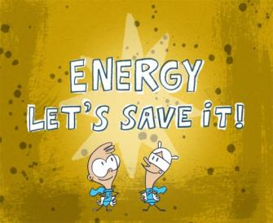


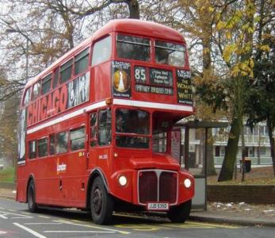
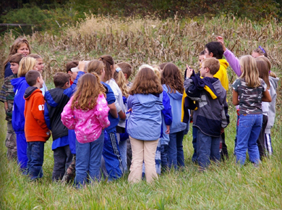
Recent and Current Projects

Slide 19
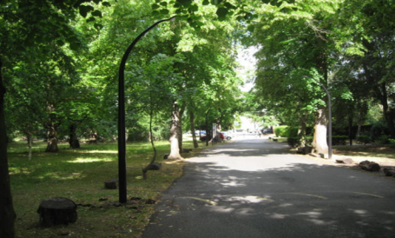
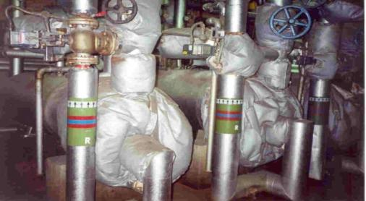

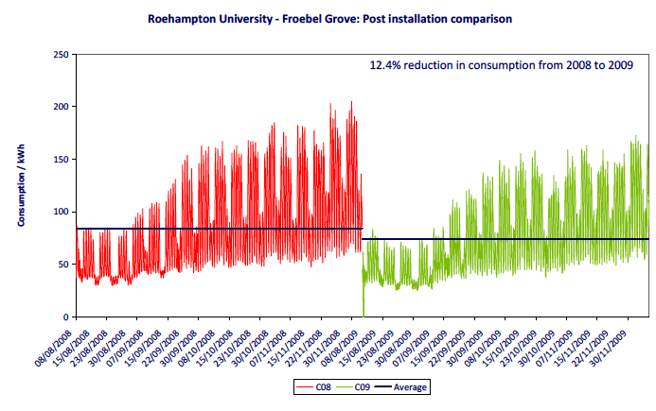
Energy Saving Projects

Slide 20
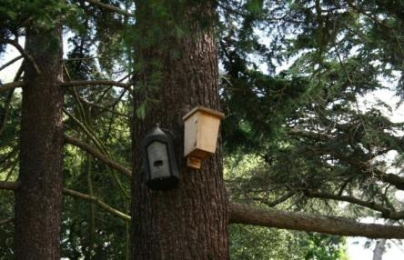
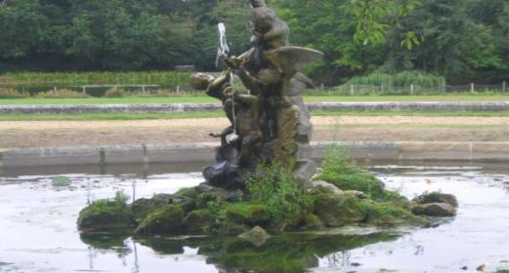
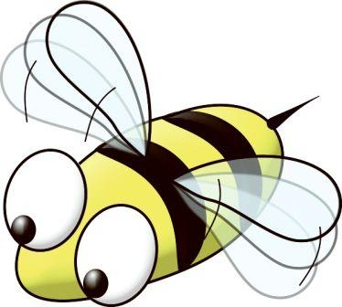
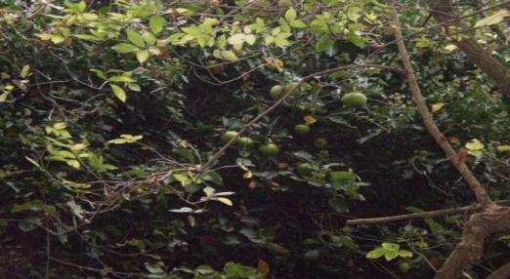
Biodiversity Projects

Slide 21



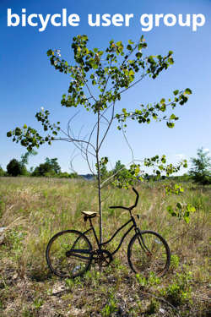
Travel Projects

Slide 22
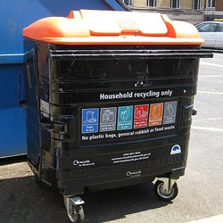

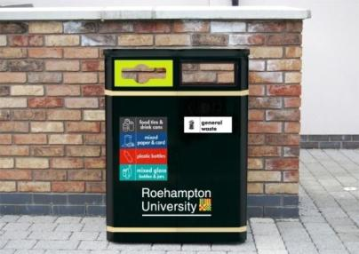
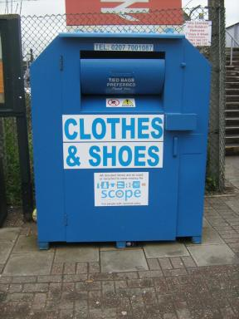
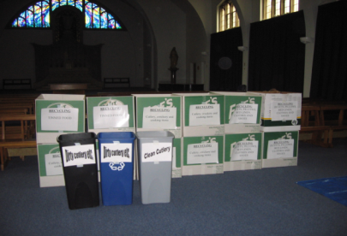
Waste Reduction Projects

Slide 23


Awareness Raising Projects
Don’t standby, switch off! The average household wastes £37 each year by leaving appliances on.
If everyone at the University turned off a light each day we could save over £50,000 per year.

Slide 24

Time for a Break!

Slide 25

ICR/UCL e-learning training

Slide 26
2 Key areas were identified regarding content:

Slide 27
1. What do we want people to know?
2. What do we want people to do differently?

Slide 28
Our suggestions…

Slide 29
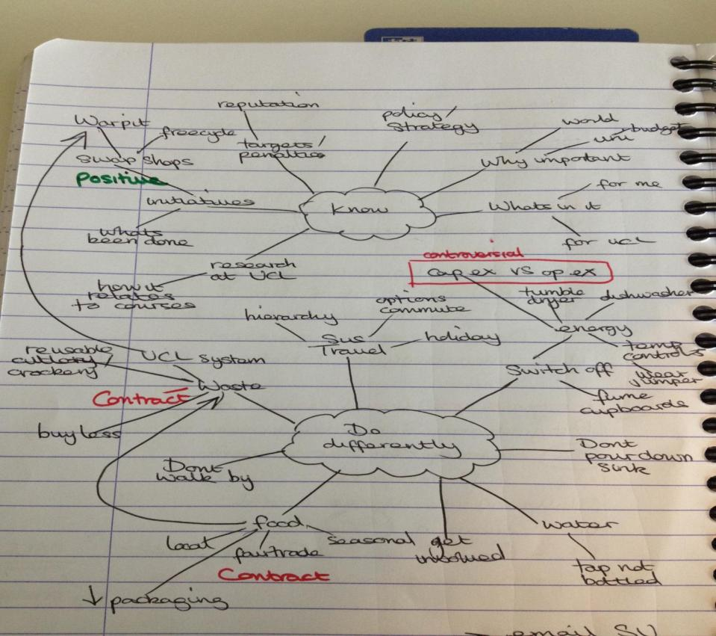

Slide 30
Key things to consider:
Set up a working group – representation across the board; academic, student, environment team, HR etc
Collaboration – working with another organisation can increase resource
Get feedback!!!

Slide 32

Lunch Break!

Slide 33
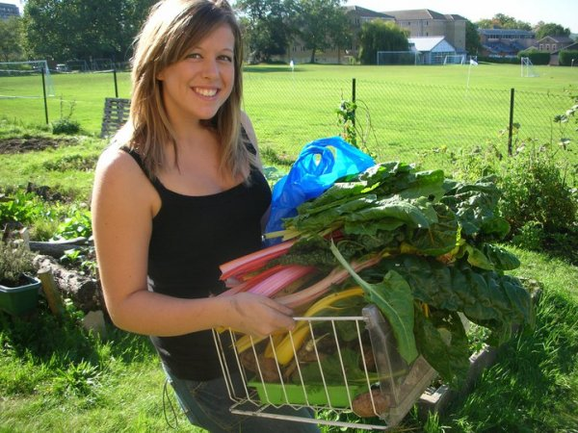
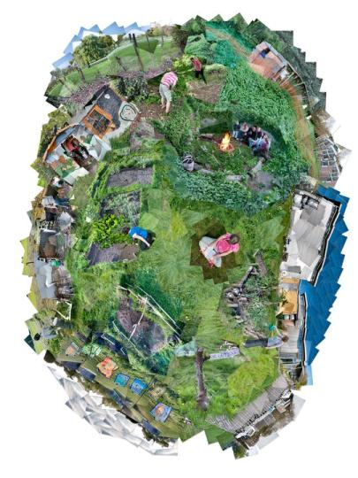
Allotments

Slide 34
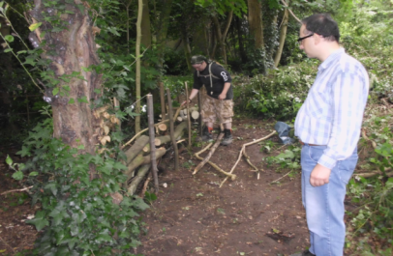
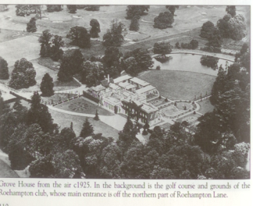
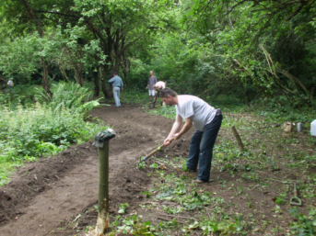
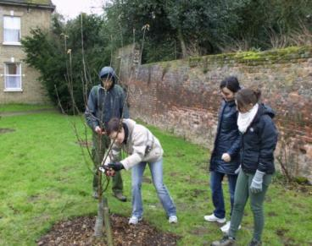
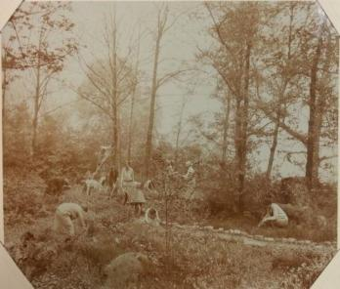
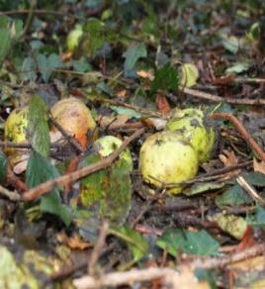
London Orchard Project

Slide 35
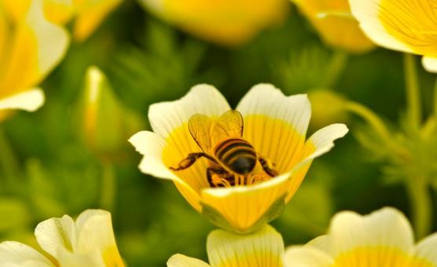
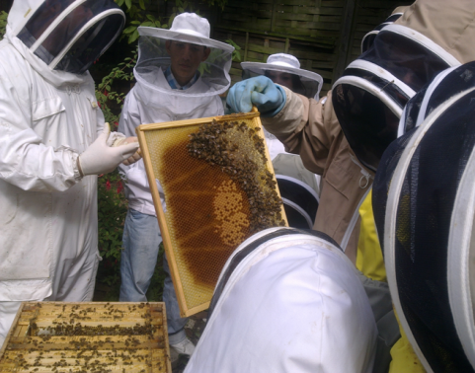
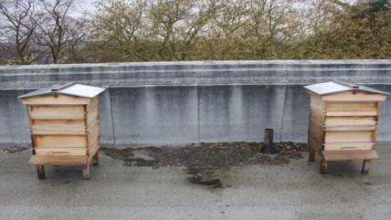
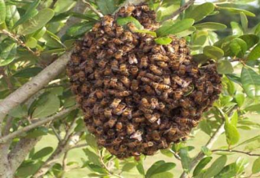

Roehampton Apiary

Slide 36

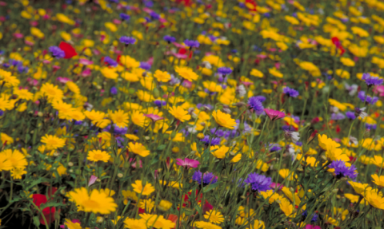
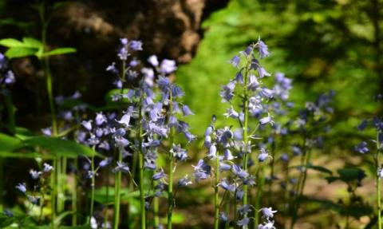
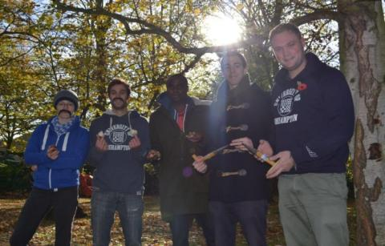

Big Movember Bulb Plant

Slide 37

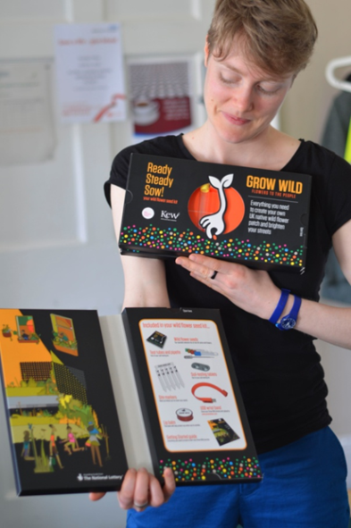
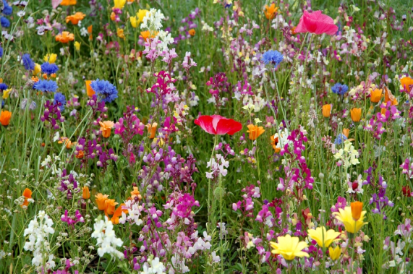

Kew Gardens Grow Wild

Slide 38
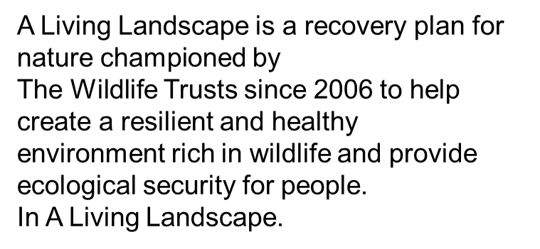


Beverley Brook Living Landscape London Wildlife Trust

Slide 39







Growhampton

