Slide 1
Love Food, Hate Waste: sustainable food procurement in practice
Liam Glasper, Strategic Contracts Manager
John Turner, Community Executive Chef

Slide 2
Background

Slide 3
16 colleges of which 10 are fully catered.
Approx. 3,700 residents 3 meals per day.
Conference and banqueting.
£3.2m annual food spend.
Procurement and Catering worked together over past 2 ½ years to fundamentally change the way in which food is sourced, prepared and provided.

Slide 4
Where We Were

Slide 5
College Structure
Individual Colleges – localised buying.
Old boys network for purchasing.
Budget holders were Bursars and some only focused on the bottom line.
10 Head Chefs with varying interest – no cohesion.
Squeakiest wheel got all the oil.
Notes:
Procurement and Catering different needs, seen the other department as a pain in the arse.
Why am I been punished for managing catering contracts.
Old boy network – butcher good beef but providing everything e.g. chicken for Thailand.
Bad toms whoever had worst system ended up with them. One college savings subsidised by others inefficiencies.

Slide 6
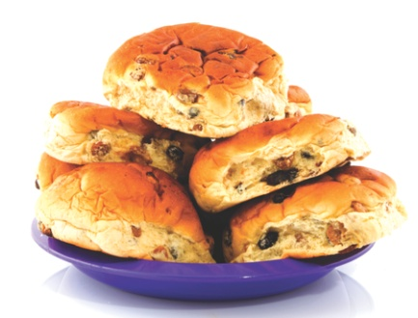
Supplier Relationships
Multiple supplier framework agreements.
Relied on national/regional agreements.
Bun fight!
Low confidence in suppliers – over stocking.
Supplier review only at tender stage.
Contract put to sleep after tender.
Escalation process was cumbersome.
Notes:
Old school procurement let suppliers fight it out and cherry pick.
Kept at arms length, no business guaranteed.
Leverage one against the other.
Escalation all colleges fed to procurement SLAs too long by the time rectified had been suffering for a month.
Too many suppliers and customers difficult to deal with all the issues – spread to thin.

Slide 7
Social and Environmental
No central consideration to the environment and carbon management.
Limited provenance of product.
Local sourcing not a concern.
Low student voice – perceived
as bad school dinners.
Enforced policies to comply with Gov. targets to support HEFCE funding.
Notes:
Provenance – took supplier’s word.
Little choice, now educate students to make informed choices with holistic data.

Slide 8
What We Did

Slide 9
Restructured Catering
One person to act as key contact with Procurement.
Gave resource to investigate problems.
Consolidated budget from Colleges to Catering.
Work with other departments.
TLC approach to overcome preconceptions.
Notes:
Changed policy.
Realisation had to get own house in order.
Started to work with other departments e.g. Greenspace.

Slide 10
Created Central Menu Bank
Better enable centralised management of procurement.
Focus was on:
Provenance;
Cost;
Environmental Impact;
Nutritional value;
Special dietary requirements.

Slide 11
Procurement Focus
Identified primary contracts – high impact areas.
Rationalised supply base:
Single supply contracts;
Guaranteed business = improved level of support;
Ensure trust and transparency;
Partnership approach.
Notes:
Supplier audits.
Robust contract management, not just reviewed as part of tender.
Share knowledge.
Seek external expertise where required.

Slide 12
Changed Procurement Practices
Central negotiation.
Bulk deals.
Forecasting.
Provided volumes for stock management.
Monthly contract review meetings.
Contract improvement plans.
Benchmark new contracts against previous and national/regional agreements.
Notes:
Bulk deals – easy with set menus across all locations.
Forecast for whole term.
Par stocks can support across the business.
Purchasing calendar – what to buy and when – save on deliveries.
Stopped cold calls.
Not like-for-like promotions.
Promotions centrally managed.

Slide 13
Improved Communication
Involved Catering staff.
Suppliers meetings.
Setup food committees.
Student awareness & feedback.
Informed Bursars and Heads of House.
Updated University Executive Council.
Close links with Greenspace (University sustainability group).
Notes:
Feel part of business and share in the kudos.
We know what our business if worth – indirect costs.

Slide 14
Set High Aspirations
Challenged ourselves.
Challenged suppliers.
Targeted environmental, social and economic savings.
Notes:
Low carbon diets.
Utilities and water in production of food.
12.5% reduction carbon in deliveries.
Refrigerants.
Better purchasing plans.
Better education.
Ethical buying.
Healthy eating.
Outreach with suppliers.
Economic 2.5% off baseline – bulk deals, branded support, restrict products.
Restructure waste from 4% to 2%.
Recovering costs from oil and food – waste as a commodity.
Fairtrade.
Freerange – took delivery cost out.

Slide 15
What We Have Achieved

Slide 16
Processes
Improved links between Procurement and Catering.
Ability to manage hedged contracts.
Single supply contracts with open-book pricing.
Notes:
Biggest challenge to manage price fluctuations.
Global issues – crop failures.
Transparency on full product range. Not just select basket – overall profit margin.
Yoghurt – change production methods to grow business.
Get out and meet suppliers – can’t manage from behind a desk.

Slide 17
Menus
Ability to engineer menus – mitigate price fluctuations.
Sustainable fish e.g. MSC.
Aligned with seasonal production cycles.
Excluded air freighted products.
Introduced lower cost cuts of meat – slow cooking methods.
Free range eggs from local farm.
Local products.
Education on frozen products.
Notes:
E.g. onion, broccoli, past to noodles.
Menus adapted to use local products.

Slide 18
Satisfaction
Staff happier – able to concentrate on cooking.
Customer satisfaction increased by 25% and uptake increased by 20%.
Suppliers see it as win-win situation.
Notes:
Confidence in process high order accuracy, any issues dealt with same day. Happy key personnel dealing with issues on their behalf.
Now working to increase satisfaction in light of student fee increases.

Slide 19
Environment
Reduced packaging and ensured recycled/re-used where possible.
Saved 12.5% on energy costs by slow cooking.
Reduced deliveries saving 41.3 tones CO² per annum.
Reduced food miles.
Notes:
Target 25% in utilities under HEFCE – menu engineering.
Slow cooking – brat pan, lower energy consumption.
Slow cooking – cuts of meat not traditionally used.
Test packaging with Waste contractor – change where required.
Audit suppliers for energy efficiencies.
Out source products where more efficient to do so, but ensure our ethos into the production e.g. soup.
Deliveries – rationalise and hub. Scheduling of orders.

Slide 20
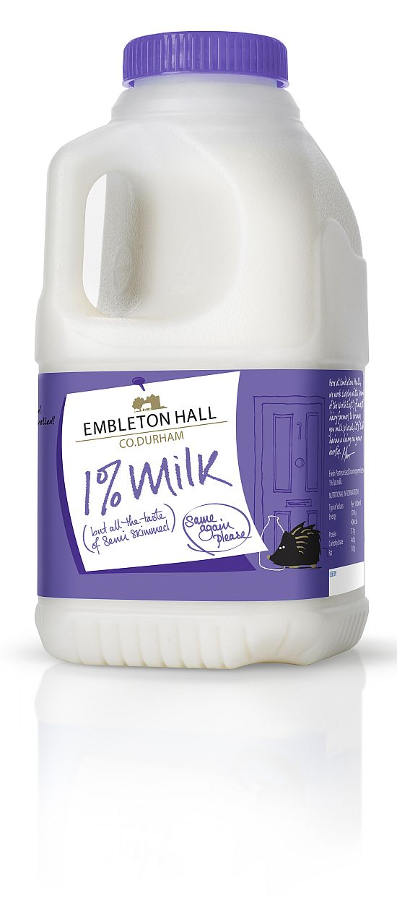
Environment
Increased %age of local produce (when in season):
Milk 100%
Yoghurt 100%
Vegetables 50%
Cheese (commercial menus) 80%
Pork 60%
Beef 20%
Artisan Bakery 100%
Notes:
Milk – was spot bought, only processed locally not farmed locally.
Yoghurts – ethically sourced fruit and sugars. Local testing group. Ethical outweighed branding e.g. Muller. Has grown their business.
Veg – low as 50% as products not grown in UK. When in UK season 95% named farms.
Set up collective, but disbanded as more money in bio-fuel.
Offer students opportunity to visit farms and suppliers.
Durham Blue Cheese – learning curve – killed golden goose! Be careful sometime better to tailor our process to their production.
Named farms.
Pork – rare breeds, named farms where money allows. Farm assured, buy abroad where needs be but ensure full provenance.
Beef – Where money allows, mostly UK but 20% local. Farm assured, but looking to implement meat free days to support the carbon loading on beef production.
Animal husbandry with better provenance.
Trying to support local wheat and grains. Real bread projects and regional delicacies.
Students have a better respect for the product knowing the effort to get it to the plate.

Slide 21
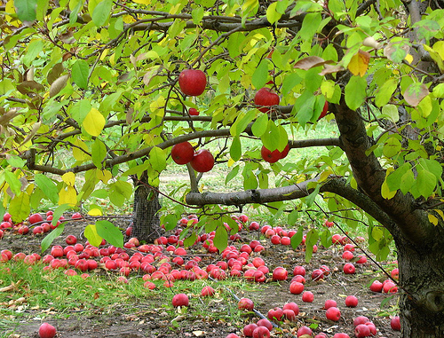
Social
Suppliers provide training to staff.
Away days following the supply chain.
Ensure suppliers support local charities.
Try to keep University money within the local economy.
Working with supplier to plant an orchard for students.
Notes:
Outreach – support schools – share best practice.
Others link onto our contracts who might not have the same resource.

Slide 22
Economic
Open book pricing with agreed profit margin.
In the first year of new contracts saved £268K in comparison to previous arrangements.
Benchmarked fresh produce against national/regional agreements and they were found to be £577K more expensive per annum.
Notes:
Audit suppliers.
Invested money for better quality products and improvements e.g. MSC processes and accreditation.
Benchmark – Defra, Food Index, Competitors.

Slide 23
What We Are Now Doing

Slide 24
Recently achieved MSC accreditation.
Working with external organisations to improve our supply chain e.g. MSC, DEFRA, Durham Council.
Working with suppliers to act as hubs for localised products.
Suppliers to produce yearly report card.
Supporting and developing local projects
Notes:
Soup and dairy.
Developing food group projects – start little infrastructures.

Slide 25
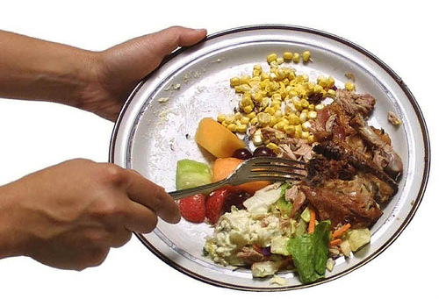
Working with suppliers to share best practice within the industry to make the supply chain more efficient.
Working with Council to create a local food strategy.
Constantly lobbying suppliers.
Reducing food waste.
Implementing maintenance contract to ensure kitchens operate efficiently.
Notes:
Lobby – innovation, source new products, look at trans fats, they look at their system as much as we look at ours.
Proactive maintenance for efficiencies – values from E&B – can attribute cost.

Slide 26
Identifying ways to reduce the carbon impact of the catering function.
Rolling out improvements to the commercial elements of the business.
Staff training and visits to suppliers to instil confidence in the procurement process.
Constantly looking at ways to evolve, what was once the exception is now the expectation.
Notes:
Share best practice from colleges to cafes and conference facilities.
Behavioural changes - default it now off in kitchens.
Trust judgment, see how the contribute, small gains in each college make big gains in University.
Keep revisiting ideas, might now be possible to implement.

Slide 27
Share best practice with other organisations, do not want to compete.
Sustainability is more important than having a unique selling point. Green league tables promotes isolation.
Want to learn from others e.g. food waste management.
Don’t want to reinvent the wheel.
Notes:
Do league tables help raise standards?

Slide 28
Why Did We Bother?

Slide 29
Believe it is morally the right thing to do.
Student body placed pressure on University.
University takes CSR seriously and we have followed corporate policy.
Desire to add value to the local economy.
Preparation for phase 3 of the University's Carbon Management Plan which addresses supply chain.

Slide 30
Take home messages
Sustainable savings can still be made in these times of austerity. Remember a lot of environmental/social savings can have an economic benefit to you and/or the supplier.
You have to become good to supply in order to get the most out of your supply chain.
Challenge yourself and your suppliers.
Notes:
Time invested at the beginning pays dividends in the long run
Check the checkers – don’t take at face value.

Slide 31
Your next steps – making the most of your EAUC Membership…
Resources - visit the dedicated sustainable procurement section on the EAUC resource bank
Training - want learn more - book onto our EAUC sustainable procurement levels 1 and 2 CPD event (April, London)
Recognition - want recognition for embedding a sustainable procurement process - enter the 2012 Green Gown Awards sustainable procurement category. Entries open summer 2012
Measure and improve - sign up to LiFE www.thelifeindex.org.uk. EAUC Members receive a significant discount
LiFE offers a dedicated ‘procurement and supplier engagement’ framework
Membership matters at www.eauc.org.uk

