Slide 1
Carbon Management Plans - achievements, maintenance and the future
Kevin Cope
Imperial College London
Head of Building Operations

Slide 2
Carbon Management Plans - achievements, maintenance and the future
Content
Imperial College’s Carbon Management Plan - brief overview
How the CMP is monitored / tracked
Achievements - Continuous Commissioning, Highly Commended Green Gown Awards 2011 Carbon Reduction
CMP - how are we doing?

Slide 3
Carbon Management Plan
Emissions and Costs
In 2008/09, Imperial College’s carbon footprint resulting from electricity, gas, steam and oil used in its buildings, owned vehicles, waste and water was
84,026 tonnes of CO₂
Our energy costs associated with these emissions was circa
£16.9 million
Nearly 70% of this energy cost and emissions are produced at our South Kensington campus.

Slide 4
Carbon Management Plan
Working with the Carbon Trust we implemented our plan in 2009/2010 academic year
2008/09 is our “Baseline Year” against which we benchmark performance within the Plan.
84,026 tCO2 over 5 years to 67,221 tCO2
Within the plan we identified 24 Carbon Reduction projects which potentially could save a total of 17,443 tCO2

Slide 5
Carbon Management Plan

Slide 6
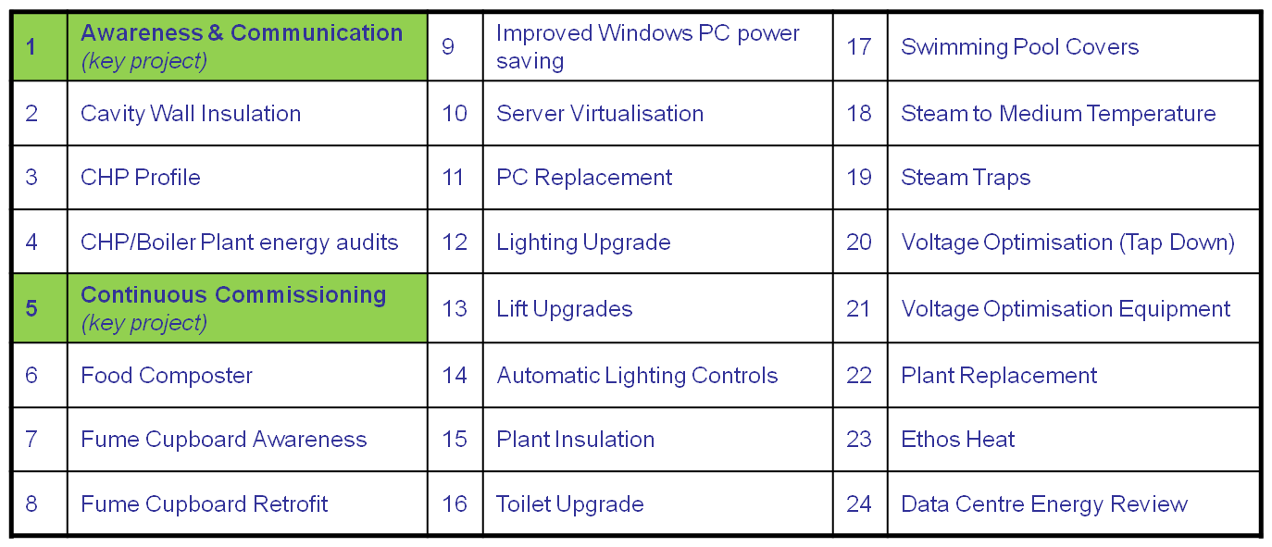
CMP opportunities identified
We identified 24 Carbon Reduction projects in the plan to be delivered out over it’s 5 years – these opportunities that could save a total of 17,443 tCO2

Slide 7
Project’s potential CO2 savings
Many of these opportunities will be relevant in both HE and FE environments

Slide 8
Managing the CMP
CMP progress is reported to and overviewed every two months, by the College
‘Carbon Management Steering Board’
Council
Audit Committee
Management Board
Health & Safety Committee
Carbon Management Steering Board
Facilities & Property Project Management Team
Head of Energy & Environmental Management
Projects

Slide 9
Managing the CMP
Within each “opportunities work package”, projects are suggested and a benefit analysis is undertaken.
Projects can be identified by our Energy & Environmental Team, Building Managers or any staff or student.
Each project is reviewed and approved by the Facilities & Property Project Management Team
Funding (where required) is allocated if the assessed benefits and payback is considered reasonable.
Savings are measured

Slide 10
Building Trackers
We have established ‘building trackers’ that incorporate:
Project Tracker (includes savings log)
Building Energy Profile
Ideas Log
HVAC & Lighting calculations
AHU & Lighting asset registers
BMS timing schedule
Filter schedules

Slide 11
Achievements
Continuous Commissioning
Highly Commended Green Gown Awards 2011 Carbon Reduction

Slide 12
Continuous Commissioning
The Continuous Commissioning (ConCom) Strategy
The operational optimisation of Imperial College estate
plant & services, reducing carbon consumption while maintaining safe and functional research and teaching environments
Continuous Optimisation of plant & services, targeted to deliver 4,903tCO2

Slide 13
ConCom Targets

Slide 14
ConCom approach
We are challenging how environments were originally commissioned by considering:
The original design, at sign-off
How the environments are now being used
The occupation strategy
What service strategies are really needed to provide, safe and productive environments, without compromising our research & teaching.
This applies equally to FE and HE environments.

Slide 15
ConCom activities
Through Continuous Optimisation we are:
Ensuring plant operates in auto mode not manual
Reducing air change volumes
Setting back AHU operation (temperature & time)
Introducing more efficient plant
Adjusting pump delivery to meet flow demands
Improving filter efficiencies
Introducing occupancy controls e.g. CO2 sensors, ‘user switches’

Slide 16
ConCom Case Study – Flowers Building ‘Set-Backs’
Methodology
We identified Flowers building main air handling services were operating 24 hours a day, 7 days a week
Environmental conditions and operational dependencies were discussed with users
The four supply & extract air handling units were re-commissioned to ensure they could continue to operate to the original design
This helped establish that new motorised dampers and controls would be required to manipulate the air pressures and volumes, while ensuring that dedicated equipment areas continued to receive 24hr ventilation / cooling.

Slide 17
ConCon Case Study’ cont’d
The energy profile for the building was then measured across a normal week
The new controls and motorised dampers were installed
The air supply pressure was then reduced from 400pa to 300pa
The air volume delivered overnight was reduced to an average of 6 air changes / hour, from 13, between 22.00hrs to 07.00hrs.
The energy profile for the building was measured throughout this process and checked in subsequent weeks.
Further commissioning followed; reducing air pressures, and extending the time to between 18.00hrs to 07.00hrs, more savings resulted.

Slide 18
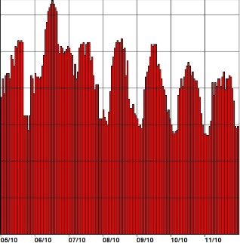
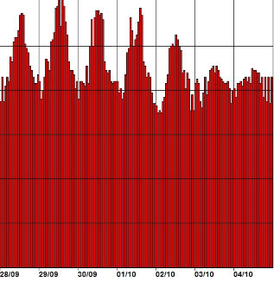
Flowers ‘Set-Back’ – Energy Profile
Electricity profile the week before the damper replacement and night setback initiation
Dampers replaced (Mon 5th & Tues 6th October)
Night set back initiated Wednesday 7th October
kW
400
320
240
160
80
Base load has reduced from 280kW to 210kW

Slide 19
Flowers ‘Set-Back’ – CO2 Savings
The base load has reduced from 280kW to 210 kW a 70kW saving
Day time air pressure was reduced, heating & cooling savings resulted
Resulting in overall savings of:

Slide 20
ConCom – the benefits
With support from our consultants ABS, the FM department working in partnership with our academic community and accumulated real sustainable savings:
3,768,621 kWhrs, £518,350 2,846 tonnesCO2
Further benefits are realised from this strategy
Extends the life of plant & infrastructure
Reduces maintenance costs
Results in fewer service failures
Engages with staff and students
Provides skills and awareness to FM staff

Slide 21
CMP – the benefit
Carbon Management Plan –
How are we doing?

Slide 22
CMP - how are we doing?

Slide 23
Most importantly how are we achieving our Carbon Reductions
Academic Community
TOGETHER
Building Management
Maintenance Services

Slide 24
Key Messages
Engagement with the HE or FE academic community is essential if your CMP is to succeed.
Continuous optimisation of plant & services has the potential to save significant amounts of carbon.
Opportunities can be delivered without compromising academic safety and are often no or low cost.

Slide 25
Your next steps – making the most of your EAUC Membership…
Resources
visit the dedicated carbon EAUC resource bank sections
visit the carbon reduction section of SORTED – the online resource for sustainability in the Learning and Skills sector
Networks - join our Carbon Intensive Research Colleges and Universities Community of Practice - for Colleges and Universities that undertake carbon intensive research
Find out more about this group at 5pm today – see programme for details
Recognition - want recognition for your carbon reduction initiatives – enter the 2012 Green Gown Awards carbon reduction category. Entries open summer 2012
Measure and improve - sign up to LiFE – www.thelifeindex.org.uk. EAUC Members receive a significant discount
LiFE offers dedicated ‘resource efficiency and waste’ and ‘utilities’ frameworks for implementation
Membership matters at www.eauc.org.uk

