Slide 1
Green and grey spaces: opportunities to enhance biodiversity wherever your campus is located
The Durham University Estate

Slide 2
Durham University and City

Slide 3
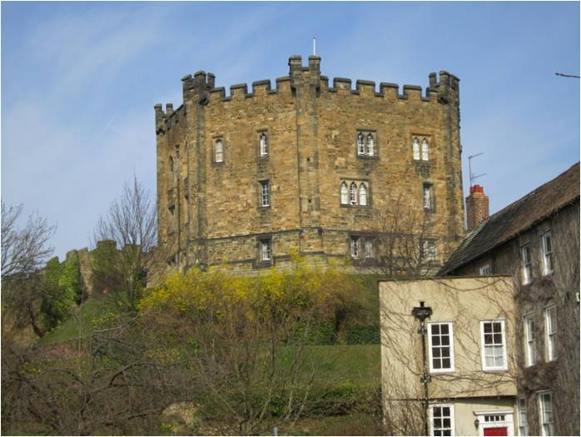
16 Colleges
47 Hectares of Woodland
112 Hectares of Grounds
10 Hectares of Botanic Garden

Slide 4
Botanic Garden: 10 Hectares
Plant collections from around the world
Woodland garden
Alpine garden
Bamboo grove
Glasshouses
Mediterranean plants
Tropical bugs, stick insects, scorpions and tarantulas
Teaching, research and school outreach (2,500 schoolchildren)

Slide 5
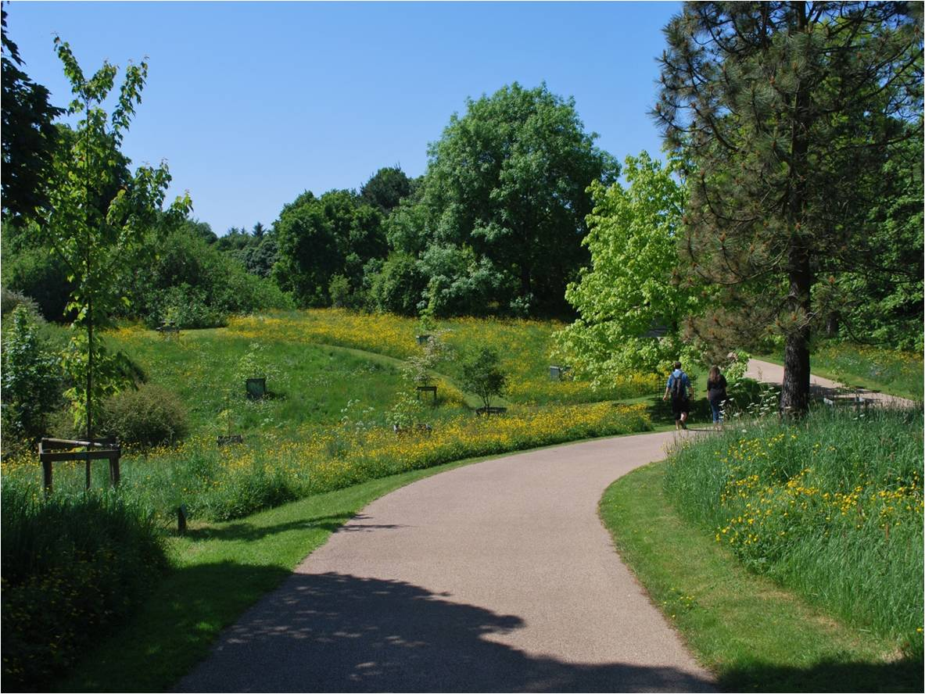
Meadow: Natural Meadows

Slide 6
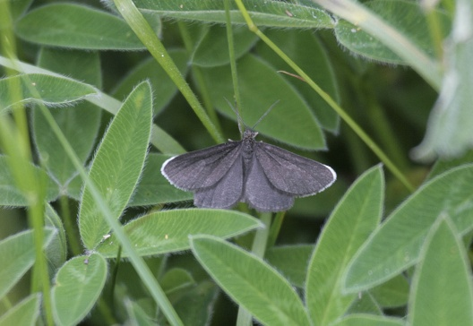
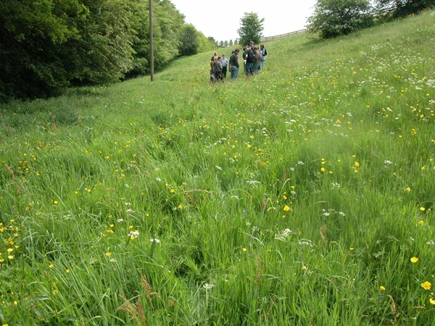
Ancient Meadow:
Pignut (Chimney Sweeper Moth)
Cow parsley
Sorrell

Slide 7
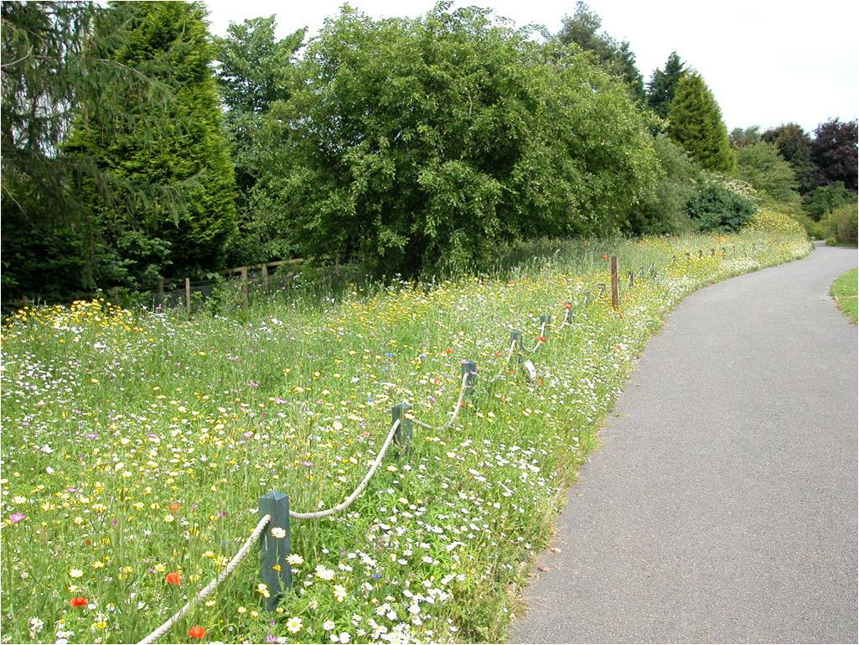
Meadow: Contrived Meadow

Slide 8
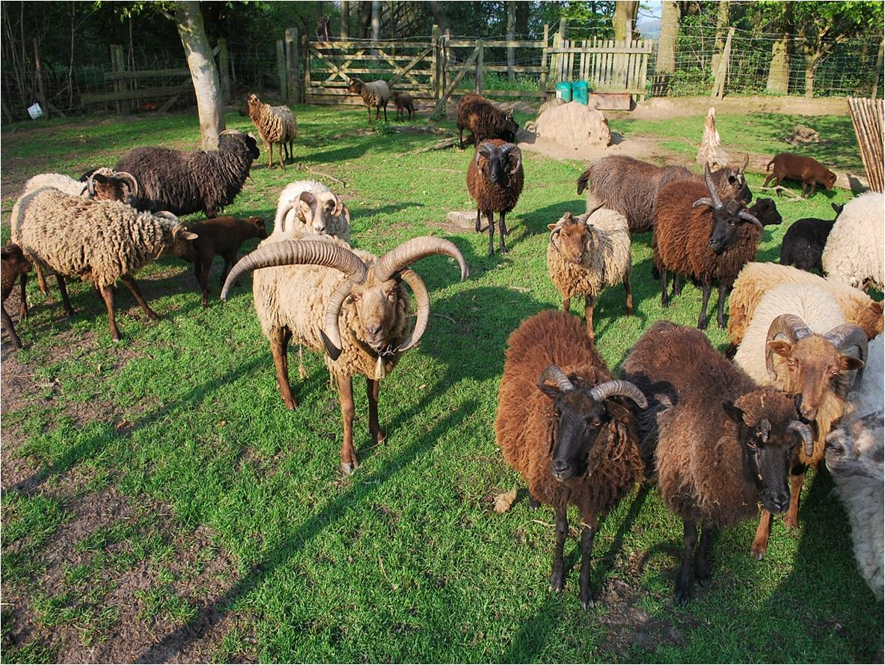
Rare Breed Sheep: Wildflower Meadow
- Manx Loughton & Hebridean sheep
- A vital part of the green management plan!

Slide 9
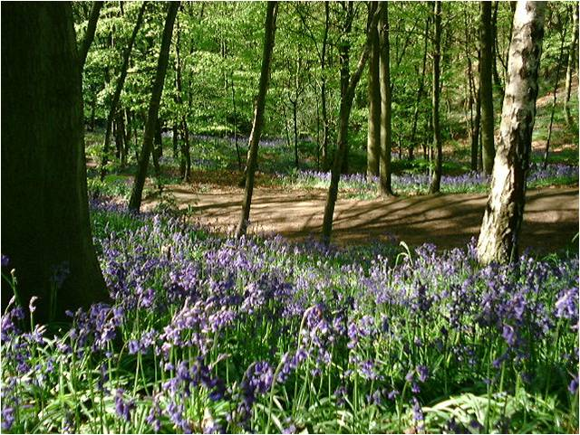
Woodland (47 Hectares)

Slide 10
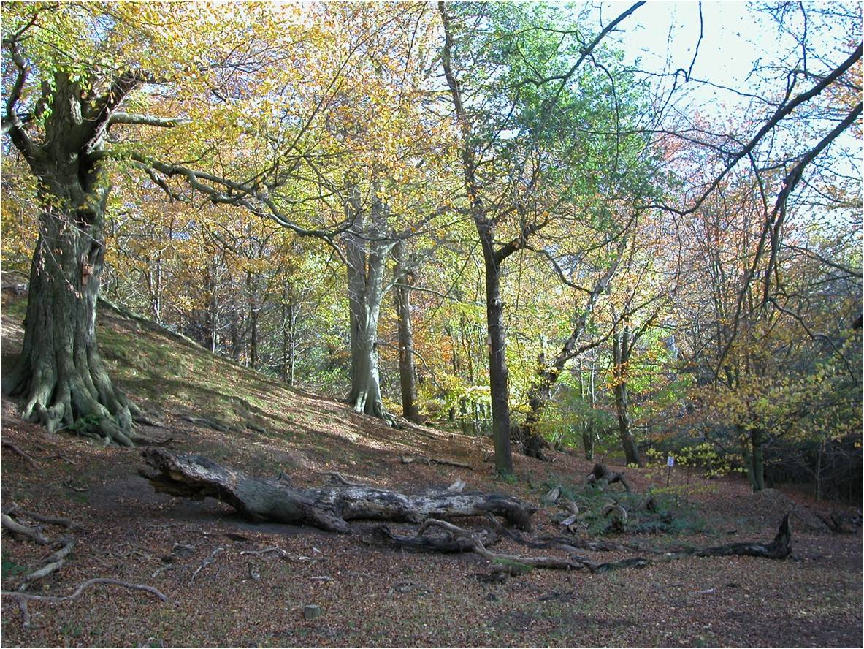
Low-intervention Woodland Management

Slide 11
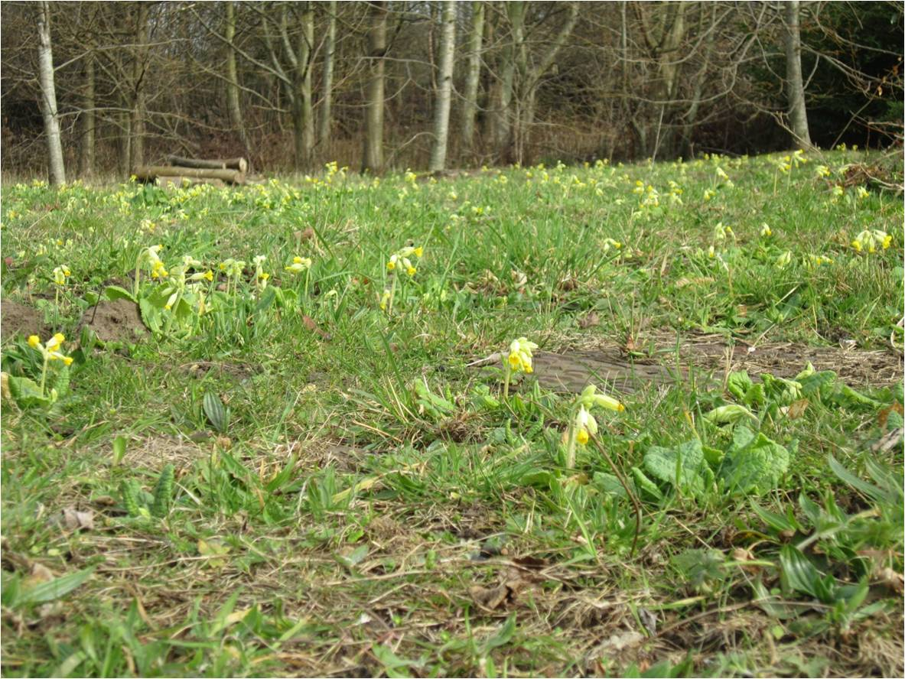
Wildflower Plantings

Slide 12
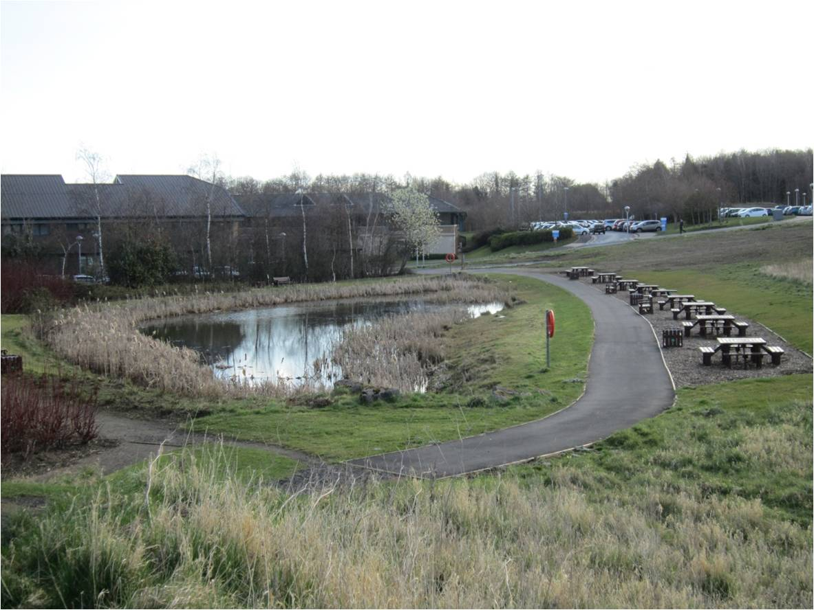
Ponds & Lakes: Mountjoy

Slide 13
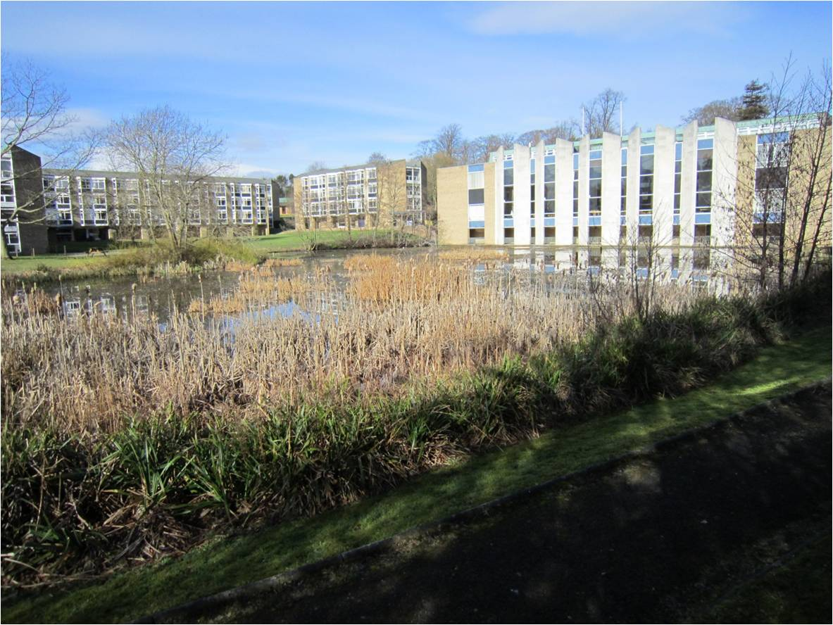
Ponds & Lakes: Colleges

Slide 14
Biodiversity Schemes

Slide 15
Biodiversity Policy
A Greenspace Policy
Covers:
Woodland
University and College grounds
Botanic Garden
A wide range of objectives, including:
preserving enhancing and creating habitats,
policy relating to pesticides,
estate management
engagement

Slide 16
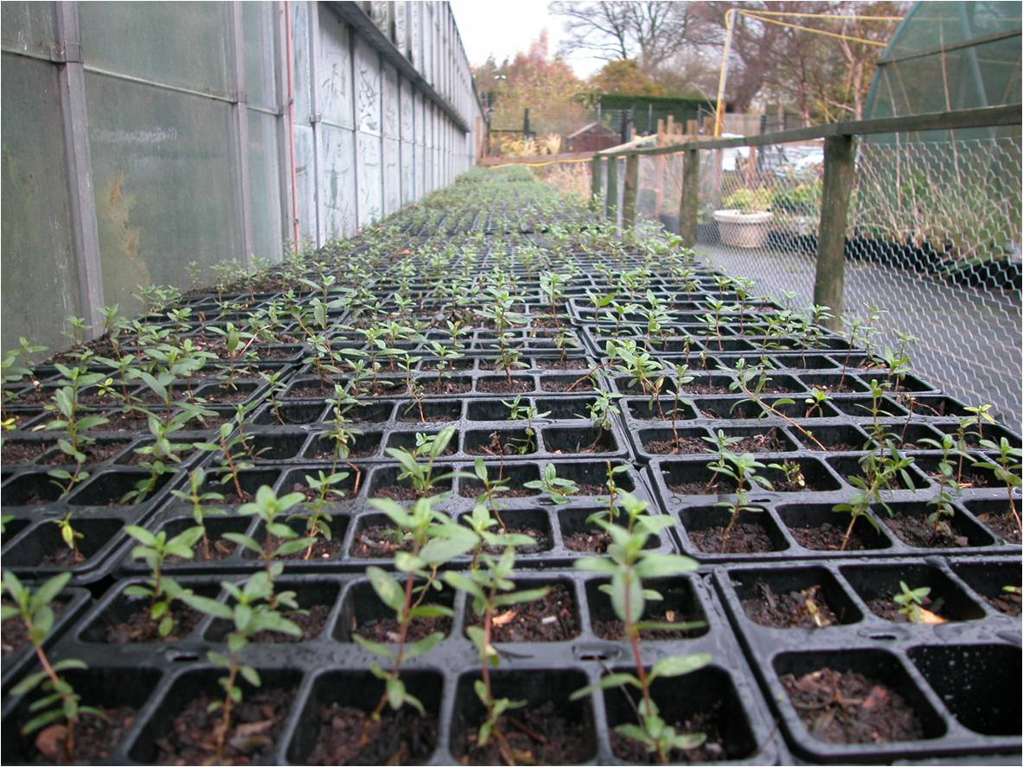
Rock Rose – Durham Wildlife Trust

Slide 17
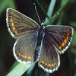
Rock Rose – Northern Brown Argus Butterfly

Slide 18
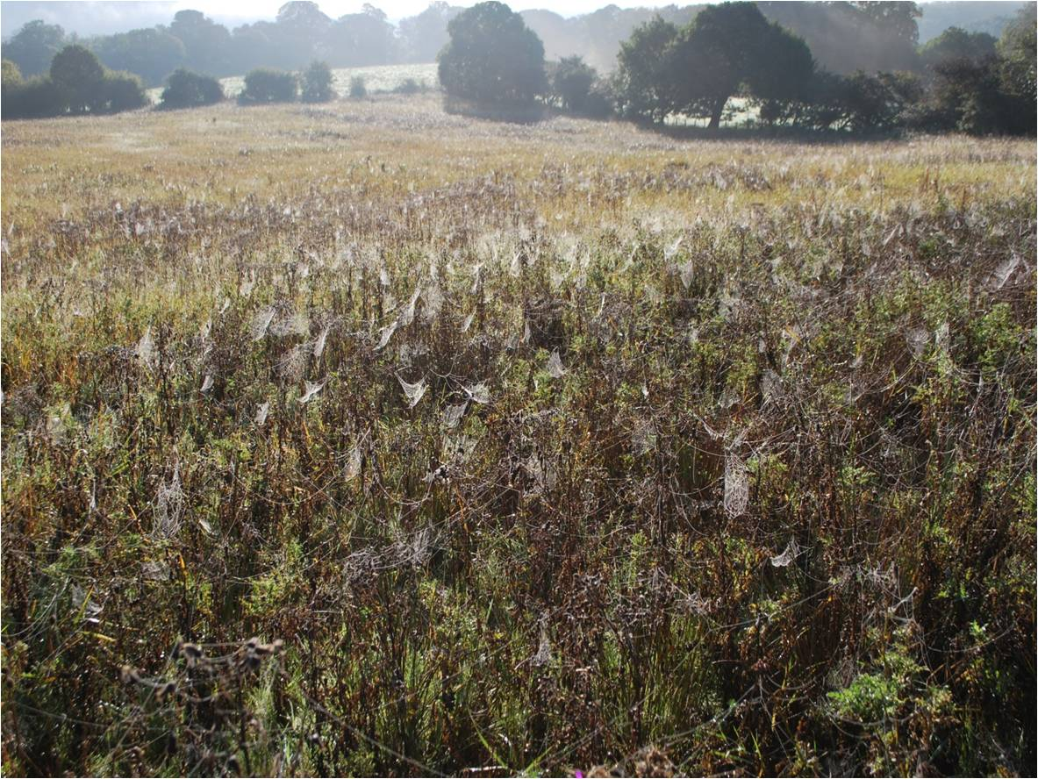
Former Farmland: RSPB Project

Slide 19
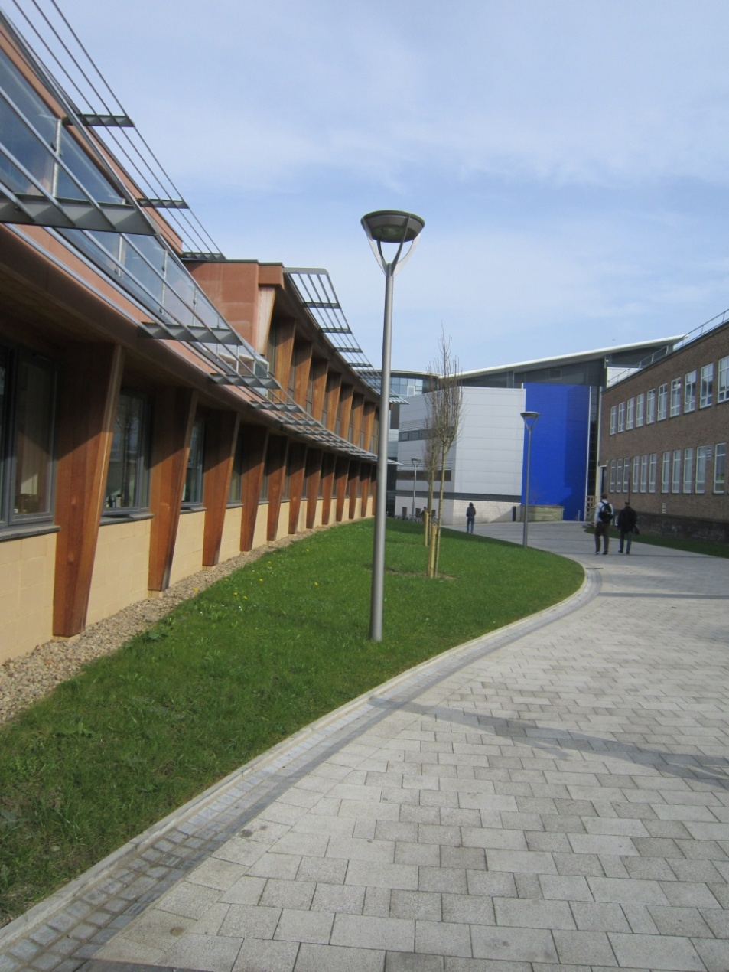
Re-landscaping using native trees:

Slide 20
Creating Green Spaces

Slide 21
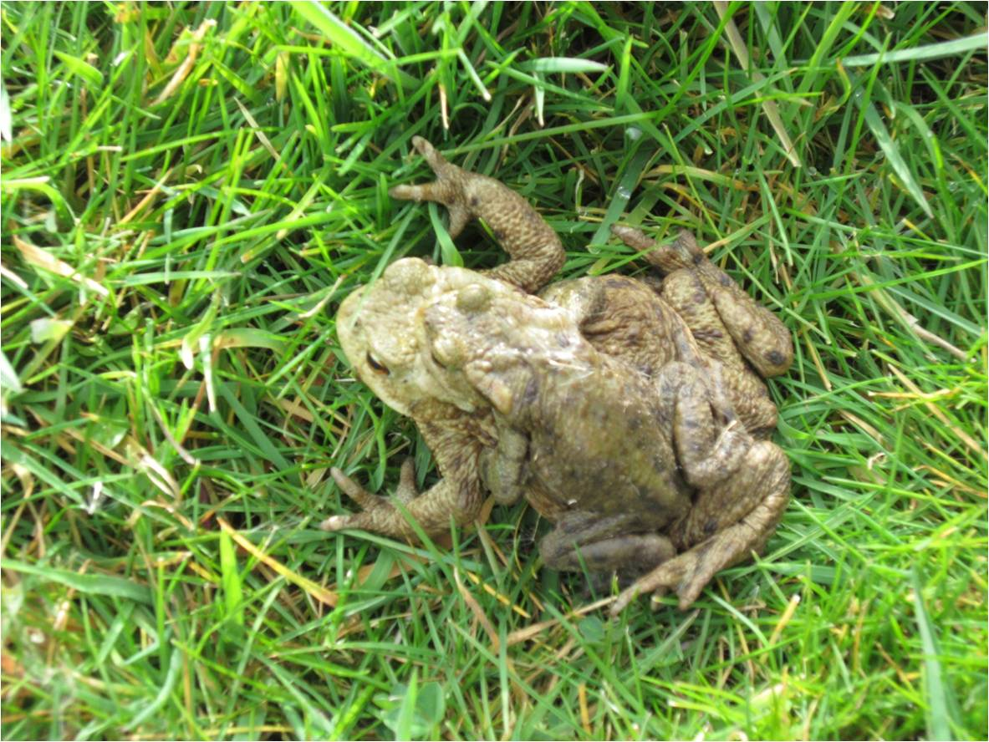
Conservation Projects: Toads & Butterflies

Slide 22
Engagement Initiatives: Sharing Biodiversity

Slide 23
Academic Research:

Slide 24
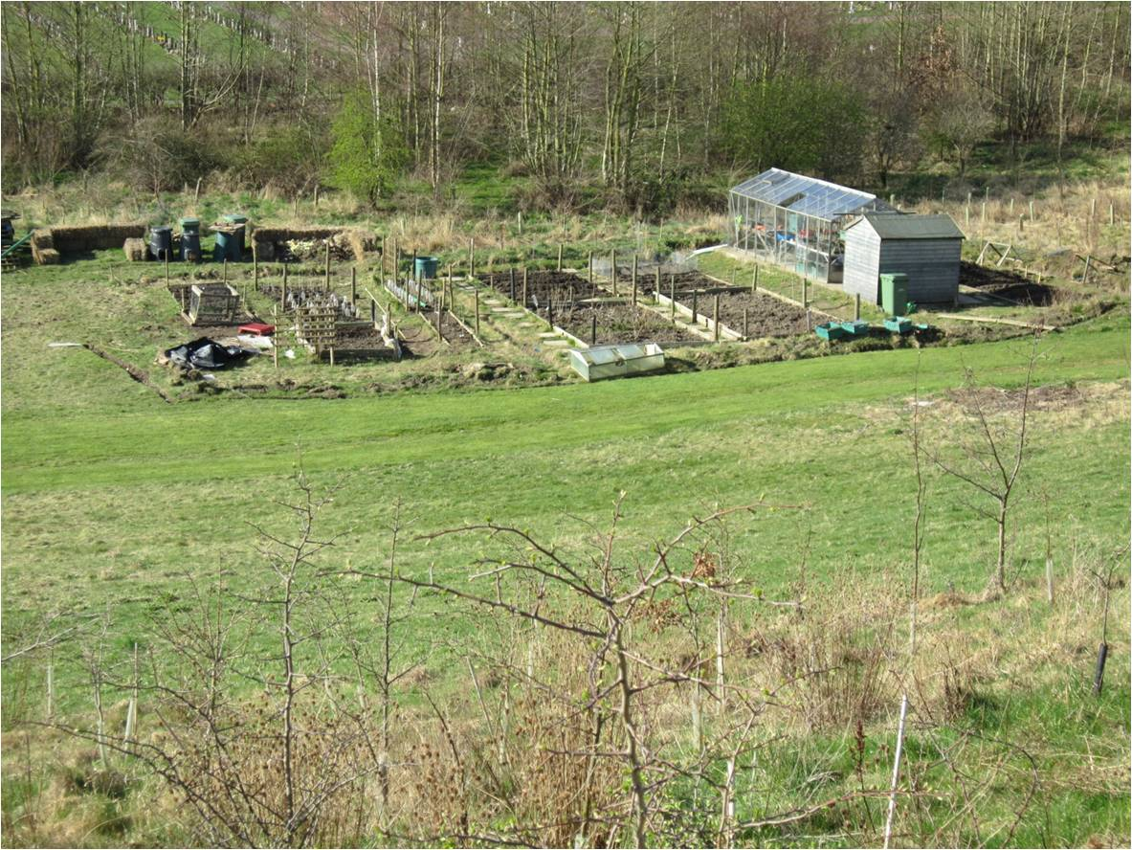
Allotments, Fruit trees and Herb Gardens:
Colleges
Student Societies & Engagement

Slide 25
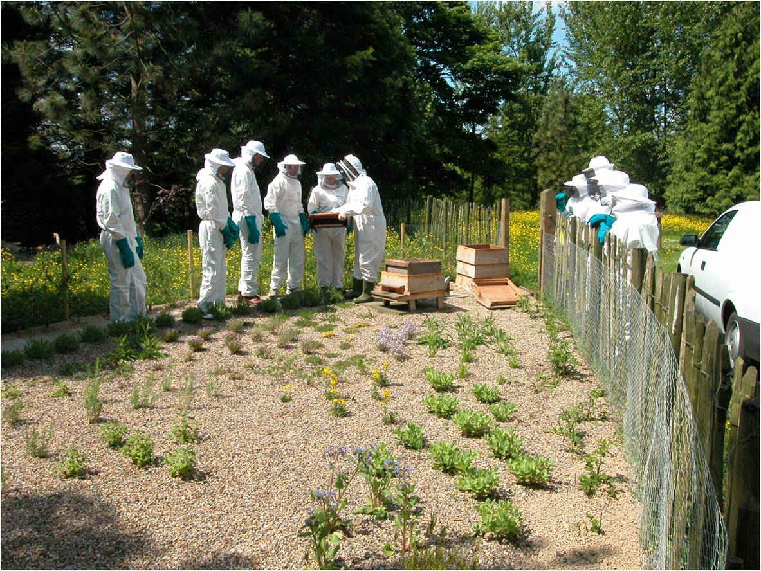
Student Engagement: Beehives

Slide 26
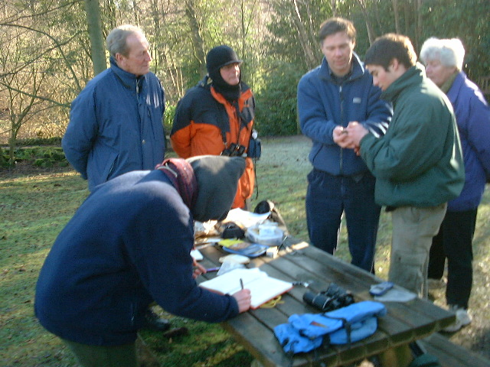
Student, Staff & Community Engagement: Bird Ringing

Slide 27
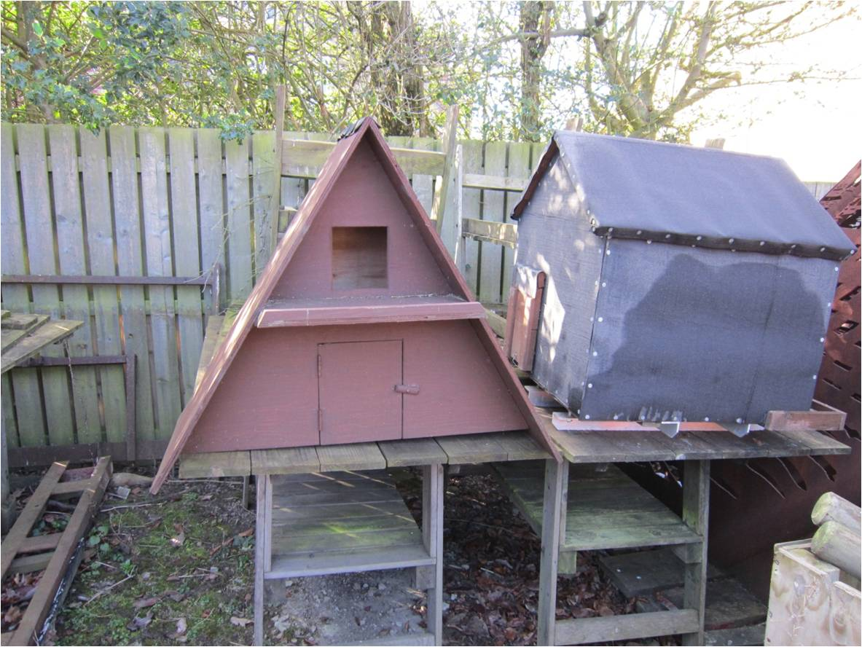
Conservation Projects: Barn Owl Boxes
Bat and Bird Boxes: Collingwood College and Durham Prison

Slide 28
Additional Projects:
Guided walks
Litter Picks
Botanic Garden Events
Gardening Clubs
Sunflower growing competition
Herb Handout
Greenspace E-bulletin...

Slide 29
Website and Blog

Slide 30
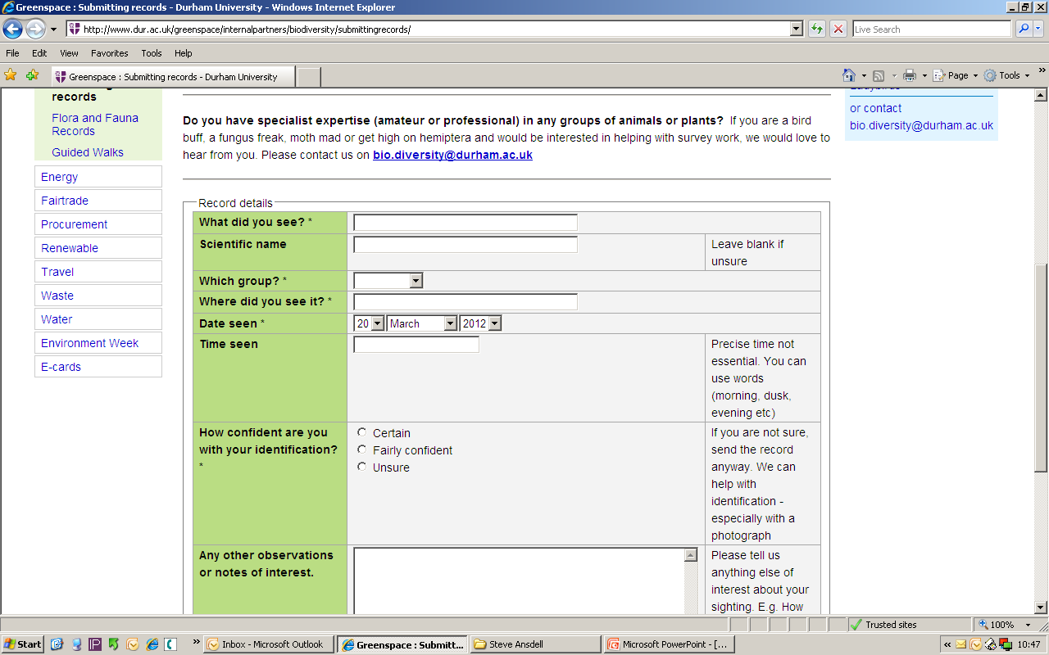
Wildlife Reporting Form:

Slide 31
Blog:

Slide 32
Take home messages
Know what you have on site – baseline survey.
Incorporate biodiversity into existing activities, contracts, maintenance schedules and projects.
Staff and student engagement is vital!

Slide 33
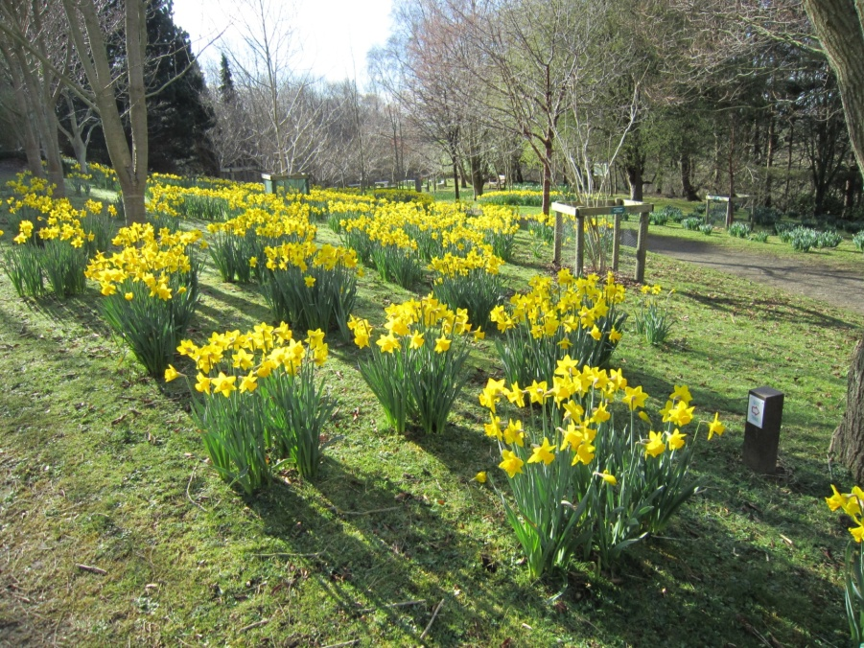
Contact
University of East London
s.kassam@uel.ac.uk
www.uel.ac.uk/greenthing
Durham University
s.j.ansdell@durham.ac.uk
www.dur.ac.uk/greenspace/internalpartners/biodiversity

Slide 34
Your next steps – making the most of your EAUC Membership…
Resources - view our biodiversity guide on the EAUC resource bank
Recognition - want recognition for your biodiversity excellence, enter the 2012 Green Gown Awards. Entries open in summer 2012
Measure and improve - sign up to LiFE - www.thelifeindex.org.uk. EAUC Members receive a significant discount
LiFE offers a dedicated ‘biodiversity’ framework for implementation
Membership matters at www.eauc.org.uk

