Slide 1
Case Study: Costing the Health Impacts of Air Pollution in Bristol
Dr Clare Beattie
Notes:
Introduce myself
This work one element of a much wider project, the main being to quantify health effects of air quality within Bristol to support the development of the Mayors Air Quality Strategy for Bristol.

Slide 2
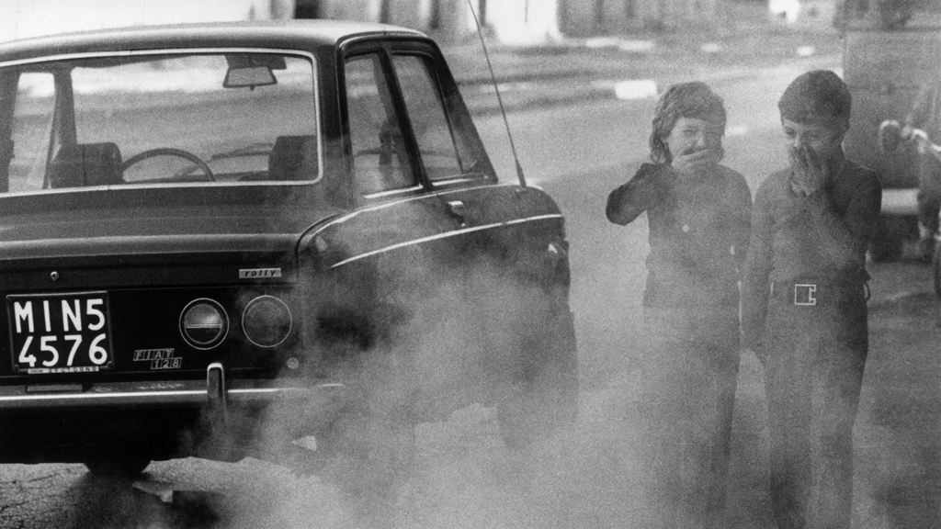
Urban Air Quality Issues
Notes:
In the UK, most issues with achieving objectives are traffic related (NO2) – particularly diesel. Sources of PM are more widespread and include both natural and man made particles, both emitted directly and those formed by chemical processes in the atmosphere.

Slide 3
Little bit of science!
Nitrogen dioxide – not achieving objectives
Particulate Matter (PM) – achieving objectives in Bristol
No threshold for health effects
All the health work relates to PM
Growing evidence of health burden of nitrogen dioxide
Notes:
Reiterate difference between NO2 and PM

Slide 4
Health Facts
UK Population lost 340,000 years of life in 2008
This loss of life is equivalent to 29,000 deaths
Assuming air pollution solely responsible for 29,000 deaths average loss of life 11 ½ years
Notes:
In public health terms second in numbers to smoking

Slide 5
The burden can also be represented as a loss of life expectancy from birth (for everyone) of 6 months
Most likely 200,000 people losing approx 2 years of life
80% of outdoor air pollution-related premature deaths were due to heart disease and strokes, while 14% due to COPD /acute lower respiratory infections; and 6% due to lung cancer (WHO: Worldwide figures)
Cost of air pollution at UK level estimated at £16 billion

Slide 6
Technical subject matter – how can we communicate this better?
Notes:
Communication Issues…. Difficult to relay this to politicians, never mind the public, but most issues in terms of legislation are to do with nitrogen dioxide, published health impacts are to do with particulate matter (mainly PM2.5). PM2.5 has much lower proportional impact from transport. NO THRESHOLD.

Slide 7
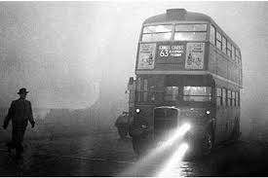
Changing face of Urban Air Pollution
Notes:
Perception that after the smogs of the 50s, we have sorted out all the problems. Now a completely different issue. NO2 is invisible and Particles are mostly invisible. Recent research shows that childrens lungs are being affected in their growth – life long impacts. Increase in inflammation of lungs even in healthy individuals – demonstrated by experiments in London

Slide 8
Sources
Nitrogen dioxide
Predominantly vehicles, especially diesel
Particulate Matter
Wider range of sources including natural and man-made, directly emitted and ‘secondary’
More difficult to manage

Slide 9
Bristol Air Quality Strategy
Wanted to quantify the health impacts of air pollution and subsequently the cost..
Death
Cardiovascular hospital admissions
Respiratory hospital admissions
Notes:
Study largely undertaken as a way of communicating the issues ahead of implementing measures. Likely to be lots of other subclinical impacts with costs in terms of days off work, etc, etc

Slide 10
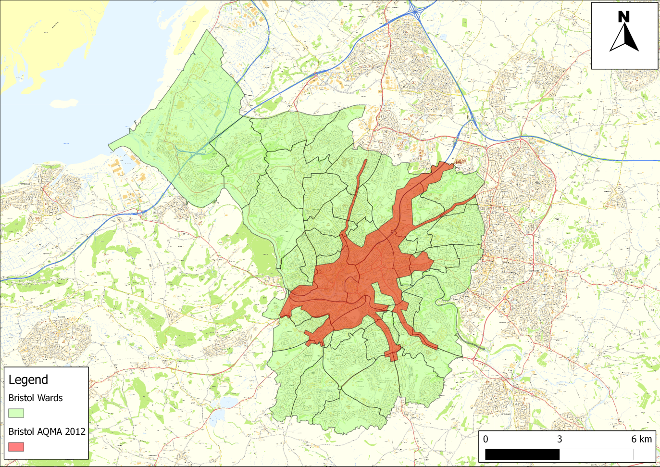
Notes:
Bristol has very typical air quality issues of a medium urban area. AQMA declared for NO2. City Centre and main arterial routes out of the city. Reflects sources of NO2.

Slide 11
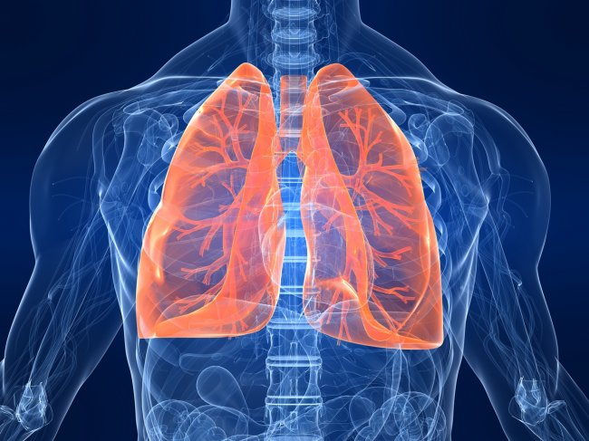
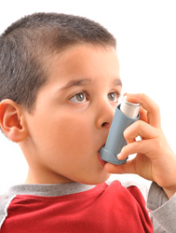
Health Impacts
Committee On the Medical Effects of Air Pollution
Publish Coefficients of impacts
These have been applied at Bristol level
Notes:
Work on health impacts relates mainly to PM in relation to published co-efficients which can be used.

Slide 12
Effects on Health
6% increase in deaths per 10 µg/m³ increase in PM_{2.5}
0.8% increase in admissions of cardiovascular disease per 10 µg/m³ increase in PM₁₀
Same increase for respiratory hospital admissions
Notes:
Explain difference between PM2.5 and PM10. illustration of how numbers are presented.

Slide 13
Costs
Not often calculated at local level…
2 main forms of costing
Cost benefit of overall strategy (eg that accompanied by NAQS)
Valuing health impacts
Notes:
Therefore costs only incorporate PM related health effects. One way of communicating the issue is through cost.

Slide 14
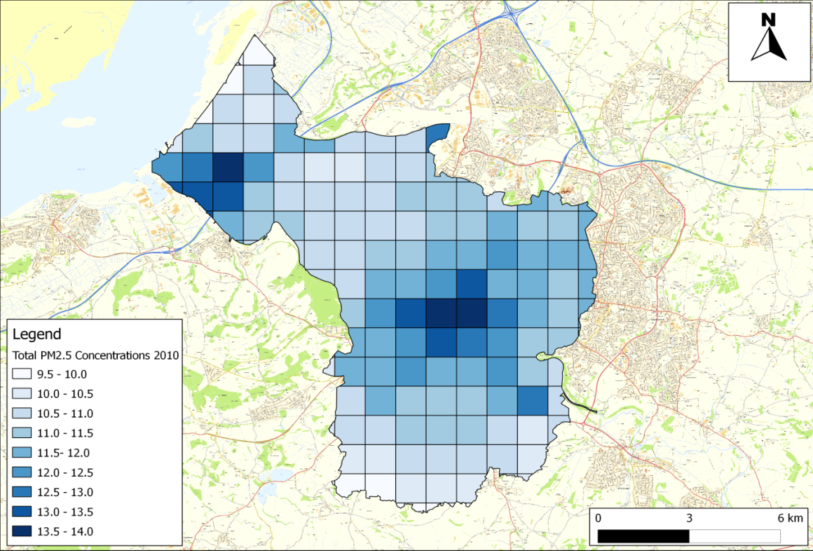
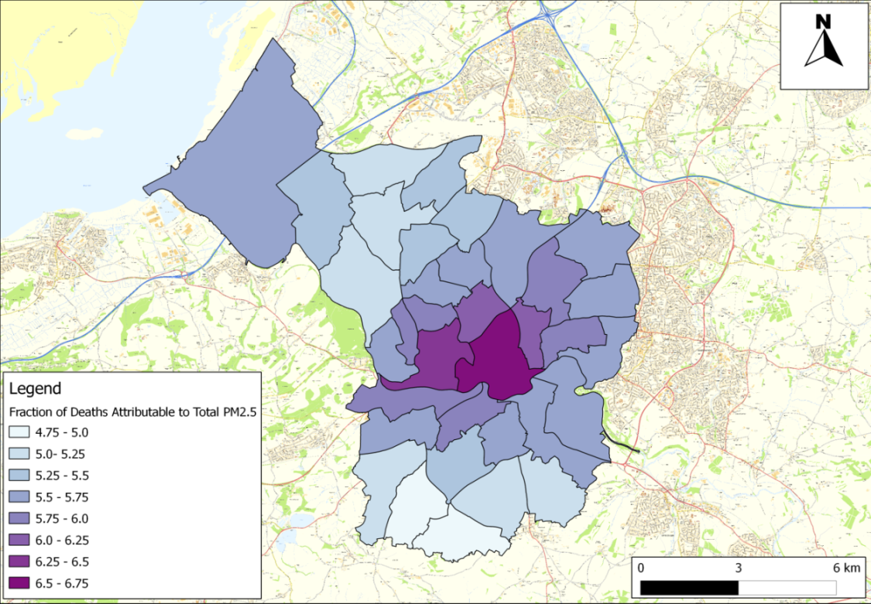
PM_{2.5} Concentrations
PM_{2.5} Deaths
Notes:
Talk through the use of background maps which have then been translated to ward level average concentrations and fraction of attributable deaths.

Slide 15
Health Impacts of Air Pollution: Bristol
Additional 188 deaths per annum
24 of these attributable to traffic emissions
52 additional respiratory admissions per annum
42 additional cardiovascular admissions per annum
Compares to 9 people killed in road traffic collisions per annum (average)
Notes:
All based on PM2.5 and PM10!!! Not NO2.

Slide 16
Costs - Death
Value of a Statistical Life (VSL) Used
Calculated from Value of Life Year (published by Defra) and years lost due to air pollution (national level).
Notes:
No VSL published by Defra in relation to air pollution. The VSL is the value that an individual places on a marginal change in their likelihood of death. Note that the VSL is very different from the value of an actual life. It is the value placed on changes in the likelihood of death, not the price someone would pay to avoid certain death. Based on willingness to pay.

Slide 17
Costs - Hospital Admissions
Cardiovascular and respiratory
Notes:
Published figures by Defra on costs of hospital admissions used. There is a range published.

Slide 18
Calculated Costs
Deaths
£439,000 per life lost
£82.6 million in Bristol
Morbidity
Respiratory admission – £115,435 to £ 552,871
Cardiovascular admission - £98,143 to £451,457
Total in region of £83 million per year
Notes:
Vast majority of costs related to deaths rather than hospital admissions

Slide 19
How certain?
Costs likely to be on the conservative side…
VSL is lower than that used in other studies which are closer to £1 million
Lower than if you proportion Bristol population in relation to UK population and overall UK cost
Coefficients used for calculating hospital admissions are old (and to be updated?)
Notes:
Our costs only include death and hospital admissions. Only include PM2.5 not NO2. if you compare to national figures which include more aspects (and proportion Bristol population within whole UK population) costs are approximately £114 million.

Slide 20
Head Office
23 Coldharbour Road, Bristol BS6 7JT Tel: 0117 974 1086
London Office
12 Airedale Road, London SW12 8SF Tel/Fax: 020 8673 4313

