Slide 1
University of Leicester Environment Team Student Volunteering Programme
Ellen Holmes - Communications and Events Officer
Catherine Russell - Volunteer Coordinator

Slide 2
Why do we do Volunteering?
Part of the Environmental Sustainability Strategy
Aim is to cut 60% CO₂ by 2020
Grass roots method

Slide 3
Our Network
University of Leicester students and staff
Environmental coordinators
Student Union
Green Impact Teams
1098 students and staff on our mailing list.
153 active volunteers
Other organisations in
Leicester

Slide 4
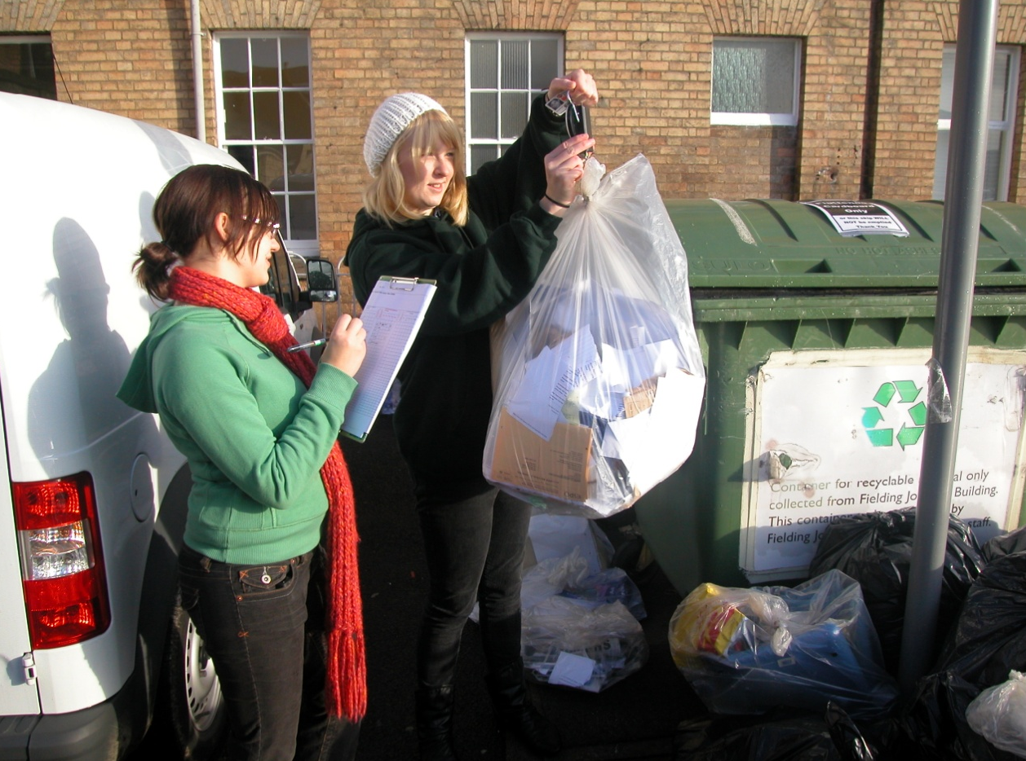
Our Volunteering
Socials
Training
Auditing
Conservation
Communications and Events Promotion
Go Green Week
Fair Trade Fortnight
Other Events in Leicester

Slide 5
1) Communication and Momentum
Weekly Newsletter
Regular events
Social Media

Slide 6
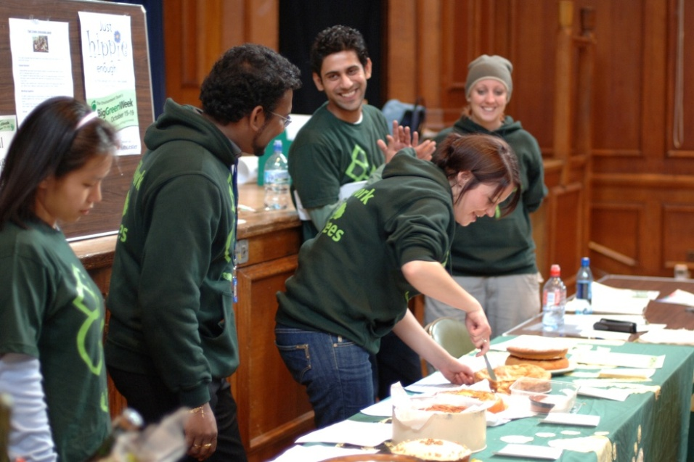
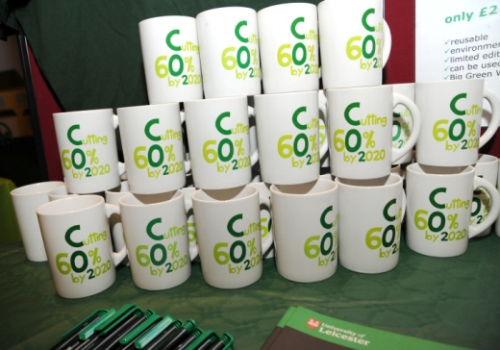
2) Incentives and Rewards
Help cut CO₂ at the university and make a positive lasting impact
Training opportunities
Employability skills
Make new friends
Freebies

Slide 7
3) Part of the Team
Make them feel like part of the team
Ensure open access to the team office
Give them responsibilities and ownership

Slide 8
Positive Outcomes
Go Green Week Success
Student Initiated Green Impact teams
Increased interest in environmental events
1035.5 hours volunteering so far this year

Slide 9
Conclusions and take home messages
Communication and Momentum
Incentives and Rewards
Part of the Team
Mention all three of these criteria when selling an event by writing a sizzle

Slide 10
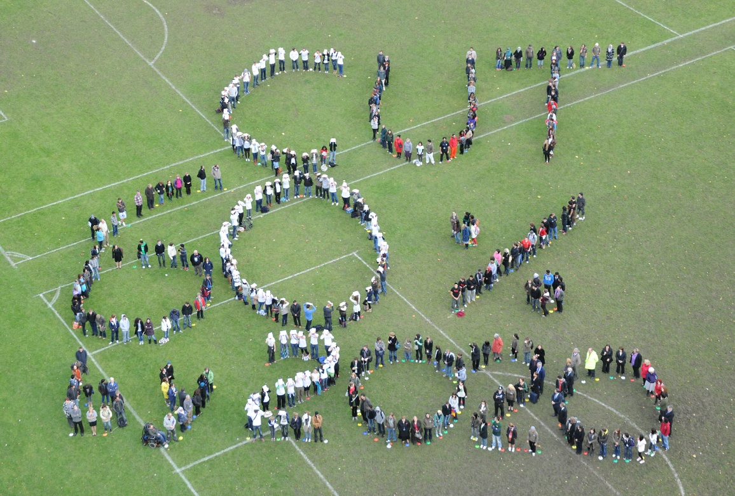
Any Questions?

Slide 11
Your next steps – making the most of your EAUC Membership…
Resources - visit the dedicated behaviour change section on the EAUC resource bank
Networks - join our Embedding Positive Attitudes and Behaviours Community of Practice - for those wanting to identify with the challenges of changing the behaviour of staff and students
Find out more about this group at 5pm today – see programme for details
Recognition - want recognition for your student engagement initiatives – enter the 2012 Green Gown Awards Student initiatives and campaigns category – entries open summer 2012
Measure and improve - sign up to LiFE – www.thelifeindex.org.uk. EAUC Members receive a significant discount
LiFE offers a dedicated ‘student engagement’ framework for implementation
Membership matters at www.eauc.org.uk

