Slide 1


Urban Energy Research Group
19th November 2014
Prof Phil Banfill P.F.G.Banfill@hw.ac.uk

Slide 2

School of Energy, Geoscience, Infrastructure & Society ~160 academics, ~200 researchers
Institute for Infrastructure & Environment
Institute of Petroleum Engineering
Institute for Social Policy, Housing, Environment & Real Estate
Royal Academy of Engineering
Centre of Excellence in Sustainable Building Design
Urban Energy Research Group (~20 people)

Slide 3
Urban Energy Research Group
Tarbase (EPSRC/Carbon Trust)
Low carbon futures (EPSRC ARCC)
Historic and traditional buildings (Historic Scotland + PhD)
Concrete to Cookers (EPSRC)
Measures for solid wall dwellings - CALEBRE (RCUK/E.on)
Adaptation and resilience in energy systems (EPSRC ARCC)
Office buildings – refurbishment and LCA (PhDs)
Schools and factories – energy utilisation (PhDs)
Wind farms – community involvement (PhD)
Fuel poverty and refurbishment campaigns (NESTA)
Whole life analysis of building components (RAEng)
Total funding of £4m since 2004, 150 research publications.

Slide 4
Research methods
Building performance modelling and energy monitoring
Life Cycle Assessment
System integration
Economic methods - whole life costing
Qualitative methods – interviews, surveys, questionnaires, focus groups

Slide 5
Low-carbon refurbishment and new-build in future climates
19th November 2014
Dr David Jenkins D.P.Jenkins@hw.ac.uk

Slide 6

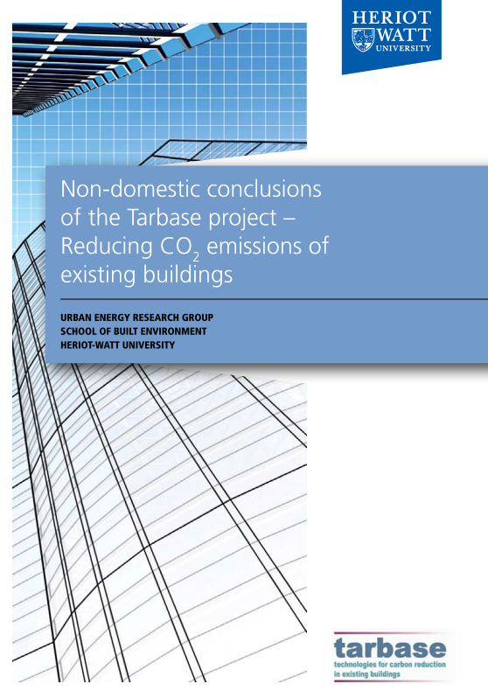
Project example 1 - TARBASE
Carbon Trust/EPSRC Carbon Vision Buildings Programme
Consortium project £1.4M
Technologies to reduce carbon emissions of the existing building stock by 50-80%
Retrofit packages costed and user acceptance analysis carried out
“Tarbase Domestic Model” produced for low-carbon retrofits

Slide 7
Project example 1 - TARBASE
Education buildings have specific issues
  Migrating towards an “office” type environment
  Has implications on building services and activity
  Considerable change to what we think of as a “school” building in last decade

Slide 8
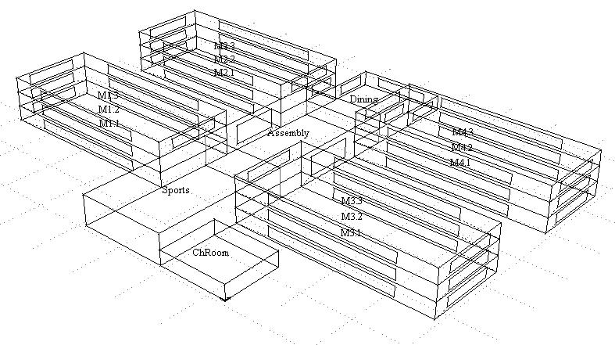
Schools – Case study
Birmingham
10,000m² Total Floor Area
1,250 pupils

Slide 10
Wind = 1 x 20kW
PV = 54kW

Slide 11
But for a building without a cooling system...
With our low-carbon retrofit

Slide 12
But this is all modelled
Energy performance modelling is useful but it must be used appropriately
The intention is to point the designer in the right direction
But we are beholden to the models to some extent...

Slide 13
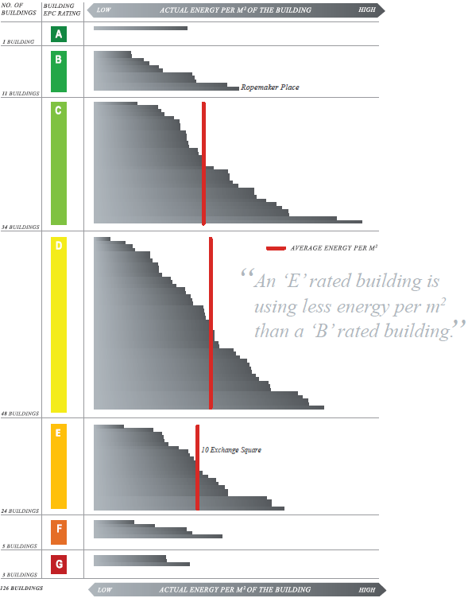
Are we producing lower energy buildings or lower energy certificates?
JLL/BBP “A Tale of Two Buildings” (2012)

Slide 14
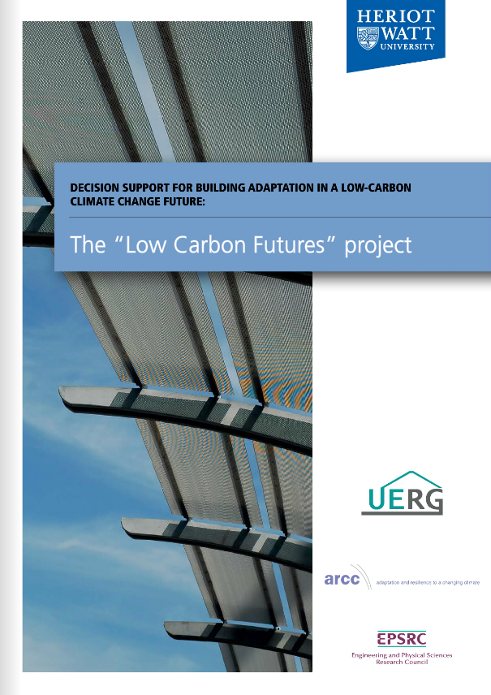
Project example 2 – Low Carbon Futures
EPSRC £624k
Part of ARCC programme using latest climate projections
Model-based risk analysis of building failure due to climate change
  Overheating
  Cooling loads
  Heating/cooling systems
Tool produced that emulates 1000s of building simulations from a single simulation

Slide 15
LCF Objectives overview
How can building simulation use the latest UK Climate Projection (UKCP’09) database?
How can this be used for designing adaptations for buildings in the future?
How can all the above be incorporated into a method that is useful for industry for overheating analyses?
  And, by association, other types of building analysis (e.g. heating/cooling loads)

Slide 16
Practitioner feedback
In parallel to modelling work, industry feedback was obtained at various stages of the work
  Interviews
  Questionnaires
  Focus Groups
Used to investigate:
  Type of overheating analysis currently carried out
  Is “probability” a useful concept in overheating?
  Does the LCF tool have an end use?

Slide 17
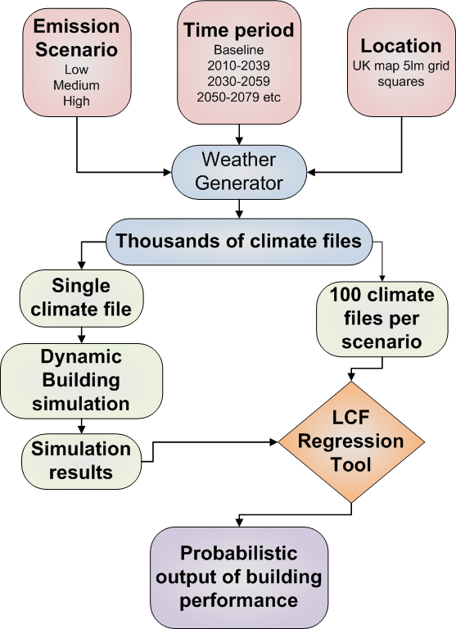
UKCP09
Use of DSM for calibration
Simplify climate input
Probabilistic overheating regression analysis

Slide 18
No Adaptation

Slide 19
With Adaptation

Slide 20
Simplifying output

Slide 21
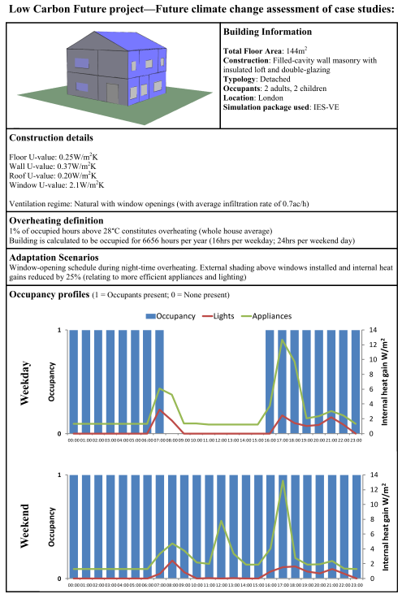
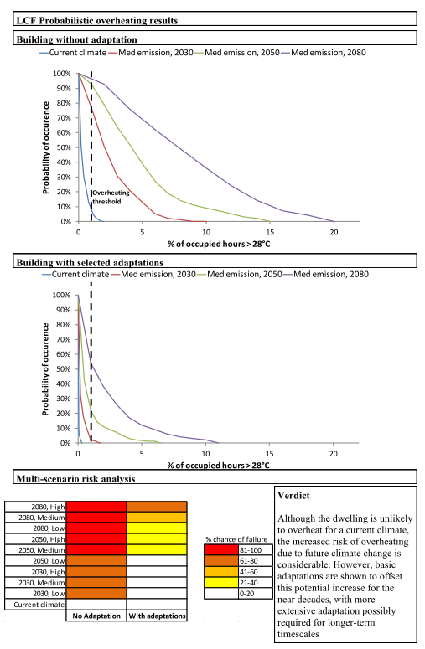

Slide 22
What we have learnt....
A modelled building is not real
  Don’t place complete trust in an EPC
A low-carbon building must be adapted for a future climate
  And having a consistent method for practitioners is important
  But do not underestimate the required action for retrofitting such buildings to a low-carbon standard
For non-domestic buildings, internal activity is key to overall energy performance

